Slide 1

Melanoma skin cancer detection using stacked ensemble model​
Presented by
GROUP 10
Apar Garg (A0231539E)​
Gopan Ravikumar Girija (A0231541U) ​
Sarah Elita Shi Yuan Wong (A0231507N) ​
Submitted
to
INSTITUTE OF SYSTEMS SCIENCE
NATIONAL UNIVERSITY OF SINGAPORE, SINGAPORE

Slide 2
Outline
Introduction
Background​
Problem​
Solution/Objective
Project Scope
Milestones​
Requirements Analysis​
Assumptions and Constraints
Dataset Used
Proposed Methodology
System Design​
Model Architecture
Results to date
Training Results
Testing Results
References
Notes:
S: Progress to date <- Results to date

Slide 3
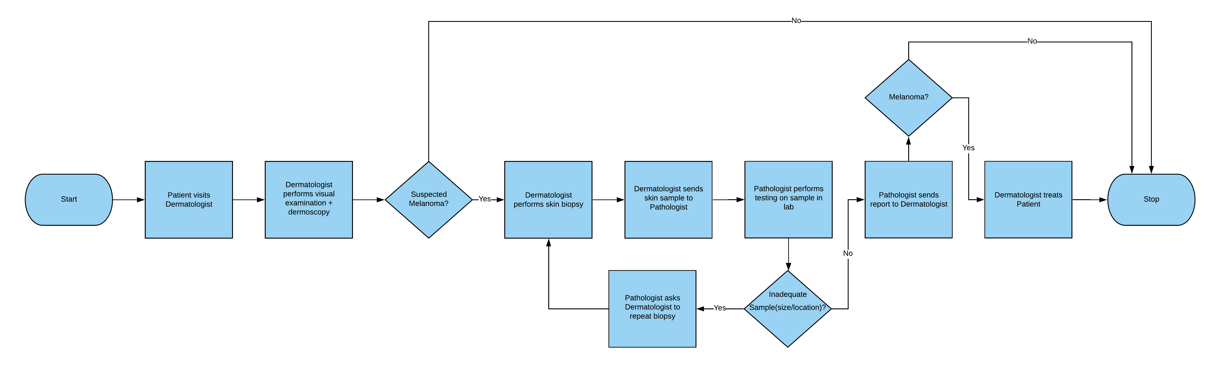
Introduction
Background
Melanoma is the deadliest type of skin cancer. Although it is responsible for only about 1% of all skin cancers diagnosed in the U.S., it makes up most skin cancer deaths [1].
Early diagnosis and treatment give patients a significantly higher chance of survival.
The diagnosis process for melanoma is illustrated in the flowchart below: ​

Slide 4
Introduction (contd.)
Problem
False Negatives (FN) - Patient has melanoma but the dermatologist concludes otherwise based on the dermoscopy he has performed.​
Dermatologist only sends suspected cases for lab-testing. Since the sensitivity of dermoscopy can range from 60% to 100% [2], some unsuspected cases, which are in fact melanoma, will be left out for lab-testing. This may cause late diagnosis and treatment.
False Positives​ (FP) - Patient does not have melanoma but the dermatologist suspects it as melanoma and performs biopsy as a further check.
Skin biopsy is an invasive (removal of a small part of the skin) process, which can leave a scar [3].
The typical cost of a skin biopsy without insurance is 120 – 450 USD. Lab evaluation fees may add extra fees from 50 – 350 USD [3].

Slide 5

Introduction (contd.)
Solution/Objective
To provide an image-based classification solution for melanoma detection during the early screening stage that can help dermatologists reduce False Negatives (FN) and False Positives (FP).

Slide 6
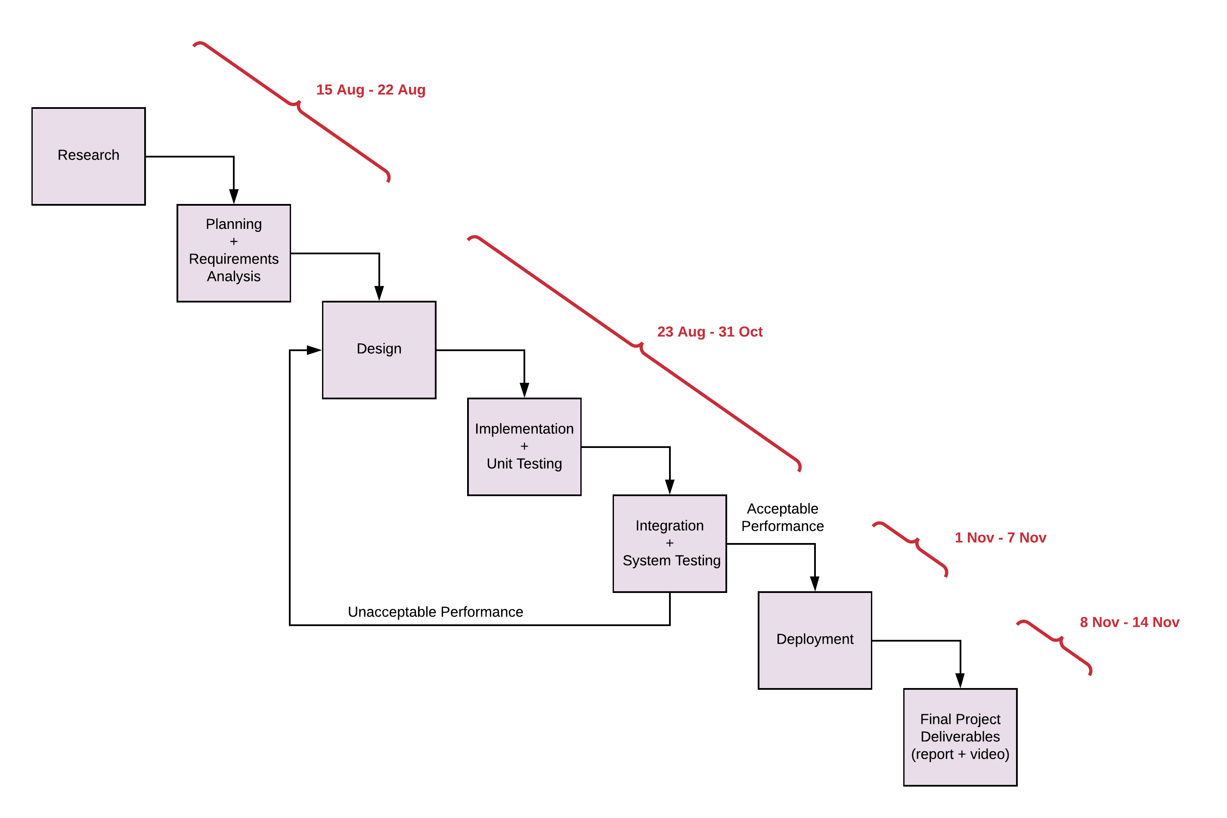
Project Scope
Milestones

Slide 7
Project Scope (contd.)
Requirements Analysis
Functional Requirements
Given an image of a lesion, the system must correctly classify melanoma/Non-melanoma.
System must handle errors properly when file formats other than “png” and “jpg” are uploaded.
System must generate a sample report for the patient.
System must mail the generated report to the patient.
Non-Functional Requirements
System must be easy to use.
System must take <10 sec to show results.

Slide 8
Project Scope (contd.)
Assumptions
Team will have sufficient time to have a working system by 14th Nov.
Arbitrator will perform better than individual base learners.
Patient data such as name, email, etc. is available to generate the report.
Dermoscopic image of the skin lesion is available for making the prediction.
Constraints
System can classify lesions into 2 classes only: Melanoma and Non-melanoma. Detailed diagnosis must be done by the dermatologist himself.

Slide 9
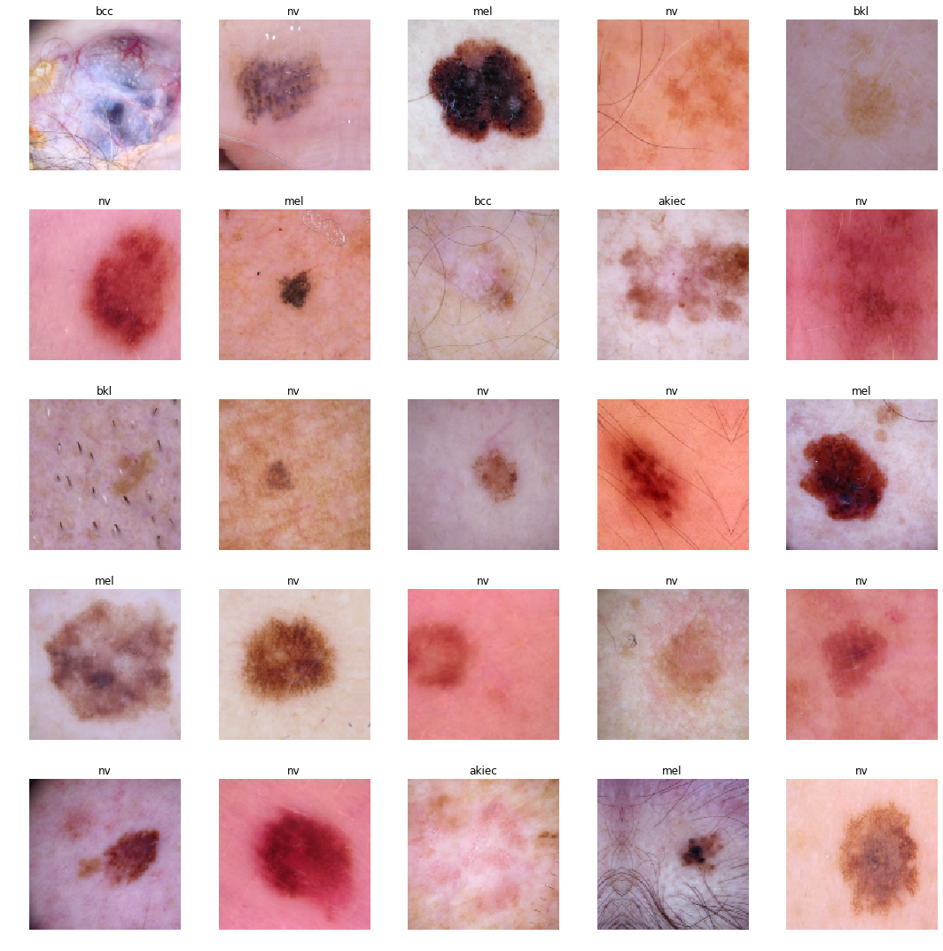
Dataset Used
Using The ISIC Archive [5] dataset.
This dataset contains the largest publicly available collection of quality-controlled dermoscopic images of skin lesions.
There are 69445 skin lesion images in the dataset, out of which 39732 images are labeled.
CLASS | NO. OF SAMPLES
Melanoma | 5598
Non-Melanoma | 34134
Total | 39732

Slide 10
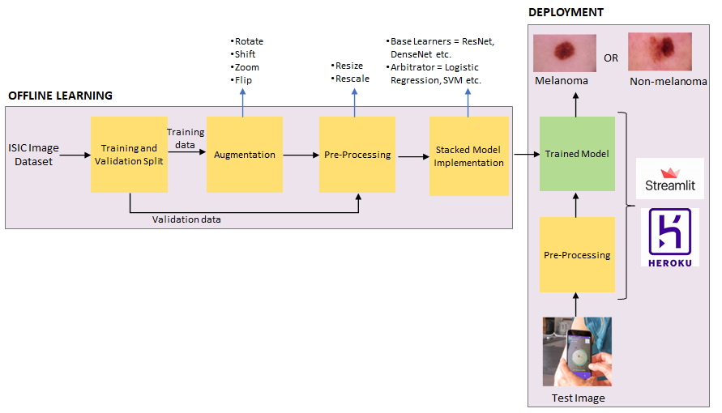
Proposed Methodology
System Design

Slide 11
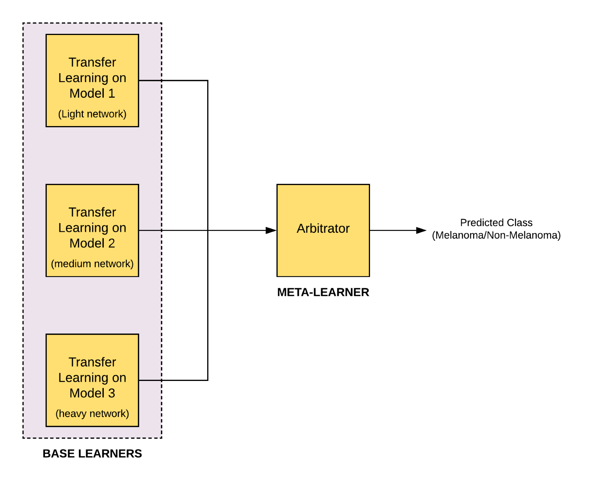
Proposed Methodology (contd.)
Model Architecture
Developing a Stacked Ensemble Model.
Networks that we will use for Transfer Learning are:
Light Network (<6M params)
MobileNetV2
EfficientNetB0
Medium Network (>6M & <20M params)
DenseNet121
EfficientNetB3
Heavy Network (>20M params)
InceptionV3
Resnet50

Slide 12
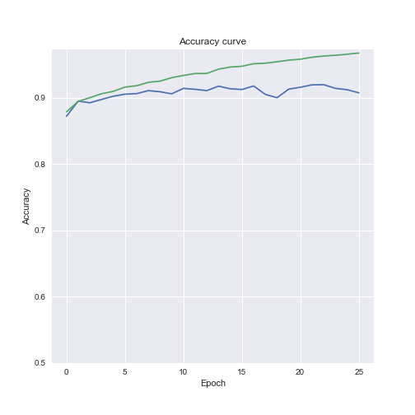
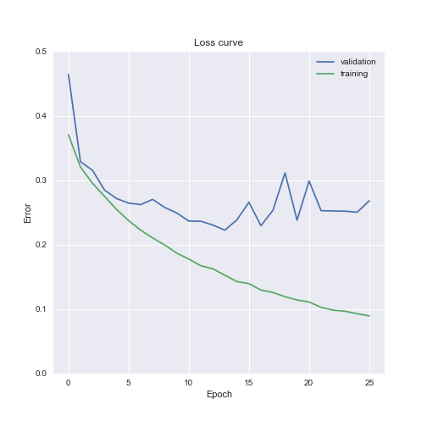
Results to date
Training Results
Trained 1 base learner i.e. MobileNetV2.
Model is overfitting as evident from the plots.
Currently exploring different techniques to remove overfitting.

Slide 13
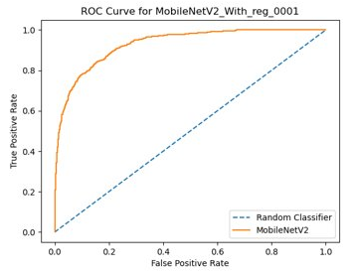
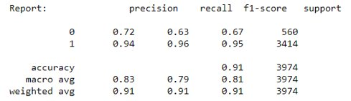
Results to date (contd.)
Testing Results
Tested the base learner using test images.
Includes metrics such as AUC Score, ROC Curve, Confusion Matrix, Accuracy, Loss.

Slide 14
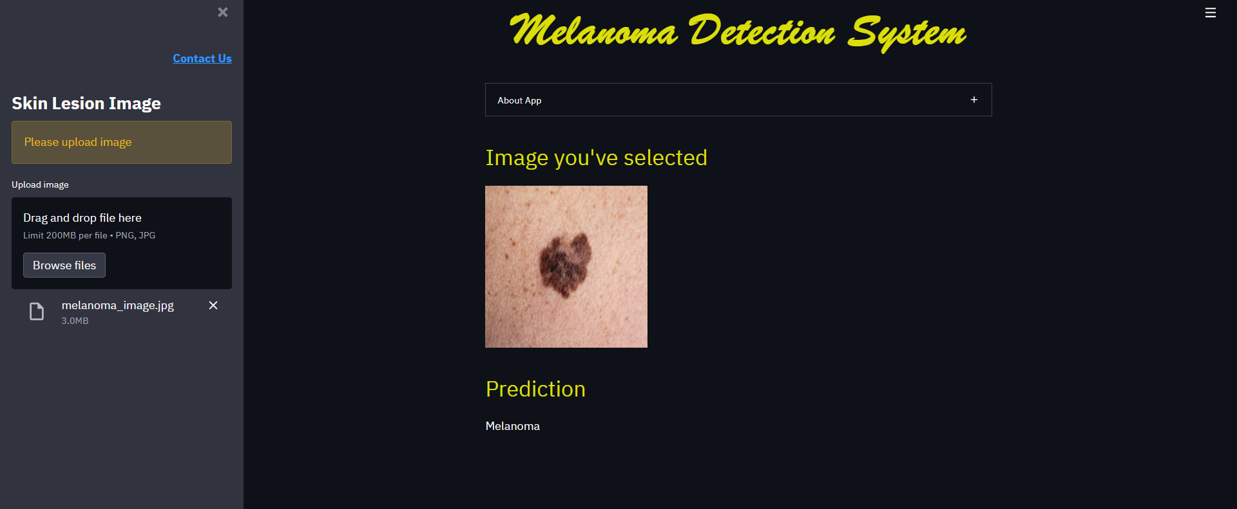
Results to date (contd.)
User Interface
Created an initial user interface.
User can upload an image and get the prediction result.

Slide 15
References
[1] https://www.cancer.net/cancer-types/melanoma/statistics
[2] https://jamanetwork.com/journals/jamadermatology/fullarticle/392759
[3] https://www.mcdermatology.com/biopsy.html
[4] http://www.drmarkseraly.com/how-long-does-it-generally-take-to-receive-skin-biopsy-results.html#:~:text=It%20generally%20takes%203%2D5,longer%20for%20a%20final%20report.
[5] https://www.isicarchive.com/#!/topWithHeader/wideContentTop/main

Slide 16
Thank you

