Slide 1
Self-Supervised Network Anomaly Detection and Attack Classification

Slide 2
Agenda
Project Introduction
Dataset Description
Implementation
Conclusion and Future Work
Learning Outcomes
References

Slide 3
Introduction
Background
Every organization in today's information age is attempting to establish a presence on the Internet. The Internet enables an organization to deploy a web application like e-commerce in order to provide timely services to customers [3]. Therefore, quick and easy access to services via web applications enables organizations to raise their revenue.
Problem
The number of attacks is exploding overwhelmingly as the number of web applications grows [4]. A resource containing a vulnerability might be exploited by the attackers, and consequently can jeopardize the confidentiality, integrity, and availability properties of the organization’s crucial resources. This could result in a significant financial loss as well as irreversible damage to an organization.

Slide 4
Introduction (contd.)
Solution
We developed intrusion detection system using artificial intelligence which could detect and classify various types of attacks in a network.
Many recent studies [5,6] use down-sampling and/or over-sampling approaches with deep neural networks to cope with class imbalance in network traffic datasets. However, down-sampling causes loss of information, while generating artificial samples may cause overfitting, noise, or class overlap. In this project, we investigated unsupervised and self-supervised learning methods to learn better representations for features in data and as a means to deal with the phenomenon of intrusion class imbalance.

Slide 5

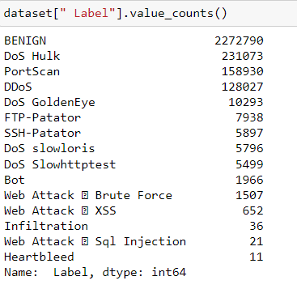
Dataset Description
CICIDS-2017 [7]
Open-source network attack traffic dataset.
Consists of >2.8 million rows and 85 columns (84 features, 1 label).
Label column contains 15 attack classes.
Figure 1: Shape of CICIDS-2017 dataset.
Figure 2: Classes with their sample frequency in CICIDS-2017 dataset.

Slide 6

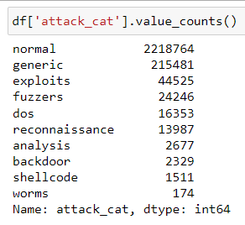
Dataset Description
UNSW-NB15 [8]
Open-source network attack traffic dataset.
Consists of >2.5 million rows and 49 columns (47 features, 2 labels).
1 label column contains attack classes (9 different categories of attack) and another label column contains attack (1)/normal category (0).
Figure 3: Shape of UNSW-NB15 dataset.
Figure 4: Classes with their sample frequency in UNSW-NB15 dataset.

Slide 7
Implementation
Multiclass classification on CICIDS-2017 without ensemble
Dataset Preparation –
Removed whitespaces in column names.
Replaced special characters in class names with an underscore.
Grouped classes.
Removed non-finite values (positive infinity and negative infinity).
Removed NULL (NaN) values.
80-20 train-test split (stratified).
Selected columns having float datatype, <85% correlation, and >1 unique value.
Handled class imbalance using resampling (random undersampling and SMOTE oversampling).
Scaled features using Standardization.
Saved 6 CSV files for modeling.

Slide 8
Implementation (contd.)
Multiclass classification on CICIDS-2017 without ensemble
Transfer Learning on DAE –
Performed unsupervised learning on Denoising Autoencoder (DAE) [9,10]. It took around 7 min to train the DAE model on the CPU.
Performed supervised learning using ANN and 1DCNN on stacked DAE latent features (feature-based transfer learning). It took around 58 min to train the ANN and around 1.2 hr to train the 1DCNN on the CPU.

Slide 9
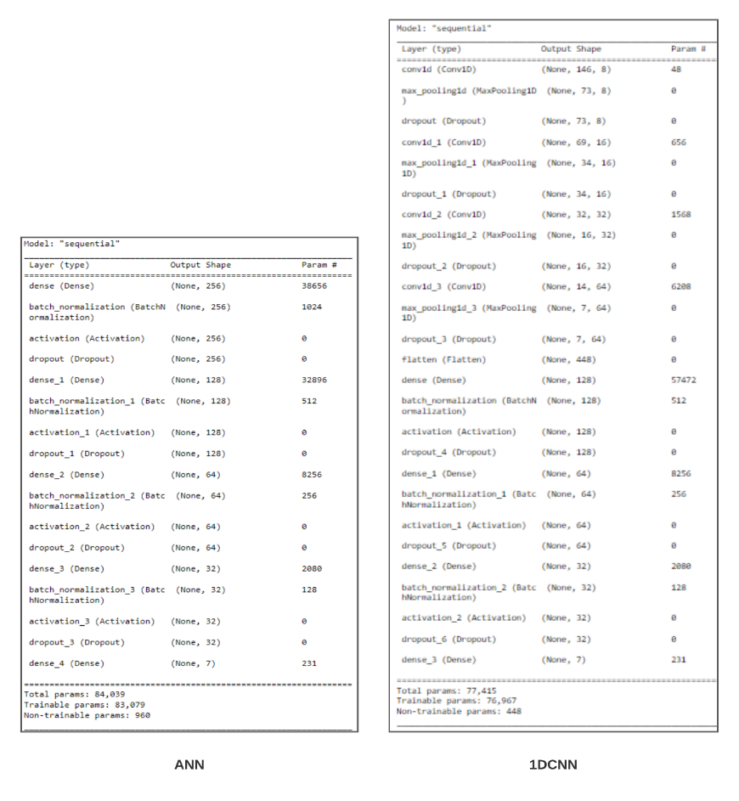
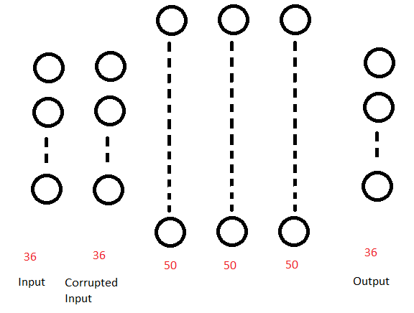
Implementation (contd.)
Multiclass classification on CICIDS-2017 without ensemble
Transfer Learning on DAE –
Figure 5: Proposed deep stack DAE architecture used for multiclass classification on CICIDS-2017 without ensemble.
Figure 6: Proposed ANN and 1DCNN model architecture trained on DAE features used for multiclass classification on CICIDS-2017 without ensemble.

Slide 10
Implementation (contd.)
Multiclass classification on CICIDS-2017 without ensemble
Transfer Learning on VIME –
Performed unsupervised learning on Value Imputation and Mask Estimation (VIME) [11,12] autoencoder. It took around 23 min to train the VIME model on the CPU.
Performed supervised learning using ANN and 1DCNN on VIME latent features (feature-based transfer learning). It took around 24 min to train the ANN and around 33 min to train the 1DCNN on the CPU.

Slide 11
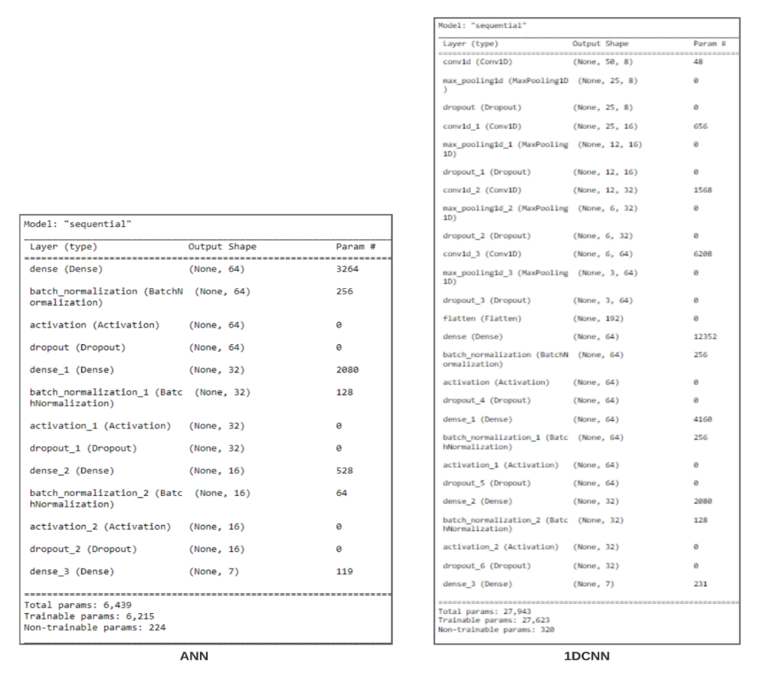
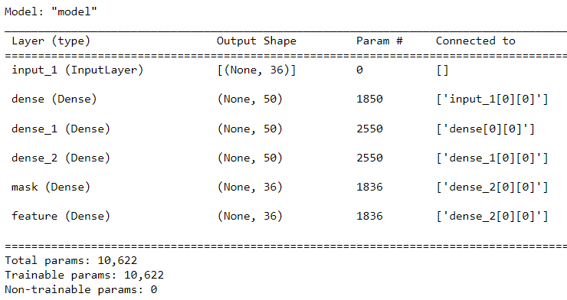
Implementation (contd.)
Multiclass classification on CICIDS-2017 without ensemble
Transfer Learning on VIME –
Figure 7: Proposed VIME model architecture used for multiclass classification on CICIDS-2017 without ensemble.
Figure 8: Proposed ANN and 1DCNN model architecture trained on VIME features used for multiclass classification on CICIDS-2017 without ensemble.

Slide 12
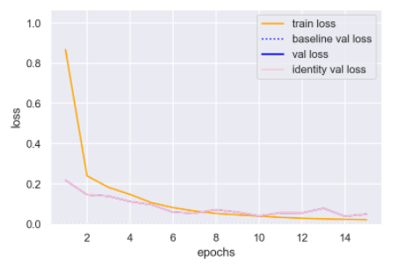
Implementation (contd.)
Multiclass classification on CICIDS-2017 without ensemble
DAE Unsupervised Learning –
Figure 9: Loss curve for DAE unsupervised training for multiclass classification on CICIDS-2017 without ensemble.

Slide 13
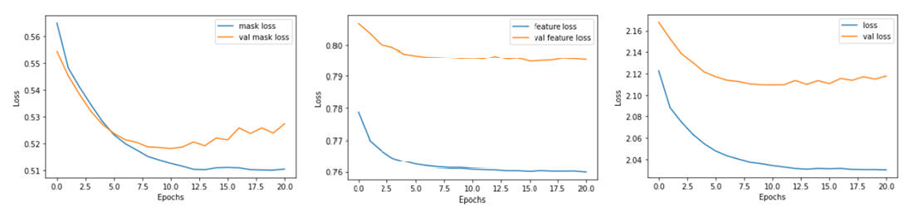
Implementation (contd.)
Multiclass classification on CICIDS-2017 without ensemble
VIME Unsupervised Learning –
Figure 10: Loss curve for VIME unsupervised training for multiclass classification on CICIDS-2017 without ensemble.

Slide 14
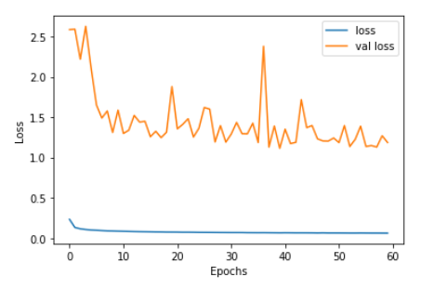
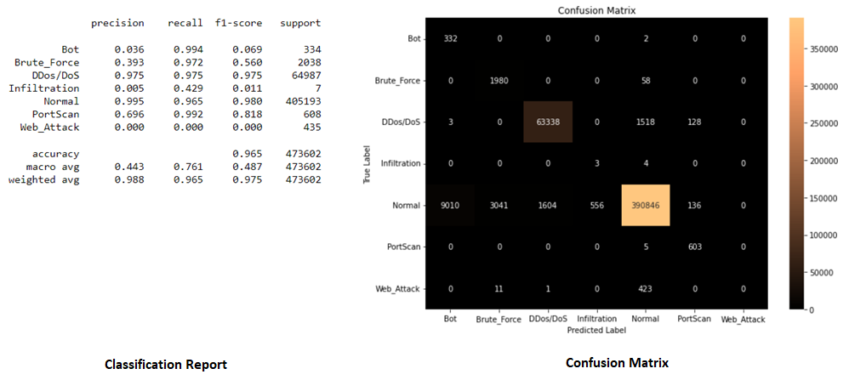
Implementation (contd.)
Multiclass classification on CICIDS-2017 without ensemble
DAE + ANN Supervised Learning –
Figure 11: Loss curve for ANN trained on DAE features for multiclass classification on CICIDS-2017 without ensemble.
Figure 12: Performance of DAE + ANN on testing dataset for multiclass classification on CICIDS-2017 without ensemble.

Slide 15
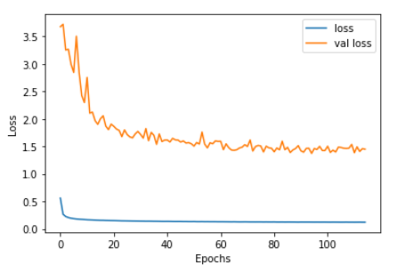
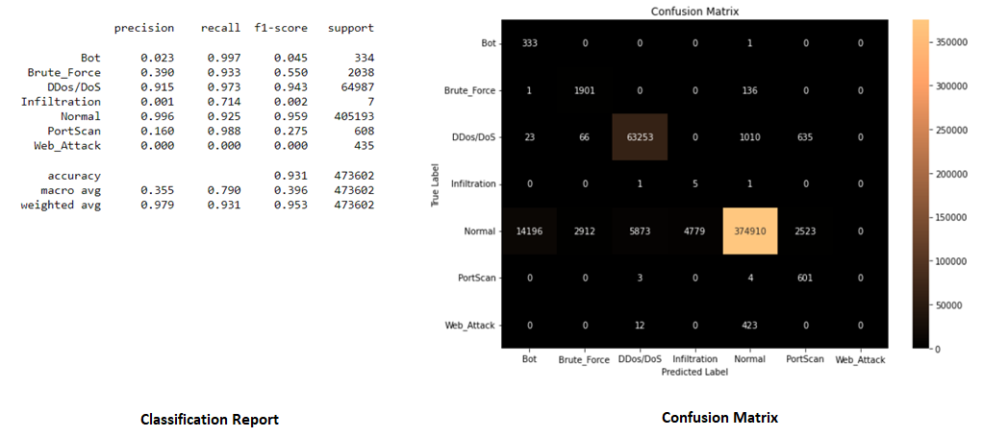
Implementation (contd.)
Multiclass classification on CICIDS-2017 without ensemble
DAE + 1DCNN Supervised Learning –
Figure 13: Loss curve for 1DCNN trained on DAE features for multiclass classification on CICIDS-2017 without ensemble.
Figure 14: Performance of DAE + 1DCNN on testing dataset for multiclass classification on CICIDS-2017 without ensemble.

Slide 16
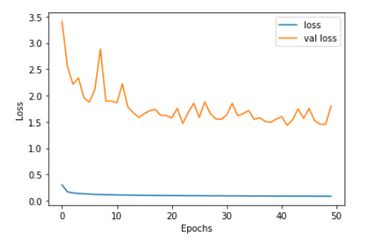
Implementation (contd.)
Multiclass classification on CICIDS-2017 without ensemble
VIME + ANN Supervised Learning –
Figure 15: Loss curve for ANN trained on VIME features for multiclass classification on CICIDS-2017 without ensemble.
Figure 16: Performance of VIME + ANN on testing dataset for multiclass classification on CICIDS-2017 without ensemble.

Slide 17
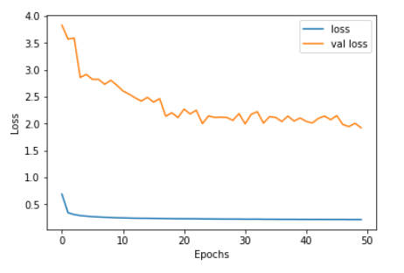
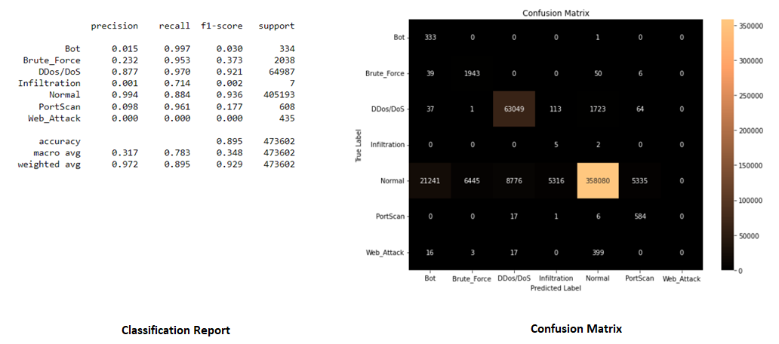
Implementation (contd.)
Multiclass classification on CICIDS-2017 without ensemble
VIME + 1DCNN Supervised Learning –
Figure 17: Loss curve for 1DCNN trained on VIME features for multiclass classification on CICIDS-2017 without ensemble.
Figure 18: Performance of VIME + 1DCNN on testing dataset for multiclass classification on CICIDS-2017 without ensemble.

Slide 18
Implementation (contd.)
Multiclass classification on CICIDS-2017 with ensemble
Dataset Preparation –
Removed whitespaces in column names.
Replaced special characters in class names with an underscore.
Grouped classes.
Removed non-finite values (positive infinity and negative infinity).
Removed NULL (NaN) values.
80-20 train-test split (stratified).
Selected columns having float datatype, <85% correlation, and >1 unique value.
Handled class imbalance using resampling (random undersampling and SMOTE oversampling).
Scaled features using Standardization.
Decomposed 7-class classification problem into 7 binary classification subproblems using the One Against All (OAA) strategy [13,14].
Saved 4 CSV files for modeling.

Slide 19
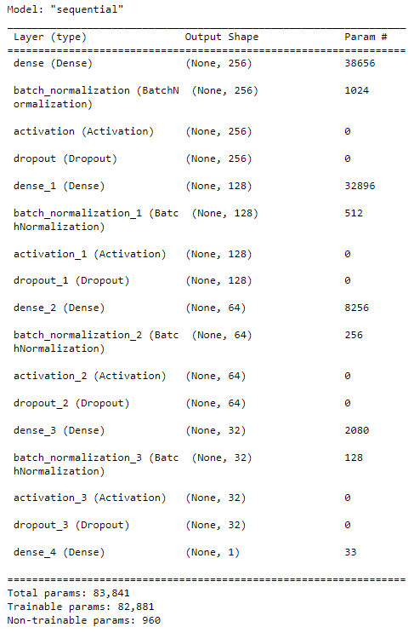
Implementation (contd.)
Multiclass classification on CICIDS-2017 with ensemble
Transfer Learning on DAE –
Performed unsupervised learning on DAE for every subproblem. It took 5-7 min to train every DAE model on the CPU.
Performed supervised learning using ANN on stacked DAE latent features (feature-based transfer learning). It took 8-23 min to train every ANN on the CPU.
Figure 19: Proposed deep stack DAE architecture used for multiclass classification on CICIDS-2017 with ensemble.
Figure 20: Proposed ANN model architecture trained on DAE features used for multiclass classification on CICIDS-2017 with ensemble.

Slide 20
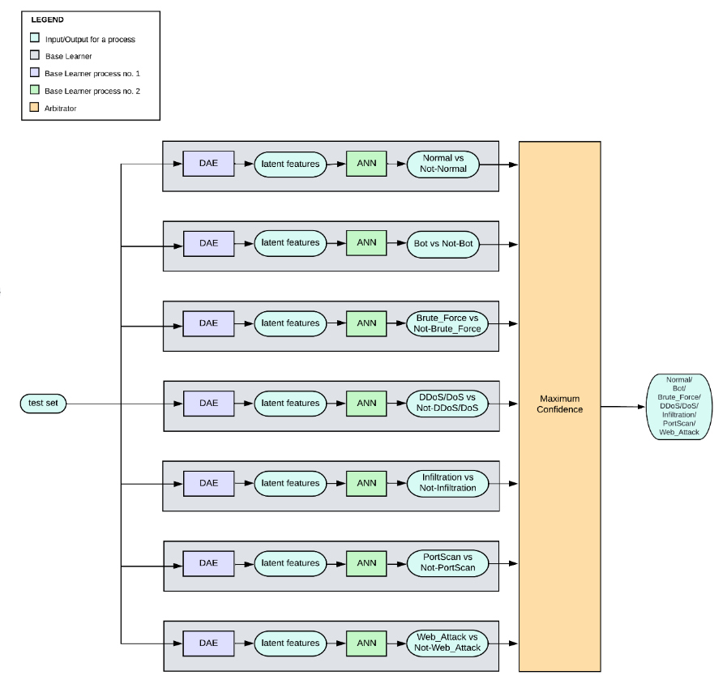
Implementation (contd.)
Multiclass classification on CICIDS-2017 with ensemble
Ensemble Model –
Created an ensemble of all 7 ANN trained on DAE features.
The decision by the Arbitrator is taken using the maximum confidence strategy [13].
Figure 21: Block diagram of proposed ensemble model used for multiclass classification on CICIDS-2017 with ensemble.

Slide 21
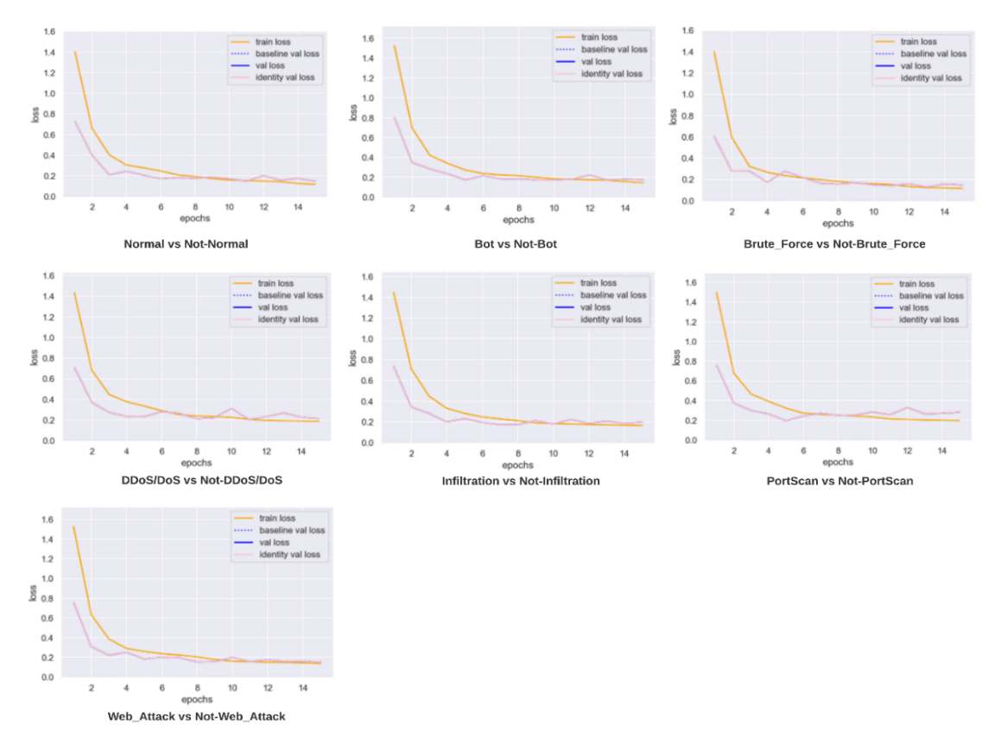
Implementation (contd.)
Multiclass classification on CICIDS-2017 with ensemble
DAE Unsupervised Learning –
Figure 22: Loss curves for DAE unsupervised training for multiclass classification on CICIDS-2017 with ensemble.

Slide 22
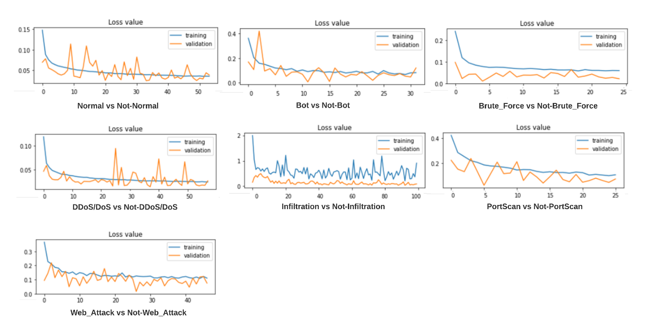
Implementation (contd.)
Multiclass classification on CICIDS-2017 with ensemble
DAE + ANN Supervised Learning –
Figure 23: Loss curve for ANN trained on DAE features for multiclass classification on CICIDS-2017 with ensemble.

Slide 23
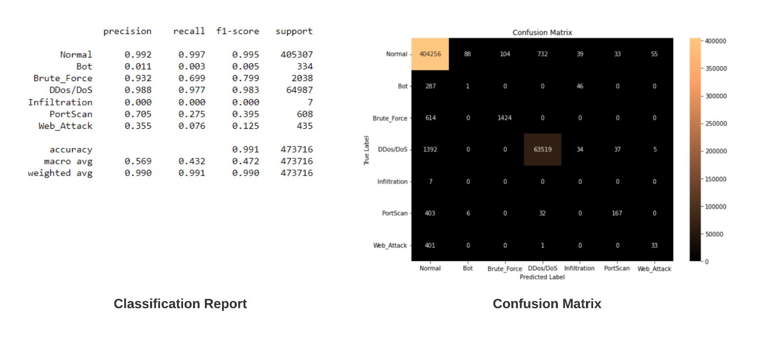
Implementation (contd.)
Multiclass classification on CICIDS-2017 with ensemble
Ensemble Model –
Figure 24: Performance of proposed ensemble model on testing dataset for multiclass classification on CICIDS-2017 with ensemble.

Slide 24
Implementation (contd.)
Anomaly score based binary classification on CICIDS-2017
Dataset Preparation –
Removed whitespaces in column names.
Replaced special characters in class names with an underscore.
Grouped classes.
Removed non-finite values (positive infinity and negative infinity).
Removed NULL (NaN) values.
80-20 train-test split (stratified).
Selected columns having float datatype, <85% correlation, and >1 unique value.
Handled class imbalance using resampling (random undersampling and SMOTE oversampling).
Scaled features using Standardization.
Saved 6 CSV files for modeling.

Slide 25
Implementation (contd.)
Anomaly score based binary classification on CICIDS-2017
DAE Unsupervised Learning –
Performed unsupervised learning on DAE. It took around 8 min to train the DAE on the CPU.
Mean Squared Error (MSE) was used to compute the reconstruction error of a sample.
Figure 25: Proposed deep stack DAE architecture used for anomaly score based binary classification on CICIDS-2017.

Slide 26
Implementation (contd.)
Anomaly score based binary classification on CICIDS-2017
VIME Unsupervised Learning –
Performed unsupervised learning on VIME. It took around 23 min to train the VIME model on the CPU.
Mean Squared Error (MSE) was used to compute the reconstruction error of a sample.
Figure 26: Proposed VIME model architecture used for anomaly score based binary classification on CICIDS-2017.

Slide 27
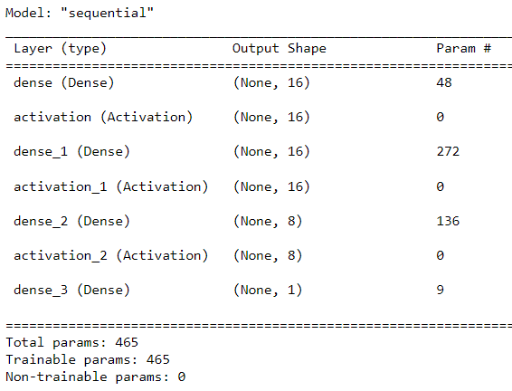
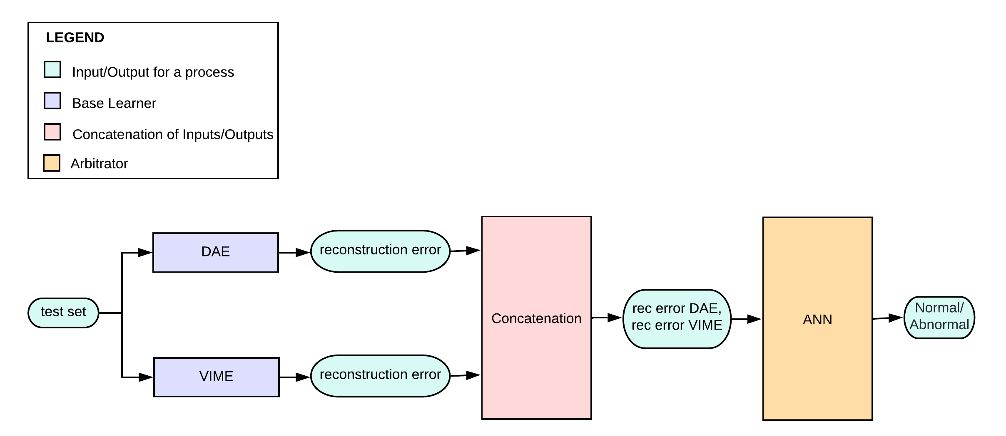
Implementation (contd.)
Anomaly score based binary classification on CICIDS-2017
Ensemble Model –
Created a novel ensemble model which takes in reconstruction errors from DAE and VIME (base learners) and outputs normal/anomaly with the help of an ANN (arbitrator). Took around 15 min to train the ANN on reconstruction error features on the CPU.
Figure 28: Block diagram of proposed ensemble network architecture used for anomaly score based binary classification on CICIDS-2017.
Figure 27: Proposed ANN model architecture trained on reconstruction error features used for anomaly score based binary classification on CICIDS-2017.

Slide 28
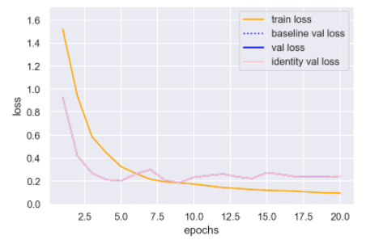
Implementation (contd.)
Anomaly score based binary classification on CICIDS-2017
DAE Unsupervised Learning –
Figure 29: Loss curve for DAE unsupervised training for anomaly score based binary classification on CICIDS-2017.

Slide 29
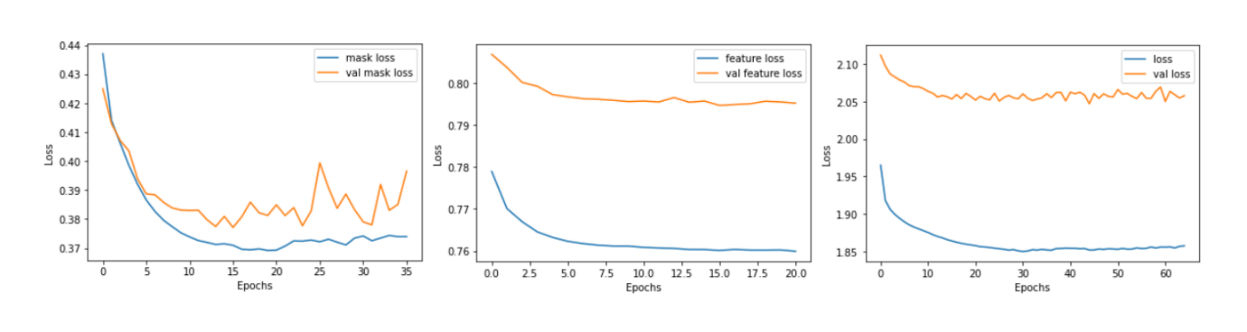
Implementation (contd.)
Anomaly score based binary classification on CICIDS-2017
VIME Unsupervised Learning –
Figure 30: Loss curves for VIME unsupervised training for anomaly score based binary classification on CICIDS-2017.

Slide 30
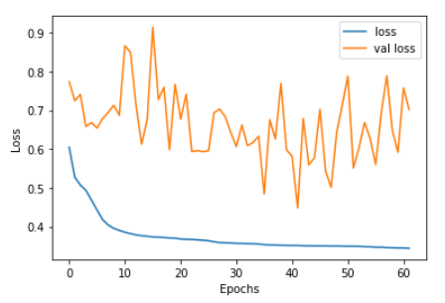
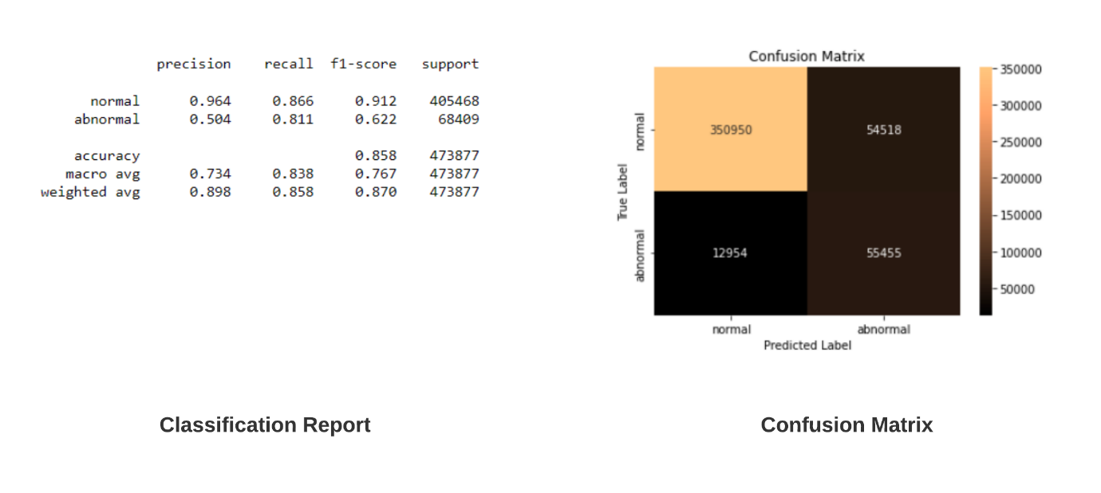
Implementation (contd.)
Anomaly score based binary classification on CICIDS-2017
Ensemble Model –
Figure 31: Loss curve for ANN trained on reconstruction error features for anomaly score based binary classification on CICIDS-2017.
Figure 32: Performance of proposed ensemble model on testing dataset for anomaly score based binary classification on CICIDS-2017.

Slide 31
Implementation (contd.)
Anomaly score based binary classification on UNSW-NB15
Dataset Preparation –
Dropped all timestamp and a few unuseful categorical features.
Changed datatype of features.
Lowercased class names.
Removed non-finite values (positive infinity and negative infinity).
Removed NULL (NaN) values.
One-hot encoded categorical features.
80-20 train-test split (stratified).
Selected columns having float datatype, <85% correlation, and >1 unique value.
Handled class imbalance using resampling (random undersampling and SMOTE oversampling).
Scaled features using Standardization.
Saved 6 CSV files for modeling.

Slide 32
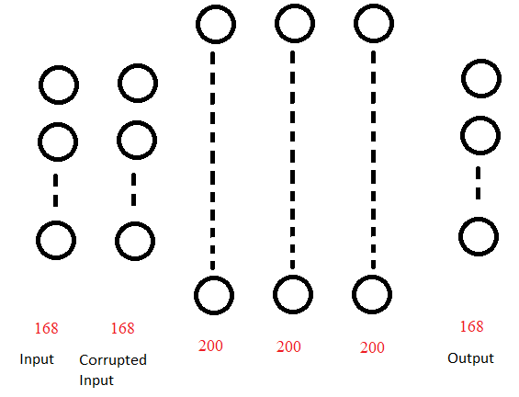
Implementation (contd.)
Anomaly score based binary classification on UNSW-NB15
DAE Unsupervised Learning –
Performed unsupervised learning on DAE. It took around 6 min to train the DAE on the CPU.
Mean Squared Error (MSE) was used to compute the reconstruction error of a sample.
Figure 33: Proposed deep stack DAE architecture used for anomaly score based binary classification on UNSW-NB15.

Slide 33
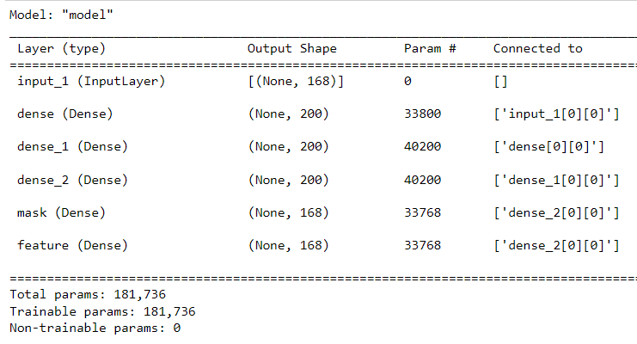
Implementation (contd.)
Anomaly score based binary classification on UNSW-NB15
VIME Unsupervised Learning –
Performed unsupervised learning on VIME. It took around 27 min to train the VIME model on the CPU.
Mean Squared Error (MSE) was used to compute the reconstruction error of a sample.
Figure 34: Proposed VIME model architecture used for anomaly score based binary classification on UNSW-NB15.

Slide 34
Implementation (contd.)
Anomaly score based binary classification on UNSW-NB15
Ensemble Model –
Created a novel ensemble model which takes in reconstruction errors from DAE and VIME (base learners) and outputs normal/anomaly with the help of an ANN (arbitrator). Took around 5 min to train the ANN on reconstruction error features on the CPU.
Figure 36: Block diagram of proposed ensemble network architecture used for anomaly score based binary classification on UNSW-NB15.
Figure 35: Proposed ANN model architecture trained on reconstruction error features used for anomaly score based binary classification on UNSW-NB15.

Slide 35
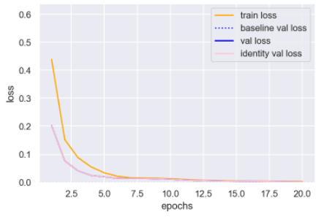
Implementation (contd.)
Anomaly score based binary classification on UNSW-NB15
DAE Unsupervised Learning –
Figure 37: Loss curve for DAE unsupervised training used for anomaly score based binary classification on UNSW-NB15.

Slide 36
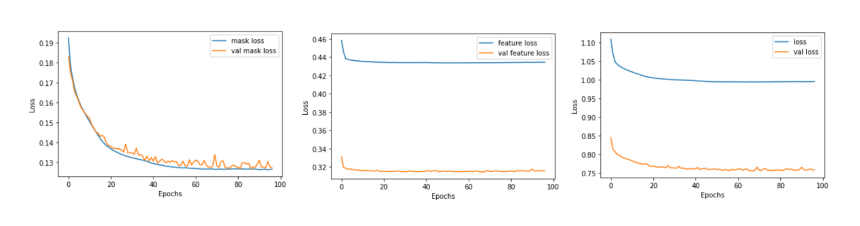
Implementation (contd.)
Anomaly score based binary classification on UNSW-NB15
VIME Unsupervised Learning –
Figure 38: Loss curves for VIME unsupervised training for anomaly score based binary classification on UNSW-NB15.

Slide 37
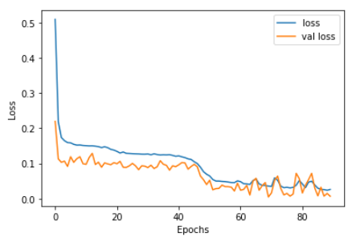
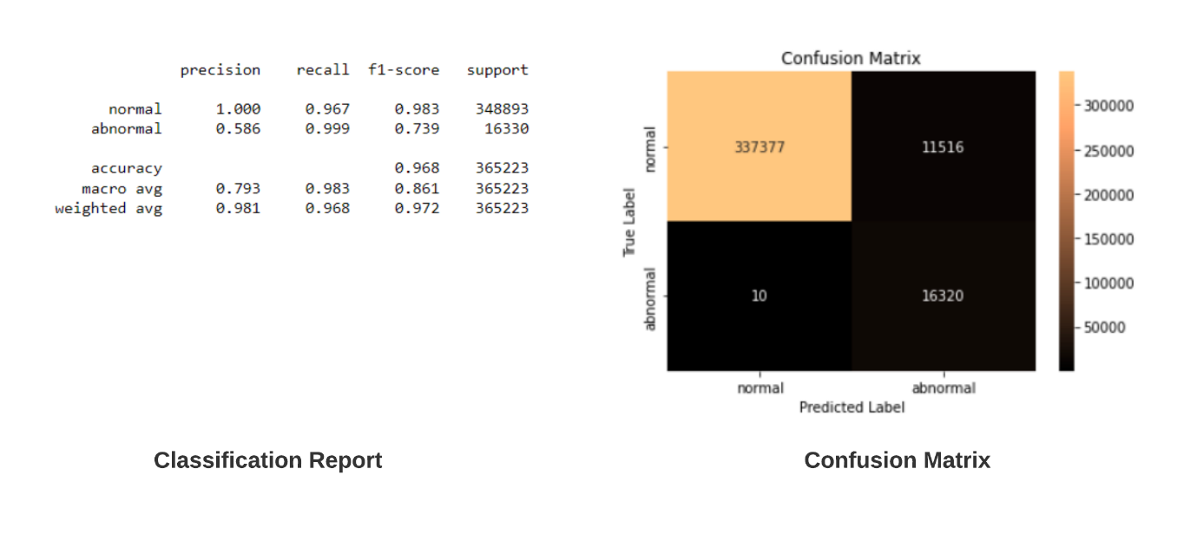
Implementation (contd.)
Anomaly score based binary classification on UNSW-NB15
Ensemble Model –
Figure 39: Loss curve for ANN trained on reconstruction error features for anomaly score based binary classification on UNSW-NB15.
Figure 40: Performance of proposed ensemble model on testing dataset for anomaly score based binary classification on UNSW-NB15.

Slide 38
Conclusion and Future Work
In this work, an intelligent intrusion detection system for network anomaly detection and attack classification was created with the help of unsupervised and self-supervised machine learning techniques.
A novel ensemble framework for unsupervised network anomaly detection was proposed. For this, two autoencoders that can effectively detect network anomalies were developed and integrated into the ensemble framework. To determine the final prediction of a traffic sample, a weighting scheme was proposed using ANN that allows the framework to quantify each model's goodness and then predicts the label of the sample based on the output of the individual models.
Two novel label-free self-supervised learning methods were introduced to learn better representations for features in data and as a means to deal with the phenomenon of intrusion class imbalance.
Extensive experiments were carried out on two widely used open-source datasets namely UNSW-NB15 and CICIDS-2017.
In the future, I would like to experiment with other commonly used open-source datasets for network intrusion detection and attack classification such as IPS stratosphere, Kitsune, and KDDCUP99.

Slide 39
References
https://www.nas.gov.sg/archivesonline/data/pdfdoc/20130516001/press_release_i2r-icm_outreach_night_2013.pdf
https://www.wikidata.org/wiki/Q30281831
https://www.sciencedirect.com/science/article/pii/S1877042813039554
https://search.ieice.org/bin/summary.php?id=e100-d_8_1729
https://www.sciencedirect.com/science/article/abs/pii/S1570870519311035
https://ieeexplore.ieee.org/document/9311173
https://www.unb.ca/cic/datasets/ids-2017.html
https://github.com/AlliedToasters/dfencoder
https://towardsdatascience.com/how-to-apply-self-supervision-to-tabular-data-introducing-dfencoder-eec21c4afaef
https://github.com/AlliedToasters/dfencoder
https://proceedings.neurips.cc//paper/2020/file/7d97667a3e056acab9aaf653807b4a03-Paper.pdf
https://github.com/jsyoon0823/VIME
https://link.springer.com/article/10.1007/s13748-021-00243-5
https://www.sciencedirect.com/science/article/abs/pii/S002002552100462X#:~:text=It%20learns%20an%20intrusion%20detection,network%20flows%20and%20attacks%2C%20respectively.

