Slide 1
Exploratory Data Analysis
By- Apar Garg

Slide 2
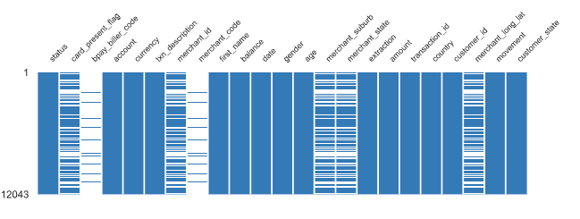
Data Issues
card_present_flag, merchant_id, merchant_suburb, merchant_state, merchant_long_lat have 4326 (35.9%) missing values.
merchant_code, bpay_biller_code have 11160 (92.7%) missing values.
There are total 15.9% missing cells in dataset.

Slide 3
Data Insights
Variable- amount
Each customer has only 1 account.
average transaction amount is $188 (approx.)
average debited transaction amount is $52.5.
average credited transaction amount is $1898.

Slide 4
Data Insights (contd.)
Variable- customer_state (derived from long_lat)
Most of the debit transactions made by customers are from NSW state.
22 % of the customers made transactions from VIC state.
NSW had the highest amount contribution in debit transactions.

Slide 5
Data Insights (contd.)
Variable- movement
Number of debit records are way more than credit records in 3 months.
All the customers engaged in debit movement.
All the customers engaged in credit movement.

Slide 6
Data Insights (contd.)
Variable- txn_description
Highest number of records are of SALES-POS.
Most of the debit transactions made by customers are for SALES-POS. Least for Phone Bank.
Payment had the highest amount contribution in debit transactions.
All the customers engage in POS, Payment and Salary transaction in 3 months.

Slide 7
Data Insights (contd.)
Variable- txn_month, txn_week (derived)
October has the highest transaction entries.
Total customer spending first increased from August to September and then decreased.
All the customers made transaction in each of the 3 months.
Week 1 of September (Week 6) had the greatest number of transactions in 3 months.
Only 67% of the customers engaged in transaction activity in last week of september.

