Slide 1
HR ANALYTICS
Employee Workforce Analysis, 2006 to 2019
311 employees | 33.4% turnover
Prepared by Idowu Blessing Apara

Slide 2
01
Project Overview
The dataset contains 311 employees and 39 columns of HR records covering 2006 to 2019.
Employee details: names, IDs, dates of birth, hire and termination dates, department, manager, and position.
Pay and performance: salary, performance score, engagement survey, satisfaction score, and absences.
Sourcing and demographics: recruitment source, marital status, and related fields.
No hires, terminations, or performance reviews exist after 2019.
Goal: clean the data, build a dashboard, and answer eight business questions
HR Analytics, 2006 to 2019
2

Slide 3
02
Data Cleaning Process
1
Age & Tenure recomputed to a 31 Dec 2019 cutoff, not today
2
Manager IDs 8 blanks filled by name lookup
3
Text trimmed and PROPER-cased, acronyms kept
4
Statuses reconciled to the Termd flag
5
New fields Term_Year, Age_Group, Exceeds added
6
Formulas converted to static values
HR Analytics, 2006 to 2019
3

Slide 4
03
Dashboard Overview & KPIs
311
207
104
33.4%
EMPLOYEES
ACTIVE
LEFT
TURNOVER
38.5
4.8 yr
$69K
4.11
AVG AGE
AVG TENURE
AVG SALARY
ENGAGEMENT
Eight KPIs, six PivotTables, six charts and three slicers, all built in Excel and refreshable.
HR Analytics, 2006 to 2019
4

Slide 5
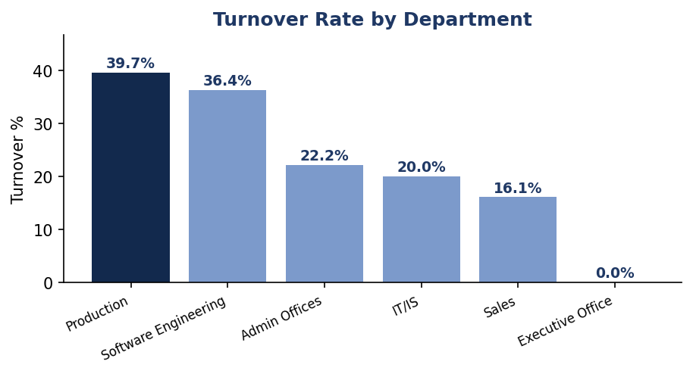
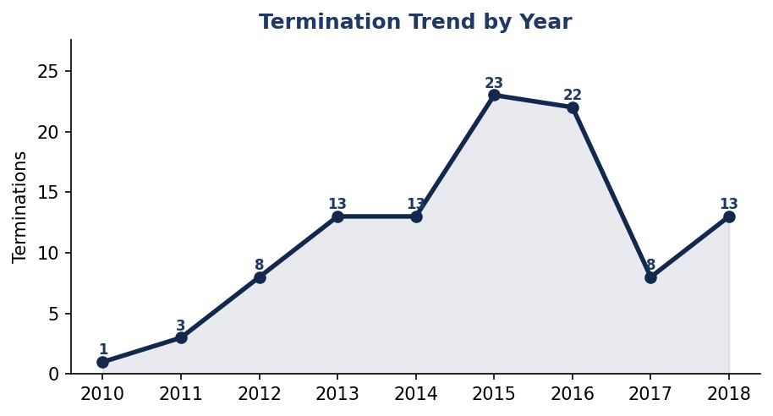
04
Employee Turnover Analysis
Turnover is 33.4%, 104 of 311 staff.
Production highest at 39.7%, Sales lowest at 16.1%.
Fix Production first.
Exits peaked in 2015 (23) and 2016 (22).
Near zero before 2012, so a specific cause.
Log an exit reason for every leaver.
HR Analytics, 2006 to 2019
5

Slide 6
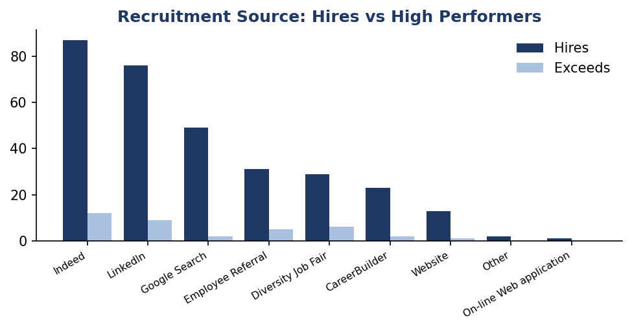
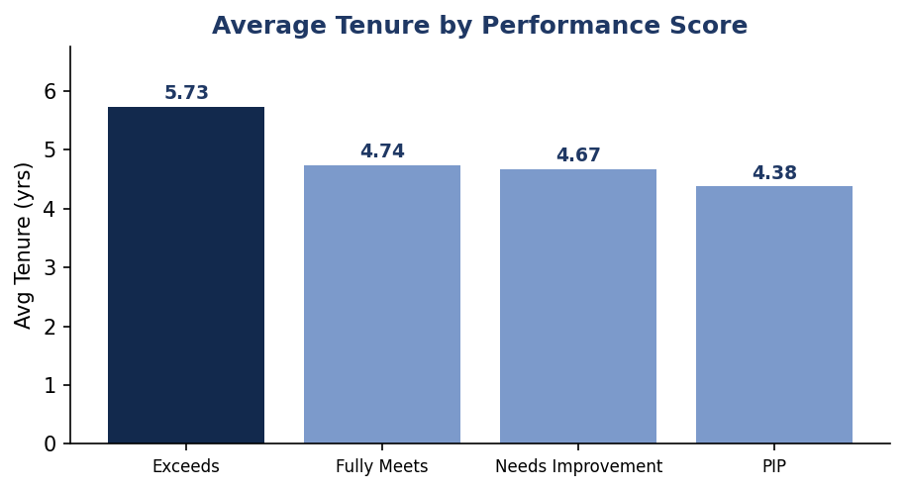
05
Recruitment & Performance Analysis
Indeed brings the most hires (87).
Diversity Job Fair best quality, 1 in 5 Exceeds.
Grow referrals and fairs for quality.
Exceeds stay 5.7 yrs, PIP stay 4.4 yrs.
Strong performers stay longest.
Protect top talent, act early on PIPs.
HR Analytics, 2006 to 2019
6

Slide 7
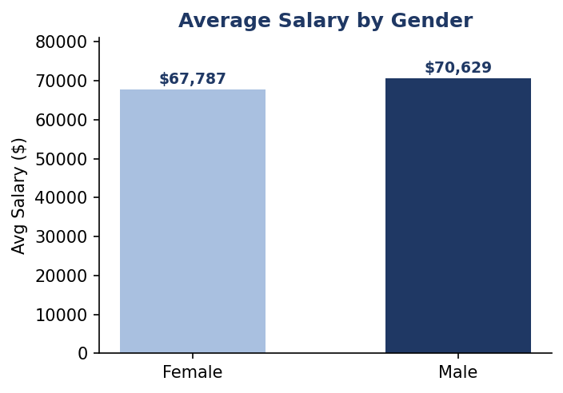
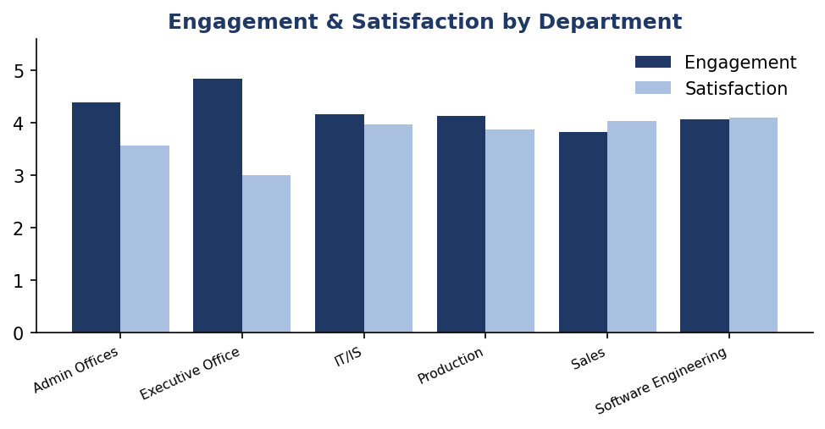
06
Salary, Engagement & Satisfaction Analysis
Men $70,629 vs women $67,787.
Gap is $2,842 (4.2%), small.
Run a like-for-like pay review.
Admin highest engagement (4.39).
Sales lowest engagement (3.82).
Check engagement in Sales now.
HR Analytics, 2006 to 2019
7

Slide 8
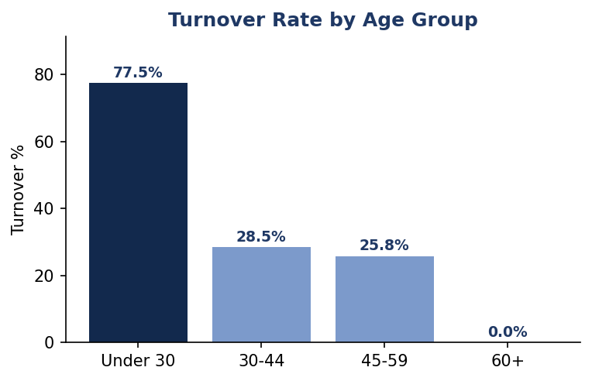
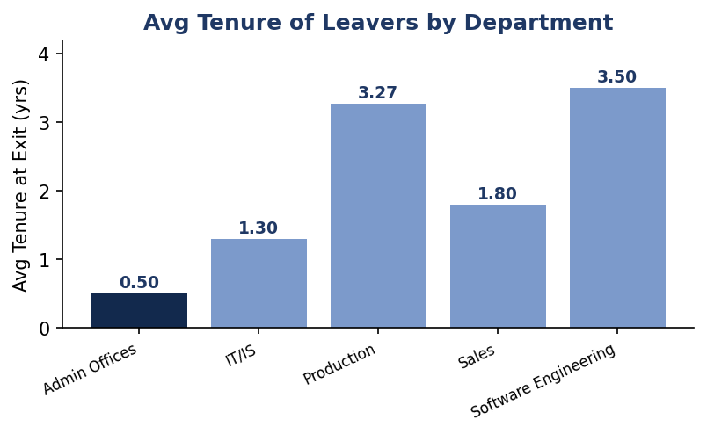
07
Age & Tenure Analysis
Under 30 turnover is 77.5%.
More than double any other age band.
Onboard and mentor young hires early.
Leavers stay about 3 yrs.
IT/IS leaves at 1.3 yrs, Production 3.3.
Fix the first year in IT/IS.
HR Analytics, 2006 to 2019
8

Slide 9
Key Recommendations
1
Fix Production Highest turnover in the largest team, the biggest single lever.
2
Keep under-30s 77.5% churn. Onboarding, mentoring, and check-ins.
3
Repair IT/IS exits People gone by 1.3 yrs. Fix the first year.
4
Recruit for quality Shift spend to referrals and the Diversity Job Fair.
5
Verify the pay gap Confirm 4.2% holds once role and tenure are controlled.
HR Analytics, 2006 to 2019
9

Slide 10
Conclusion
Turnover is high but concentrated, so it is fixable. Stabilize Production, keep young employees longer, and protect top performers.
Thank you.

