Slide 1

Analysis of AMCAT Data
Presented by:
Aparajita Singh

Slide 2
About me
I am Aparajita Singh, currently in my third year pursuing a Bachelor's degree in Computer Science and Engineering from Motilal Nehru National Institute of Technology (MNNIT) in Allahabad. Throughout my academic journey, I have maintained a CPI of 8.5, reflecting my strong theoretical foundation in the field.
My ongoing internship experience as a Data Science Intern at Innomatics Research Labs has been invaluable. It provided me with hands-on exposure to various data analysis methodologies and techniques, enriching my analytical skills. This opportunity has deepened my understanding of the practical applications of data science.
Eager to explore the corporate landscape, I am known for my adaptability and enthusiasm for embracing new concepts. I am excited about the prospect of applying my knowledge in real-world settings, aiming to excel as a Data Scientist. With a focus on continuous learning and professional growth, I am committed to making meaningful contributions to innovative projects and advancements in technology.
Link to project repository: https://github.com/Aparajita-singh/AMCAT-
LinkedIn
GitHub

Slide 3
Objectives of the Report
The objective of this Exploratory Data Analysis (EDA) is to deeply explore the given dataset, focusing on understanding the relationship between different variables and the target variable, Salary.
The primary goals of this analysis are as follows:
Detailed examination of the dataset's attributes and features.
Identification of noticeable patterns or trends within the data.
Exploration of how the independent variables relate to the target variable (Salary).
Detection of any outliers or irregularities present in the dataset.
Providing actionable insights and recommendations based on the analysis.
Through this analysis, we aim to gain a comprehensive understanding of the dataset's characteristics, uncover significant relationships, and offer valuable insights to support decision-making processes.

Slide 4
II. Description of the Dataset
The dataset, sourced from the Aspiring Mind Employment Outcome 2015 (AMEO) by Aspiring Minds, focuses on employment outcomes specifically within the engineering discipline. This study predominantly centers on engineering graduates, analyzing their employment status through key variables such as Salary, Job Titles, and Job Locations. It delves deeper into the standardized scores across three critical areas: cognitive skills, technical skills, and personality traits. Alongside these metrics, the dataset includes various demographic features to provide a comprehensive view.
With approximately 40 independent variables and a dataset comprising around 4000 data points, this dataset offers a robust exploration into the factors influencing employment outcomes for engineering graduates. Each candidate in the dataset is uniquely identified, ensuring precise analysis and individual-level insights.

Slide 5
III. Data Cleaning and Preprocessing
Checking for Null or Duplicate values
We checked the dataset for duplicate and null values, and found none.
Changing data types
To ensure the consistency of our date columns, we converted the data types of DOL, DOJ, and DOB columns to Datetime. We replaced the ‘present’ values in attribute DOL with the current date, which helped us figure out the Experience of employees.
Removing Columns with highly unusable values
Some columns describing optional exam subjects, had a substantial number of -1 values (representing nulls). To streamline our analysis, we dropped the columns where the percentage of -1 values was 50% or more. For the remaining columns, we imputed the -1 values with zeros.

Slide 6
IV. Attributes Selection and Transformation
Age Attribute
A new attribute ‘Age’ was introduced in the dataset using the DOB column. It helped us perform analysis, with respect to the age distribution of employees.
Experience Attribute
A new attribute ‘Experience’ was introduced in the dataset using the DOJ and DOL column. It helped us perform analysis, with respect to the experience (in years) of the employees.
Personality Score Attribute
From the data description, we know that the following columns: conscientiousness, agreeableness, extraversion, nueroticism, openess_to_experience, contain the scores for one section in the personality test.
Thus, for reducing the dimentionality of the dataframe, we combine these scores into one column named personality_test, and drop the other.

Slide 7
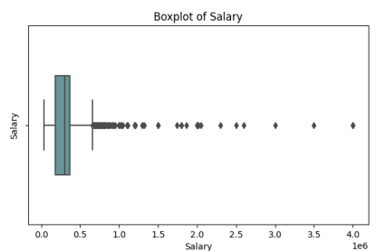
V. Univariate Analysis
Numerical Columns
Salary
The salary data shows significant variability, with a notable standard deviation. The data exhibits positive skewness, indicating a departure from a normal distribution. The mean and median values are approximately equal. There is a concentration of high salary points, as depicted by the box plot.

Slide 8
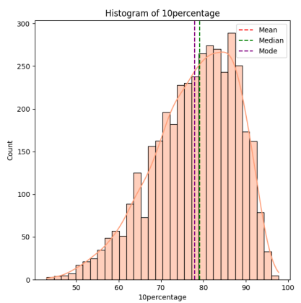
V. Univariate Analysis
10th Percentage
Around 50% of students achieved scores of roughly 79% or lower. The histogram shows a scarcity of students with low percentages, with a peak frequency at 77%, and an average score of 76%. There are a few outliers on the lower end, as seen in the box plot.
12th Percentage
About half of the students scored 77% or lower. The histogram reveals a concentration of scores between 68% and 83%, peaking at 69%, with an average of 73%. The box plot indicates a single data point with an extremely low score.

Slide 9
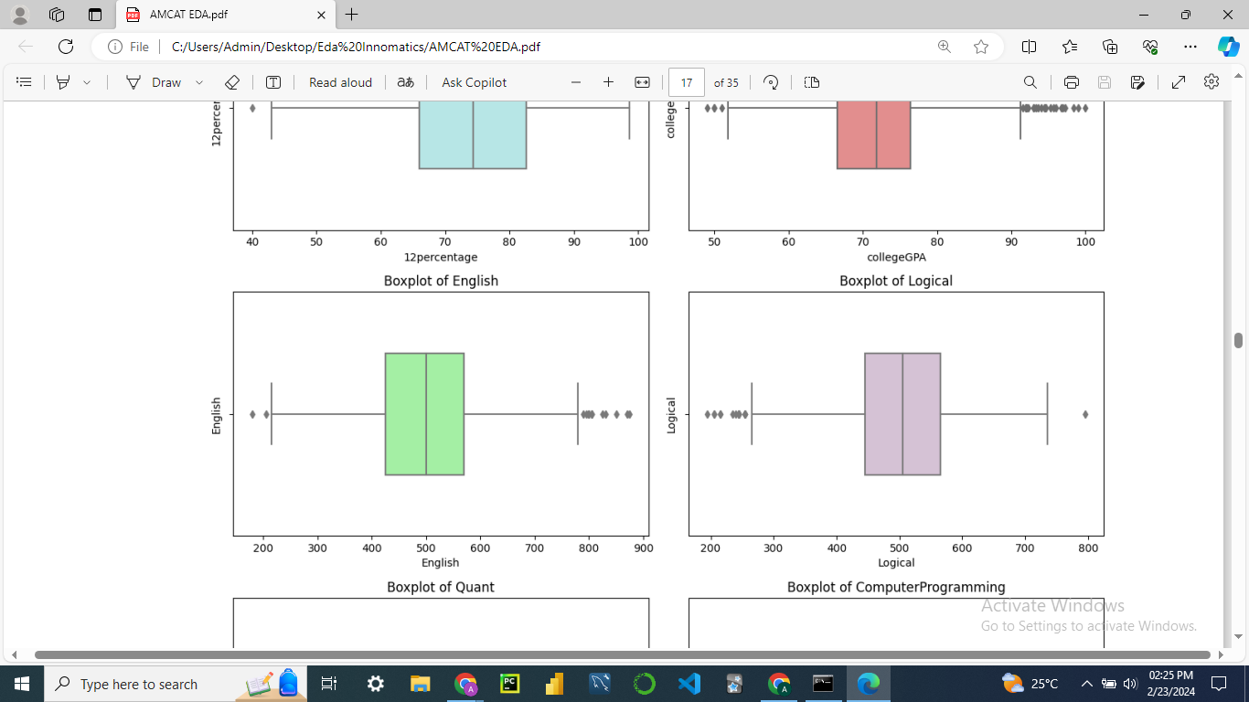
V. Univariate Analysis
Logical
Half of the students scored below 499 in logical reasoning. Scores clustered between 453 and 583, peaking at 494, with an average of 501. Presence of some lower extreme values, with a single high extreme value.
English
Half of the students scored below 499 in English. Most scores ranged from 388 to 544, peaking at 474, with an average score of 501. There are both lower and higher extreme values in the distribution.

Slide 10
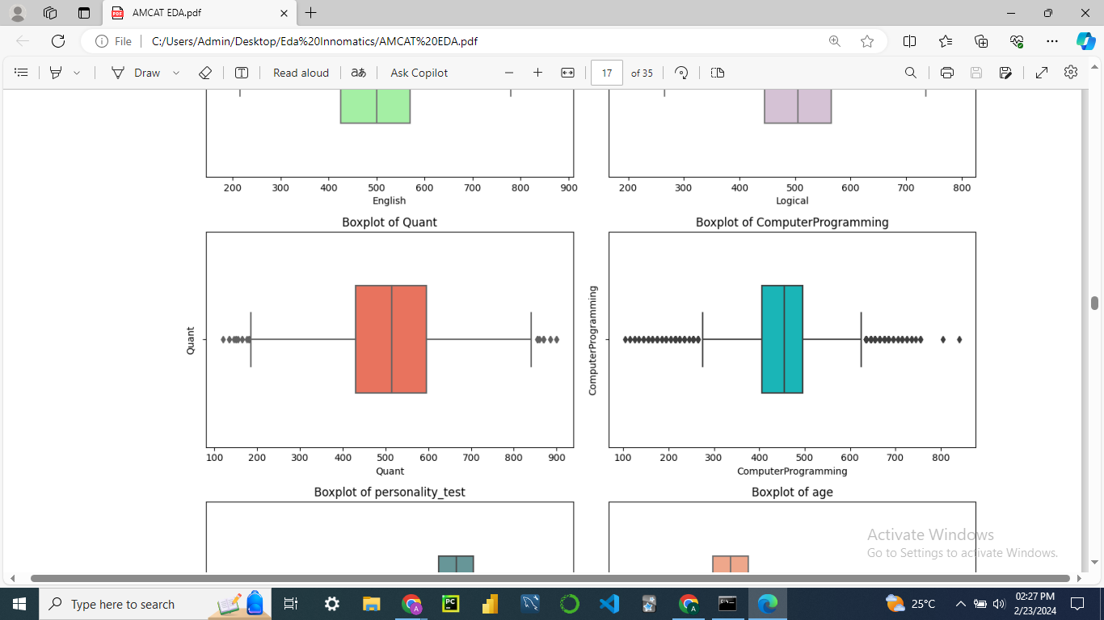
V. Univariate Analysis
Quant
75% of students scored below 590 in the quantitative section. Scores spread between 424 and 607, with the majority around 512, and an average of 512. The box plot highlights both low and high extreme values.
Computer Programming
Half of the students scored below 500 in programming. Scores were concentrated between 415 and 458, peaking at 454, with an average score of 451. Numerous low and high extreme values are evident.

Slide 11
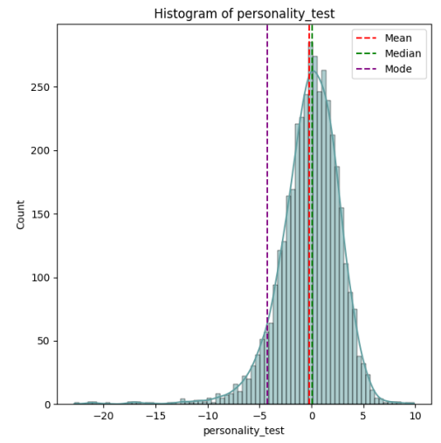
V. Univariate Analysis
College GPA
75% of students had a GPA of 79% or lower. The majority of GPAs fell between 62% and 77%, with the most common score being 70%, and an average GPA of 73%. Extreme values, both low and high, are visible in the box plot.
Personality Test
Most students scored in the negative range, with the highest value not exceeding 2. The data shows a slightly negative skew, with significant outliers in the negative direction.

Slide 12
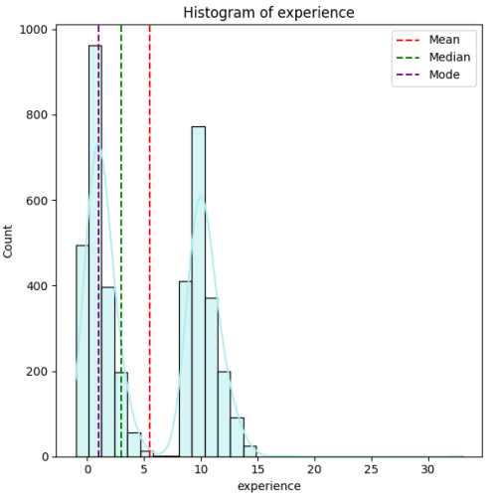
V. Univariate Analysis
Age
About 75% of students are under 25 years old. Ages mainly ranged from 21 to 24, with an average, median, and mode around 24. The box plot indicates a few students with very high ages and one with a very low age compared to others.
Experience
The range for experience is 3 years. The data is positively skewed, with more respondents having lower tenure. 50% of data points are below 1.5 years, with an average of 1.5 years. Some outliers have notably higher tenure values.

Slide 13
V. Univariate Analysis
2. Categorical Columns
Job City
Most common job city is Bangalore, followed by Noida by a very wide margin. The 'Other' section is a group of quantitatively smaller cities.
10th and 12th Board
Highest number of students have studied from CBSE, followed by the State Board, in both 10th and 12th.
Specialization
Most people are from the branch ECE, closely followed by CS and IT.
College State
The most favourable state for colleges is Uttar Pradesh.

Slide 14
V. Univariate Analysis
Graduation Year
2013 is the year that most of the people graduated.
College Tier
There is a huge disparity, with almost 93% students being from Tier 2 colleges.
Degree
The most common degree is B. Tech., with a huge percentage of 92.5%. It is followed by MCA by a wide margin.
College City Tier
Most people are from Tier 0 college states.
Gender
Disparity in gender can be seen, with around 76% of population being male.
In general, the data is highly imbalanced with regards to every feature.

Slide 15
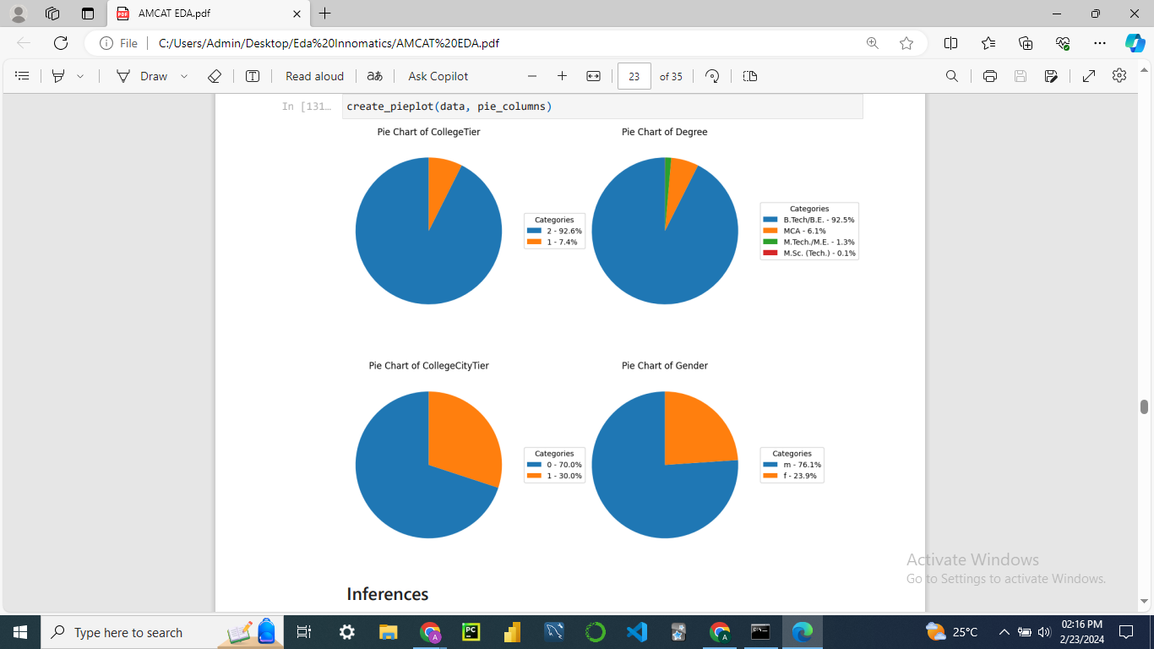
V. Univariate Analysis

Slide 16
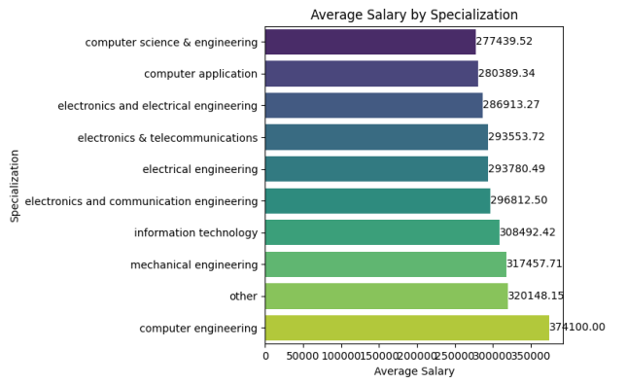
VI. Bivariate Analysis
Gender
Male employees have a higher average salary distribution than female employees. Also, female employees have average salaries below the overall average.
Specialization
The highest average salary is of a Computer Science graduate, followed closely by Mechanical and IT graduate.

Slide 17
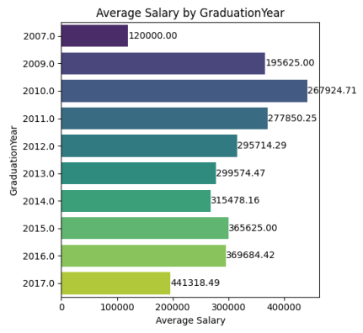
VI. Bivariate Analysis
College Tier
There is a large disparity in the average salaries between Tier 1 and Tier 2 colleges, with Tier 1 being on top.
Graduation Year
2010 graduates earn the highest salary.
Correlation Analysis
Experience has the highest correlation with Salary, with r = 0.40, indicating that salary depends on experience.

Slide 18
VII. Research Questions
1. Times of India article dated Jan 18, 2019 states that “After doing your Computer Science Engineering if you take up jobs as a Programming Analyst, Software Engineer, Hardware Engineer and Associate Engineer you can earn up to 2.5-3 lakhs as a fresh graduate.”
Average Salary by Designation: One-Sample t-test Results:
programmer analyst: 347589.285714 t-statistic: 22.83187390542922
software engineer: 354239.130435 p-value: 0.02786513129231036
Hypothesis Testing:
Reject the null hypothesis.
There is enough evidence to suggest that the average salaries are within the given range.

Slide 19
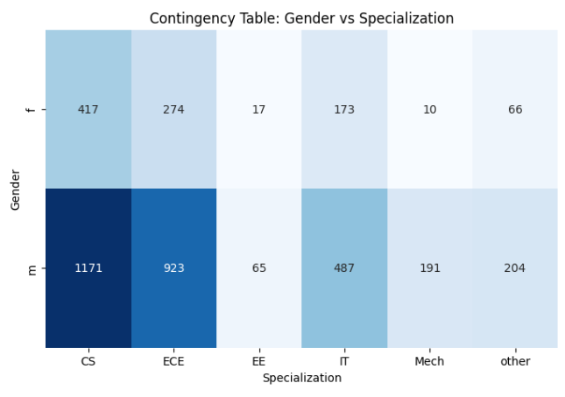
VII. Research Questions
2. Is there a relationship between gender and specialization? (i.e. Does the preference of Specialisation depend on the Gender?)
Chi-square Statistic: 47.494660404870665
p-value: 4.503854477756338e-09
Hypothesis Testing:
The null hypothesis (H0) is rejected.
There is a significant relationship between Gender and Specialization.

Slide 20
VIII. Recommendations
Salary Consideration
While the average salaries for the specified job roles fall within the expected range, further analysis could provide more insights.
Consider additional factors such as industry trends, location-specific salary variations, and experience levels to refine salary expectations.
Academic Support
Schools and colleges could focus on maintaining the positive trend seen in academic scores, encouraging students to excel in their studies.
Skill Enhancement
Students aiming for roles such as Programming Analyst, Software Engineer, Hardware Engineer, and Associate Engineer should focus on improving their skills in areas such as English, Logical Reasoning, Quantitative Aptitude, and Computer Programming.

Slide 21
IX. Conclusion
In conclusion, this analysis provides valuable insights into the dataset, shedding light on student performance, salary expectations, and potential areas for improvement. While the average salaries for specified job roles align with expectations, further exploration into various factors can enhance decision-making processes for students, educational institutions, and employers alike.
The dataset paints a picture of a diverse and capable student population, with strong academic foundations and varied skill sets.
Average salaries for specified job roles are in line with industry standards, providing a benchmark for entry-level salary expectations.
Understanding the nuances of academic performance, personality traits, and work experiences can aid both students and employers in making informed decisions.

Slide 22

THANK YOU

