Slide 1

Exploratory Data Analysis Report
Online Retail
Sales Analysis
Strategic Insights & Recommendations from 1M+ Transactions
Total Transactions
Revenue Analyzed
Countries
Analysis Period
1.07M
£21M+
38
Dec 2009 - Dec 2011

Slide 2
Navigation
Executive Overview
01
Dataset Overview
02
Revenue Performance
Data structure, quality metrics, and processing workflow
Distribution analysis, key metrics, and transaction patterns
03
Geographic Insights
04
Customer Segmentation
Market concentration and country-wise revenue distribution
RFM analysis and value-based customer tiers
05
Retention Analysis
06
Strategic Recommendations
Cohort patterns and customer lifetime value insights
Actionable strategies for revenue growth and optimization

Slide 3
Data Foundation
Dataset Overview
Total Transactions
Variables
Valid Sales Records
1,067,371
8
1,041,671
Data Structure
Data Quality Assessment
Invoice
Transaction ID
Customer ID Missing
243,007 (22.8%)
StockCode
Product Code
Impacts customer-level analysis; filtered for segmentation
Description Missing
4,382 (0.4%)
Description
Product Name
Minimal impact; retained for revenue calculations
Quantity
Units Sold
Processing Workflow
InvoiceDate
Transaction Date
Converted InvoiceDate to datetime format
Filtered positive Quantity & Price for sales analysis
Price
Unit Price (£)
Created Revenue = Quantity × Price
Customer ID
Customer Identifier
Extracted time features (Month, Quarter, DayOfWeek)
Country
Market Location

Slide 4
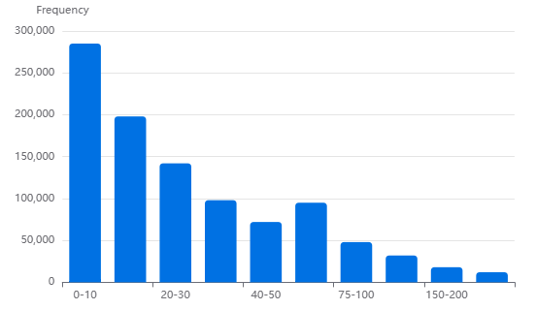
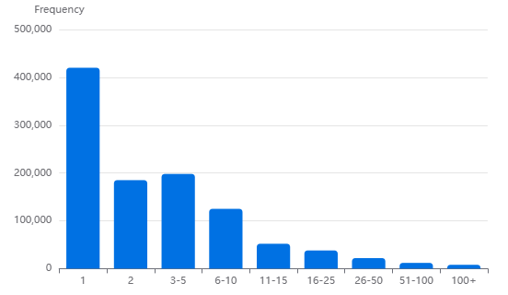
Financial Performance
Revenue Distribution & Key Metrics
Mean Revenue
Median Revenue
Max Revenue
Std Deviation
£20.13
£9.96
£168K
£203
Revenue Distribution (99th Percentile)
Quantity Distribution
Key Insight: Right-Skewed Distribution
The revenue distribution exhibits a highly right-skewed pattern typical of retail data, with most transactions clustered at lower values and a long tail of high-value orders. The significant gap between mean (£20.13) and median (£9.96) indicates the presence of high-value outliers. Outlier treatment using the 99th percentile threshold preserves data integrity while enabling clearer visualization of the core transaction distribution.

Slide 5
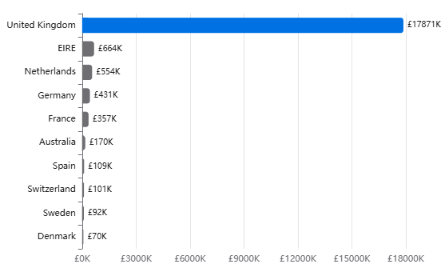
Market Analysis
Geographic Revenue Distribution
UK Market Share
Top 5 Countries
Total Markets
85.2%
95%
38
£17.87M revenue
of total revenue
Countries served
Top 10 Countries by Revenue
Market Concentration Analysis
1
United Kingdom
85.2%
Primary Market
£17.87M
2
EIRE
3.2%
Secondary Market
£664K
3
Netherlands
2.6%
European Hub
£554K
4
Germany
2.1%
Major EU Market
£431K
5
France
1.7%
Key EU Market
£357K

Slide 6
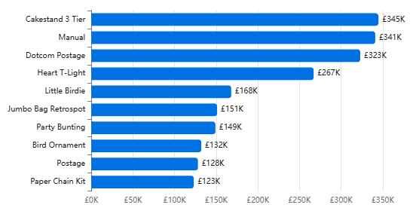
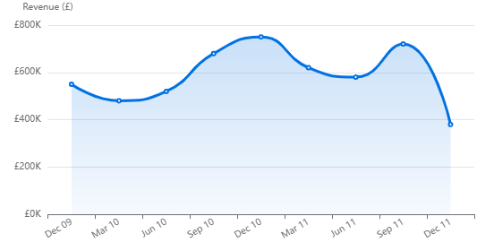
Product & Temporal Analysis
Top Products & Seasonal Trends
Top 10 Products by Revenue
Monthly Revenue Trend
Top Product
Peak Season
Notable Drop
Regency Cakestand 3 Tier
Q4 (Oct-Dec)
December 2011
£344,563
+35%
-45%
1.6% of total revenue
vs. quarterly average
vs. December 2010
Seasonality Insights
The data exhibits classic retail seasonality with Q4 peaks driven by holiday shopping. The sharp drop in December 2011 suggests data collection ended mid-month. Home décor and gift items dominate top products, indicating strong positioning in the seasonal gifting market. The concentration of top 10 products suggests opportunities for portfolio diversification.

Slide 7
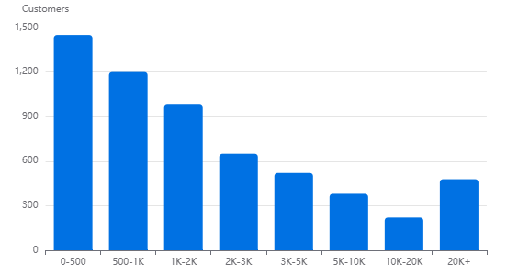
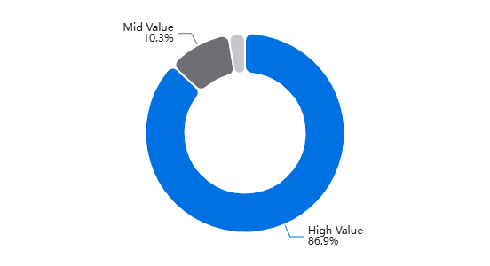
Customer Analytics
Customer Value Segmentation
Total Customers
Avg Spend/Customer
Median Spend
5,878
£3,440
£1,662
With valid Customer ID
Mean total spend
More representative
Customer Spend Distribution
Revenue Contribution by Segment
High Value
33%
Mid Value
33%
Low Value
33%
86.9%
10.3%
2.7%
of total revenue
of total revenue
of total revenue
1,960 customers with highest lifetime value
1,958 customers with growth potential
1,960 customers requiring activation

Slide 8
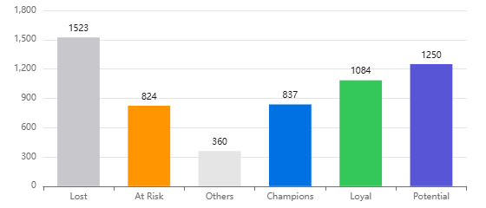
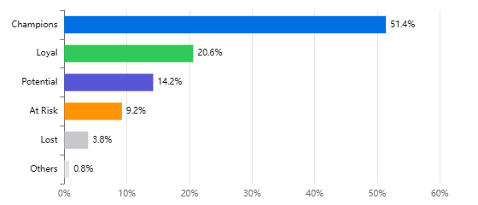
Advanced Segmentation
RFM Customer Segmentation
Recency (R)
Frequency (F)
Monetary (M)
Days since last purchase
Total number of orders
Total spend amount
Customer Segments by Count
Revenue Contribution by Segment
Champions
Loyal Customers
At Risk
837
1,084
824
customers (14.2%)
customers (18.4%)
customers (14.0%)
51.4%
20.6%
9.2%
of total revenue
of total revenue
of total revenue
R=5, F≥4: Recent, frequent, high-value buyers
R≥4, F≥3: Consistent repeat buyers
R≤2, F≥3: Were frequent but haven't purchased recently
Segmentation Insights
Champions + Loyal Customers represent only 32.6% of the customer base but generate 72% of total revenue. The At Risk segment (824 customers) still contributes 9.2% of revenue and represents a critical win-back opportunity. The Lost segment (1,523 customers, 25.9%) contributes only 3.8% of revenue, indicating successful identification of truly inactive customers.

Slide 9
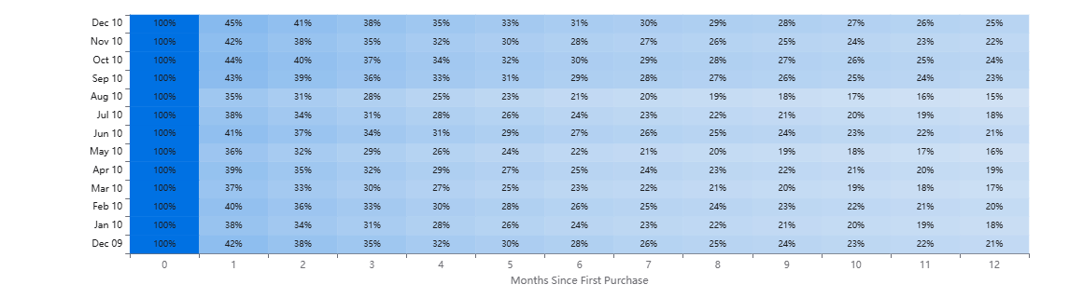
Customer Lifecycle
Cohort Retention Analysis
Month 1 Retention
Month 6 Retention
Month 12 Retention
Best Cohort
35-45%
20-30%
15-25%
Dec 2009
Customer Retention Heatmap by Cohort
Sharp First-Month Drop
Gradual Decline Pattern
55-65% of customers don't return after their first purchase, indicating a critical engagement window.
After the initial drop, retention stabilizes with gradual decline, suggesting loyal customers remain engaged.

Slide 10
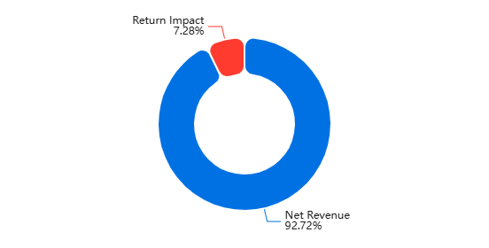
Operational Analysis
Return Analysis & Impact
Return Transactions
Return Rate
Return Value
Revenue Impact
22,950
2.15%
£1.53M
7.28%
Return Impact Breakdown
Return Analysis Insights
Low Return Rate
At 2.15%, the return rate is below industry average (8-10% for online retail), indicating strong product quality and accurate descriptions.
Significant Value Impact
Despite low transaction rate, returns impact 7.28% of revenue, suggesting higher-value items are more frequently returned.
Inventory Implications
Returns affect inventory planning and cash flow. Understanding return reasons can optimize stock levels and reduce holding costs.
Fraud Detection Opportunity
Pattern analysis of returns can identify potential fraudulent activity and customers with abnormally high return rates.
Strategic Recommendation
While the return rate is favorable, the 7.28% revenue impact warrants investigation. Implement return reason tracking to identify patterns. Consider enhanced product photography, detailed sizing guides, and customer reviews to reduce fit-related returns. Analyze high-value returns separately to understand premium product issues.

Slide 11
Action Plan
Strategic Recommendations
01
Geographic Diversification
02
VIP Customer Program
Challenge: 85% revenue concentration in UK creates market risk.
Insight: Champions + Loyal (32.6%) generate 72% of revenue.
Actions:
Actions:
• Expand marketing in Germany, France, Netherlands
• Launch exclusive loyalty program for top segments
• Localize website and customer service
• Early access to new products and sales
• Develop region-specific product offerings
• Personalized recommendations and offers
• Target: Reduce UK dependency to 70% within 18 months
• Dedicated customer success manager
Expected Impact: +15% revenue growth
Expected Impact: +10% retention, +20% CLV
03
At-Risk Win-Back Campaign
04
Seasonal Optimization
Opportunity: 824 At-Risk customers contribute 9.2% of revenue.
Pattern: Q4 shows 35% higher revenue; classic retail seasonality.
Actions:
Actions:
• Triggered email campaigns with personalized offers
• Increase inventory 40% ahead of Q4
• Limited-time discounts based on purchase history
• Launch holiday marketing campaigns in October
• Survey to understand reasons for inactivity
• Bundle products for gift-giving occasions
• Retargeting ads on social media platforms
• Offer extended return window for holiday purchases
Expected Impact: Recover 30-40% of at-risk revenue
Expected Impact: +25% Q4 revenue
Implementation Priority
Combined Revenue Impact
Start with VIP Program (immediate impact) → At-Risk Campaign (quick wins) → Geographic Expansion (long-term growth)
+35-50%

Slide 12

Conclusion
Key Takeaways
01
Market Concentration Risk
02
Customer Value Concentration
UK dominance (85.2% revenue) presents both strength and vulnerability. Diversification into EU markets is critical for long-term stability.
Top 33% of customers drive 87% of revenue. RFM segmentation identifies clear tiers for targeted retention and growth strategies.
03
Seasonal Revenue Patterns
04
Retention Opportunity
Strong Q4 seasonality (+35%) requires proactive inventory and marketing planning. Holiday-focused product strategy can maximize peak periods.
55-65% customer drop-off after first purchase highlights critical engagement window. Early-stage nurturing can significantly improve lifetime value.
05
Return Management
Low return rate (2.15%) but significant revenue impact (7.28%) suggests opportunity for improvement. Understanding return drivers can recover substantial value.
Total Revenue Analyzed
Customers Analyzed
Markets Covered
Analysis Period
£21.0M
5,878
38
Dec 2009 - Dec 2011

