Slide 1
Employee Data Analysis using Excel
STUDENT NAME: R. APARANJITHA
REGISTER NO: 312209265
DEPARTMENT:B.com (General)
COLLEGE: Anna Adarsh College for Women

Slide 2
PROJECT TITLE
Employee Performance Analysis using Excel

Slide 3


AGENDA
Problem Statement
Project Overview
End Users
Our Solution and Proposition
Dataset Description
Modelling Approach
Results and Discussion
Conclusion
3/21/2024 Annual Review

Slide 4

PROBLEM STATEMENT
"Analyze employee performance using Excel by gathering data like work output and attendance. Use Excel tools to find trends and identify who is performing well or needs improvement. Create easy-to-understand charts and tables to help managers make better decisions. Offer clear suggestions based on the analysis."

Slide 5

PROJECT OVERVIEW
.
This project is about using Excel to check how well employees are doing at work. We'll gather data like how much work they complete and how often they are present. Then, we'll use Excel to find patterns, see who's doing well, and who might need some help. The results will be shown in easy-to-read charts and tables to help managers make better decisions and improve employee performance.

Slide 6

WHO ARE THE END USERS?
The end users of this project are managers, team leaders, and HR professionals. They will use the analysis to make decisions about employee performance, identify areas for improvement, and support their teams more effectively.

Slide 7

OUR SOLUTION AND ITS VALUE PROPOSITION
A simple Excel tool that analyzes employee performance data, automatically generating reports and charts to help managers easily assess and improve team performance.
Our solution simplifies performance evaluation, offering clear insights that enable better decision-making and team productivity with minimal effort.

Slide 8
Dataset Description
Employee ID:
A unique number for each employee.
Work Output:
Data on how much work each employee has done.
Records of when employees were present, absent, or late.
Attendance:
Ratings or comments from managers or coworkers.
Feedback Scores:
The team or department the employee works in.
Department:
How long each employee has worked at the company.
Tenure:

Slide 9

THE "WOW" IN OUR SOLUTION
The "wow" factor is how our tool makes it super easy to see and understand employee performance. It turns messy data into clear, simple reports and charts, helping managers quickly spot trends and make better decisions with minimal effort.
3/21/2024 Annual Review
9

Slide 10
MODELLING
Setting up a clear process to analyze employee performance. It involves: Collecting data: Gather information life work completed, attendance, and feedback. Organizing Data: Arrange the data in excel for easy access. Analyzing Data: use formulas and charts to find patterns and trends. Creating Visuals: Make graphs and charts to show the results clearly. Reporting:Summarizr the findings and give recommendations based on the analysis.
10

Slide 11
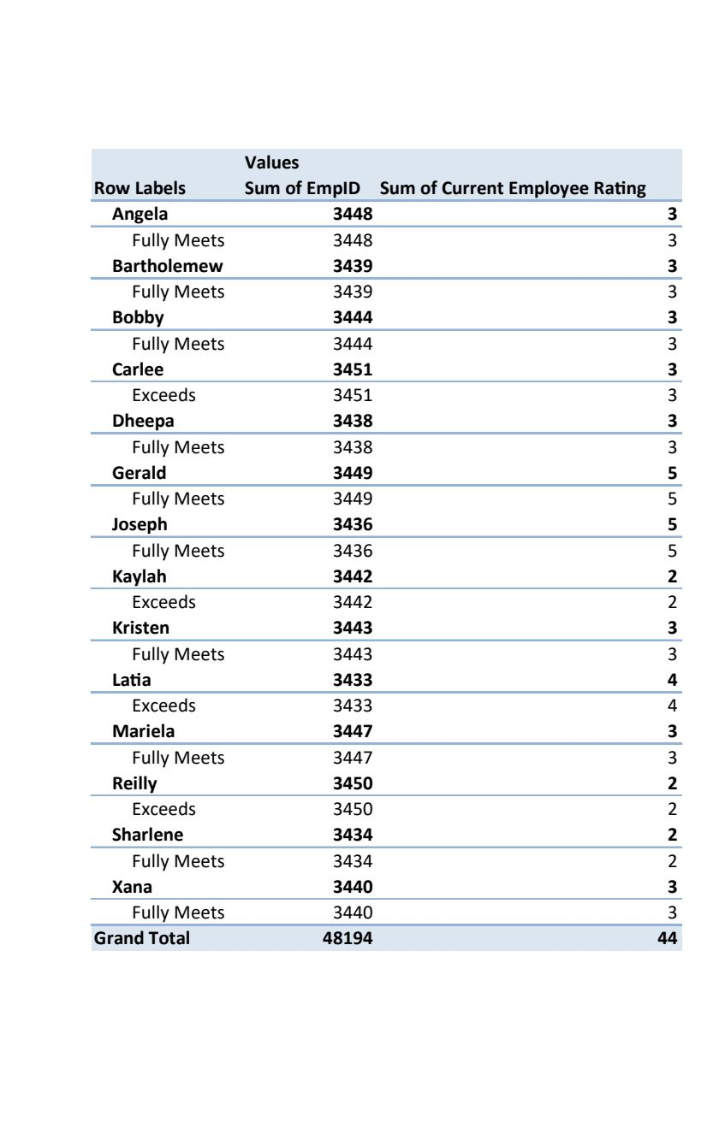
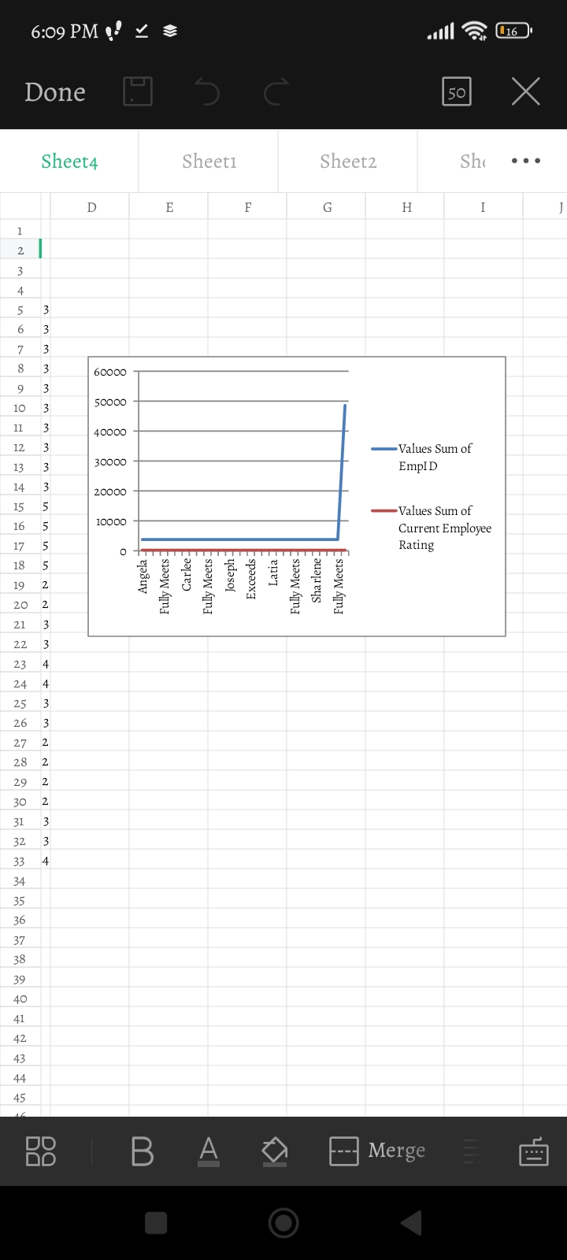
RESULTS
11

Slide 12
conclusion
**Conclusion:** Using Excel to analyze employee performance helps make sense of data easily. It lets you see how employees are doing by showing trends and patterns clearly through charts and reports. This makes it easier for managers to make informed decisions and improve team performance.

