Slide 1

Seasonal Agriculture Performance Analysis
Student Name- APARNA MANOJ
College Name- Co-operative Arts & Science College, Madayi
AICTE STU ID : STU6a3fc44be35991782563915

Slide 2

PROBLEM STATEMENT
Agricultural activities are influenced by seasonal variations in environmental conditions, farming practices, resource availability and market conditions. As a result, agricultural performance may differ from one season to another.
However, raw agricultural data does not clearly explain how agricultural performance changes across seasons or what patterns can be observed in different seasonal conditions.
The problem is to analyze the given agricultural dataset and investigate seasonal differences in agricultural performance by identifying meaningful patterns, trends, relationships and variations within the available data.

Slide 3
Project Description
In this project, I analyze the seasonal performances of various agricultural activities from an extensive database containing 4,000+ farm records spread over 8 different types of crops (Rice, Wheat, Maize, Pulses, Cotton, Chilli, Groundnut & Sugarcane), 3 distinct seasons (Kharif, Rabi & Zaid) in various Indian states.
I perform all sorts of data analyses on these data in Python by utilizing libraries such as pandas, numpy, matplotlib, seaborn & scipy within the environment provided by a Jupyter Notebook.
I first clean my datasets (missing values related to rainfall, soil-moisture & yields are handled via Median Imputations), then validate several crucial financial formulas including production, revenue, profit & water-efficiency. Lastly, I explore some important parameters like yield, profits & water efficiency between different seasons, crops & states, and use relevant statistical tools such as Kruskal-Wallis Test, Mann-Whitney U Test (with Bonferonni Correction) & Spearman Correlation to validate their significance. Finally, I summarize up my findings and provide actionable insights in form of recommendations regarding agricultural planning

Slide 4

WHO ARE THE END USERS?
Farmers
They will benefit from this information, aiding them in choosing their crops and irrigation techniques during a particular season.
Agricultural planners/policymakers
Use to determine which seasons/regions need further attention
Agribusiness and Agri-Finance Companies
Use to evaluate Seasonal Risk Before Lending/Investment.
Students and Researchers
Who want a reference on the Analysis of Seasonal Agricultural Data.

Slide 5

Technology Used
Language: Python
Libraries: pandas, numpy, matplotlib, seaborn, scipy
Environment: Jupyter Notebook (VS Code)
Statistical methods: Kruskal-Wallis test, Mann-Whitney U test (Bonferroni correction), Spearman correlation
Version Control: GitHub

Slide 6
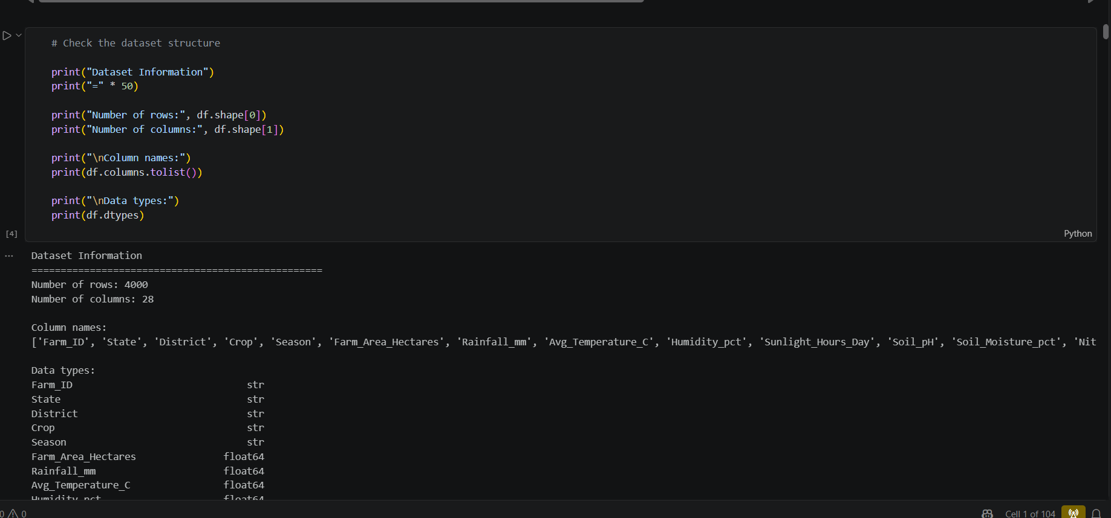
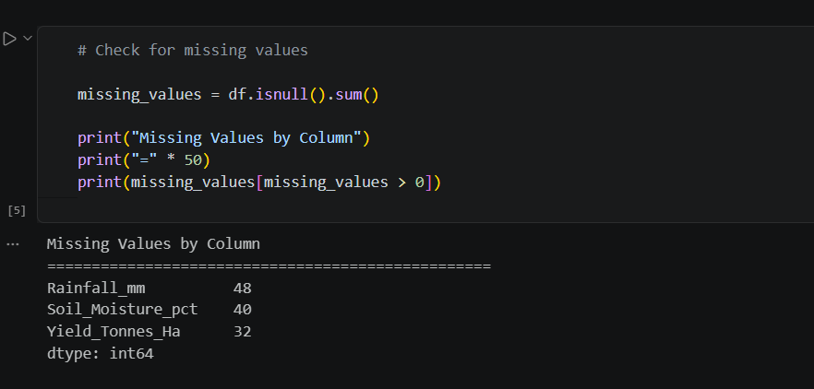
RESULTS
It has 4,000 rows and 28 columns. No duplicate row was found. Three of the columns contain missing data points for Rainfall(48), Soil Moisture(40), and Yield(32). These missing data points have been addressed by filling them with their corresponding column medians.

Slide 7
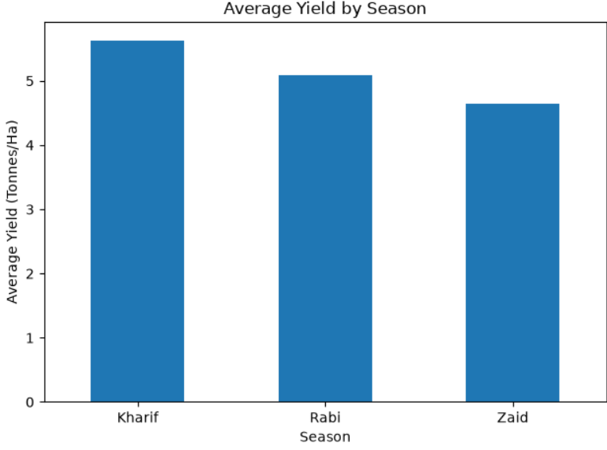
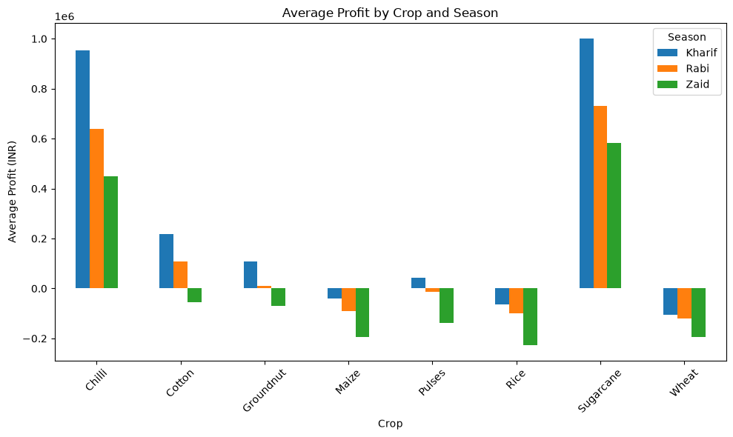
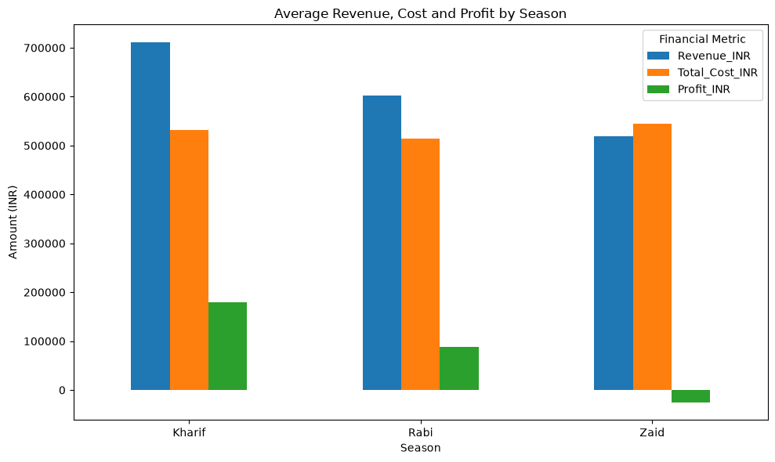
RESULTS
Kharif shows the highest yield and profit across most crops and the strongest revenue-to-cost ratio, while Zaid consistently underperforms across all three metrics.

Slide 8
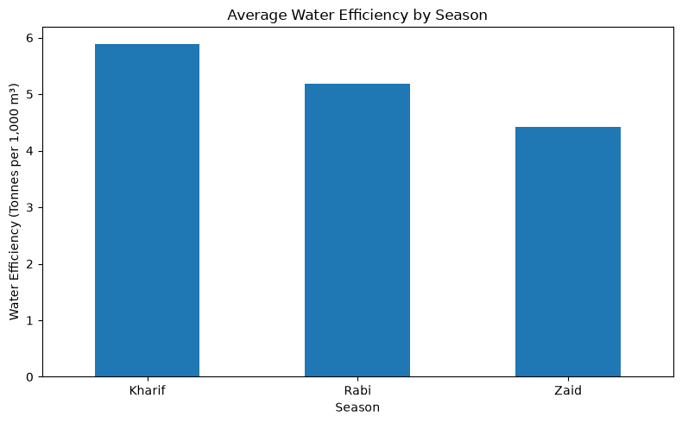
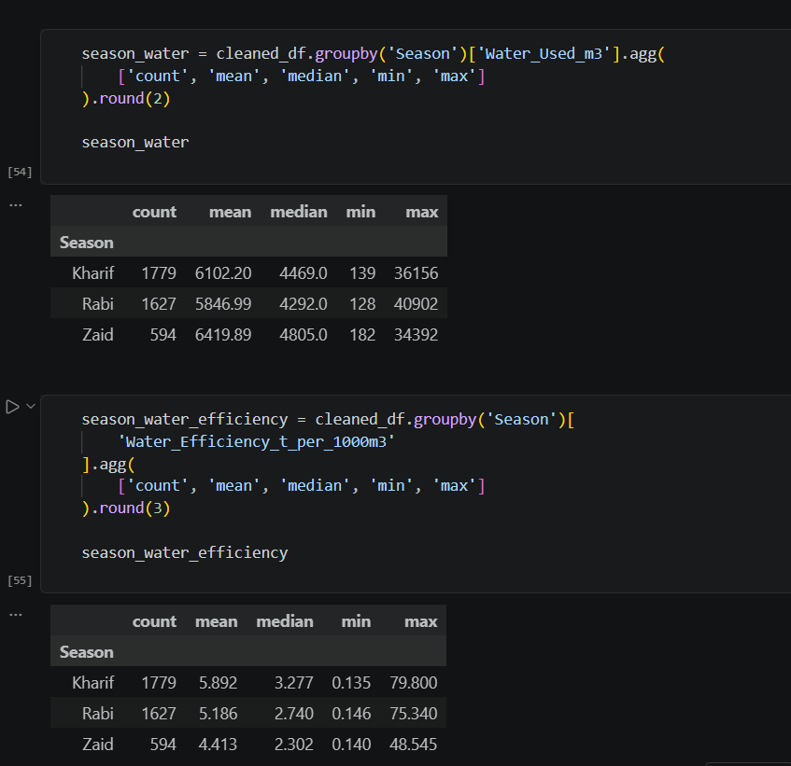
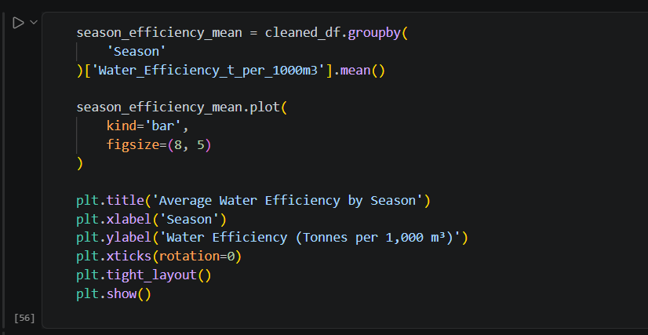
RESULTS
Water efficiency was highest in Kharif (5.89 tonnes per 1,000 m³) and lowest in Zaid (4.41 tonnes per 1,000 m³), even though Zaid used a comparable amount of water on average. This shows Kharif converts water into production more effectively than the other seasons.

Slide 9
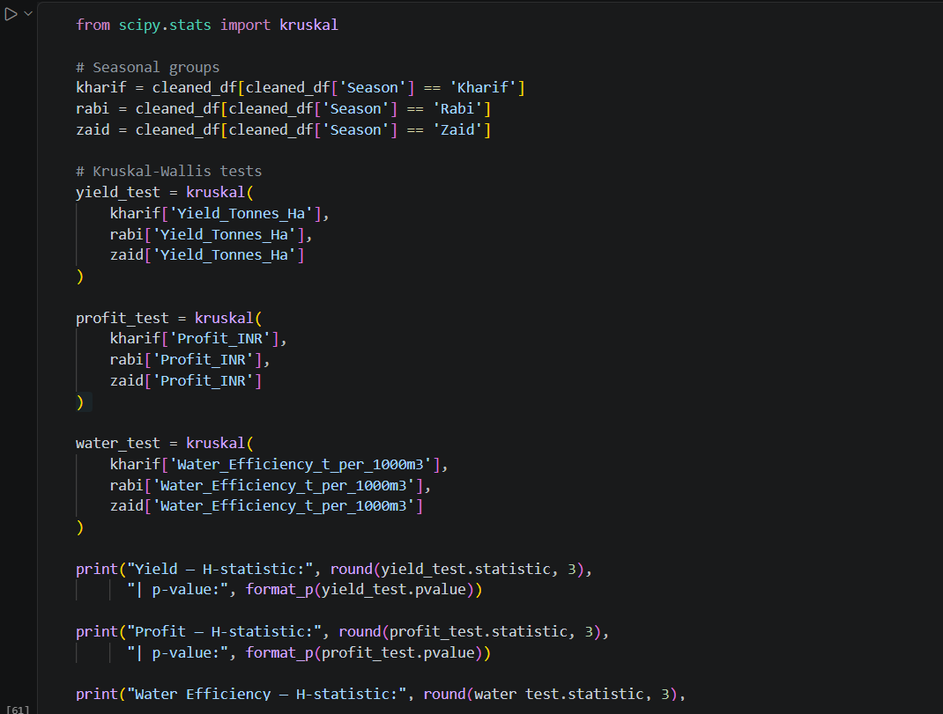
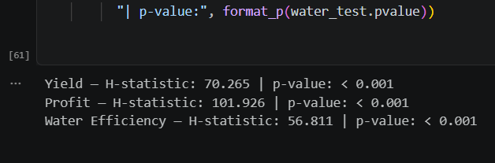
RESULTS
The differences in yield, profit and water use between seasons were found to be actual differences and not by chance. Tests were carried out using the three seasons (p < 0.001).

Slide 10
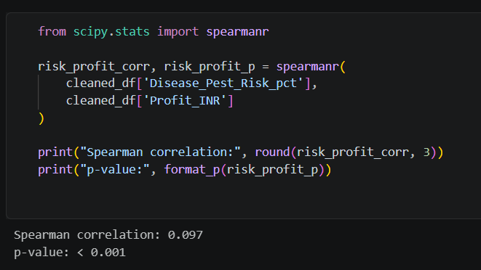
RESULTS
Disease/pest risk showed a very weak relationship with profit (correlation ≈ 0.10) — meaning the two are only loosely connected, even though the result is statistically significant.

Slide 11
Future scope
Use more recent multi-year data for studying year over year trends by seasons.
Create a predictive model (regression etc.) that will allow you to predict profit/yield given some parameters of season/crop/environment.
Add some weather forecast data into the mix.
Make an easy to use, interactive dashboard where you can filter out by season/crop/state etc. for farmer/planners.

Slide 12
GitHub Link
https://github.com/Aparna-manoj/Seasonal_Agriculture_Performance_Analysis

Slide 13

VOIS Course completion certificate - Course name- Data Visualization

Slide 14
Thank you
APARNA MANOJ
.
.

