Slide 1
INDIAN FAKE CURRENCY DETECTION USING COMPUTER VISION
Presented By:
Aparna Das

Slide 2
Introduction
Fake Indian Currency Note (FICN) is a term used to refer to counterfeit currency notes circulated in the Indian economy.
In the last eight years more than 3.53 lakh cases of counterfeit currency is reported.
The Reserve Bank of India(RBI) is the only one which has the singular authority to issue bank notes in India
Under federal law, the use or attempted use of counterfeit currency is illegal if the person has the intent to defraud the recipient. A conviction for the offense carries up to 20 years in prison and a fine.
Several security features have been published by the RBI so that the counterfeit notes can be detected by the general public.

Slide 3
Continues..
The primary features which are used by the RBI include a watermark, security thread, latent image of denomination numeral, bleed lines etcetera.However, distinguishing a counterfeit note just by visual per lustration is not an easy task
Developing applications which can detect a currency note to be counterfeit by a camera image can help to solve this problem.
This project propose a novel approach for the detection and classification of duplication in currency note using ORB (Oriented FAST and Rotated BRIEF) and Brute-Force matcher in OpenCV.

Slide 4
Existing System
Fake note detector mechine:Fake note detection unit consist of UV LED, photodiode, amplifier and comparator. The UV LED source transmits the UV rays, if the note is real it will absorb some amount of UV rays and if the note is fake then the all rays will be reflected back towards the photodiode.
Counterfeit Detector Pen:It is simply a equipment which has been designed to infer whether the note is real or forged. The ink (containing tincture of iodine) present in the pen will turn black or dark blue if it is fake else it turns yellow. Limitations of a pen is they unworkable for starch free papers and success is much lower.
Image Processing Techniques for currency detection

Slide 5
Proposed System
This project is identifies the security feature which is provided by the government of India so that they can differentiate between the fake and real note.
Detecting of fake note some module including image acquisition, Image per-processing, Image adjusting, Gray scale conversion, Edge detection, Segmentation, Feature extraction and classification.
This project propose a novel approach for the detection and classification of duplication in currency note using ORB (Oriented FAST and Rotated BRIEF) and Brute-Force matcher in OpenCV.
This project uses computer vision technics for predicting if the currency is fake or real.

Slide 6
Proposed Sytem-Continues
The system proposed here work on the image of Indian currency note acquired by a digital camera. The method which is applied here is as follows
a. Acquisition of image of Indian currency note by simple digital camera or scanner.
b. Image acquired is RGB image and converted to Gray scale image.
c. Edge detection of whole gray scale image.
d. Now Indian currency features of the paper currency both observe and reverse will be cropped and segmented.
e. After segmentation, feature of Indian currency note are extracted.
f. BF matcher match that database features with test images note then the test note is said as original otherwise fake

Slide 7
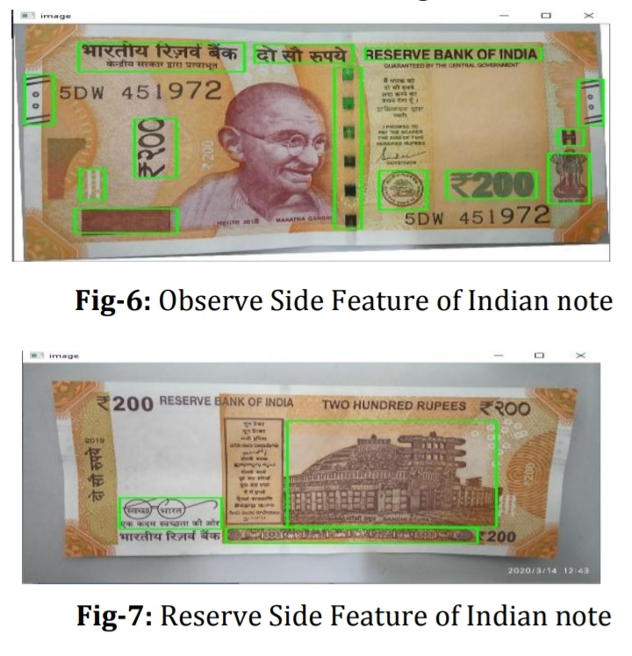
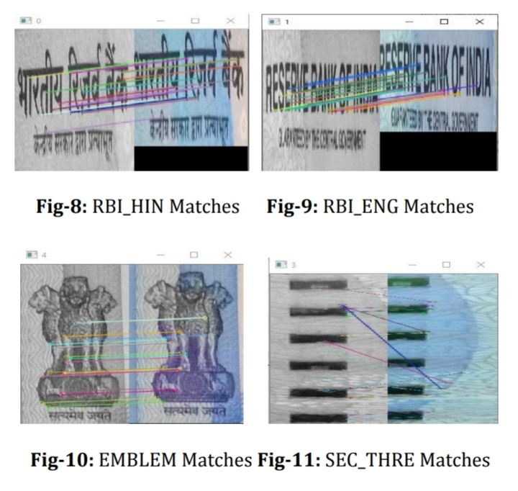

Slide 8
Module Description
1) Data Collection
2) Preprocessing : The image is cropped and adjusting is done using image interpolation.Theimage is smoothened.
3) Grey scale conversion : The image which contains the RGB values are converted into greyscale.
4) Edge detection : Points on the image where brightness changes sharply are identified.
5) Image segmentation : Image segmentation is performed to locate objects and boundaries (lines, curves etc.)in the image.
6) Feature extraction :The main features are extracted from the image.
7) Comparison : The characteristics of the resultant image are compared with a genuine image stored in the system
8) Result Prediction

Slide 9
Actors & Roles
User
User can upload currency for checking if it is fake or real
User can view the result (prediction-fake/real)

Slide 10
UML DIAGRAMS

Slide 11
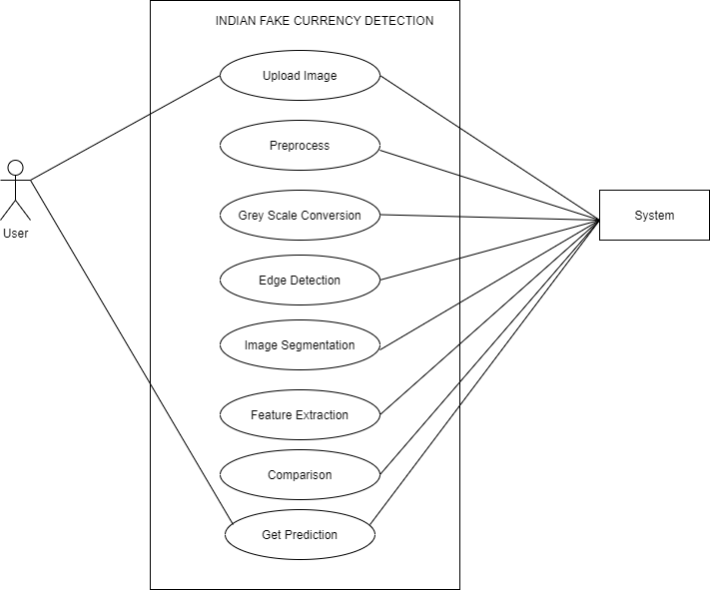
USECASE

Slide 12
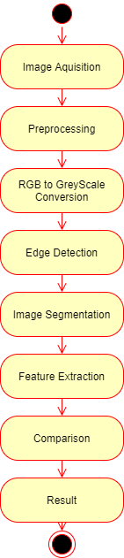
Activity Diagram-Prediction

Slide 13
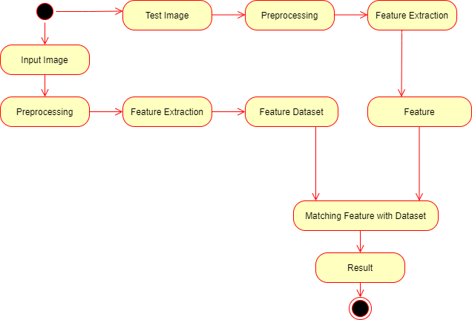
Activity Diagram-Overall

Slide 14
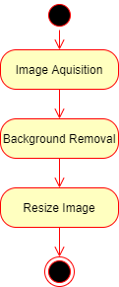
Preprocessing

Slide 15
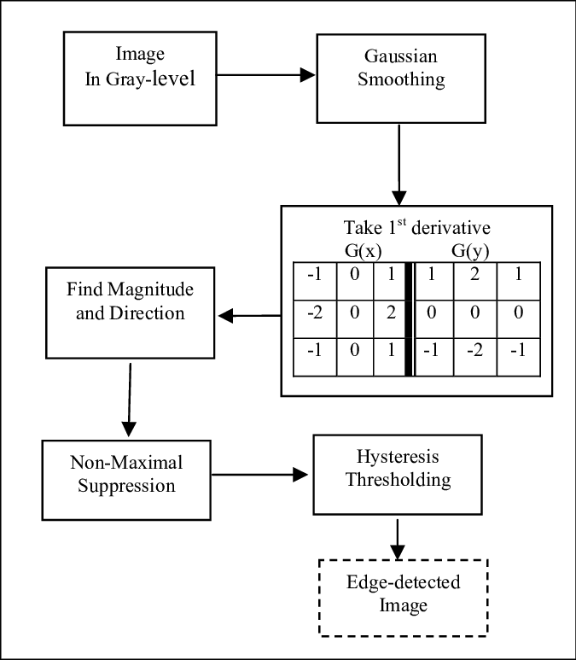
Edge Detection-Canny Edge Detection Algorithm

Slide 16
THANK YOU

