Slide 1
Performance Evaluation of
IoT Data Management Using MongoDB Versus MySQL Databases in Different Cloud Environments
BY :
MAHMOUD EYADA , WALAA SABER , MOHAMMED M. EL GENIDY
AND FATHY AMER

Slide 2
Overview of technologies used in the paper
Amazon Web Services (AWS) provides various services , one of which is Elastic Compute Cloud (EC2) which gives the power to create a Virtual Private Server(VPS) such as your PC.
It provides a service Simple Storage Service(S3) that is used to save the dataset in the database server.
MySQL as Relational Database and MongoDB as Non- Relational Database is taken into consideration.

Slide 3
Background
IoT i.e, Internet of Things is a system that is based on sensing , collecting and sharing data.
This generates a large amount of heterogeneous data like texts, audios, images which needs to be stored and managed efficiently.
Thus the appropriate selection of relational or non-relational DBMSs is a challenge.
Performance evaluation of the Relational and Non-relational DBMS is one of the solutions that help to meet this challenge.

Slide 4
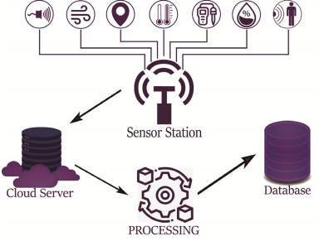
How it works?
Data is collected by sensors and transmitted
through network to appropriate cloud platform
Databases use the cloud computing
paradigm to optimize , consistency,availability
and partition tolerance.
Finally data is stored in databases after
different manipulation operations done by the
programming languages.

Slide 5
MySQL / SQL Databases MongoDB/NoSQL Databases
Requires predefined schemas.
Stores data in tables with specified fields only.
A change in this structure would would be very difficult and disruptive .
Document-oriented database.
Stores data as documents in the form of JSON objects.
Documents are organised in “collections’’ .
Dynamic schema .
Thus, their performance evaluation is done on the basis of latency (access time) , database size and also cloud server hardware specifications. Also, a statistical analysis is introduced to predict the best DBMS you should use.

Slide 6
EXPERIMENT FOR PERFORMANCE EVALUATION
INCREASING WORKLOADS
IMPROVING CAPABILITIES OF CLOUD INSTANCE
PROPOSES A PREDICTION MODEL ON MEASURED DATA FROM EXPERIMENTS
Compares DBs handling large amount of data
Decides which DB can save resources better
2 approaches to estimate latency in terms of data size and instance performance

Slide 7
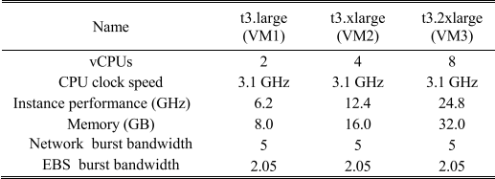
Hardware and Software for the experiment
Node.JS LTS version 10.16.3 and NPM version 6.10.2 -- to process the collected data.
Ubuntu 16.04 LTS version -- operating system to setup MongoDB, MySQL and Node.JS.
Elastic Compute Cloud (EC2) instance is used during the implementation of this comparison.

Slide 8
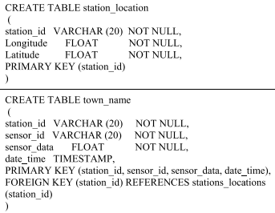
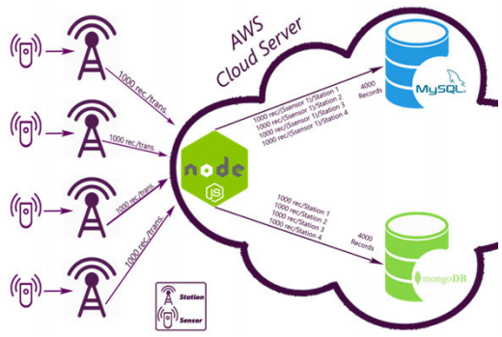
MySQL DB setup
SQL statements to create 2 tables for MySQL DB.
station_location : saves location of every station.
town_name: stores sensor’s information.
One sensor scenario

Slide 9
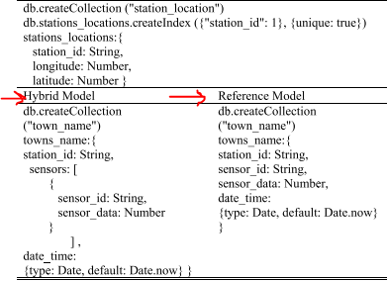
MongoDB DB setup
3 models in MongoDB - reference, embedded and hybrid.
Hybrid →reference + embedded, comparatively occupies less size of memory.
2 collections created using MongoDB queries.
Reference model - when a field of a document is referenced in another document
Embedded model - document within a document.

Slide 10
Increasing Workloads
It means increasing the number of sensors connected to each station.
In each experiment, each station collects the data from all its related connected sensors in data records.
These collected data records are inserted as records in MySQL and as record objects in MongoDB.
There are 4 stations in a town each having 1 sensor initially and each station sends data to the cloud at a rate of 1000 records per transmission.
The proposed experiment scenarios were carried out based on increasing the number of sensors connected to each station from 1 to 12 sensors.

Slide 11
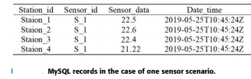
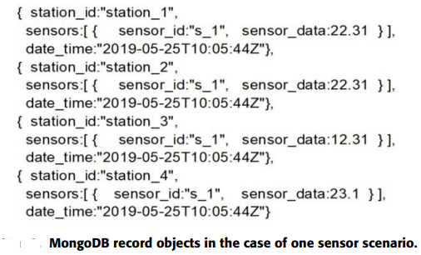
Impact of increasing number of sensor nodes on insertion operation
In case of one sensor each station:
1000 records per transmission by each station , there are 4 such stations.
Therefore at a time , 4000 records are being transmitted (1000 x 4).
Each record is inserted in one record in case of MySQL and one record object in case of MongoDB.
Therefore , the transmitted data is inserted in 4000 records in MySQL and 4000 record objects in MongoDB.

Slide 12
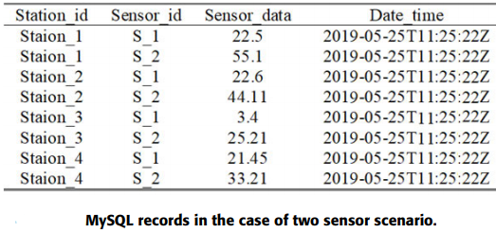
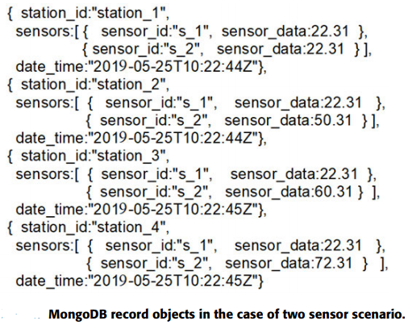
Impact of increasing number of sensor nodes on insertion operation
In case of two sensors each station:
The four stations transmit 4000 data records at a time for the cloud. Each record contains data from two sensor nodes.
In MySQL, the data for each sensor needs to be inserted in a separate record.
It needs 8000 records to insert the transmitted data.
Unlike MongoDB, all sensors data can be inserted into one record object. So, it needs 4000 record objects to insert the transmitted data.

Slide 13
MySQL
MongoDB
The addition of a new sensor is represented by adding an independent record for this sensor measurement. Therefore, the data record received from the station is separated into independent records one per each sensor data.
MongoDB is a document-oriented database and the addition of new sensor results in a document with a different structure for the newly inserted record object

Slide 14
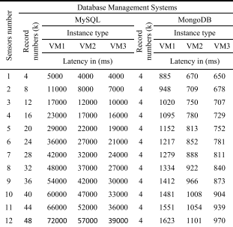
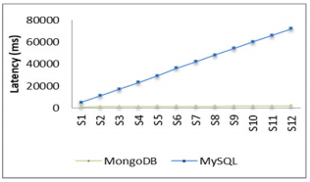
Impact of increasing number of sensor nodes on latency
MySQL accepts from 4000 to 48000 records till last insertion operation.MongoDB accepts 4000 records in all cases from the first to the last operations.
82.3% decrease in latency
97.7% decrease in latency
The latency of the insertion operation.

Slide 15
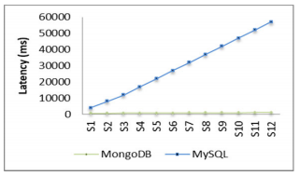
Impact of increasing number of sensor nodes on latency
MySQL accepts from 4000 to 48000 records till last insertion operation.MongoDB accepts 4000 records in all cases from the first to the last operations.
83.3% decrease in latency
98% decrease in latency
The latency of the insertion operation.

Slide 16
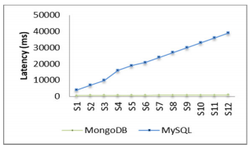
Impact of increasing number of sensor nodes on latency
MySQL accepts from 4000 to 48000 records till last insertion operation.MongoDB accepts 4000 records in all cases from the first to the last operations.
83.7% decrease in latency
97.5% decrease in latency
The latency of the insertion operation.

Slide 17
Using VM2 improves the performance of MySQL with 29% over using VM1 while it improves the performance of MongoDB with 23% over using VM1.
A. Using VM3 improves the performance of MySQL with 43% over using VM1 and with 26% over using VM2.
B. Besides, it improves the performance of MongoDB with 35% over using VM1 and with 8% over using VM2.
Conclusion :
Increasing workloads -->the difference in latency between MongoDB and MySQL is also increased in favor of MongoDB.
Also, VM1(lower capabilities) MongoDB gives better results than VM3 MySQL.
This ensures that MySQL needs instances with high capabilities to work well on the contrary to MongoDB which works very well with all instances capabilities.

Slide 18
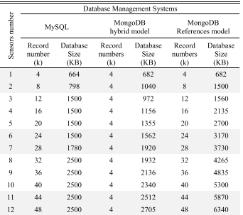
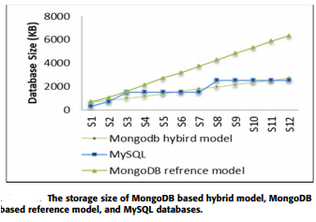
Impact of increasing the workloads on the database size
Database size comparison
MongoDB: linear increase
MySQL: periods of linear increase
and periods of relative stability.

Slide 19
Impact of increasing the workloads on the database size
Database size comparison
MySQL outperforms → insertion of small number of records, at the end of each stability period like S1,S2,S6,S7,S11,S12.
MongoDB (hybrid) outperforms → S3 to S5 and from S8 TO S10
In addition, the results also show that MongoDB based hybrid model has average improvement in the database size by 6.6% over MySQL and 51.5% over MongoDB based reference model.

Slide 20
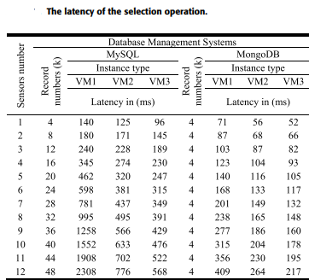
Impact of increasing the number of sensor nodes on the selection operation
average improvement of the selection latency of VM3 over other instances
---- | MongoDB | MySQL
VM1 | 38% | 63.2%
VM2 | 12.3% | 22.5%
These results ensure that MySQL is affected; more than MongoDB, by the instance performance.

Slide 21
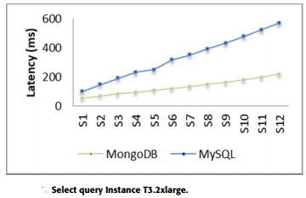
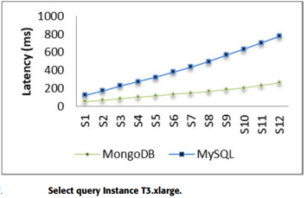
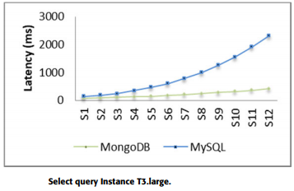
VM3
VM2
VM1
In all 3 cases we can see that MongoDB is faster than MySQL.

Slide 22
Statistical Analysis
In this section, a statistical analysis is introduced to estimate the latency of data from a measured data size and instance performance using two approaches: Multiple Linear Regression and Multiple Non-linear Regression. A benefit from applying the regressions approach is to select the appropriate DBMS based on the low estimated latency.
The first aim is to compare the two types of databases in terms of latency. The second aim is to evaluate the two estimation approaches and select the appropriate one.
The analysis starts by establishing the equations models from a previously measured dataset which contains three parameters; namely latency in milliseconds, data size in KB(avg size of 1 record x no. of records) and instance performance in GHz( vCPU x clock speed).

Slide 23

Statistical Analysis
Linear Multiple regression :
The proposed evaluation needs to find a relation between three variables: latency, data size and instance performance. The dependent variable (latency) is related to two independent variables (data size and instance performance). In this case, the Multiple Linear Regression can be implemented as
where x1 is the data size, x2 is the instance performance and y is the latency.
The determiner method is used to solve the previous equation and get the final equation of prediction for both MongoDB and MySQL latency.

Slide 24
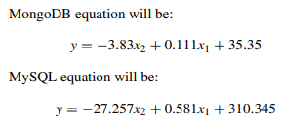
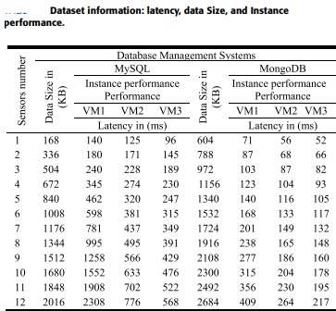



Linear regression
Non Linear regression
In this case, the Multiple Non-linear Regression can be implemented as
After solving using determiner method :

Slide 25
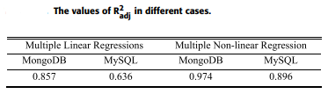
Result
R-squared is a statistical measure of how close the data are to the fitted regression line
Adjusted R-squared also indicates how well terms fit a curve or line, but adjusts for the number of terms in a model.
High adjusted R-squared means good performance in the estimation process and vice versa.
Results show that the Non-linear Regression approach provides better estimation results for MongoDB .

Slide 26
Conclusion
The results showed that increasing workloads in case of using MySQL leads to a considerable loss in performance greater than the case of using MongoDB.
The results showed that there are cases where MongoDB is better than MySQL in terms of both latency and database size. On the other hand, there are other cases where MongoDB is better in terms of latency and MySQL is better in terms of database size; based on the database workload and the number of connected sensors which is differentiated on available resource capabilities.
The results show that the hybrid model is better than the reference model and also better than MySQL in terms of database size.
2 prediction models of estimating latency from measured data based on 2 approaches-Non-linear Regression is better than Linear Regression for estimating the latency in both MongoDB and MySQL.

Slide 27
Bibliography
https://www.guru99.com/what-is-mongodb.html
https://www.mongodb.com/nosql-explained/nosql-vs-sql
https://ieeexplore.ieee.org/document/9116940
https://www.youtube.com/watch?v=a8Ojk6Fnt6I
THANK YOU

