Slide 1
Indic-English translation

Slide 2
IndicTrans
IndicTrans is a multilingual NMT model
It can translate Indic-Indic, Indic-English and English-Indic
Supports 11 Indian languages
Trained on Samanantar dataset, largest publicly available parallel corpora for Indian Languages.
Assamese (as) | Hindi (hi) | Marathi (mr) | Tamil (ta)
Bengali (bn) | Kannada (kn) | Odia (or) | Telugu (te)
Gujarati (gu) | Malayalam (ml) | Punjabi (pa)

Slide 3
Examples for Indic-English, English-Indic and Indic-Indic translation

Slide 4
Indic-English

Slide 5
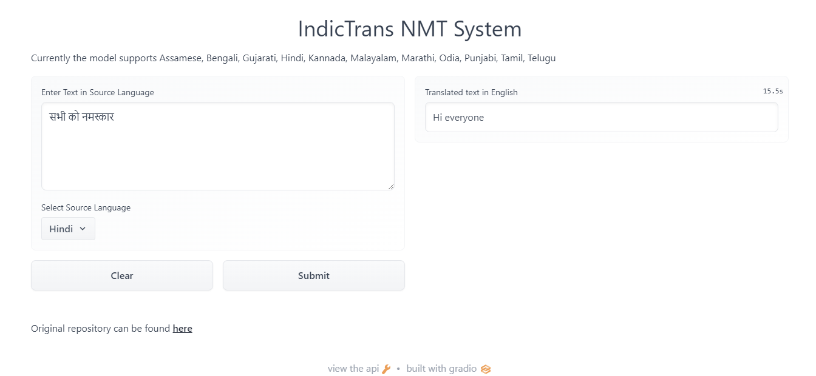

Slide 6
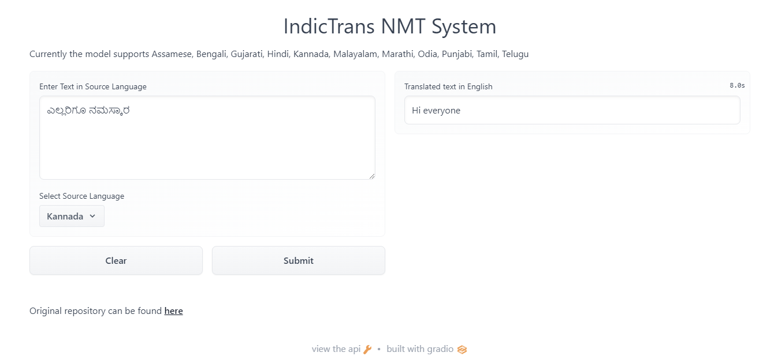

Slide 7
English-Indic

Slide 8
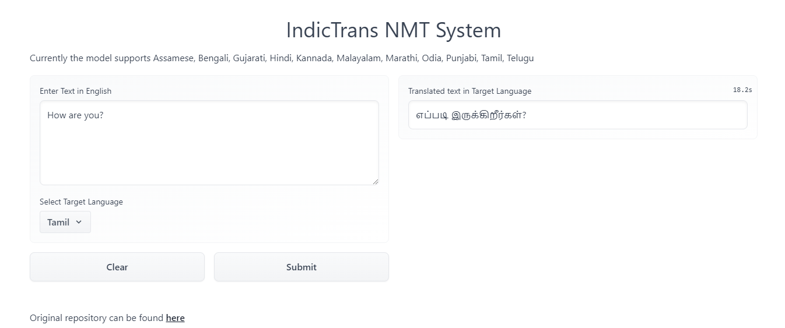

Slide 9
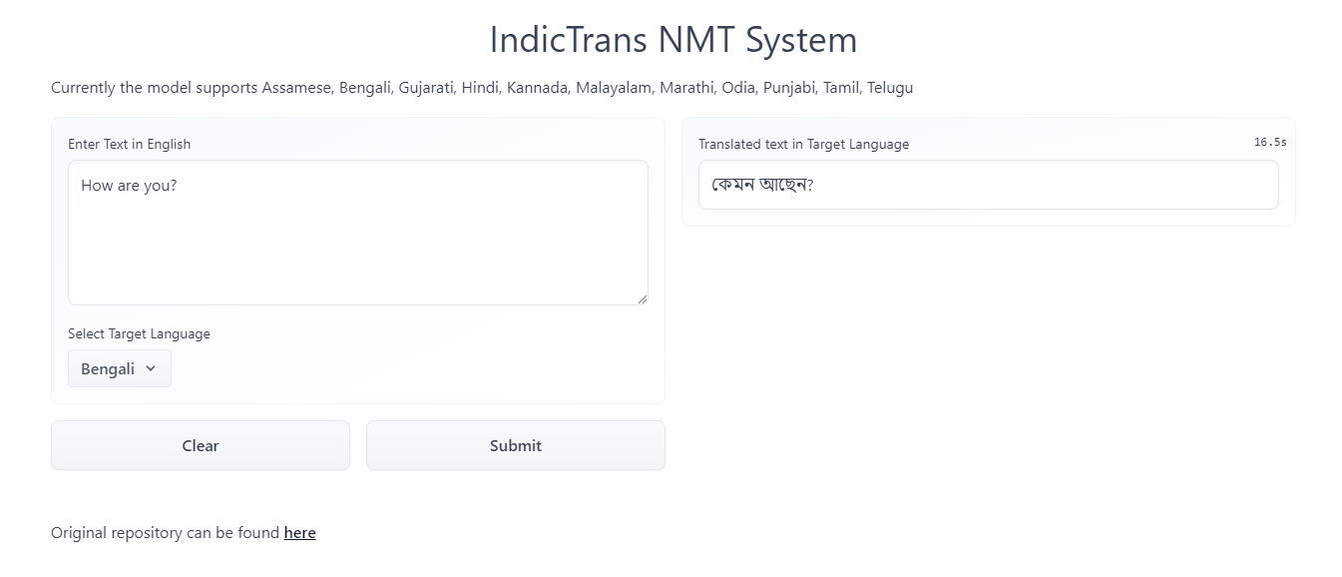

Slide 10
Indic-Indic

Slide 11
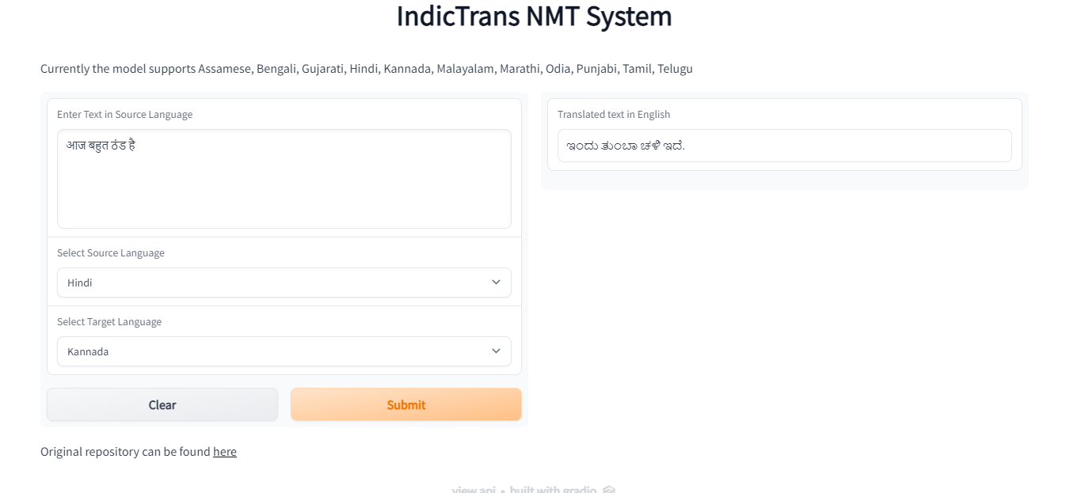

Slide 12
Shortcomings?

Slide 13
Wrong language code

Slide 14
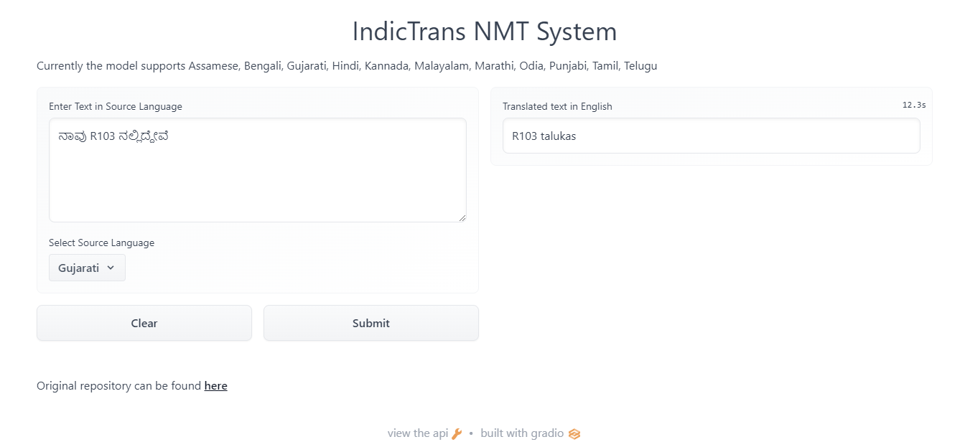

Slide 15
Different script

Slide 16
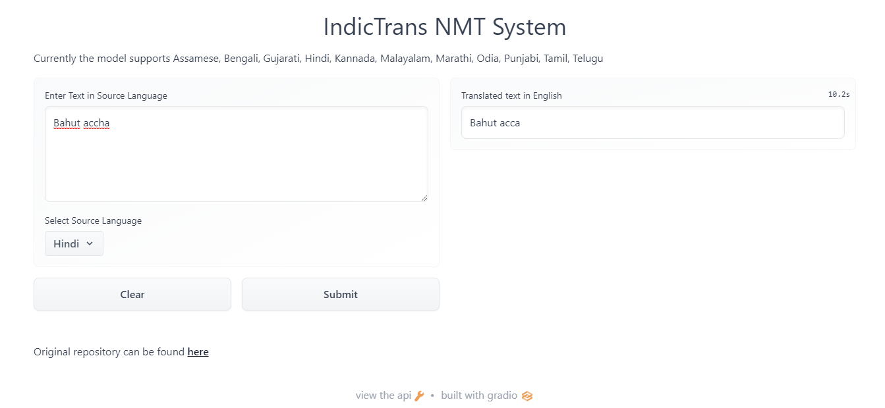

Slide 17
samamantar
IndicTrans
(pre-trained)
?
train
fine-tune

Slide 18
Transliteration
Translation : meaning of a given text is rendered from one language to another.
how are you -> आप कैसे हैं
Transliteration : conversion of text from one script to another
how are you -> हौ आर यू
colab_notebook
Notes:
Translation preserves meaning, transliteration preserves sounds/pronunciation.

Slide 19
Useful links
[1] IndicTrans (translation)
[2] Samanantar
[3] indic-trans (transliteration)
[4] DakshinaDataset

