Slide 1

The Battle Of Neighborhood
Introduction
Manhattan is the most densely populated of New York City’s 5 boroughs. It's mostly made up of Manhattan Island, bounded by the Hudson, East and Harlem rivers. Among the world’s major commercial, financial and cultural centers, it’s the heart of “the Big Apple”. New York City has been called both the most economically powerful city and the leading financial center of the world. City with high population and fast developing resources requires more food outlets. Due to its dense population there is a huge increase in demand for restaurant business and Manhattan is an ideal place to open a restaurant.

Slide 2
Business Problem
A entrepreneur wants to open an Mexican Restaurant in Manhattan,New York. The success of any restaurant depends on multiple factors like location, menu, interior, consistency in taste and many other. Entrepreneur approached us to help him to find a perfect location which is economic and profitable to them.
Target Audience
A entrepreneur wants to open an Mexican Restaurant in Manhattan,New York.

Slide 3
Data Overview
The data prepared for the purposes of the analysis from multiple sources which will provide the list of neighborhoods in New York (https://cocl.us/new_york_dataset), the Geographical location of the neighborhoods (via Geocoder package) and Venue data pertaining to Mexican restaurants (via Foursquare). The venues data will help find which neighborhood is best suitable to open an Mexican restaurant.

Slide 4
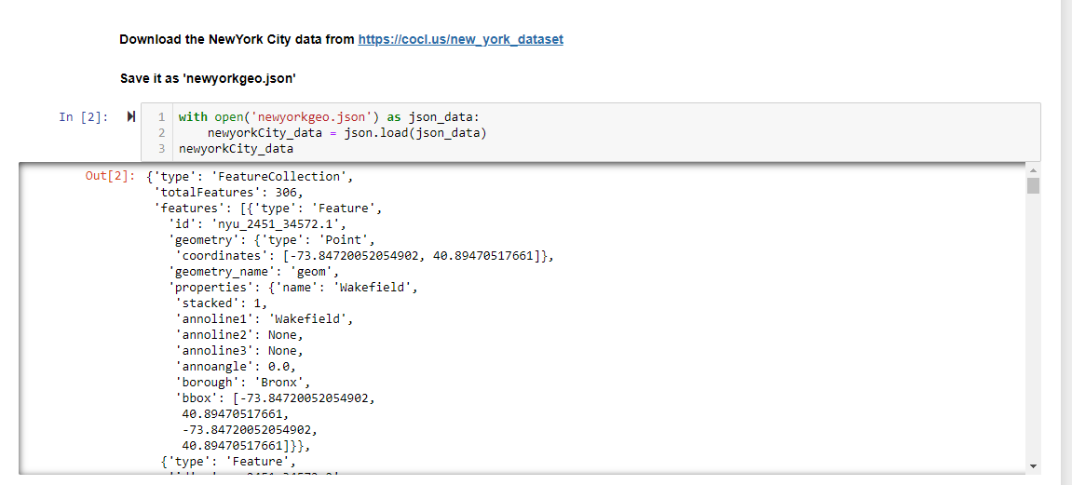
Methodology
NewYork City data from https://cocl.us/new_york_dataset

Slide 5
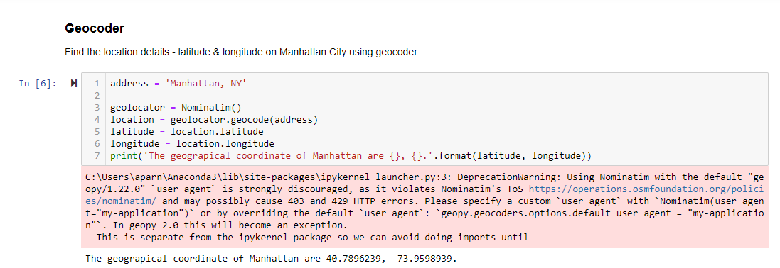
Using geopy package we could get,Geo location like latitude and longitude of each location

Slide 6
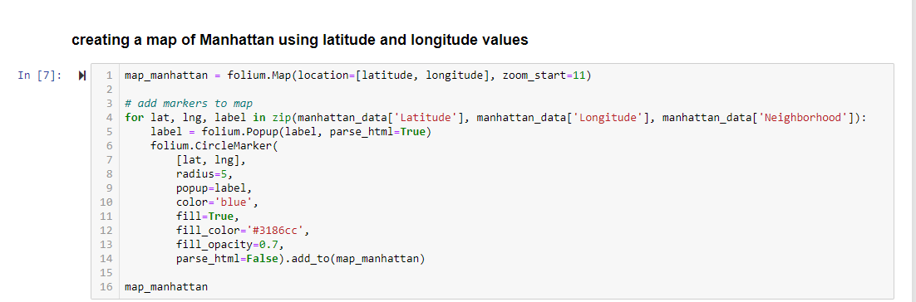
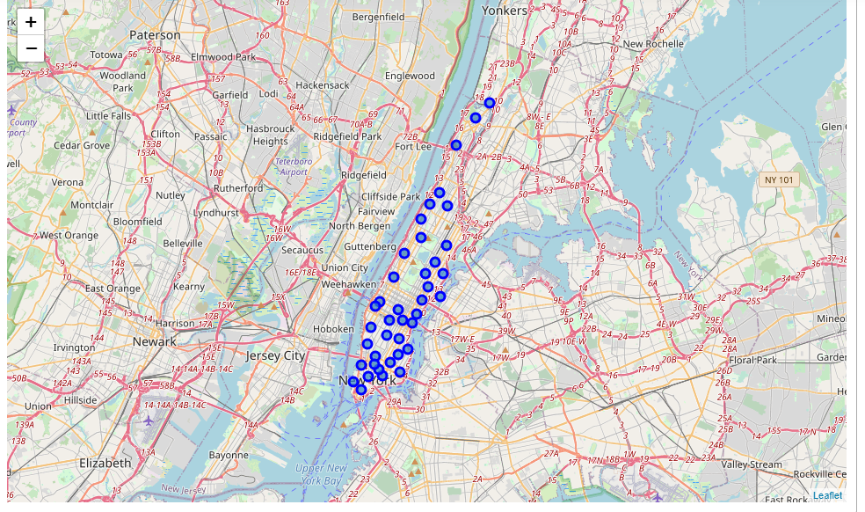

Slide 7
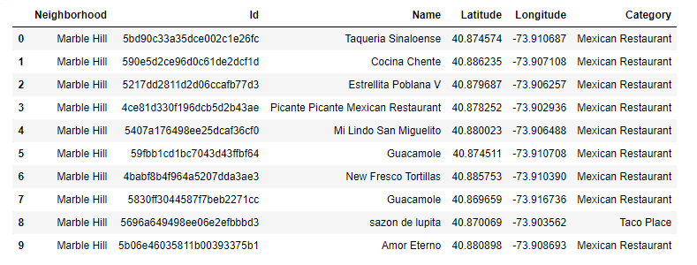
From foursquare API we get
- Restaurant names
- Id
- Location
The retrieval of the location, name and category about the various venues in Manhattan was collected through the Foursquare explore API. To obtain the data, it was required to make an account where it would provide a ‘Secret Key’ as well as a ‘Client ID’ which would allow me to pull any data.

Slide 8
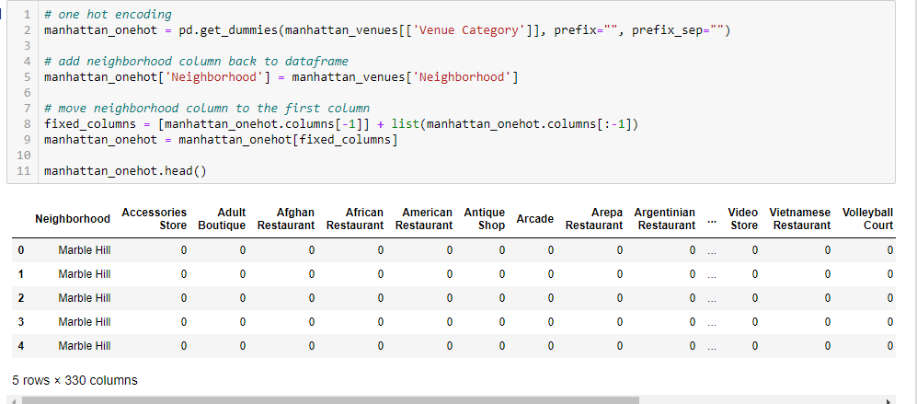
Then to analyze the data we performed a technique in which Categorical Data is transformed into Numerical Data for Machine Learning algorithms. This technique is called One hot encoding. For each of the neighborhoods, individual venues were turned into the frequency at how many of those Venues were located in each neighborhood.

Slide 9
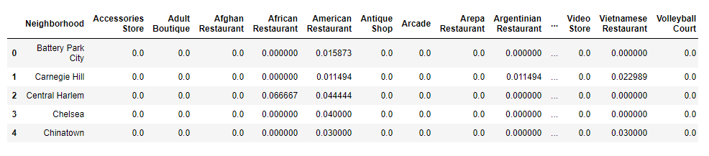
To make the analysis more interesting, we wanted to cluster the neighborhoods based on the neighborhoods that had similar averages of Mexican Restaurants in that Neighborhood. To do this we used K-Means clustering.

Slide 10
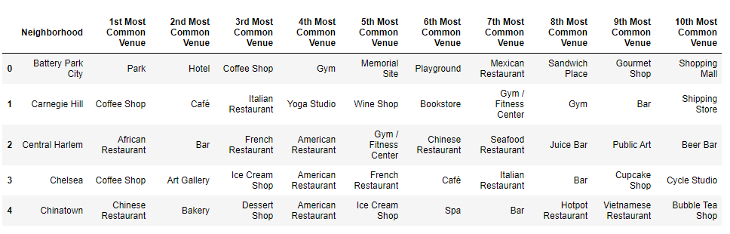
After, we created a new data frame which only stored the Neighborhood names as well as the common venues of Mexican Restaurants in that Neighborhood. This allowed the data to be summarized based on each individual Neighborhood and made the data much simpler to analyze.

Slide 11
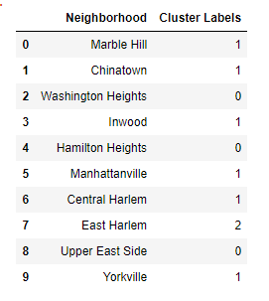
Clusters are labeled based on neighborhood

Slide 12
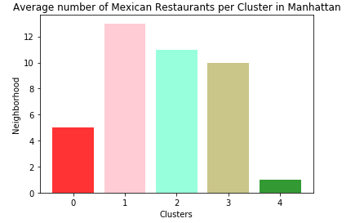
Then we calculated the average number of Mexican restaurants per cluster in Manhattan
Observations
Most of the Mexican Restaurants are in cluster 1 represented by the pink clusters. Looking at the nearby clusters, the optimum place to put a new Mexican Restaurant is Cluster 4 because in cluster 3 there is less Mexican restaurants compared to cluster2 and cluster1. There are many Neighborhoods in the area but less Mexican Restaurants therefore, eliminating any competition.

Slide 13
Results
Using New York neighborhood data and Foursquare API we found the neighborhood details.
Found neighborhood where there is a good Mexican restaurant and get the details of neighborhood using data analysis. Then we got neighborhood with less Mexican restaurants.
Using K Mean Clustering, cluster those restaurants into groups.

Slide 14
Discussion
Utilizing more features from Foursquare API we could find its ratings and the menus they provide
Conclusion
Finally, we found best neighborhoods to start a new Mexican restaurant in Manhattan, New York..

Slide 15
Thank You
Submitted by,
Aparna

