Slide 1

Understanding retreat rate of glacier using flowline model
Aparna Sharma
aparna.ramgopalsharma@students.iiserpune.ac.in

Slide 2

Flowline model
Conservation of Mass
$\frac{∂h}{∂t}=\frac{∂q}{∂x}$ + $β(z_{ice}$-$ela$)
Glen’s Flow Law
Force balance

Slide 3
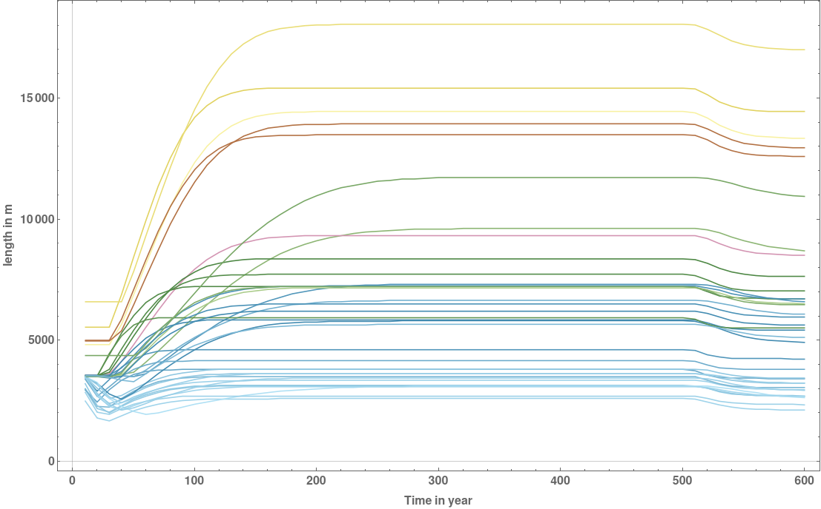
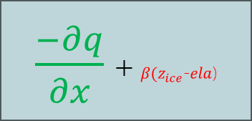
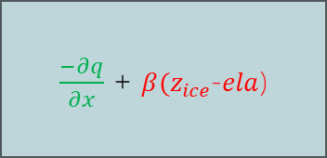
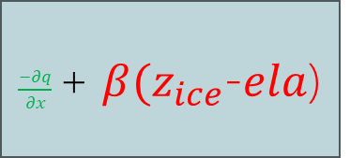
Length variation with time
$\frac{−∂q}{∂x}$ + $β(z_{ice}$-$ela$)
Glacier advances
$\frac{−∂q}{∂x}$ + $β(z_{ice}$-$ela$)
Glacier retreats
$\frac{−∂q}{∂x}$ + $β(z_{ice}$-$ela$)
Steady state

Slide 4

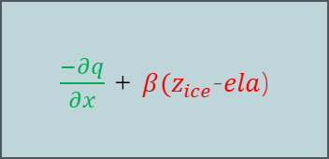

Length variation with time
$\frac{−∂q}{∂x}$ + $β(z_{ice}$-$ela$)
$\frac{−∂q}{∂x}$ + $β(z_{ice}$-$ela$)
$\frac{−∂q}{∂x}$ + $β(z_{ice}$-$ela$)

Slide 5
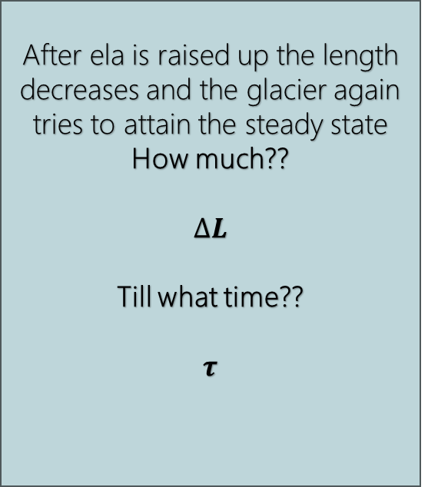
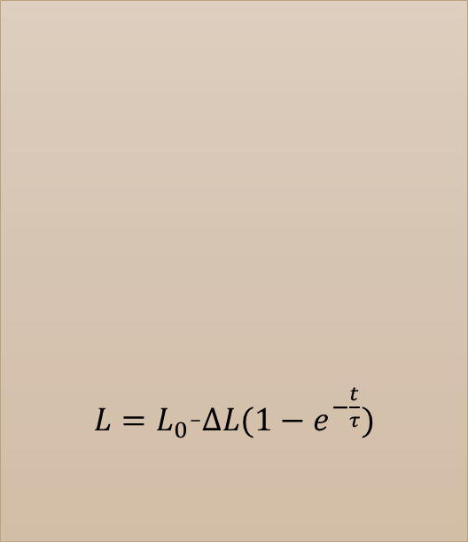

Sensitivity and Response time
$$∆L$$
After ela is raised up the length decreases and the glacier again tries to attain the steady state
How much??
$$∆L$$
Till what time??
$$τ$$
$L=L_{0}$-$∆L(1−e^{−\frac{t}{τ}})$
$$τ$$
$$∆L$$
$$τ$$

Slide 6

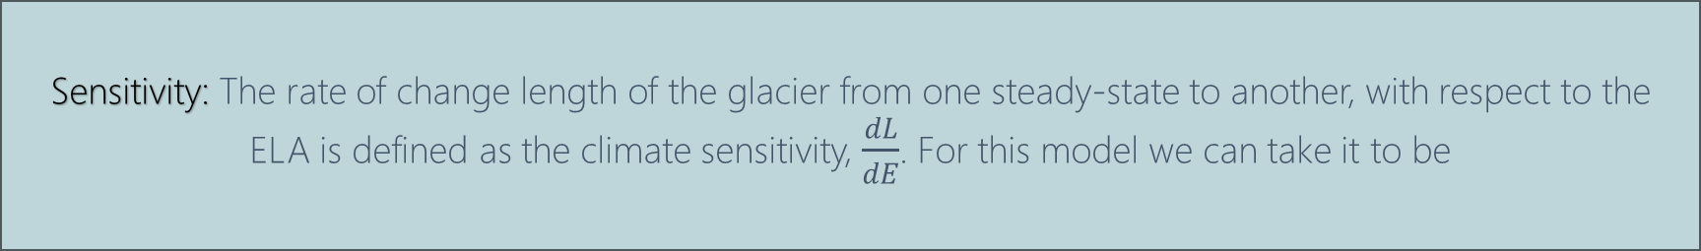
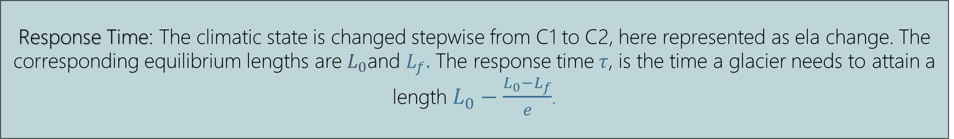
Sensitivity and Response time
Sensitivity: The rate of change length of the glacier from one steady-state to another, with respect to the ELA is defined as the climate sensitivity, $\frac{dL}{dE}$. For this model we can take it to be
$$\frac{L_{0}−L_{f}}{50}.$$
Response Time: The climatic state is changed stepwise from C1 to C2, here represented as ela change. The corresponding equilibrium lengths are $L_{0}$and $L_{f}.$ The response time$τ$, is the time a glacier needs to attain a length $L_{0}−\frac{L_{0}−L_{f}}{e}$.

Slide 7
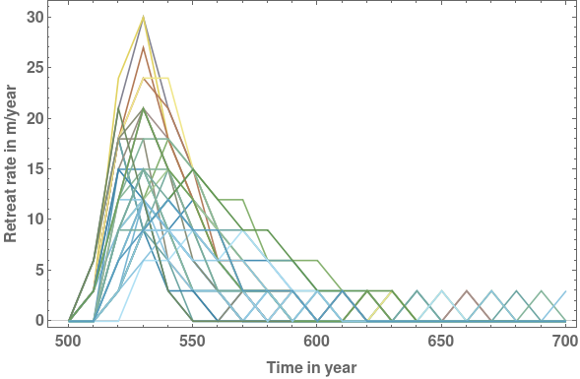


Retreat rate of a glacier
Notice the nature of the retreat rate curves.
Can you find the hidden parameters
$∆L$ and $τ$
in these curves??
$$\frac{dL}{dt}=\frac{∆L}{τ}\frac{t}{τ}e^{−\frac{t}{τ}}$$

Slide 8
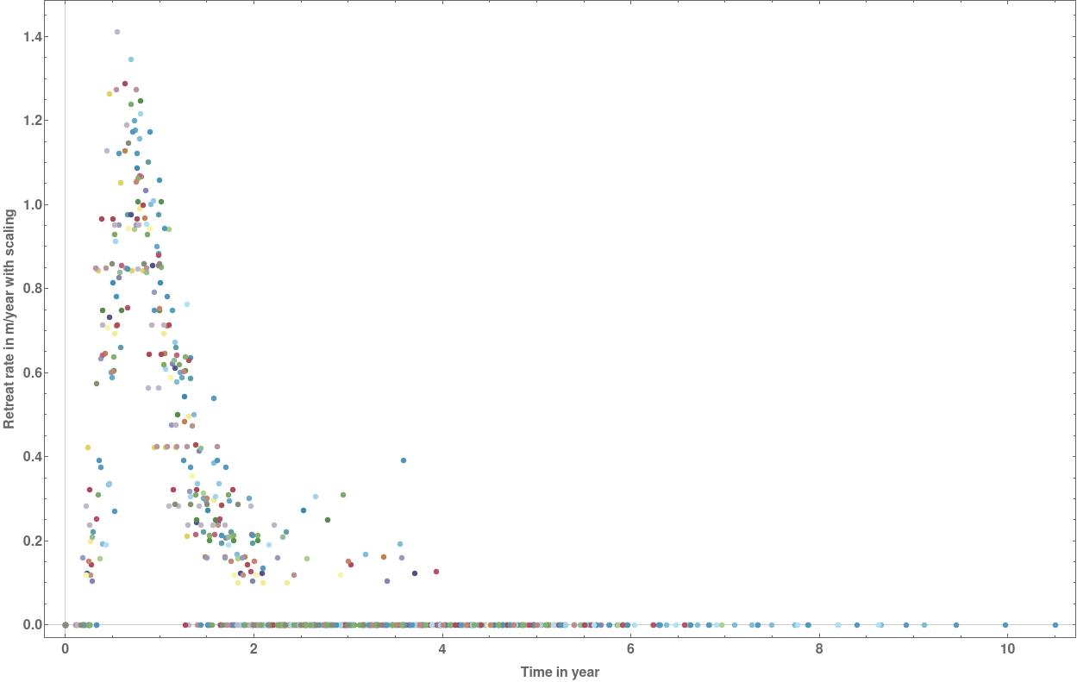
Retreat rate of a glacier
Retreat rate depends on sensitivity and response time of the glacier.

Slide 9
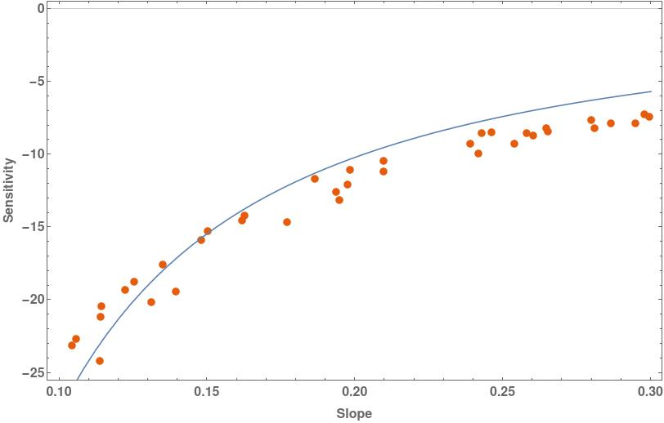
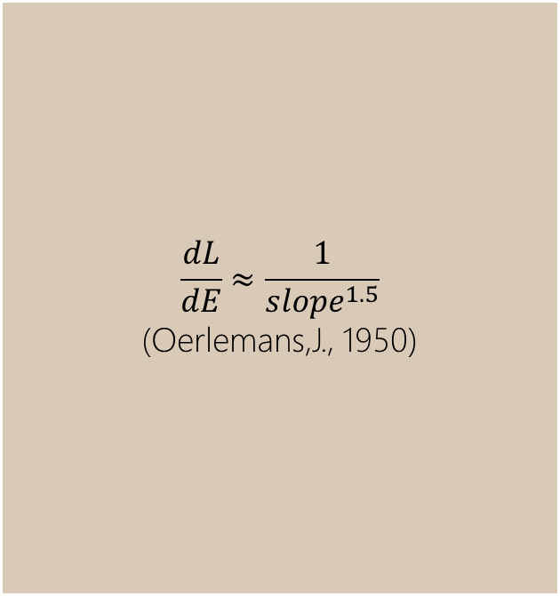
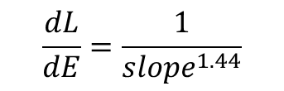
Sensitivity-slope dependence
$$\frac{dL}{dE}≈\frac{1}{{slope}^{1.5}}$$
(Oerlemans,J., 1950)
$$\frac{dL}{dE}=\frac{1}{{slope}^{1.44}}$$

Slide 10
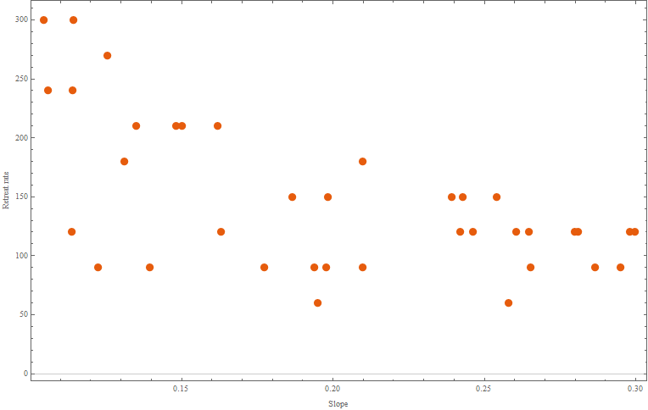
Retreat rate slope relation
Retreat rate depends on response time, response time is a strong function of slope but retreat rate and slope are not related!
What could be the hidden factor controlling the retreat rate of a glacier

