Slide 1
Netflix Catalog
Data Exploration
What 8,807 titles reveal about catalog mix, growth, geography, genres, and audience targeting
5 MINUTES
6-SLIDE STORY
Independent Data Exploration
By : Aparna Raveendran Nair Remadevi
Notes:
Open with the question: What can the composition of the Netflix catalog tell us about the company’s content strategy? Explain that the analysis uses catalog metadata, not viewing behavior. The goal is to clean the data, identify patterns, and communicate evidence-based conclusions.
[Sources]
Netflix Movies and TV Shows dataset, Kaggle, netflix_titles.csv. Figures should be refreshed from the final Colab notebook output before submission.

Slide 2
From raw catalog data to an analytical story
Cleaning choices protected useful records while making dates and durations comparable.
1
2
3
4
Inspect
Clean
Transform
Analyze
8,807 rows, 12 fields
Duplicates, whitespace, missing values
Dates, movie minutes, TV seasons
IQR outliers, trends, categories
Key decision
Outliers were flagged, not automatically deleted. Extremely short or long titles can be legitimate specials, documentaries, or extended features.
Notes:
Briefly explain the pipeline. Missing director, cast, and country values were labeled Unknown rather than dropping the entire title. Duration was split because movie minutes and TV-show seasons are different measures. The IQR method was used to flag movie-duration outliers, but valid unusual titles were retained.
[Sources]
Netflix Movies and TV Shows dataset, Kaggle, netflix_titles.csv. Figures should be refreshed from the final Colab notebook output before submission.

Slide 3
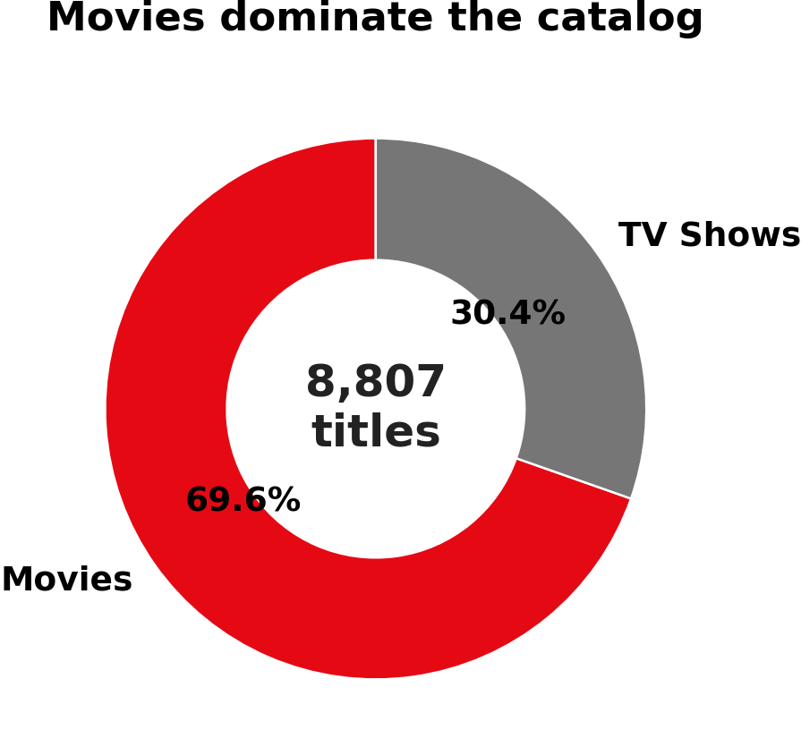
The catalog is movie-heavy
Movies represent roughly seven out of every ten titles in this historical snapshot.
6,131
movies
2,676
TV shows
Interpretation
This is a catalog-composition finding. It does not show that subscribers prefer movies.
Notes:
Highlight the first major finding: movies account for 69.6% of titles, while TV shows account for 30.4%. Emphasize the limitation. This dataset describes what was listed in the catalog, not what customers watched or preferred.
[Sources]
Netflix Movies and TV Shows dataset, Kaggle, netflix_titles.csv. Figures should be refreshed from the final Colab notebook output before submission.

Slide 4
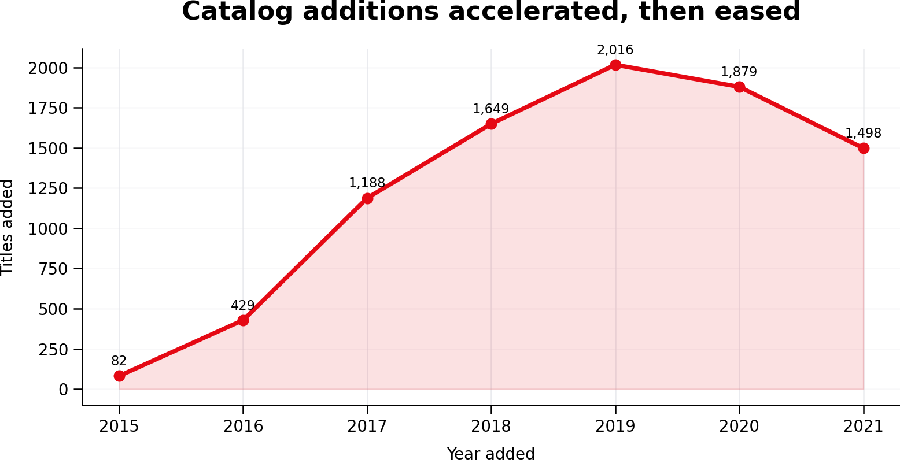
Expansion peaked before the dataset ended
The catalog grew rapidly from 2016 through 2019; the final year is only a partial snapshot.
2019 peak
2,016 titles added
Caution
2021 should not be read as a full-year decline because records end in September.
Notes:
Describe the growth story. Additions accelerated sharply after 2016 and reached a peak in 2019. Counts eased in 2020 and 2021, but the last year is incomplete because the dataset ends in September 2021. Avoid claiming that Netflix permanently reduced its catalog based on a partial year.
[Sources]
Netflix Movies and TV Shows dataset, Kaggle, netflix_titles.csv. Figures should be refreshed from the final Colab notebook output before submission.

Slide 5
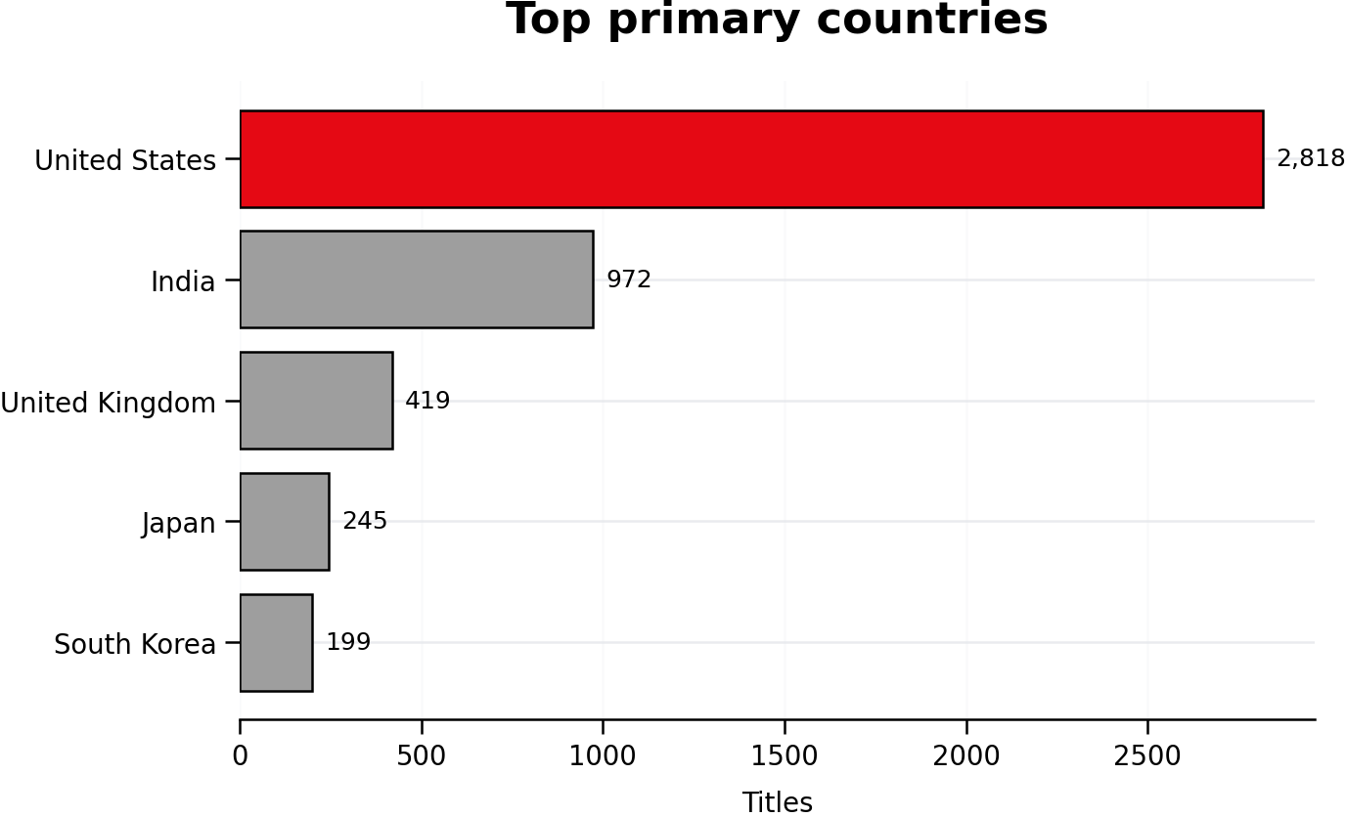
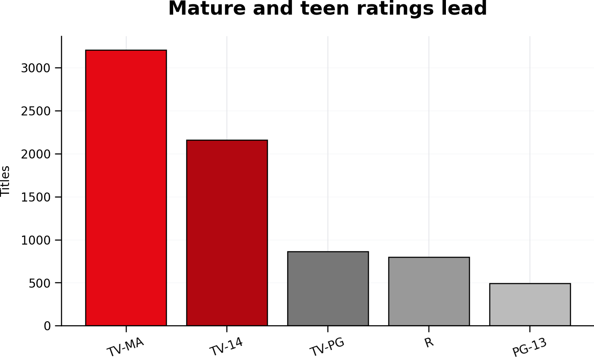
Global reach, concentrated supply, mature audience mix
The catalog spans many markets, but a few countries and content categories dominate.
Genre context: International Movies, Dramas, and Comedies are the most frequent assignments.
Notes:
Explain that the United States is the largest primary-country contributor, followed by India and the United Kingdom. On the audience side, TV-MA and TV-14 are the most common ratings, showing strong representation of mature and teen content. Mention that multi-country titles were assigned to the first listed country for this comparison.
[Sources]
Netflix Movies and TV Shows dataset, Kaggle, netflix_titles.csv. Figures should be refreshed from the final Colab notebook output before submission.

Slide 6
What the analysis tells us
Four conclusions and three practical next steps.
1
Movie-heavy catalog
69.6% of titles are movies.
Recommendations
2
Rapid historical expansion
Additions peaked in 2019.
✓
Analyze movies and TV shows separately because their duration measures differ.
3
Global but concentrated
The U.S. and India lead primary-country counts.
✓
Split multi-value country and genre fields for more complete attribution.
4
Adult and teen orientation
TV-MA and TV-14 dominate ratings.
✓
Combine catalog data with IMDb ratings or viewing metrics before making popularity decisions.
Bottom line: the dataset reveals catalog strategy, not customer preference.
Notes:
Close with the four findings and the recommended next steps. Separate movies and TV shows in analysis, normalize multi-value country and genre fields, and enrich the catalog with popularity or engagement data before making audience conclusions. End with the bottom line: catalog metadata shows content strategy, not customer preference.
[Sources]
Netflix Movies and TV Shows dataset, Kaggle, netflix_titles.csv. Figures should be refreshed from the final Colab notebook output before submission.

