Slide 1
YOUTUBE SONG ANALYSIS PRESENTED BY; APARNA SANTHOSH BATCH : MIP-DA-10

Slide 2
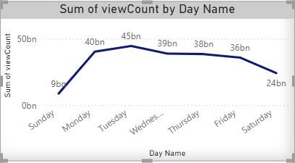
VIEW COUNT TRENDS PER DAY

Slide 3
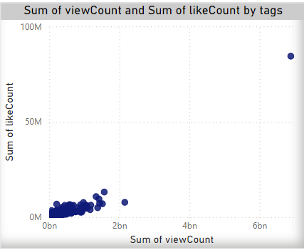
VIEW COUNT AND LIKE COUNT OF TAGS

Slide 4
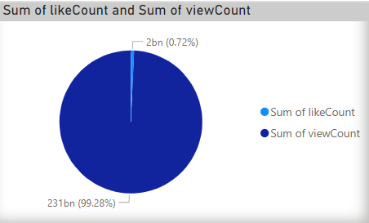
SUM OF LIKE COUNT AND VIEW COUNT

Slide 5
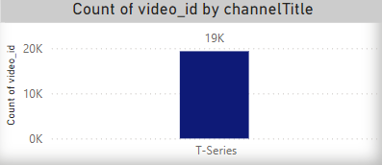
NUMBER OF VIDEOS IN T-SERIES CHANNEL

Slide 6
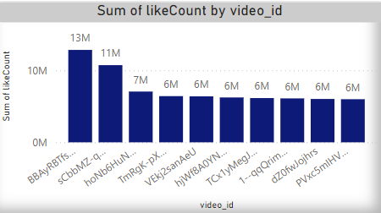
SUM OF LIKE COUNT IN EACH VIDEOS

Slide 7
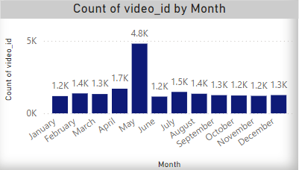
COUNT OF VIDEOS BY MONTH

Slide 8
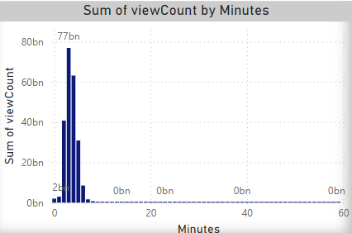
SUM OF VIEW COUNT BY MINUTES

Slide 9
Thank you

