Slide 1
SMART PLANT DISEASE DETECTION
Team Members
N. Ashwitha 24UP5A0523
P. Srinidhi 23UP1A05N2
Aparna Kumari 23UP1A05I7
A. Navya Sree 23UP1A05I8
Under the Guidance of
P. Rupa
Assistant Professor

Slide 2
Abstract
Agriculture is essential to the global economy, but plant diseases reduce crop yield and quality. This project develops a Full Stack Plant Disease Detection System using Google Gemini AI to identify diseases from images, live camera input, and text symptoms.
The system uses a vision-enabled AI model to provide accurate diagnosis without retraining. It is built with React.js, Node.js, Express.js, and SQLite.
Key features include secure authentication, user history tracking, and an admin dashboard for monitoring trends, helping farmers make timely and effective decisions.

Slide 3
Introduction
Smart plant disease detection is an advanced approach that uses Artificial Intelligence and modern web technologies to identify plant diseases at an early stage. Plant diseases can significantly reduce crop yield and impact farmers’ income if not detected in time.
This system analyzes leaf images, live camera input, and text symptoms to provide accurate disease diagnosis without manual inspection. It reduces dependency on agricultural experts, saves time, and improves efficiency.
Thus, this system supports smart, accessible, and sustainable farming practices.

Slide 4
Literature Survey
Author & Year | Title | Technique Used | Dataset / Crop | Result | Remarks
Mohanty et al., 2016 | Using Deep Learning for Image-Based Plant Disease Detection | Deep CNN (AlexNet, GoogLeNet with transfer learning) | PlantVillage dataset (14 crops, 26 diseases, 54,306 images) | 99.3% accuracy | Very high accuracy but requires high computation and controlled images
Jali Suhaman et al., 2023 | Smart Plant: A Mobile Application for Plant Disease Detection | Low-complexity CNN | Tomato leaf dataset (10 classes – Kaggle) | 89% accuracy | Optimized for mobile use; limited to tomato plants

Slide 5
Existing System
Existing plant disease detection systems include CNN models, IoT sensors, mobile apps, and manual inspection. While useful, they have limitations in flexibility and accessibility.
CNN models depend on specific datasets and need retraining. Apps/IoT systems require internet and predefined models, while manual methods are time-consuming and need experts.
These systems lack multi-modal input, user history, authentication, and admin analytics, making them less suitable for smart farming.

Slide 6
Proposed system
The proposed system is a Full Stack Plant Disease Detection System using Google Gemini AI and modern web technologies.
It supports multi-modal input (image, camera, text) and provides accurate disease detection with treatment suggestions.
The system includes JWT authentication, user history, admin analytics, and guest access, making it secure, scalable, and suitable for smart farming.

Slide 7
Hardware Requirements
Minimum Requirements:
Processor: Intel Core i3 (1.8 GHz+)
RAM: 4 GB (8 GB recommended)
Storage: 5 GB free space
Display: 1024 × 768 or higher
Camera: Optional (for image capture)
Internet: Required
Recommended Requirements:
Processor: Intel Core i5/i7 (2.5 GHz+)
RAM: 8 GB or higher
Storage: 10 GB free space
Display: 1920 × 1080 or higher

Slide 8
Software Requirements
Operating System:
Windows 10+, Linux (Ubuntu 18.04+), macOS 10.14+
Frontend:
React.js, Vite, React Router DOM, CSS
Backend:
Node.js, Express.js, SQLite3
JWT, bcryptjs
AI Integration:
Google Gemini API (gemini-2.5-flash)

Slide 9
UML DIAGRAMS
SMART PLANT DISEASE DETECTION

Slide 10
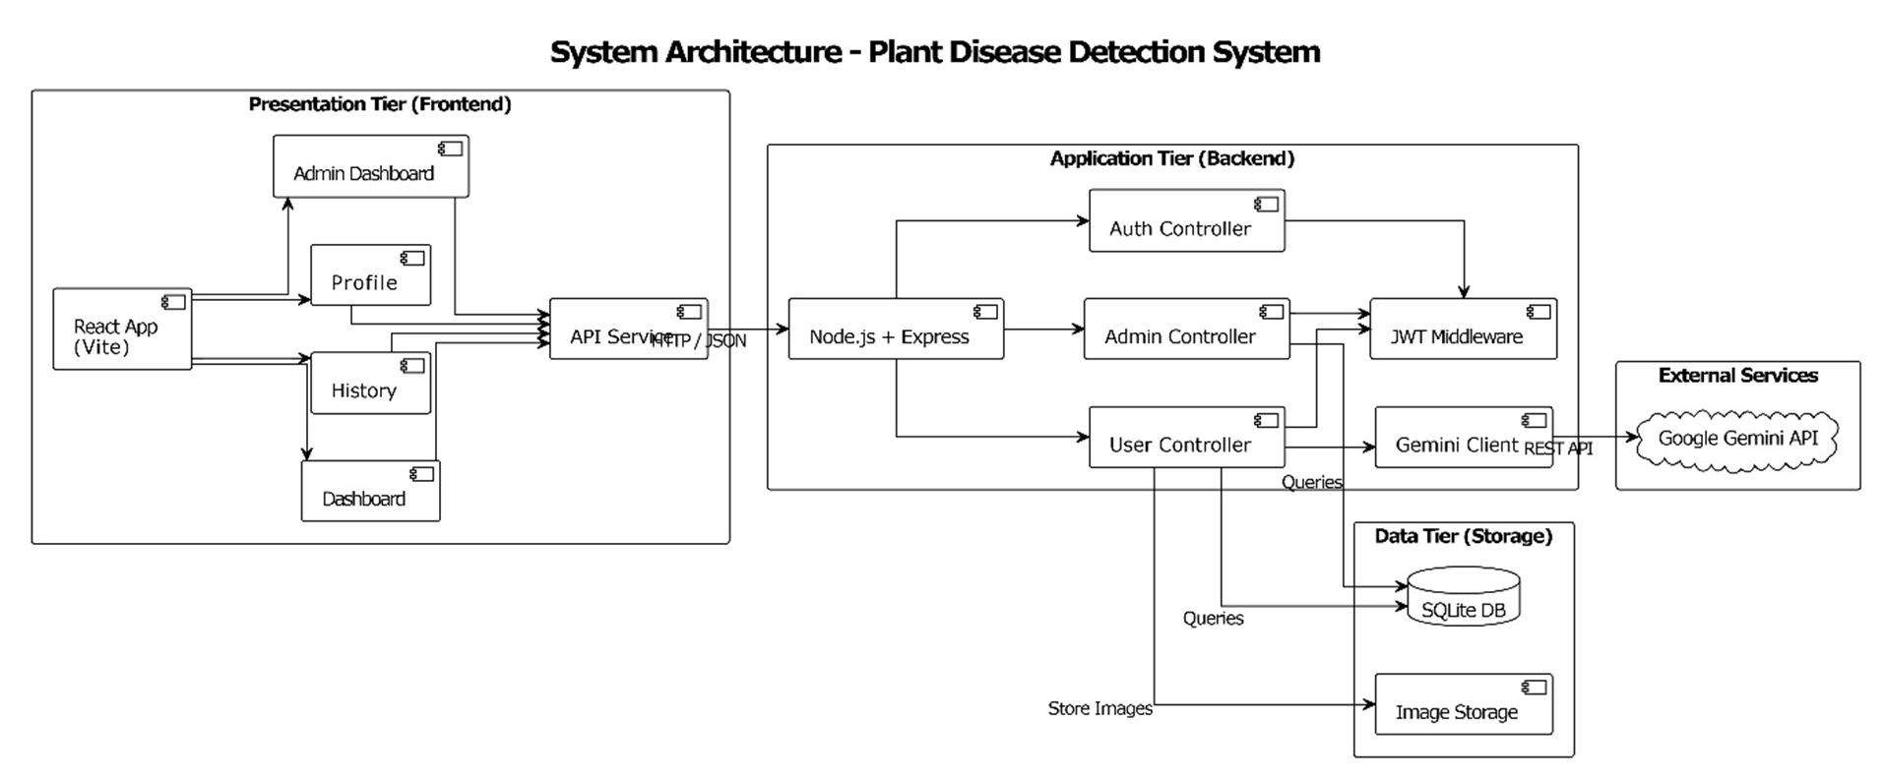
System Architecture

Slide 11
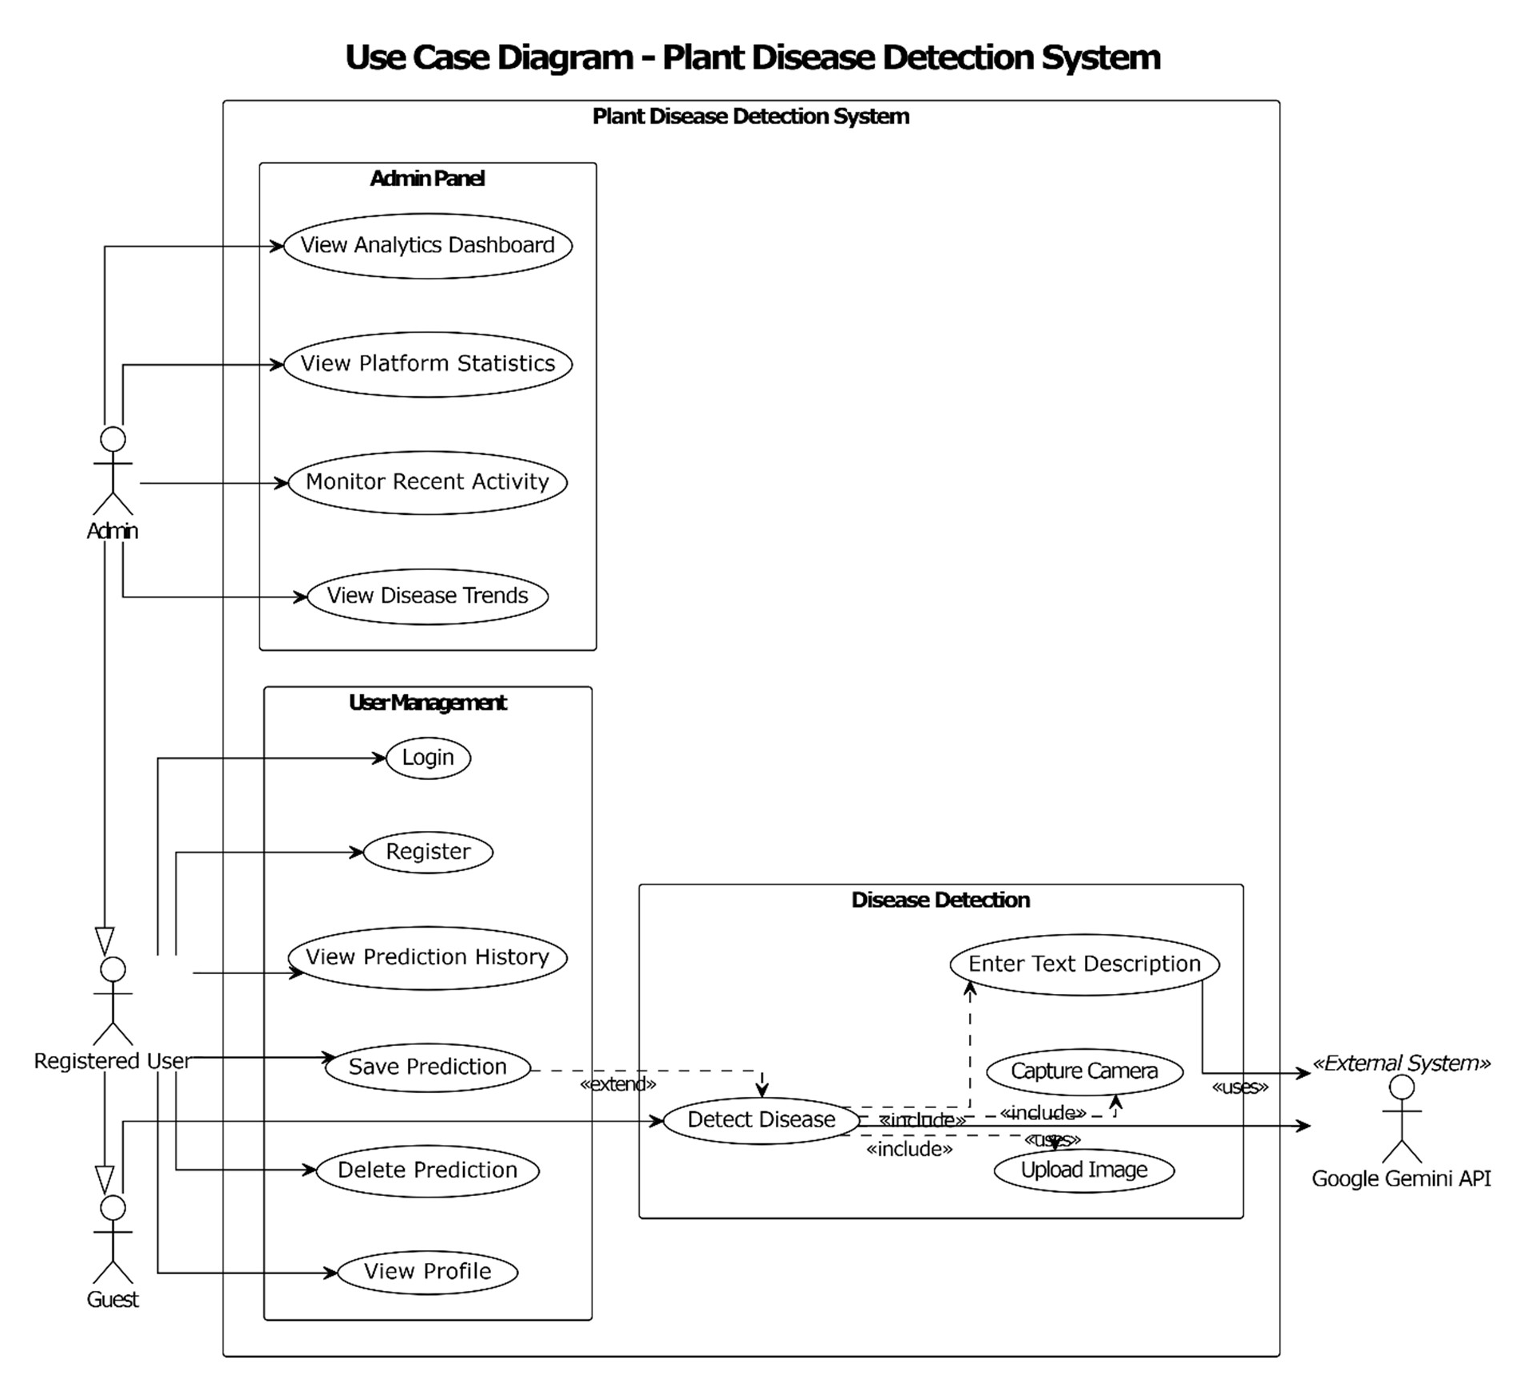
Use case Diagram

Slide 12
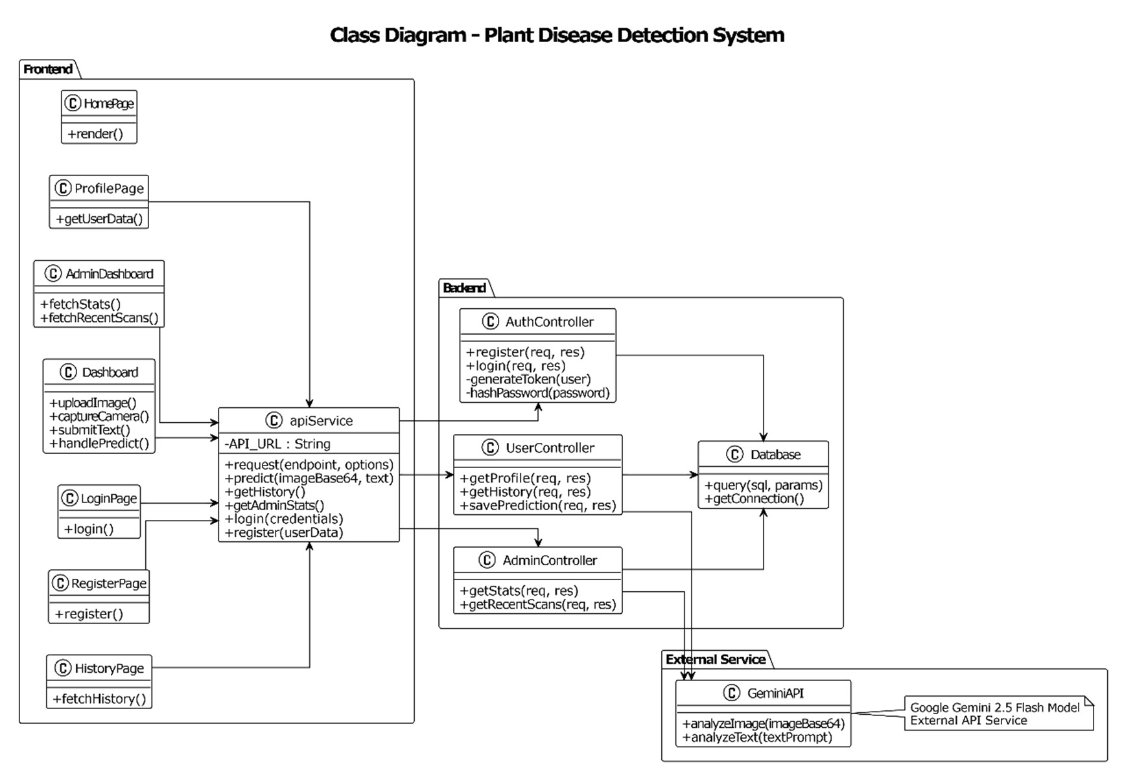
Class Diagram

Slide 13
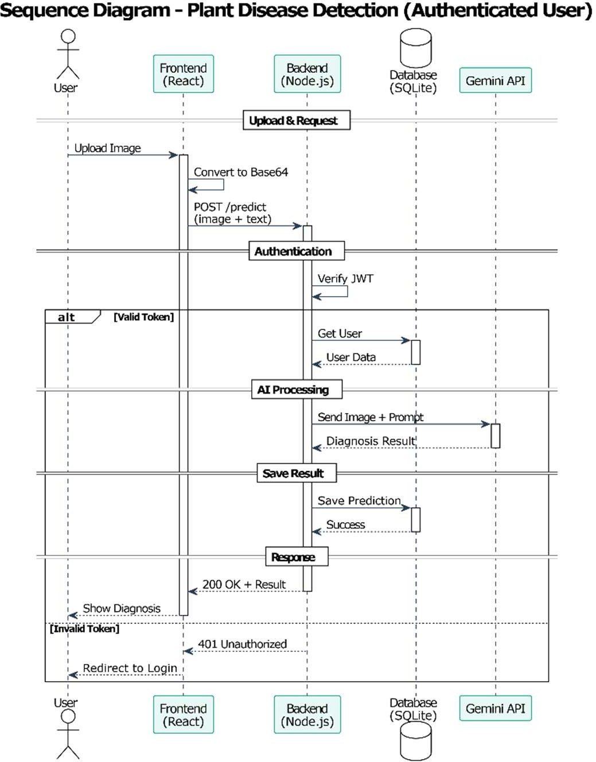
Sequence Diagram

Slide 14
RESULT
SMART PLANT DISEASE DETECTION

Slide 15
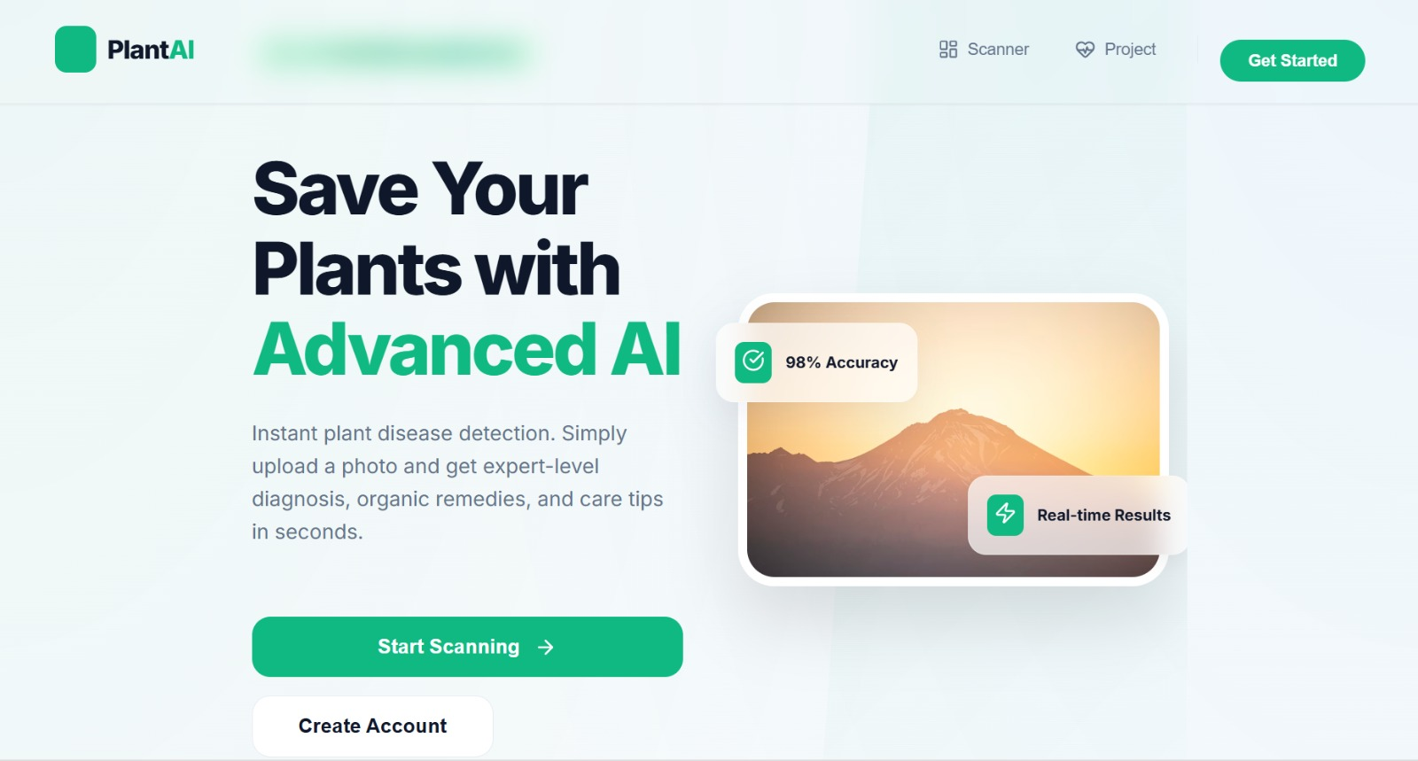

Slide 16
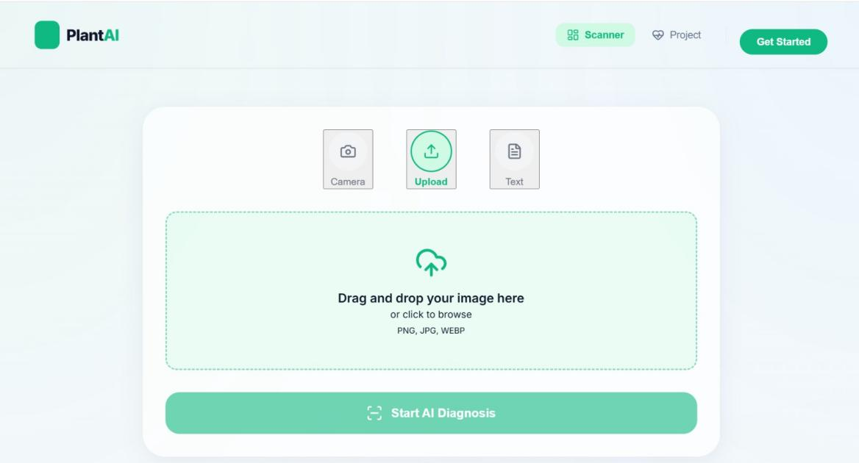

Slide 17
Thank You!!!

