Slide 1
MANUFACTURING ANALYSIS PROJECT
Presented by Group 6
G.Abhishek
Aparna patil

Slide 2
Introduction
The Manufacturing Analytics Project was created to deliver a unified, data-driven perspective on production efficiency by integrating multiple analytical platforms — Excel, SQL, Power BI, and Tableau. The purpose of this initiative is to evaluate manufacturing productivity, detect bottlenecks in operations, monitor rejection and wastage trends, and analyze how effectively resources such as machines and employees are utilized.
Data extraction and transformation were handled through SQL, while Excel was used for initial validation and data refinement. The processed data was then visualized using Power BI and Tableau, forming a connected analytical environment. This comprehensive setup enables management to continuously track production performance, enhance quality assurance, and make timely, evidence-based strategic decisions.

Slide 3
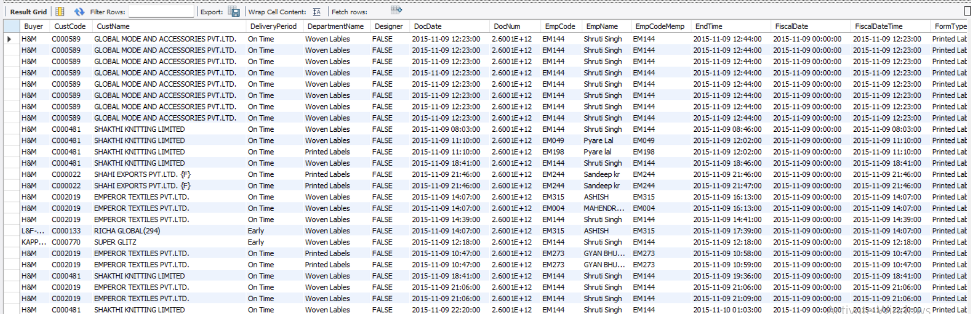
Data Overview
The dataset covers detailed production information collected from multiple departments. It includes Employee IDs, Machine Codes, Department Names, and quantities for Manufactured, Processed, and Rejected units. SQL helped in extracting clean data directly from company databases, while Excel was used for cleaning and organizing it. After this, Power BI and Tableau were used for making dashboards that connect employees, machines, and departments together. This data covers sections like Woven Labels, Printed Labels, Weaving, Cutting, and Packing — giving a complete view of production.

Slide 4
Objectives
The main goal is to track and improve manufacturing performance using KPIs. These KPIs include total Manufactured Quantity, Processed Quantity, Rejected Quantity, and Wastage %. It also studies how efficiently machines and employees work. By using these values, management can see where improvements are needed and plan accordingly. This makes it easier to find production trends and maintain consistency across teams.
Manufactured Qty
86.73 M
Processed Qtyy
86.20 M
Wastage Qty
125.0
Rejected Qty
525k

Slide 5
Process
The first step was collecting relevant data using SQL queries by joining tables like employees, machines, and departments. Excel was then used to clean missing data, fix errors, and remove duplicates. We calculated important formulas such as Wastage % = (Rejected Quantity / Manufactured Quantity) × 100. Once clean data was ready, it was imported into Power BI and Tableau to make visual dashboards. This made it easier to analyze and display production information clearly.

Slide 6
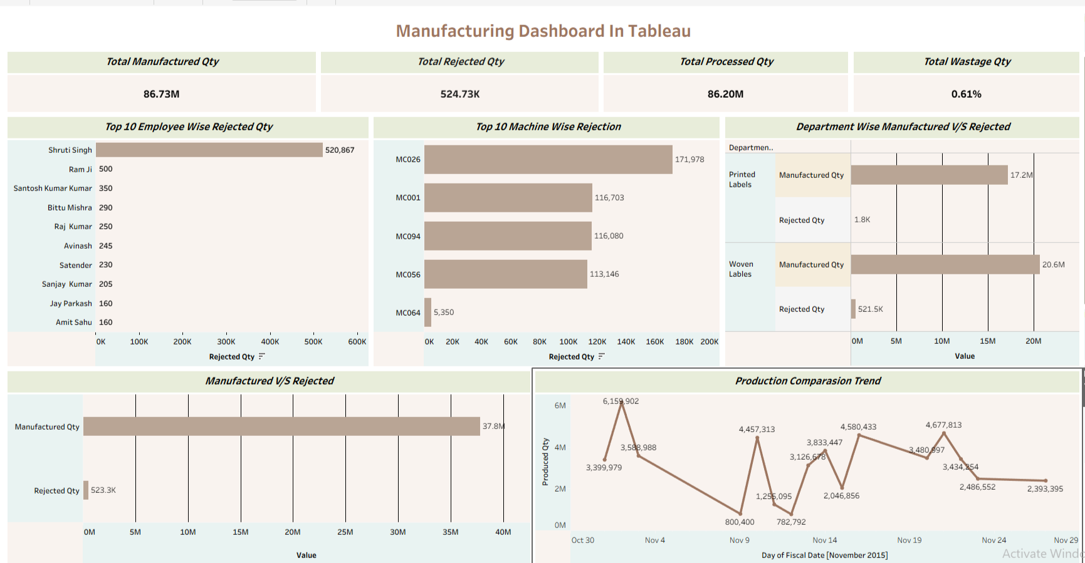
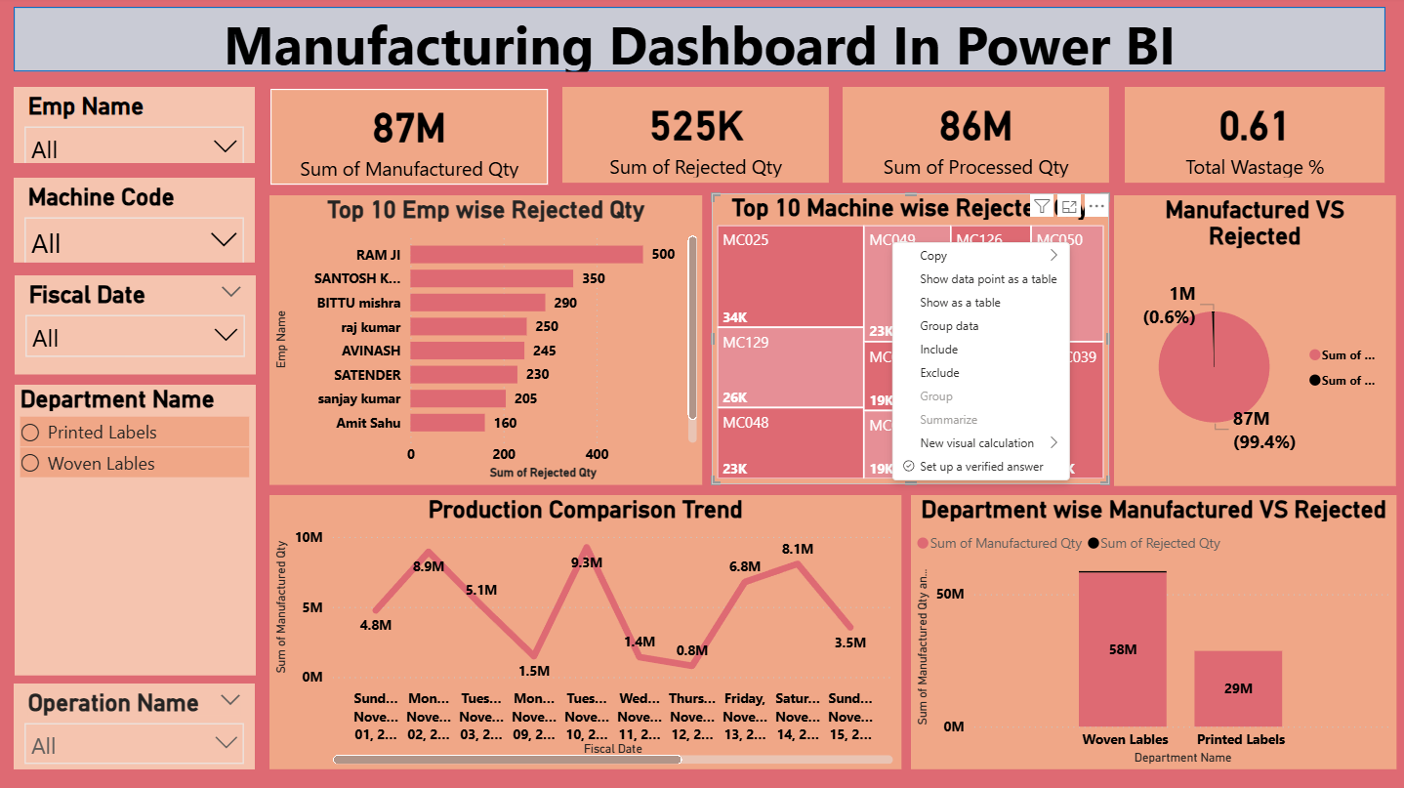
Dashboard Development and Visualization
Power BI and Tableau were used to design dashboards that present data in an easy-to-understand way. Power BI displayed KPIs in simple cards, while Tableau focused on charts that compare departments and time periods. Visuals included Employee-wise and Machine-wise Rejections, Production Trends, and comparisons between Manufactured and Rejected products. These visuals help identify strengths, weaknesses, and progress in the production system.

Slide 7
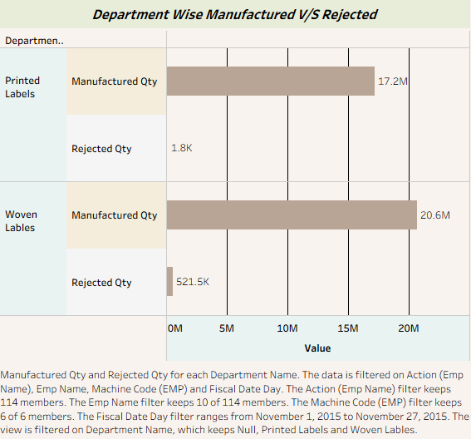
Department-wise Analysis
Each department was studied for how much it produced and how much got rejected. Woven Labels made the most products but also had more rejections, while Printed Labels made fewer products but with higher quality. This shows which departments focus on quantity and which focus on consistency. By understanding these differences, management can balance both speed and quality across departments.

Slide 8
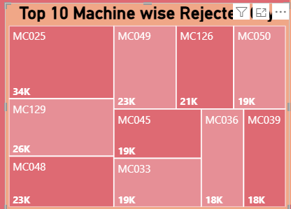
Machine-wise Analysis
The Machine-wise analysis helped spot which machines caused more defects. Machines like MC025 had high rejections, indicating maintenance issues. Others like MC048 and MC126 performed better with fewer rejections, showing good stability. This helps schedule maintenance properly and ensure smoother production. Such insights improve long-term machine efficiency and reduce breakdown time.

Slide 9
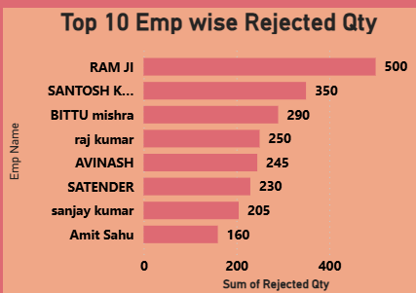
Employee-wise Analysis
Employees were compared based on how many products they processed and how many were rejected. Some employees had almost zero rejections, proving their skills and focus, while others showed higher rejection rates. This helps identify who needs extra training or support. It also motivates good performers to maintain high standards, improving team efficiency overall.

Slide 10
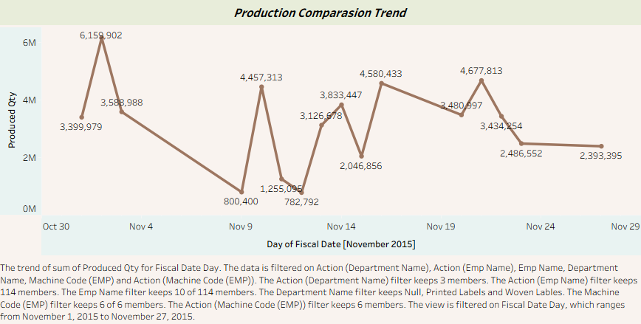
Production Trend Analysis
Production trends were studied to understand how output changed over time or across departments. This helps see if production is growing, steady, or facing drops. When compared with rejection or wastage data, it shows whether improvements or changes are working. Such analysis helps predict future performance and plan for higher efficiency.

Slide 11
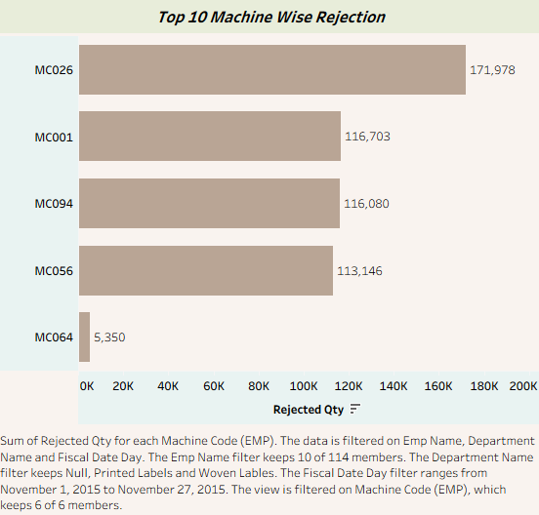
Recommendations & Insights
Based on the findings, the unit should focus on reducing rejections and wastage. Machines with repeated rejections should be checked and calibrated regularly. Employees can receive short training to improve handling and accuracy. Early-stage quality checks will prevent material loss and save time. Regular data monitoring will also ensure constant improvement.

Slide 12
Strategic Insights
Integrating SQL, Power BI, and Tableau creates a continuous flow of updated information. This allows real-time tracking of all KPIs and helps managers take timely decisions. Top-performing employees can be rewarded, and underperforming machines can be scheduled for maintenance. Keeping wastage low and processed quantity high ensures long-term quality and profit growth.

Slide 13
Conclusion
The Manufacturing Analytics Project gives a clear and complete view of factory operations. It connects data from different tools and departments into one place. Managers can now identify weak areas, improve production, and make better decisions. The project proves how modern analytics tools can improve both quality and efficiency in manufacturing.

Slide 14

Challenges & Learnings
We faced challenges like inconsistent data between systems, which required a lot of cleaning. It was also tough to maintain the same measures across Power BI and Tableau. These issues taught us the value of data governance, accuracy, and teamwork. Overall, the project showed how data analytics can make real improvements in industrial performance.

