Slide 1
Smart Meal Planner using User Profiles and Dietary Preferences
22AIE111-OOP in JAVA
22AIE112-Data Structure and Algorithm
Team Members:
Aparna A (CB.SC.U4AIE24206)
Gaddam Deepika Reddy (CB.SC.U4AIE24215)
Pabbathi Gnana Vikas Sai (CB.SC.U4AE24238)
P. Praveen Reddy(CB.SC.U4AIE24243)

Slide 2
Introduction
In today’s fast-paced world, maintaining a healthy lifestyle through a balanced diet is essential. However, planning meals that suit personal dietary needs, restrictions, and calorie requirements is time-consuming and often neglected.
This project aims to automate personalized meal planning using a structured approach by leveraging user input, nutritional data from a CSV file, and decision logic through Python programming. It ensures each meal plan is tailored to the user’s preferences (Vegan, Vegetarian, Non-Vegetarian) and nutritional needs.

Slide 3
Problem Statement
Personalized diet planning is essential for health-conscious users.
The challenge: Generate meal plans based on user profile, calorie needs, and dietary restrictions.

Slide 4
Objectives
Create user profiles storing age, preferences, restrictions, and calorie needs.
Use food data (CSV) to filter matching meals.
Generate meal plans (breakfast, lunch, dinner) automatically.
Store and retrieve users efficiently using Binary Search Tree (BST).

Slide 5
Concepts used:
subject | Concepts used
Java | Class, Object, Constructor, Static Methods, Encapsulation, File Handling, List (ArrayList), Conditional Statements, Looping, Method Definition
Dsa | Binary Search Tree (BST), Inorder Traversal (Recursion), Data Abstraction, Filtering, Matching using Conditions, Sorting via BST traversal

Slide 6
UI Integration:
Web-based UI integrated with the meal planning system
User Inputs: Name, Age, Dietary Preferences, Calorie Requirements, Dietary Restrictions
Functionality: Meal plans generated based on user profile
Display: Personalized meal suggestions for breakfast, lunch, and dinner
Goal: Simple and intuitive interface for easy interaction with the system

Slide 7
Java concepts:
Concept | Explanation | Example from Project
Class | Blueprint for creating objects | class UserProfile, class Meal, class MealPlanner
Object | Instance of a class | UserProfile user = new UserProfile(...);
Constructor | Initializes an object | public Meal(String name, int calories, ...)
Static Methods | Called without creating object | MealPlanner.generatePlan()
Encapsulation | Hiding data using private vars & accessors | private int calories;, getCalories()
File Handling | Reading/writing data from files | BufferedReader reader = new FileReader(...)
ArrayList | Dynamic array to store items | ArrayList<Meal> meals = new ArrayList<>();
Conditional Statements | Controls logic flow | if (meal.getCalories() < user.getLimit())
Looping | Iterates over list or array | for (Meal m : meals)
Method Definition | Block of code to perform task | public void displayMeal()

Slide 8
DSA concepts:
Concept | Explanation | Example from Project
ArrayList (List) | Used to store data like meals, preferences | List<Meal> matchingMeals = new ArrayList<>();
Filtering | Used to select data based on conditions | if (meal.category.equals(user.category))
Binary Search Tree | Organizes UserProfile nodes by calorie requirement, enabling efficient, sorted storage of user data. | DietaryBST.insert(userProfile)
Insertion (BST) | Compares a new user’s calorie value against each node and places it in the left or right subtree to maintain BST order. | if (newUser.calorie < root.calorie)
Inorder Traversal | Recursively visits the left subtree, the node, then the right subtree to print user profiles in ascending calorie order. | inorderTraversal(root)
Recursion | Calls function within itself | displayInorder(node.left);
Time Complexity | Efficiency of operations | List filtering = O(n), BST insertion = O(log n)

Slide 9
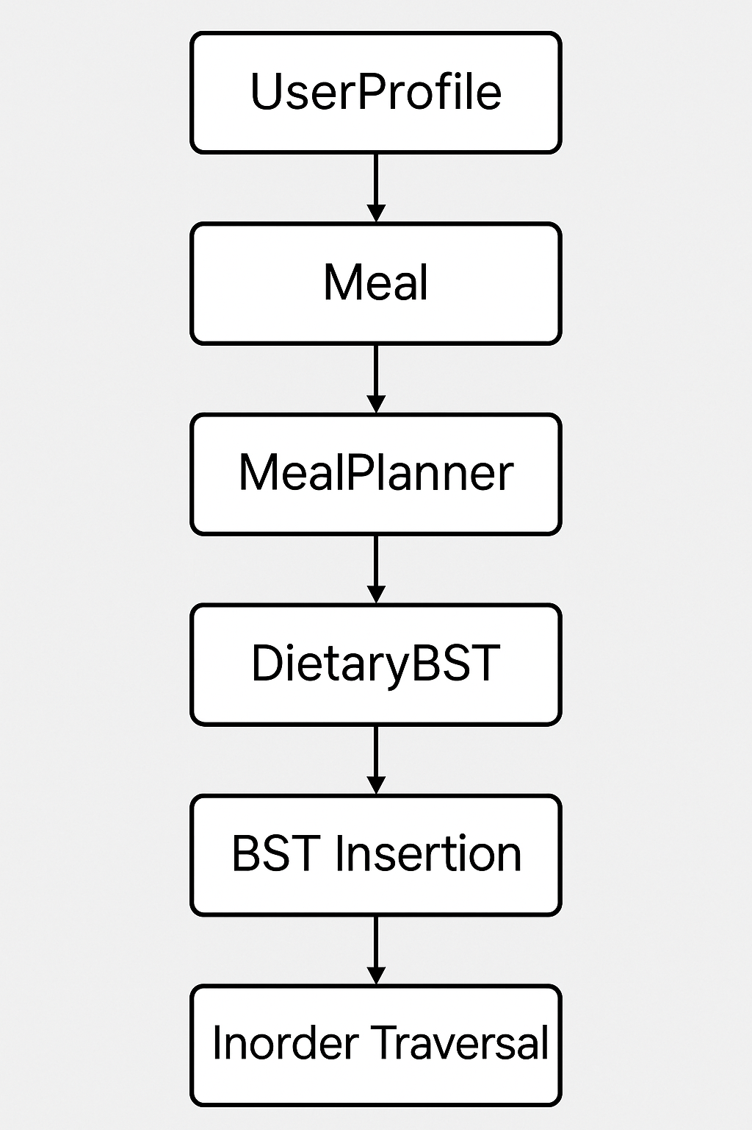
Flow chart of workflow:

Slide 10
Conclusion:
This project successfully integrates object-oriented programming concepts and data structures to create a personalized meal planning system. By utilizing classes, methods, and a binary search tree (BST), it efficiently handles user profiles and meal data. The system offers tailored meal plans based on calorie requirements and dietary preferences, while also leveraging pandas for handling and processing CSV data. The implementation showcases the practical use of DSA concepts, making it an effective and scalable solution for meal planning.

