Slide 1

Airbnb Price Analysis According to Weather and Events
Aparnna Dash
SRH Hochschule Heidelberg

Slide 2
Contents
About the Dataset
User Story and Business Questions
Architecture
Big Query Dataset
DBT File Exploration
DBT - Transformations
DBT Schema
Conclusion
Thank You

Slide 3
About the Dataset
Live Weather Data: Collected from OpenWeather API
Static Airbnb Data: Sourced from https://insideairbnb.com/get-the-data/
Event Data: Gathered from EU Open Data Portal - https://data.europa.eu/en/news-events/events

Slide 4
User Story and Business Questions
👤 User Story:
As a data analyst, I want to explore how weather and events impact Airbnb pricing and availability across European cities(Barcelona,Brussels,Florence,Madrid), so I can recommend data-driven strategies to hosts.
🔍 Business Questions:
• How do weather conditions affect Airbnb prices?
• Do public events increase Airbnb listing prices or bookings?
• What weather risk can be associated with each listing date and city?
• How many listings are available during events?

Slide 5
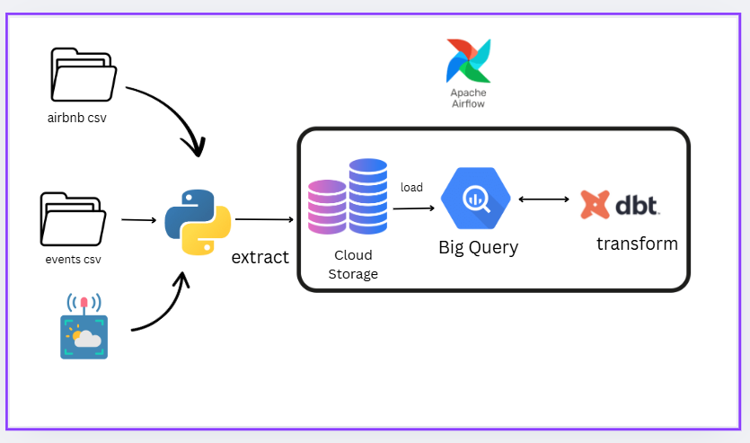
Architecture

Slide 6
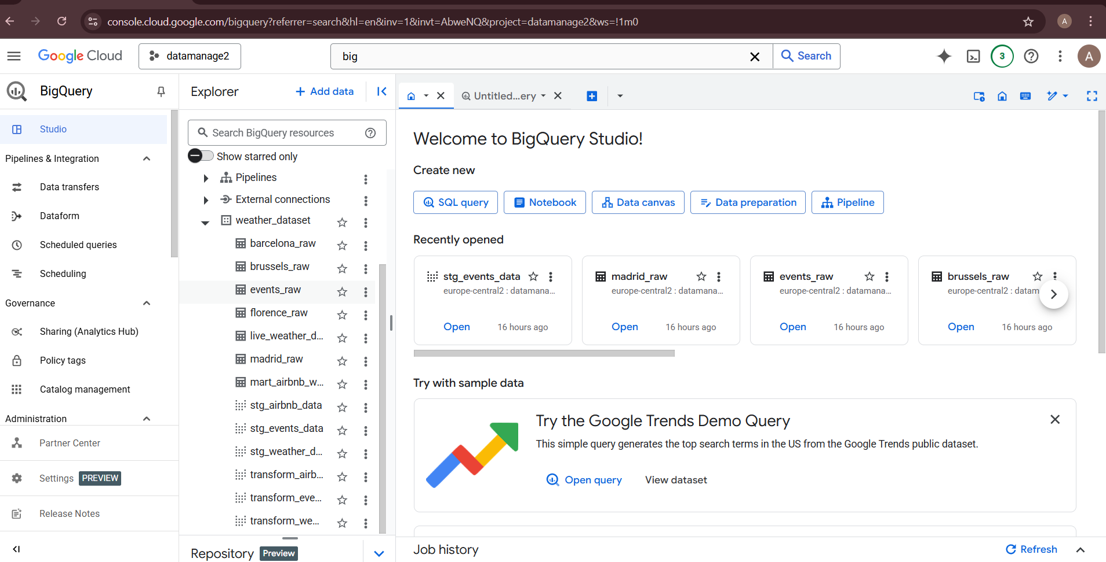
Big Query Dataset

Slide 7
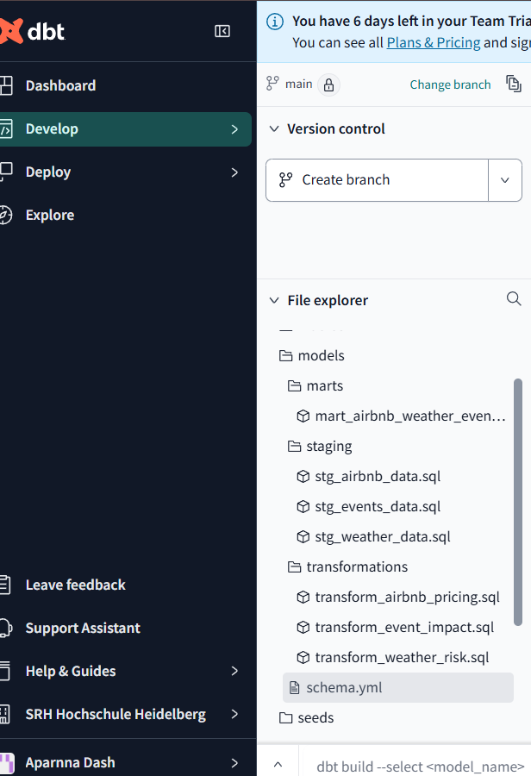
DBT File Exploration

Slide 8
Staging Models:
stg_airbnb_data
stg_weather_data
stg_events_data
Mart Model:
mart_airbnb_weather_events: Joined Airbnb listings with corresponding weather conditions and local event data by city and date to form the analytical base model.
Transformations Models:
transform_airbnb_pricing: Classified listings into pricing categories and labelled weather risk levels for price optimization insights.
transform_event_impact: Aggregated listings and average prices by event and city to analyse the impact of public events on Airbnb availability.
transform_weather_risk: Assigned weather risk scores to listings based on weather conditions and temperature thresholds.

Slide 9
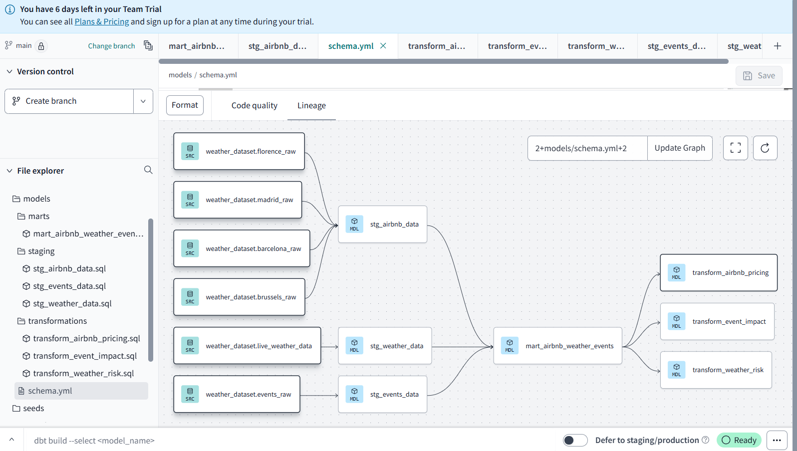
DBT Schema

Slide 10
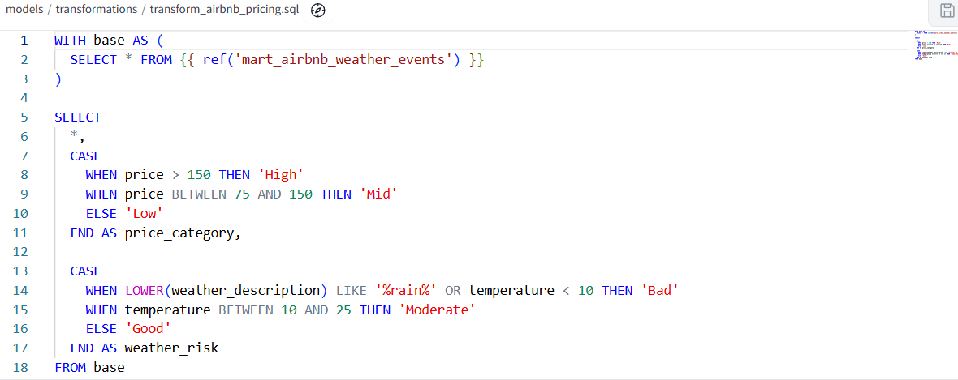
How do weather conditions affect Airbnb prices?

Slide 11
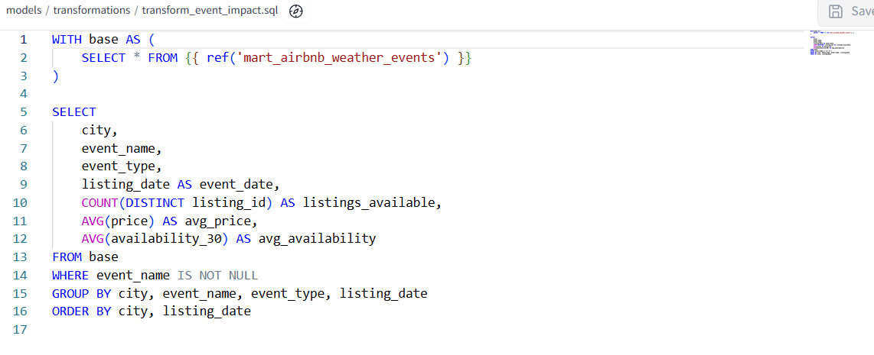
How many listings are available during events?
Do public events increase Airbnb listing prices or bookings?

Slide 12
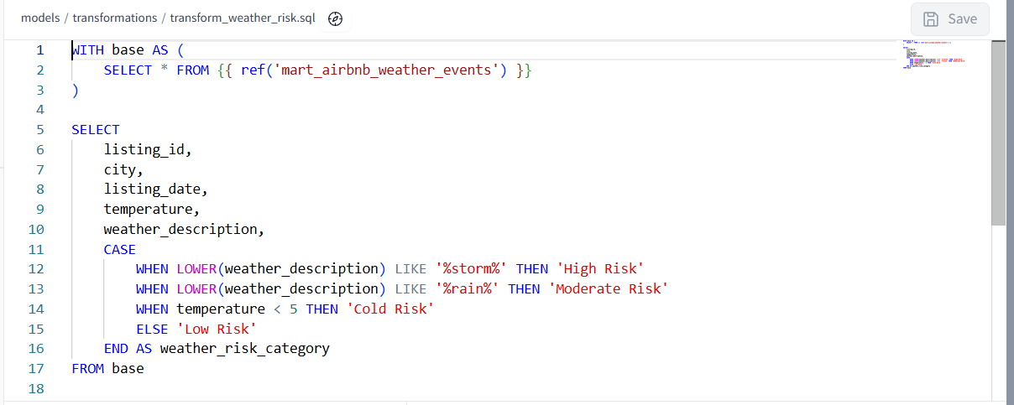
What weather risk can be associated with each listing date and city?

Slide 13
Conclusion
Built an automated data pipeline combining static and live data
Centralized data warehouse using BigQuery
Modular transformation logic using dbt Cloud
Scheduled and automated with Apache Airflow
Enables rich analytics on Airbnb pricing patterns

Slide 14
Thank You

