Slide 1







TECHNOLOGY TRENDS AND ANALYSIS PRESENTATION
APARUPA BANERJEE
9th MAY , 2024

Slide 2



OUTLINE
Executive Summary
Introduction
Methodology
Results
Visualization – Charts
Dashboard
Discussion
Findings & Implications
Conclusion
Appendix

Slide 3

EXECUTIVE SUMMARY
Trends in Programming languages and databases
Demographics Survey
Technological Gap in Countries
Gender Gap in Job Market

Slide 4

INTRODUCTION
About:
Analyzing the trends in Software Development
Purpose:
Identify skill requirement for future
What are the top programming languages in demand
What are the top database skills in demand
What are the popular IDEs
Audience:
IT DEPARTMENT HEAD AND HUMAN RESOURCE

Slide 5

METHODOLOGY
Data Collection sources:
Stack Overflow Developer 2019 Survey
GitHub Job Postings
Programming Languages Annual Salary
Data Exploration
Data Cleaning
Data Visualization
Presentation

Slide 6
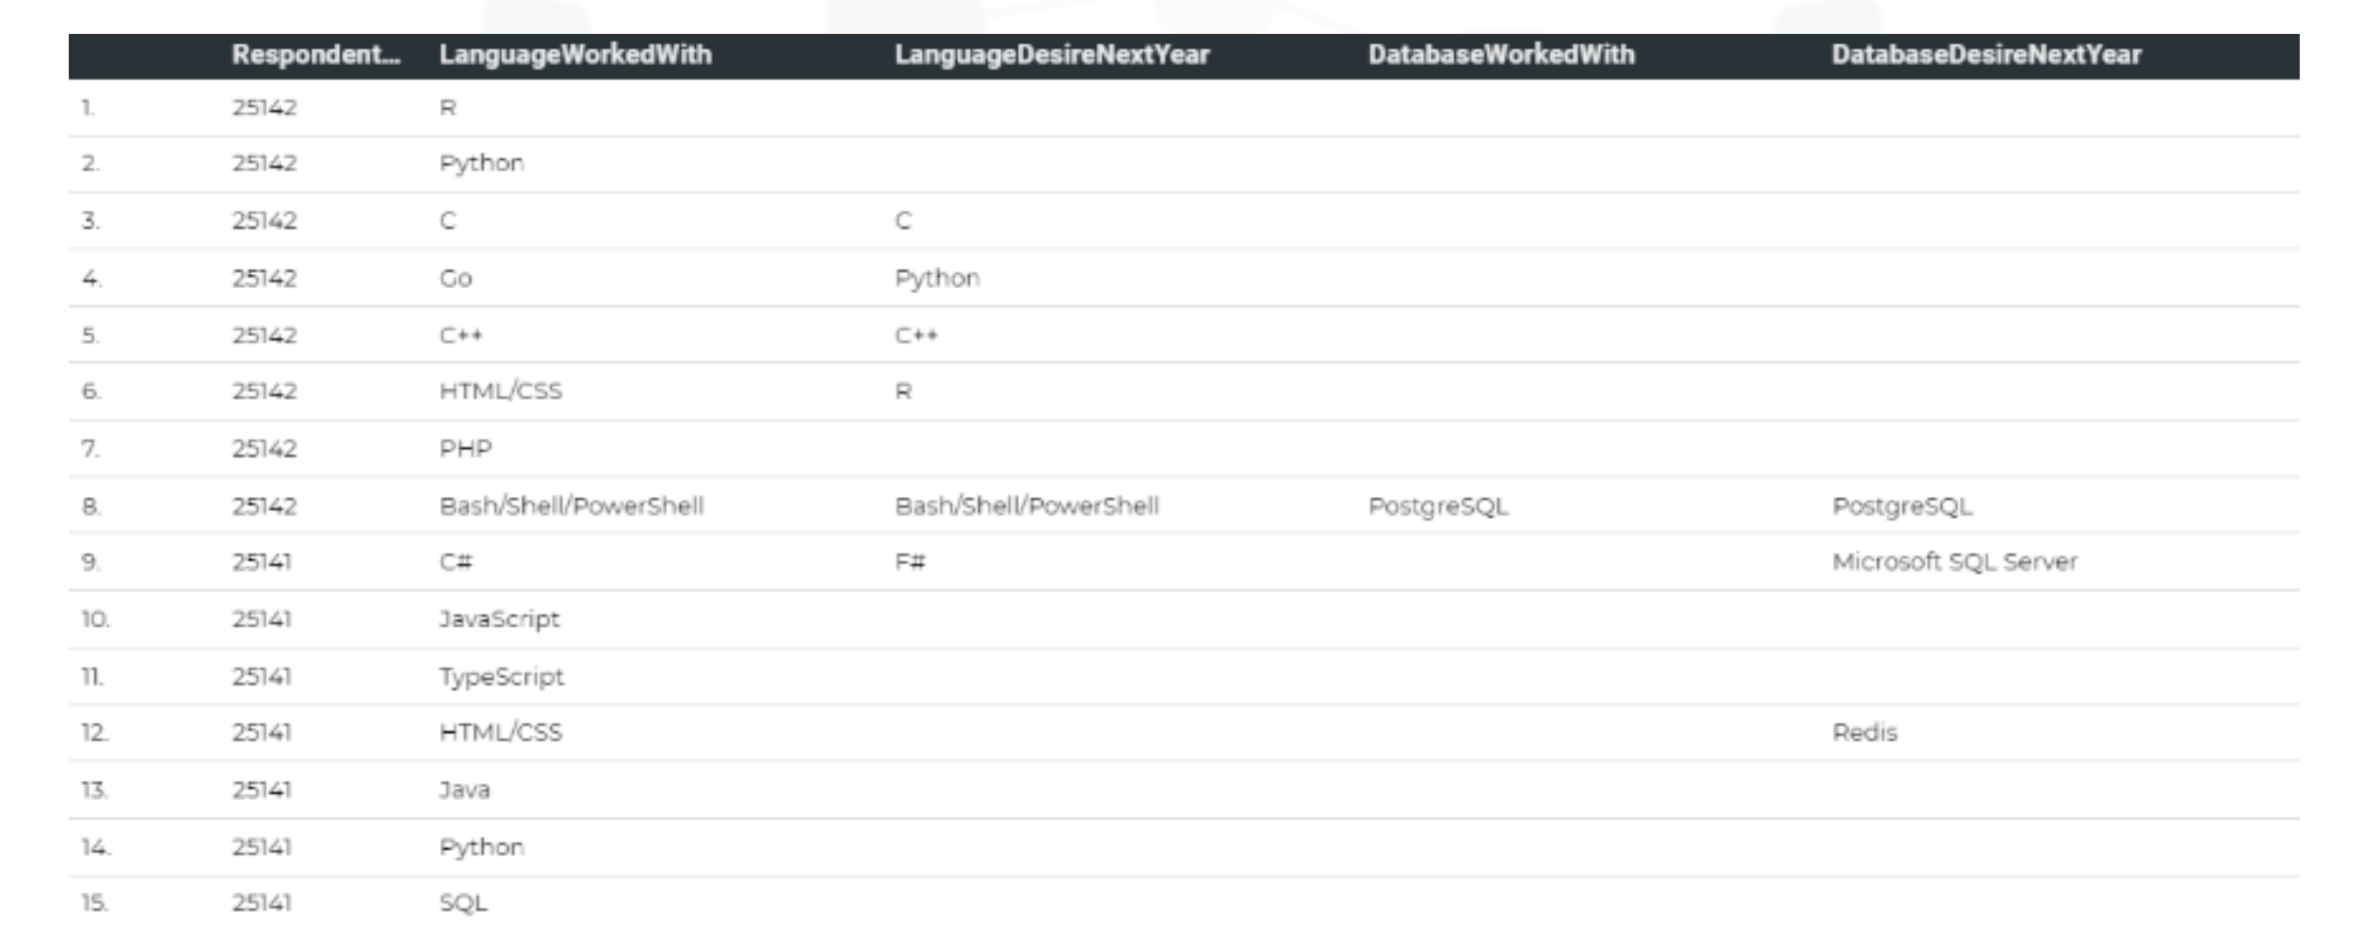
RESULTS

Slide 7
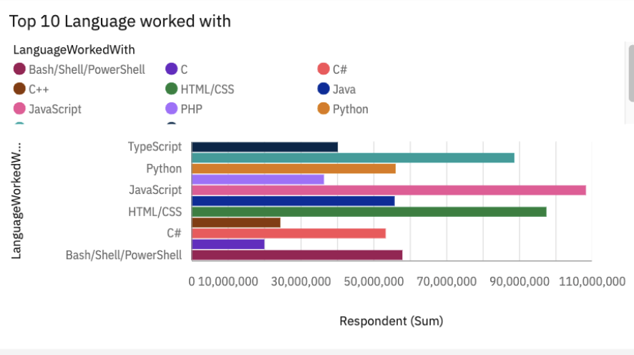
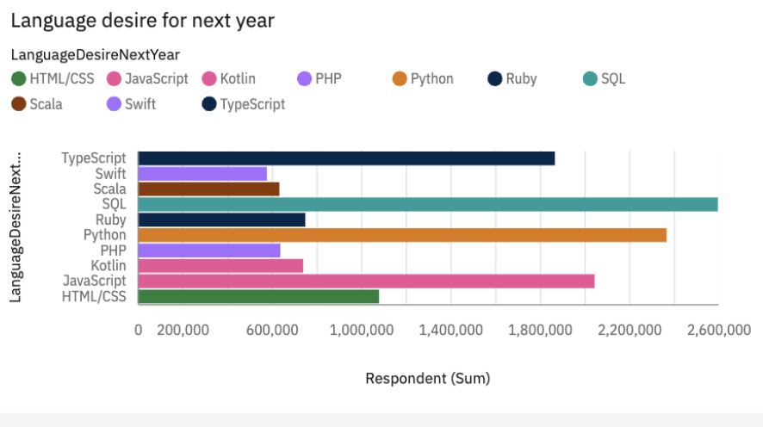
PROGRAMMING LANGUAGE TRENDS
Current Year
Next Year

Slide 8
PROGRAMMING LANGUAGE TRENDS - FINDINGS & IMPLICATIONS
Findings
Javascript, HTML/CSS, SQL, Shell languages and Python are the most used languages currently.
Javascript, HTML/CSS, Python, SQL, and Typescript will be the most used languages next year and future years.
Python will have more demand than SQL next year.
Implications
Web development is demanding
In companies Big Data Technology requires SQL
AI and ML demand is rising so python is the best choice
Javascript and HTML are used for web development which means that web development as a tech skill has the highest demand, especially as Typescript is getting viral.
Python is gaining more and more traction due to the increase in demand for AI and ML skills.
SQL is the still the most relevant language for data professionals. It is important for aspiring data analysts, scientists, business analysts etc to have SQL skills.

Slide 9
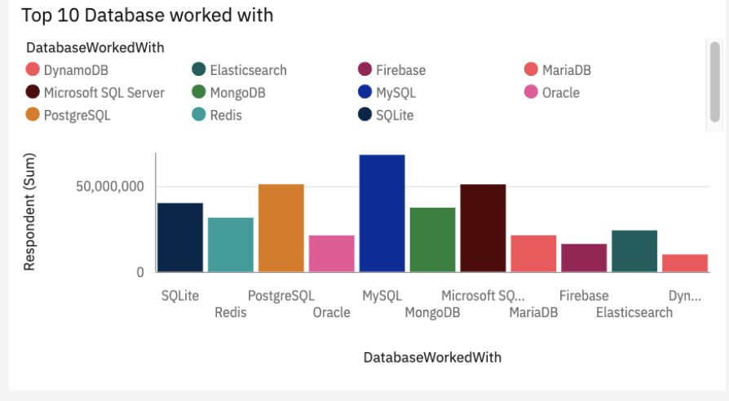
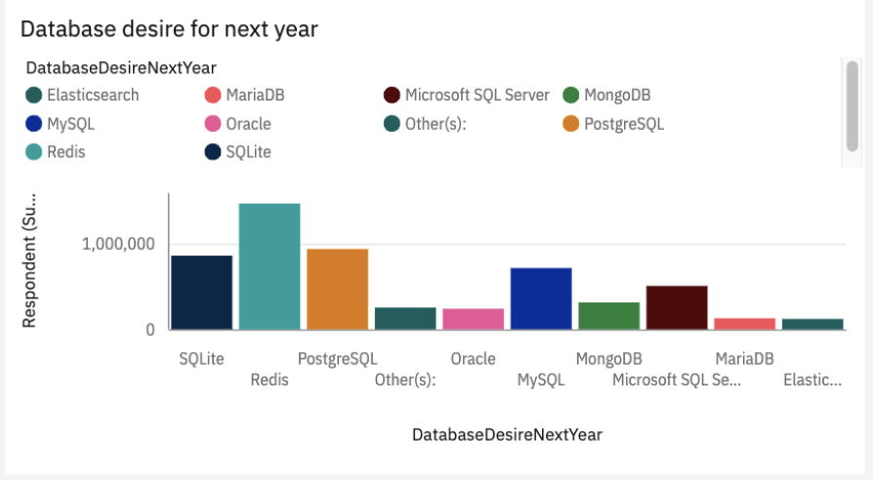
DATABASE TRENDS
Current Year
Next Year

Slide 10
DATABASE TRENDS - FINDINGS & IMPLICATIONS
Findings
MySQL, Microsoft SQL server, Postgre SQL, SQLite and MongoDB are the top 5 most used databases at the moment.
However, Postgre SQL, MongoDB, Redis, MySQL and Elasticsense are projected to become more popular in the future.
Redis and Elasticsense are relaatively new tools and are set to gain more traction in the IT space.
MongoDB and Redis are the immerging favorites
There is a New Kid in the Block- Elasticsearch
Implications
Open Source databases are still chosen in companies
NoSQL Databases will make an impact for storing non relational data
Redis supports abstract data types
Pre tune search to website , app or E-commerce store
SQL is still a top tool to watch out for in data specialists.
Oracle SQL was not among the top 5. It is losing relevance as time passes.

Slide 11

DASHBOARD
https://github.com/Aparupa1993/ibmProject/blob/main/Project%20dashboard.pdf

Slide 12
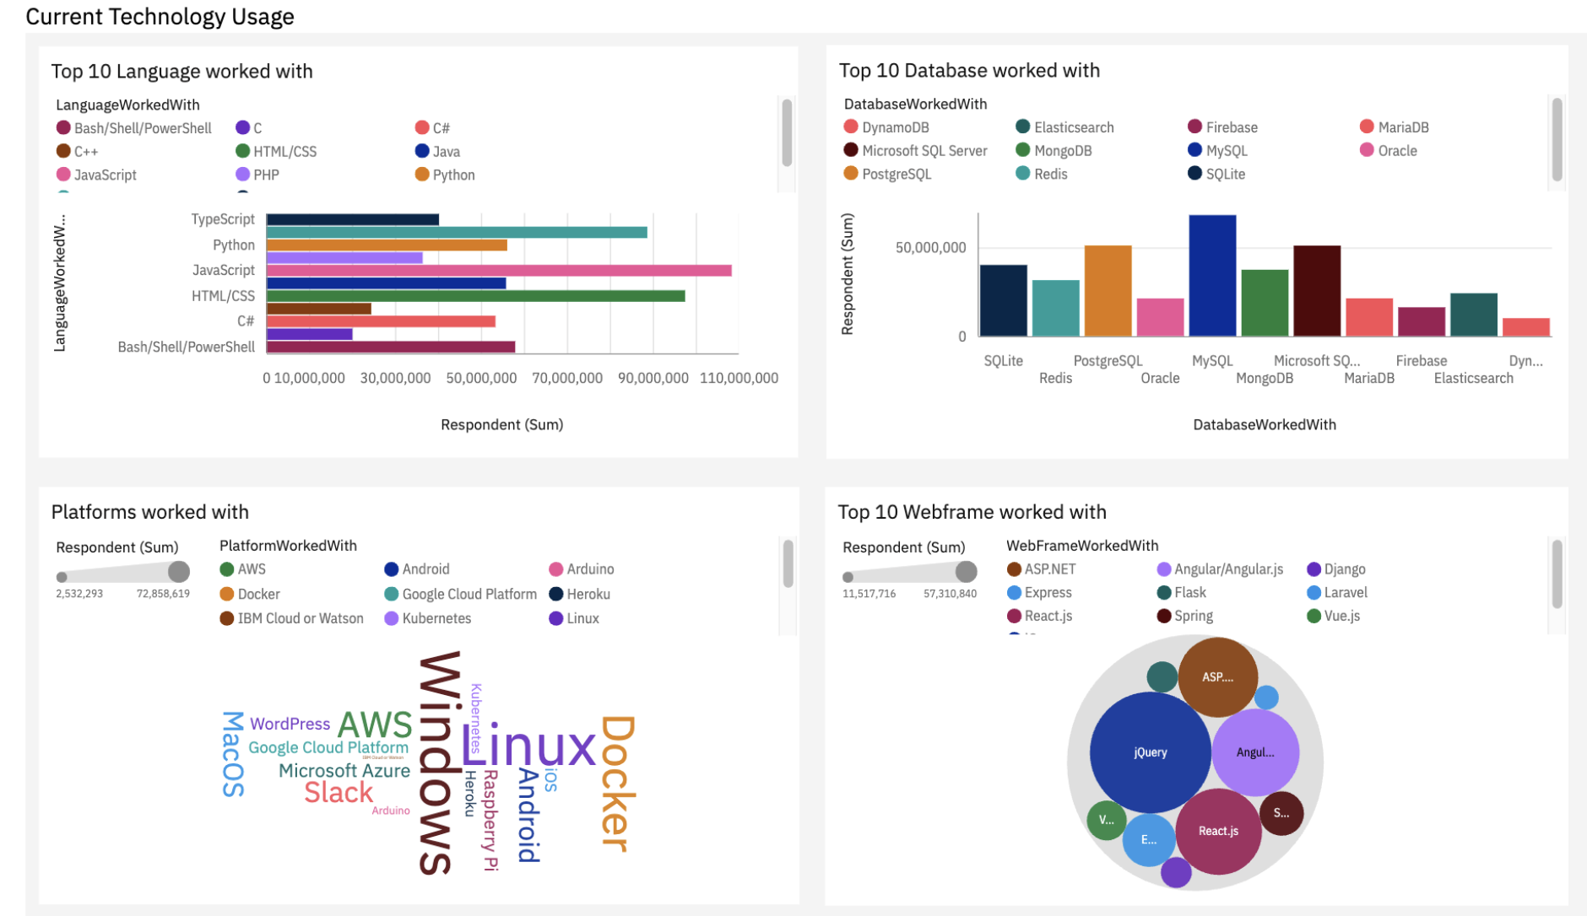
DASHBOARD TAB 1
Screenshot of dashboard tab 1 goes here

Slide 13
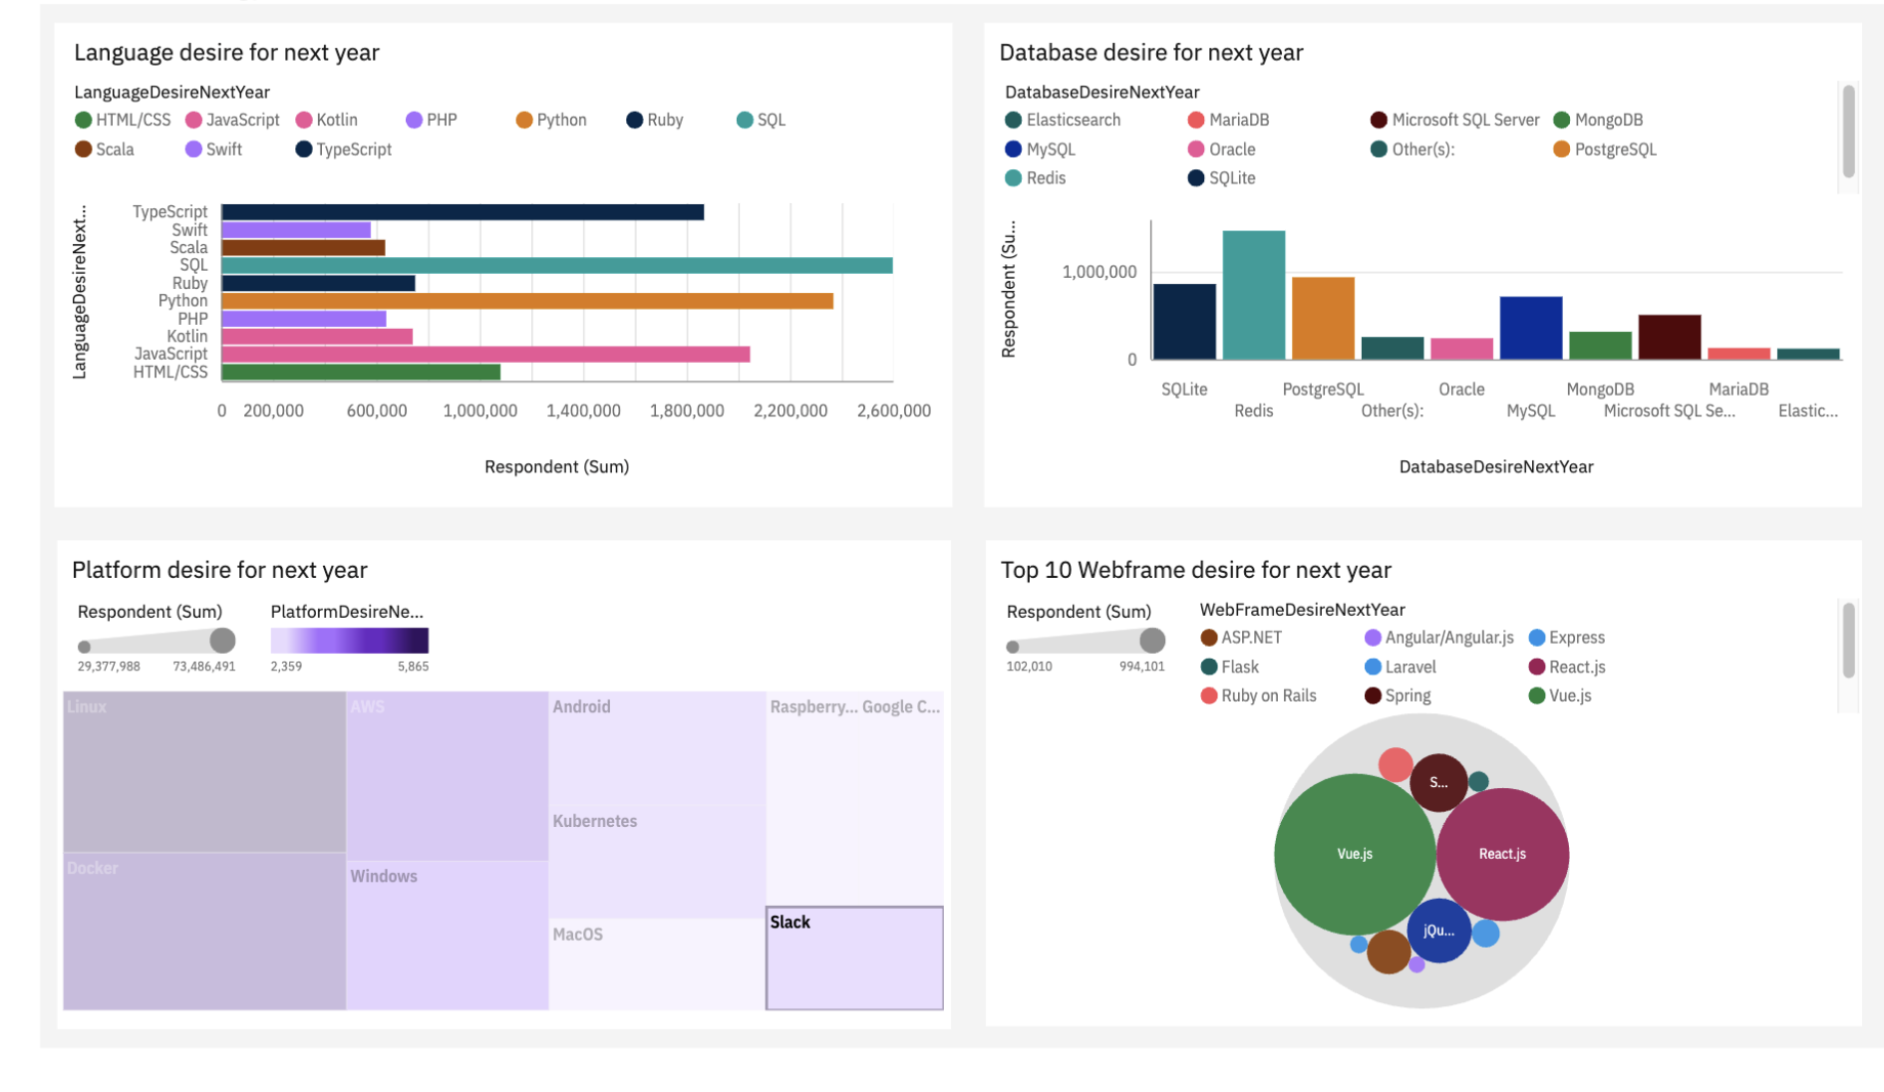
DASHBOARD TAB 2

Slide 14
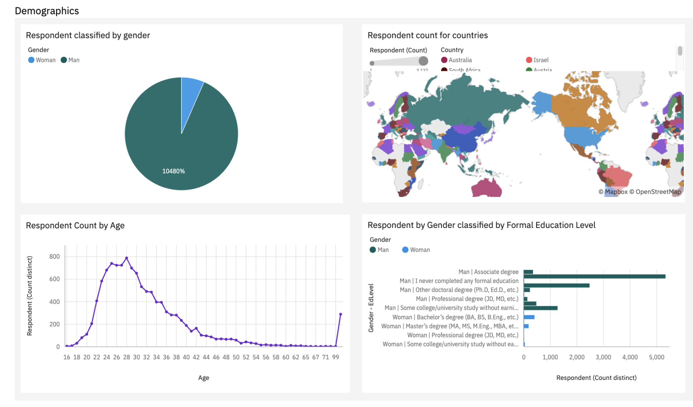
DASHBOARD TAB 3

Slide 15
DISCUSSION
Technology trends now and in future
Training and Reskilling workers
Female Participation in Technology Field
Bridge divide of Technology gaps in Developing Countries
Elimination of Age and Education Discrimination in Employment
Upskilling in the Technology sector.
Is completing a masters or doctorate degree really a requirement?
The increasing demand for mobile development as Kotlin is getting popular.
More tech education, access and development in less developed regions in South east Asia, South America, Africa and some parts of Europe.
How relevant will Oracle SQL still be in the future?

Slide 16
OVERALL FINDINGS & IMPLICATIONS
Findings
Fast changing Technology with year and time
Concentration of several countries like USA and INDIA
Gender gap in Tech Jobs
Platforms like Docker and AWS are growing at a rapid rate
Most people in the IT field have a Bachelors' degree.
Web development languages are the most popular and on-demand tools in the IT field currently.
The Tech sector is filled with majorly young people under 40 years of age.
Most respondents want to learn Postgres SQL and React JS next year.
Implications
Companies needs to be flexible and be adaptive to rapid changes
The need of spreading technology out to lagging countries
Impact of Job hiring´s
Shift to faster App deployments and Cloud services in future
It is important for data professionals to develop proficiencies in NoSQL in addition to SQL databases.
Web development is still a very lucrative skill.

Slide 17

CONCLUSION
Technology trends for current and next year
Programming Languages, Database and Platform overview
Demographics Overview
Actions to be taken
In future, incorporate Machine Learning to predict trends and salaries
It is expedient to stay updated in the Tech sector as the trends keep changing over time.

Slide 18
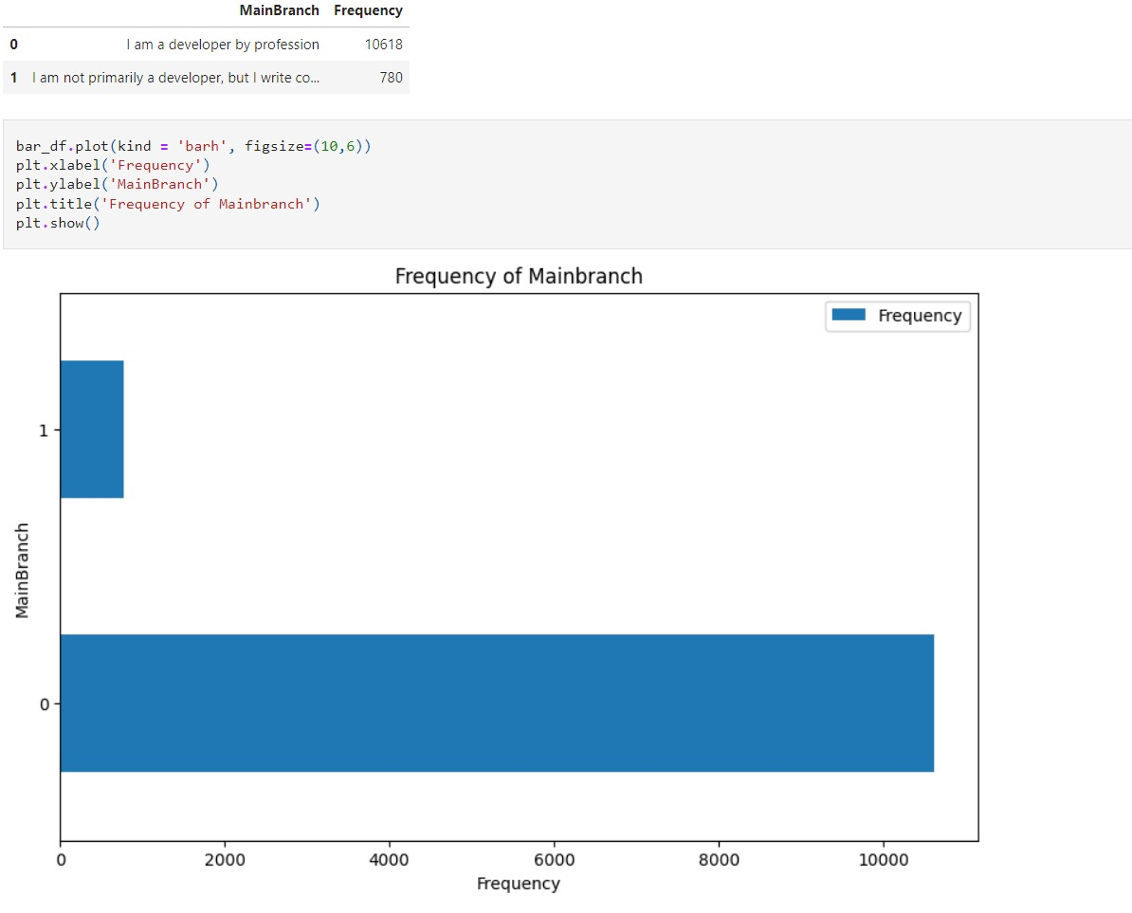
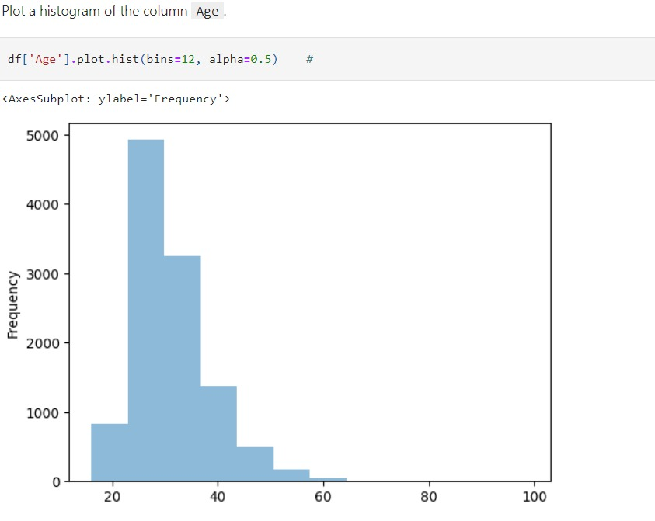

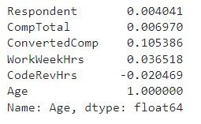
APPENDIX

Slide 19
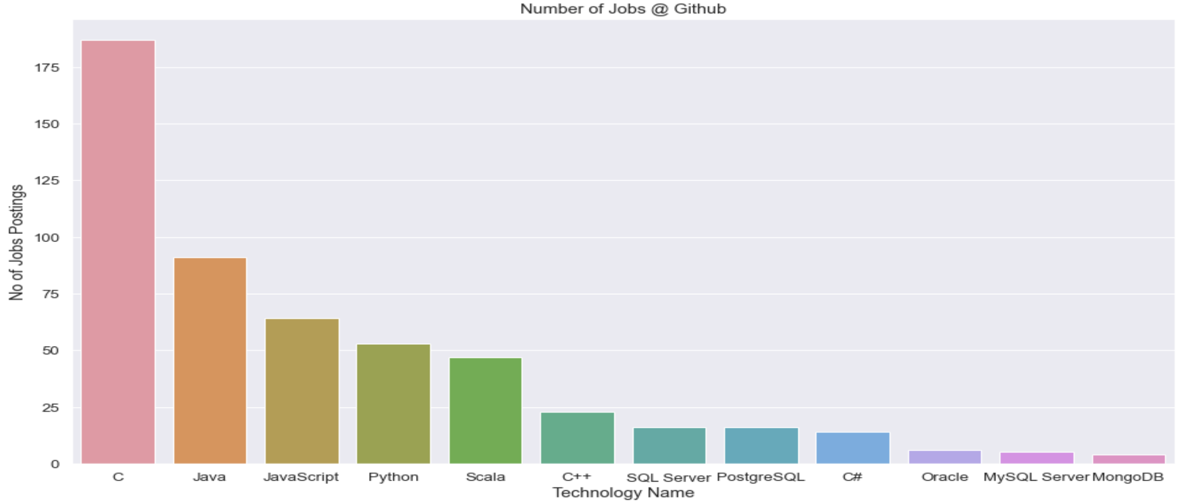
JOB POSTINGS

Slide 20
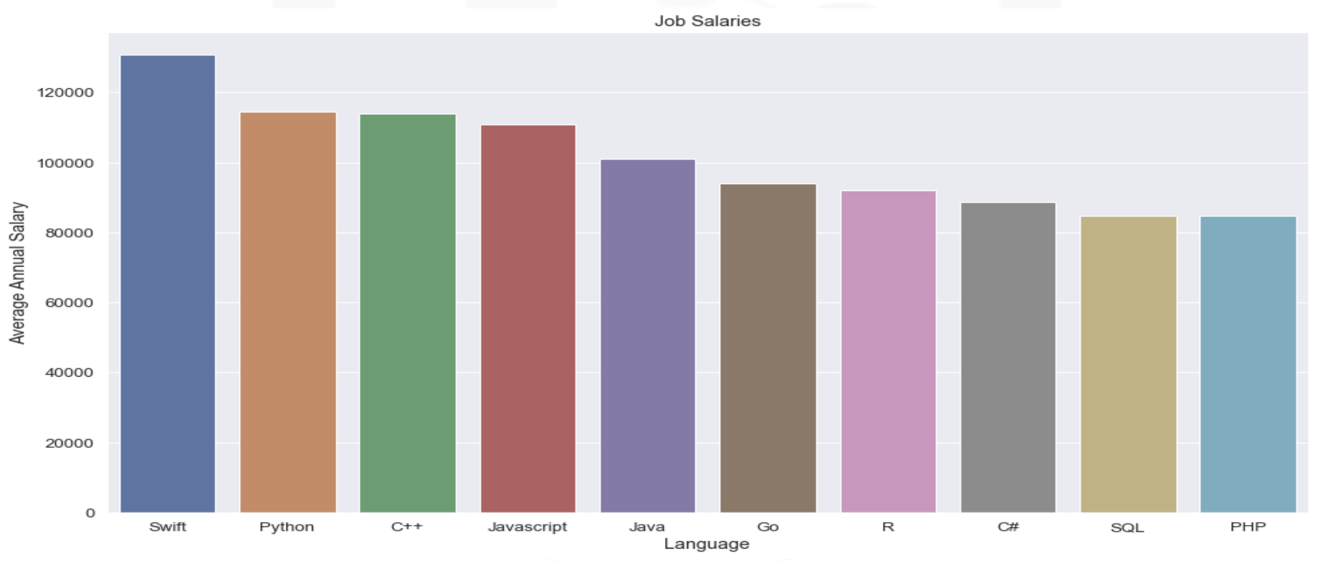
POPULAR LANGUAGES

