Slide 1

How Long Do Students Stay in the Library?
A normal distribution study of time spent per library visit
APM-1110 | Group Project | n = 50 students

Slide 2
Our Variable and Method
What we measured and how we collected it
The variable
The sample
Minutes a student spends inside the school library on an average visit
50 students across 1st–4th year, collected through an online survey
Ethical data collection
Data cleaning
Voluntary responses; answers used only for this class project, no names reported
Ranges such as "2–3 hrs" and "20–40" were converted to single minute values

Slide 3
Frequency Distribution
Minutes per visit grouped in 30-minute classes
Class (min) | Frequency | Relative freq.
0–30 | 15 | 30%
31–60 | 14 | 28%
61–90 | 1 | 2%
91–120 | 4 | 8%
121–150 | 5 | 10%
151–180 | 7 | 14%
181–210 | 0 | 0%
211–240 | 1 | 2%
241–270 | 2 | 4%
271–300 | 1 | 2%
Total | 50 | 100%
Most common class
1–30 min
15 of 50 students (30%) stay half an hour or less
A second, smaller group stays 2–3 hours, so the data has two clusters.

Slide 4
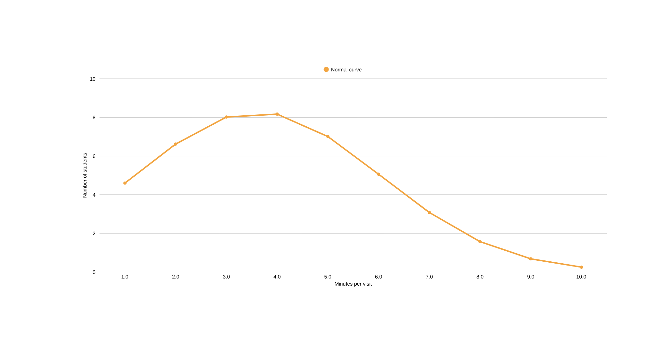
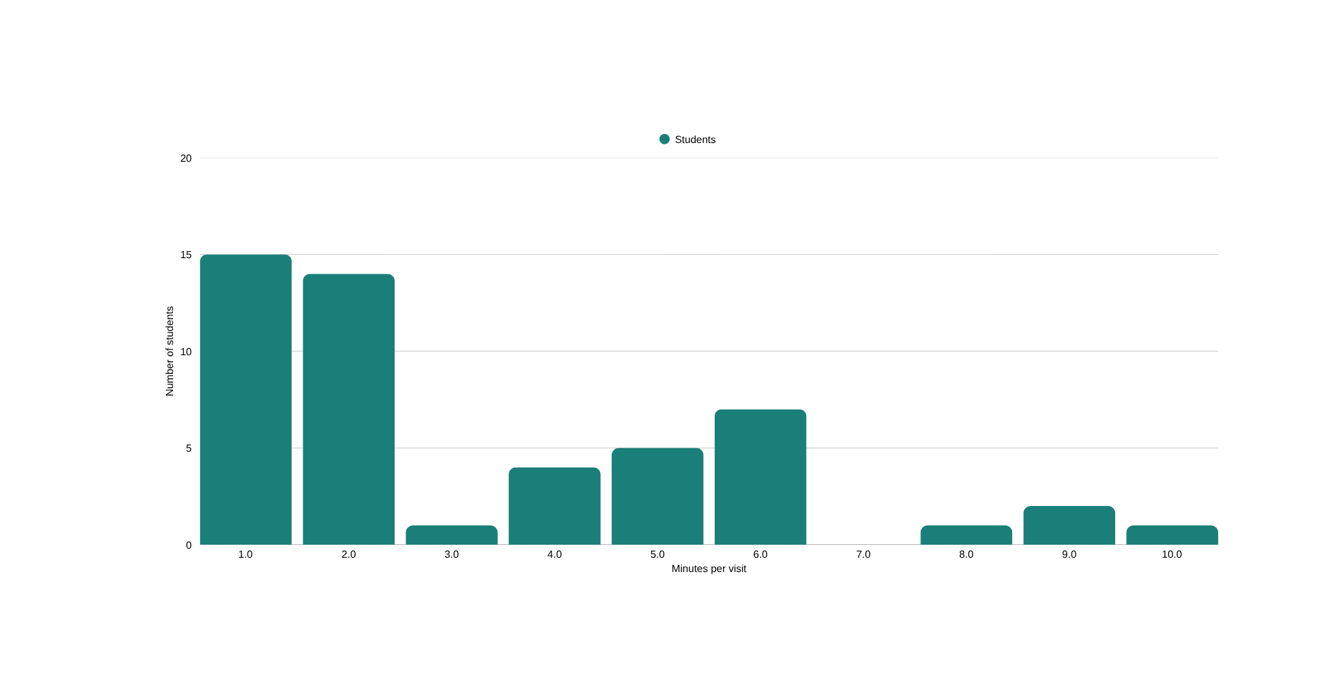
Histogram and Normal Curve
Bars = actual students, line = normal curve with μ = 93.3 and σ = 72.3

Slide 5
Mean and Standard Deviation
The two numbers that define our normal curve
93.3 min
72.3 min
60 min
Mean (μ)
Std. deviation (σ)
Median
The average visit lasts about 93 minutes (1 h 33 min), but the typical student (median) stays only 60 minutes.
A σ of 72 minutes means visit lengths vary a lot from one student to another.

Slide 6
The Empirical Rule: 68 – 95 – 99.7
Share of our 50 students within 1σ, 2σ and 3σ of the mean
1σ
2σ
3σ
78%
92%
100%
21 – 166 min
Normal curve expects 68%
0 – 238 min*
Normal curve expects 95%
0 – 310 min*
Normal curve expects 99.7%
Within 1σ our data is above the expected 68% (78%) and within 2σ it matches 95% closely (92%). All students fall within 3σ.
*The lower limits (μ − 2σ and μ − 3σ) are negative, so time cannot go below 0 minutes. This is a sign the data is not perfectly normal.

Slide 7
Interpreting the Distribution
Is it symmetric? Are there outliers? What does the shape mean?
Symmetric?
Outliers?
No. It is right-skewed (skewness ≈ 1.03). The mean (93 min) is higher than the median (60 min).
No extreme outliers by the 1.5×IQR rule (upper fence 330 min). But 4 students (240–300 min) are more than 2σ above the mean.
What the shape implies
Why it is not fully normal
Most students make short visits, while a smaller group stays for hours. The distribution is only roughly bell-shaped.
Time cannot be negative, and there is a hard floor near 0, so long visits stretch the right tail.

Slide 8
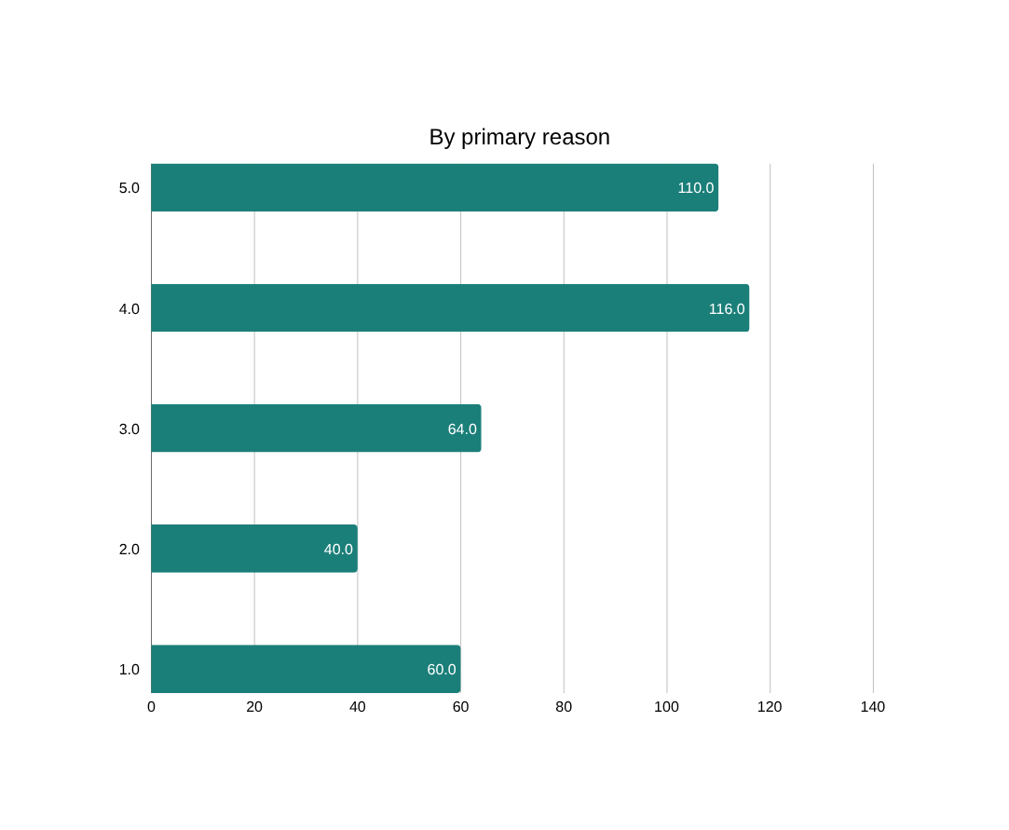
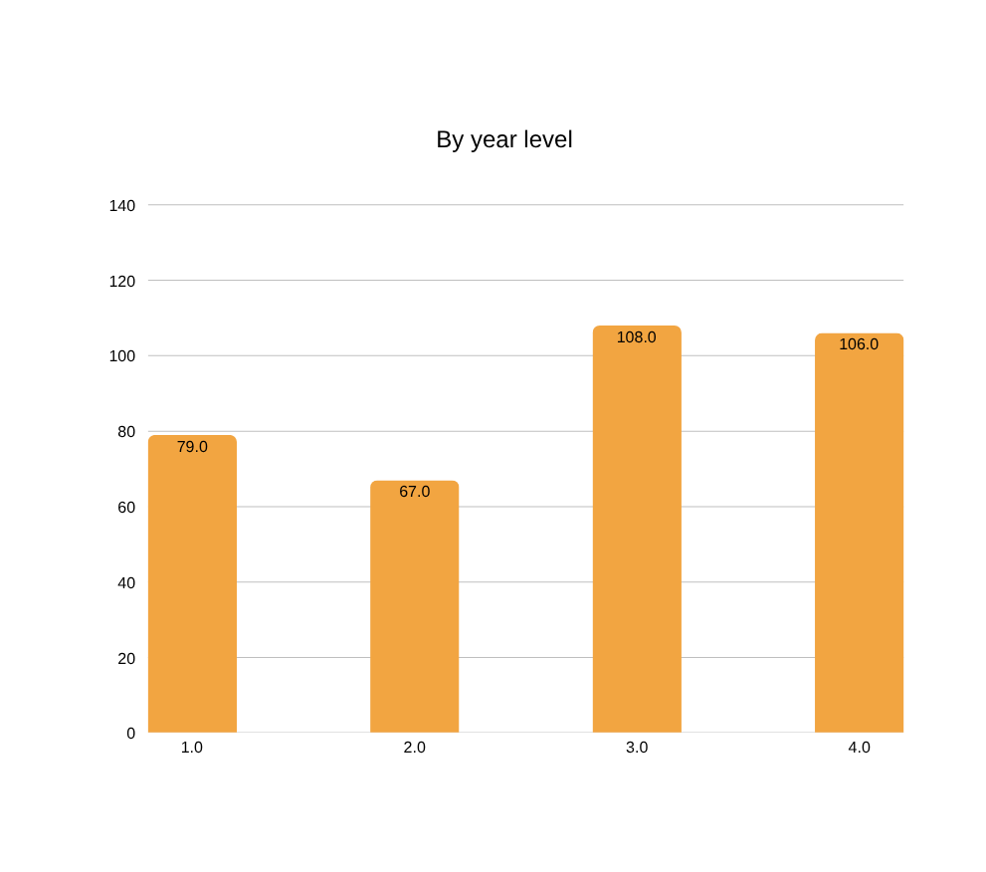
Who Stays Longer?
Average minutes per visit by reason and by year level

Slide 9
Implications and Recommendations
1
Plan for two kinds of visitors
Most visits are about 30–60 minutes, but many stay 2–3+ hours. Seating and quiet zones should support both.
2
Add comfortable rest and computer areas
Resting and computer use have the longest average stays (about 110–115 min), so these areas are in high demand.
3
Prepare for upper-year demand
3rd and 4th years stay about 105 minutes on average, so expect heavier use as thesis season approaches.
4
Plan around the typical, not the average
Because the data is skewed, use the median (60 min) for quick-service planning such as printing queues.

Slide 10
Key Takeaways
  Average visit: 93 min (σ = 72 min); typical visit: 60 min
  78% / 92% / 100% of students fall within 1σ / 2σ / 3σ
  The distribution is right-skewed, so it is only approximately normal
  Resting, computer use and upper-year students account for the longest stays
Thank you!

