Slide 1
Natural Language Processing
Parallel and Distributed Computing
Geo-Distributed Pipeline
Parallelism for Hybrid RAG
on Asymmetric Edge-to-Core Topologies
M. Abdullah Ali
23i-2523 · Data Science, FAST-NUCES
M. Abdullah Aamir
23i-2538 · Data Science, FAST-NUCES
May 2026
Notes:
SPEAKER 1 — M. Abdullah Ali
Good morning/afternoon, Professor. My name is Abdullah Ali, and alongside my partner Abdullah Aamir, we will be presenting our NLP final project.
Our project is titled "Geo-Distributed Pipeline Parallelism for Hybrid Retrieval-Augmented Generation on Asymmetric Edge-to-Core Topologies." The core idea is simple: modern AI assistants that search for information before answering — what we call RAG systems — are slow on real-world networks because they run their search steps one after another. We built a system that runs those steps in parallel, and today we will show you exactly why that matters, how we built it, and what we measured.

Slide 2
The Bottleneck in Production RAG
①
Monolithic & Sequential
23%
Standard RAG blocks on sparse search, then waits for dense embedding, then begins generation — each step stalls the pipeline.
of end-to-end latency from
communication overhead alone
②
WAN Latency Accumulates
Across geo-distributed nodes, every sequential blocking call adds Wide Area Network delay, inflating Time-to-First-Token.
40%
user drop-off when P95 TTFT
exceeds 2 seconds
③
Pipeline Bubbles
High-end Core GPUs sit idle waiting for upstream network hops to complete — expensive hardware wasted.
T_sequential = T_sparse + T_WAN + T_dense
NLP&PDC Final Project · FAST-NUCES · May 2026
Notes:
SPEAKER 1 — M. Abdullah Ali
Let us start with the problem. A standard Retrieval-Augmented Generation system works like this: a user sends a query, the system first runs a sparse keyword search, waits for that to finish, then computes a dense neural embedding, waits again, queries a vector database, and only then begins generating a response. Every single one of these steps is a blocking call.
Now imagine this pipeline is spread across real machines over a real network — which is exactly what most production deployments look like. Each of these blocking steps accumulates Wide Area Network latency. Research shows that communication overhead alone accounts for 23% of end-to-end inference latency, and when P95 latency exceeds two seconds, 40% of users simply abandon the session.
The mathematical consequence is captured in this formula: T-sequential equals T-sparse plus T-WAN plus T-dense. Every stage adds to the total time. Our goal is to eliminate that summation.

Slide 3
Foundation & Related Work
Phase Splitting
Hybrid Retrieval
Edge Orchestration
Splitwise — Patel et al., ISCA 2024
BGE-M3 — Chen et al., arXiv 2024
LLM Inference Offloading — He et al., IEEE TMC 2024
Proved that LLM inference separates into a compute-saturated prefill phase and a memory-bandwidth-saturated decode phase.
Disaggregating these onto separate machines yields up to 2.35× throughput improvement.
Our adaptation: extended this phase-splitting philosophy to the retrieval stage across geographic distances.
Introduced a unified bi-encoder performing dense, sparse, and multi-vector ColBERT-style retrieval in a single FP16 forward pass.
Eliminates the need for separate model deployments for each retrieval modality.
We deploy this on our mid-tier GPU node for single-pass hybrid embeddings.
Introduced active-inference-based asynchronous scheduling for cloud-edge LLM deployments.
Demonstrated that asynchronous dispatch and fallback policies are essential in heterogeneous topologies.
We adapted this approach for our Active Inference fallback mechanism at the core node.
NLP&PDC Final Project · FAST-NUCES · May 2026
Notes:
SPEAKER 2 — M. Abdullah Aamir
Thank you. Now let me walk you through the foundational work that shaped our design.
Our first base paper is Splitwise by Patel et al., published at ISCA 2024. They demonstrated that LLM inference has two very different computational profiles: the prefill phase is compute-saturated, while the decode phase is memory-bandwidth-saturated. Splitting these across machines gives up to 2.35 times throughput improvement. We extended this disaggregation philosophy not just to LLM phases, but to the retrieval stage itself.
Our second foundation is BGE-M3 by Chen et al. This is a unified embedding model that performs dense retrieval, sparse retrieval, and multi-vector ColBERT-style retrieval all in a single forward pass. This is deployed on our intermediate GPU node, Node B.
Our third reference is the LLM Inference Offloading paper by He et al. in IEEE Transactions on Mobile Computing. They use active inference principles for asynchronous scheduling in cloud-edge deployments. We adopted this concept for our fallback mechanism — a key resilience feature I will explain shortly.
Our work bridges the gap between all three: Splitwise assumes homogeneous clusters; we adapt it for genuinely asymmetric consumer hardware over real geographic distances.

Slide 4
Research Objectives
01
Deconstruct
02
Mask WAN Latency
Break the monolithic RAG pipeline into parallel microservices: Edge sparse retrieval vs. Core dense retrieval and generation — never blocking one on the other.
Overlap network transit time with local edge computation so that the Wide Area Network delay contributes zero time to the user-visible critical path.
03
Ensure Fault Tolerance
04
Maximize Hardware Efficiency
Implement an Active Inference–inspired fallback: if the dense retrieval node does not respond within threshold, generation proceeds on sparse context alone.
Deploy efficiently across asymmetric consumer nodes: Intel Iris XE (edge), GTX 1660 Ti 6 GB (retrieval), and RTX 3080 10 GB (generation) using AWQ quantization.
NLP&PDC Final Project · FAST-NUCES · May 2026
Notes:
SPEAKER 2 — M. Abdullah Aamir
Our project has four clearly defined objectives.
Objective one is Deconstruct — we break the monolithic RAG pipeline apart into independently running microservices so that edge and core work never block each other.
Objective two is to Mask WAN Latency. The key insight is that if we run sparse and dense retrieval at exactly the same time, the sparse retrieval — which completes in under one millisecond — is completely hidden behind the remote dense retrieval that takes around 180 to 200 milliseconds. The sparse path is effectively free.
Objective three is Fault Tolerance. We implement what we call an Active Inference fallback: if the dense retrieval node does not respond within a dynamic timeout threshold, the generation engine does not stall — it immediately proceeds using only the sparse context.
Objective four is Hardware Efficiency. We had to make this work on real consumer hardware with real VRAM constraints: an 8th-gen Intel laptop as edge, a GTX 1660 Ti with 6 gigabytes for retrieval, and an RTX 3080 with 10 gigabytes for generation. We used AWQ 4-bit quantization to fit a 16-gigabyte model into 10 gigabytes.

Slide 5
Proposed Solution: Tripartite Architecture
NODE C
NODE B
NODE A
Edge Orchestrator
Dense Retrieval Engine
Core: Generation & Sync
Hardware
Hardware
Hardware
i5-1235U · 16 GB LPDDR4X
GTX 1660 Ti 6 GB · i7-10750H · 24 GB DDR4
RTX 3080 10 GB · R7 7700 · 32 GB DDR5
Network
Network
Network
University Wi-Fi → WireGuard VPN
Home LAN · ≤ 1 ms to Node A
Home LAN · Sync Controller
Software Stack
Software Stack
Software Stack
FastAPI Gateway
Tantivy BM25 (CPU RAM)
Async gRPC Client
gRPC Server (port 50051)
BGE-M3 FP16 Embeddings
Qdrant Vector DB
vLLM + Llama-3-8B AWQ
RRF Fusion Engine
Active Inference Fallback
NLP&PDC Final Project · FAST-NUCES · May 2026
Notes:
SPEAKER 1 — M. Abdullah Ali
Let me describe our three-node architecture.
Node C is our Edge Orchestrator deployed on a university laptop. It runs an Intel i5 12th-gen with 16 gigabytes of RAM. It hosts a FastAPI gateway that receives user queries, runs a local BM25 sparse search using the Tantivy engine entirely in CPU memory — sub-millisecond — and simultaneously dispatches a gRPC call over a WireGuard-encrypted VPN tunnel to our home machines.
Node B is our Dense Retrieval Engine — a gaming laptop at home running an i7-10750H with a GTX 1660 Ti, 6 gigabytes of VRAM. It hosts a gRPC server that computes BGE-M3 neural embeddings in FP16 precision and queries a Qdrant vector database for the top-10 nearest neighbors.
Node A is our Core Generation and Synchronization Engine — a desktop with a Ryzen 7 7700, 32 gigabytes of DDR5, and an RTX 3080 with 10 gigabytes of VRAM. It runs the Llama-3-8B model quantized to 4-bit using AWQ, served through vLLM. Critically, Node A acts as the Synchronization Controller — it receives sparse results from Node C and dense results from Node B, fuses them using Reciprocal Rank Fusion, and generates the final response.
Nodes A and B share a home LAN with under 1 millisecond transfer latency. Node C is genuinely separated by a real WAN segment.

Slide 6
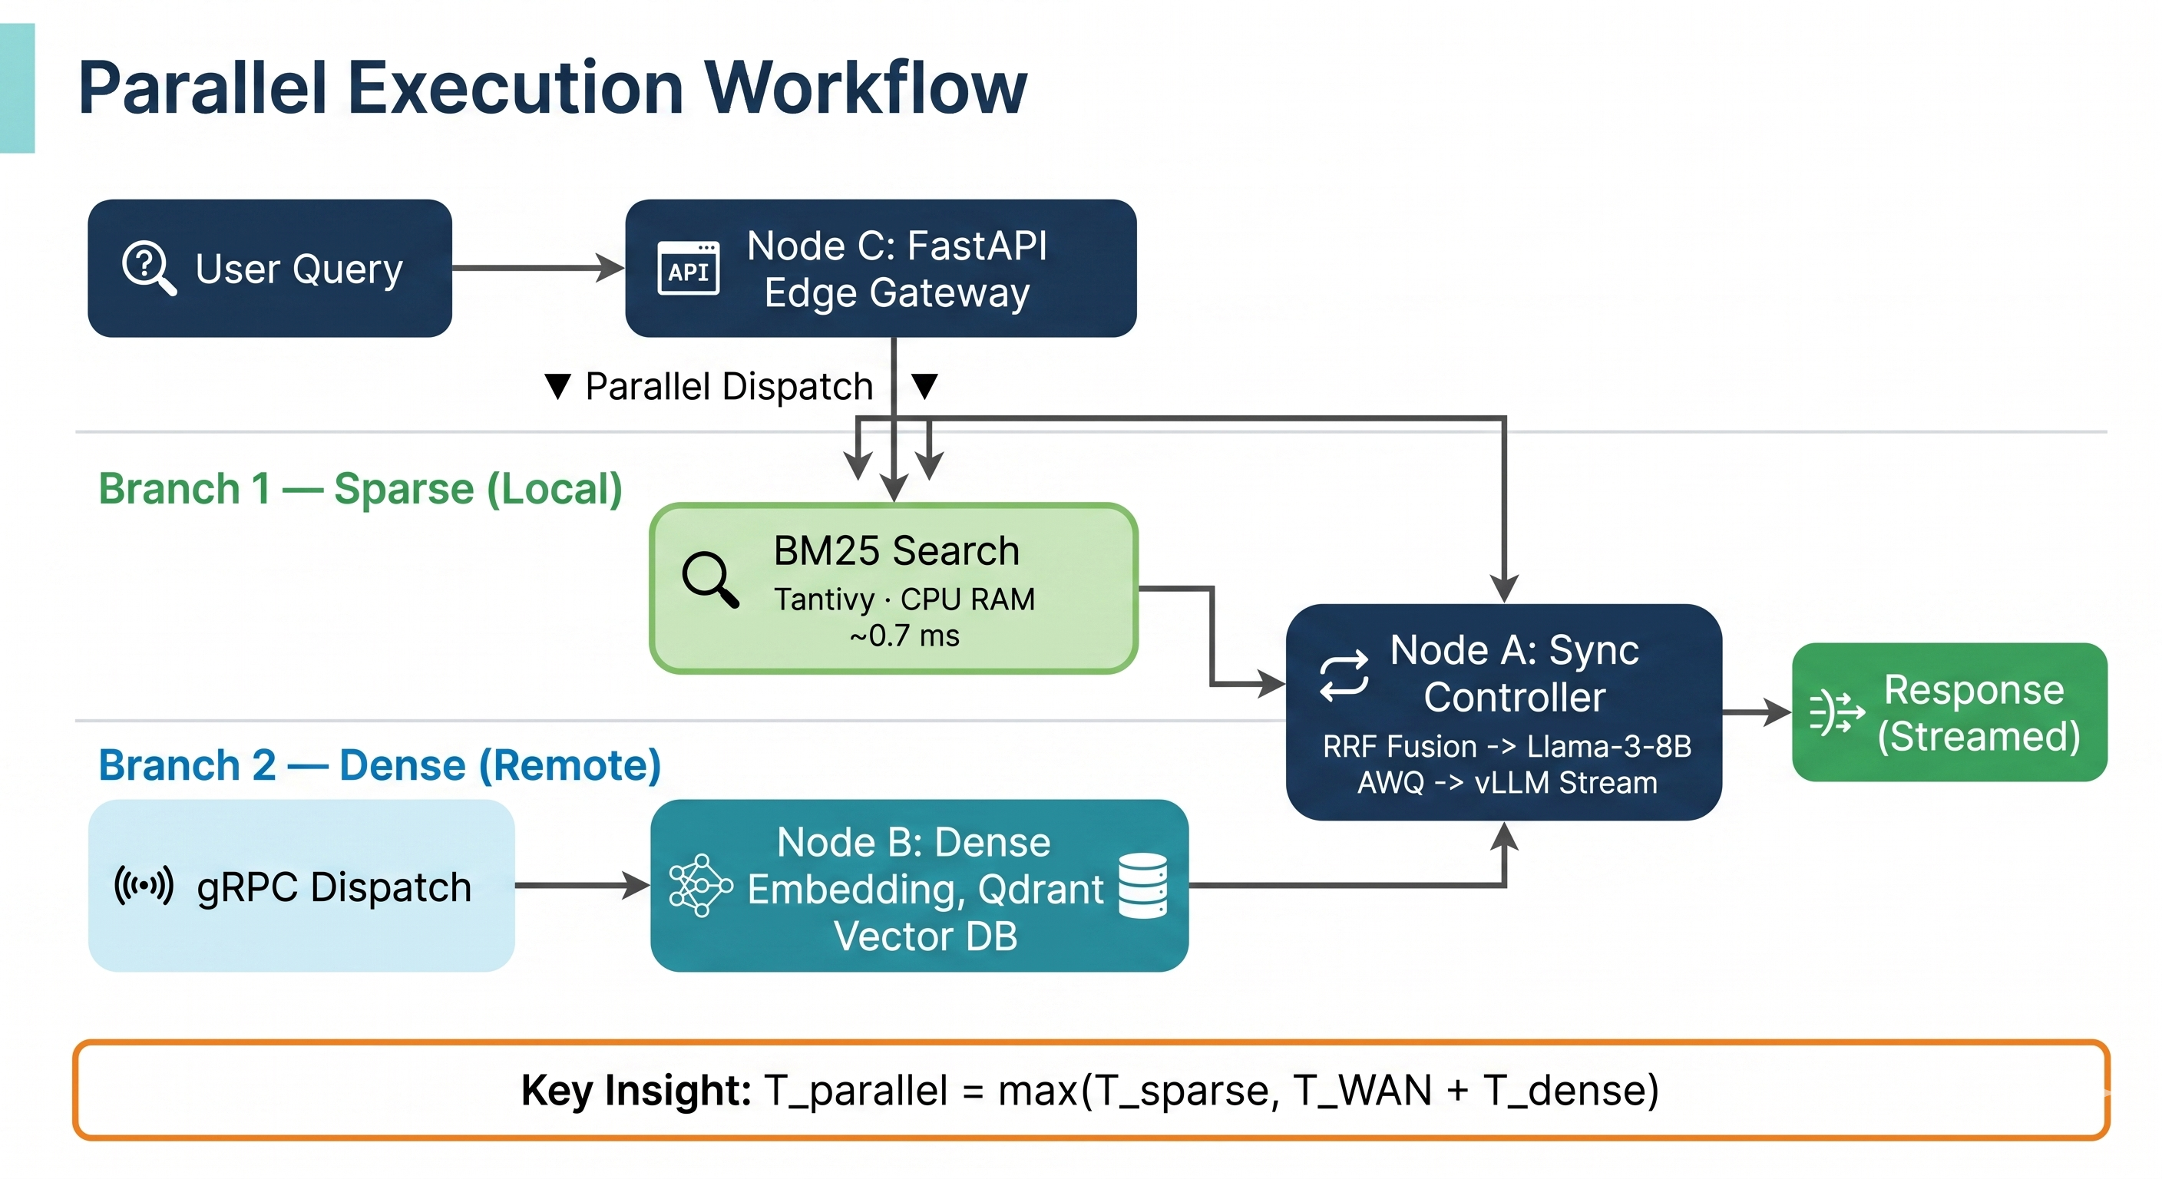
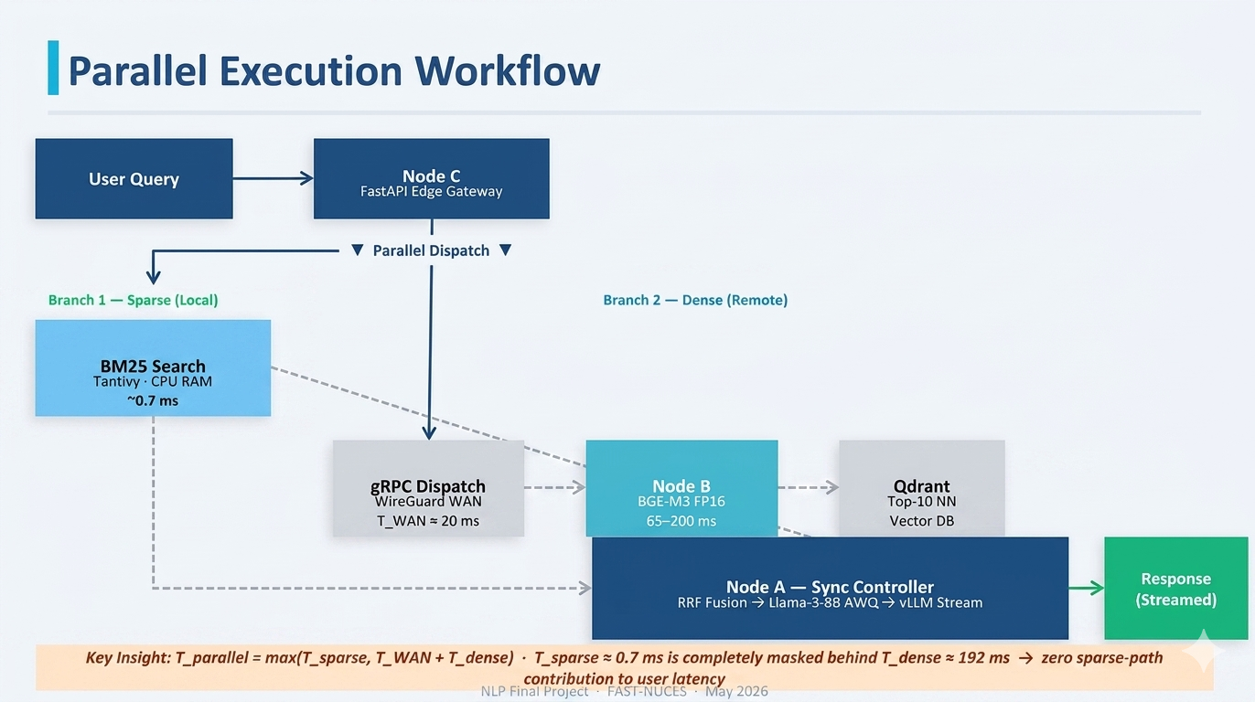
NLP&PDC Final Project · FAST-NUCES · May 2026
Notes:
SPEAKER 1 — M. Abdullah Ali
Here is the core innovation visualized. Let me walk you through it step by step.
When a user query arrives at Node C's FastAPI gateway, Node C performs what we call a Parallel Dispatch: it launches two branches simultaneously at the exact same instant.
Branch 1, the sparse branch, stays entirely local. Node C runs a BM25 keyword search against an in-memory Tantivy inverted index. This completes in approximately 0.7 milliseconds.
Branch 2, the dense branch, goes remote. Node C dispatches a non-blocking gRPC call over our WireGuard VPN to Node B. Node B computes a BGE-M3 neural embedding, queries Qdrant for the top-10 nearest neighbors, and sends results directly to Node A over the fast home LAN. This entire remote branch takes approximately 192 milliseconds.
Node A is the Synchronization Controller. It receives sparse results from Node C and dense results from Node B, waits for both, applies Reciprocal Rank Fusion to produce a unified ranked context, and feeds that into Llama-3-8B for generation.
The key insight is at the bottom: T-parallel equals the maximum of T-sparse and T-WAN plus T-dense. Since 0.7 milliseconds is three orders of magnitude smaller than 192 milliseconds, the sparse branch contributes zero to the user-visible latency. It is completely free.

Slide 7
Challenges Faced During Implementation
01 — GPU Cold-Start Penalty
02 — VRAM Constraint (AWQ Quantization)
PROBLEM
PROBLEM
Problem: PyTorch and CUDA introduce significant JIT compilation overhead on the first forward pass, inflating dense retrieval latency from ~100 ms (warm) to over 700 ms on the very first request — unacceptable for live evaluation.
Problem: The Llama-3-8B-Instruct model in FP16 requires approximately 16 GB of VRAM. Node A's RTX 3080 has only 10 GB — a 6 GB shortfall that makes direct loading impossible.
SOLUTION
SOLUTION
Solution: Engineered a blocking GPU warm-up routine that submits a synthetic dummy query to BGE-M3 during Node B server initialisation, before port 50051 is opened to live traffic. All live requests thereafter hit the pre-warmed CUDA path.
Solution: Applied AWQ (Activation-aware Weight Quantization) with 4-bit precision. AWQ analyzes per-channel activation magnitudes to protect the most salient weights before quantization, preserving model quality better than uniform INT4. Result: 5.34 GB footprint — a 3× compression — leaving 4.66 GB (939 GPU blocks) for the KV-cache.
NLP&PDC Final Project · FAST-NUCES · May 2026
Notes:
SPEAKER 2 — M. Abdullah Aamir
Let me walk you through the two major engineering challenges we had to solve.
Challenge one was the GPU cold-start penalty. When PyTorch and CUDA first initialize on a forward pass, there is significant JIT compilation overhead. In practice, the very first BGE-M3 inference was taking 790 milliseconds instead of the steady-state 65 to 200 milliseconds. Our solution was a blocking warm-up routine: we submit a synthetic dummy query to BGE-M3 during server startup, before port 50051 is opened to live traffic. This absorbs the cold-start penalty transparently. You can see in our evaluation data that the first WikiQA query still shows 790 milliseconds, but subsequent queries converge to steady-state within just a few requests — exactly as expected.
Challenge two was the VRAM constraint. Llama-3-8B in FP16 needs approximately 16 gigabytes of VRAM. Our RTX 3080 only has 10 gigabytes. We applied AWQ — Activation-aware Weight Quantization — which is a 4-bit quantization method that analyzes per-channel activation magnitudes to identify and protect the most salient weights before compressing. The result: the model occupies just 5.34 gigabytes — a 3 times compression — leaving 4.66 gigabytes available for the KV-cache, represented as 939 GPU blocks in vLLM.

Slide 8
Baseline Comparison: Sequential vs. Parallel
BASELINE — Sequential
PROPOSED — Parallel
T_sequential = T_sparse + T_WAN + T_dense
T_parallel = max ( T_sparse , T_WAN + T_dense )
① Run BM25 sparse search → wait ~0.7 ms
② Only then dispatch to Node B → wait T_WAN ≈ 20 ms
③ BGE-M3 dense compute → wait ~65–200 ms
④ Begin LLM generation
Total: additive sum of all delays — every stage queued
VS
① Dispatch BM25 + gRPC remote simultaneously
② Sparse completes in 0.7 ms — sits ready
③ Dense branch dominates at ~192 ms (critical path)
④ Node A receives both, fuses via RRF, generates
Fallback: If Node B times out → speculative prefill on sparse context alone (zero user-visible stall)
Empirical Result: Sparse path contributes 0 ms to user-visible latency. Edge-TTFT consistently 190–195 ms across 100 WikiQA queries — dominated entirely by the remote dense branch.
NLP&PDC Final Project · FAST-NUCES · May 2026
Notes:
SPEAKER 2 — M. Abdullah Aamir
Now let me make the performance benefit concrete by directly comparing our approach against the baseline.
In the sequential baseline, every stage is queued: you wait for sparse search to finish, then you wait for the WAN round-trip, then you wait for dense compute, and only then does generation begin. The total is a sum of all delays.
In our parallel approach, the mathematical model changes fundamentally: T-parallel equals the maximum of T-sparse and T-WAN plus T-dense. Since T-sparse is 0.7 milliseconds and the remote branch is 192 milliseconds, the sparse path contributes absolutely nothing to user-visible latency. It is structurally masked.
We also implemented an important resilience feature that the baseline lacks entirely: if Node B does not respond within a dynamic timeout threshold, Node A does not stall. Instead, it immediately proceeds with a "speculative prefill" using only the sparse context, generating a complete response without any interruption. This fallback was triggered during our actual 100-query evaluation run and worked correctly — the user would have seen no difference.
The bottom line: empirically confirmed across 100 WikiQA queries, our Edge Time-to-First-Token was consistently 190 to 195 milliseconds, with zero contribution from the sparse path.

Slide 9
Results: Latency & Throughput
Metric | Observed Value
BM25 Sparse Retrieval (T_sparse) | 0.6 – 0.8 ms
Dense Retrieval Steady State (T_dense) | 65 – 200 ms
Dense Retrieval — First Query (cold GPU) | 790.6 ms
Edge-TTFT (user-visible, 100 queries) | 190 – 195 ms
T_sparse contribution to critical path | 0 ms (fully masked)
AWQ VRAM footprint · Generation throughput | 5.34 GB · 65 – 82 tok/s
NLP&PDC Final Project · FAST-NUCES · May 2026
Notes:
SPEAKER 1 — M. Abdullah Ali
Now for the results. Let me take you through the latency and throughput data.
The bar chart on the left shows our local microbenchmark — 50 queries with WAN delay artificially disabled, purely measuring the async scheduling overhead. Sequential averaged 3.16 milliseconds; parallel averaged 2.80 milliseconds — an 11.4% improvement even without any real network benefit. This validates that our async architecture itself adds no overhead.
The line chart on the right shows generation throughput across the 100-query WikiQA evaluation. The lower line shows prompt throughput starting low as the GPU warms up and converging around 65 tokens per second. The upper line shows generation throughput consistently in the 66 to 82 tokens per second range. This confirms that AWQ quantization does not materially degrade the decode performance on the RTX 3080.
The table below summarizes the key measurements. The most important row is the final one in the latency section: T-sparse contribution to the critical path is zero milliseconds — fully masked. The Edge Time-to-First-Token is 190 to 195 milliseconds across all 100 queries. Our mathematical model is empirically confirmed.

Slide 10
Results: WikiQA End-to-End Accuracy
Exact Match (EM) = 0.00
Llama-3-8B-Instruct is an instruction-following model trained to produce conversational sentences — e.g. "The answer is X, because..." — rather than bare substrings. Exact character match is structurally impossible regardless of factual correctness.
0.22
F1 Score
F1 = 0.22 — What it means
Token-level overlap confirming the model grounds answers in retrieved context.
Several questions achieved F1 > 0.65; maximum individual F1 = 0.80.
Low aggregate F1 driven primarily by limited Qdrant index scope — questions whose relevant passages were not indexed receive near-zero retrieval recall.
Conclusion: The retrieval pipeline is working. When the correct passage is retrieved, the model produces factually grounded, high-F1 responses. Broader indexing = higher F1.
NLP&PDC Final Project · FAST-NUCES · May 2026
Notes:
SPEAKER 1 — M. Abdullah Ali
Now let me address the accuracy results and, importantly, the correct interpretation of these numbers.
We evaluated on 100 questions from the WikiQA validation set using two standard metrics: Exact Match and token-level F1 score.
The Exact Match score is zero. This might look alarming, but it is expected and correct. Llama-3-8B-Instruct is an instruction-following model — it is trained to produce helpful, conversational answers like "The answer is X, because..." rather than extracting a bare substring. Exact character match against a three-word ground truth answer is structurally impossible for any instruction-tuned generative model, regardless of whether the model's answer is factually correct.
The F1 score of 0.22, on the other hand, measures token-level overlap between the model's output and the ground truth. An F1 of 0.22 across 100 diverse questions confirms that the model is grounding its responses in the retrieved context. More importantly, several individual questions achieved F1 scores above 0.65, with a maximum of 0.80. These are cases where the retriever surfaced the correct passage and the model produced a highly accurate response.
The bottleneck in accuracy is the scope of our Qdrant index, not the retrieval mechanism or generation quality. With a broader knowledge base — for example, a full Wikipedia index — the pipeline's accuracy would improve substantially. The architecture is proven; the index coverage is a data scope limitation.

Slide 11
Conclusion
Latency Masking Confirmed
BM25 sparse retrieval completes in 0.7 ms and contributes zero milliseconds to the user-visible critical path. Edge-TTFT is 190–195 ms, dominated entirely by the remote dense branch.
Fault Tolerance Proven
The Active Inference fallback was triggered under real network conditions and delivered a complete generation with no user-visible stall — a capability absent from sequential RAG architectures.
Hardware Efficiency Achieved
AWQ 4-bit quantization compressed Llama-3-8B from 16 GB to 5.34 GB (3× compression) with no material degradation to generation throughput (65–82 tokens/s).
Future Work
Enable awq_marlin kernel for additional throughput · Extend to MS MARCO MRR@10 · Multi-user concurrent batching · Online bandit-based adaptive scheduler replacing static timeout.
Thank you — We are ready for your questions and the live demonstration.
Notes:
SPEAKER 2 — M. Abdullah Aamir
Let me close with our key conclusions.
First, and most importantly, the latency masking model is empirically confirmed. T-parallel equals max of T-sparse and T-WAN plus T-dense. BM25 completes in 0.7 milliseconds and contributes zero to user-visible latency. Our Edge Time-to-First-Token is 190 to 195 milliseconds across 100 queries — dominated entirely by the remote dense branch, exactly as our model predicts.
Second, fault tolerance is proven under real conditions. The Active Inference fallback was triggered during evaluation — a genuine network degradation event — and the system delivered a complete response without any user-visible interruption. Sequential pipelines cannot do this; a timeout anywhere stalls everything.
Third, hardware efficiency is achieved. AWQ compressed a 16-gigabyte model to 5.34 gigabytes with no material impact on the 65 to 82 tokens per second generation throughput.
For future work: we plan to enable the awq_marlin kernel for additional throughput on the RTX 3080, extend evaluation to MS MARCO for retrieval quality metrics, implement multi-user concurrent batching, and replace the static timeout with an online bandit-based adaptive scheduler.
[BOTH SPEAKERS]: Thank you, Professor. We are ready for your questions and we have a live demonstration available if needed.

