Slide 1
Insurance
Management System
Developed in PHP & MySQL

Slide 2
Abstract
PROJECT TITLE : Insurance Management System
APPLICATION TYPE: Web Application
DESCRIPTION
The main purpose of this project is to estimate some important statistics of Micro insurance in the current market of India by gathering and analyzing data which is available. The statistics will be useful to prepare better insurance plans to boost up the Life Insurance industry in India.
MODULES
Admin module: This module allows only registered members to log in and manage the users and article.
users module: This module allows to known the premium details of the users and product details.

Slide 3
Introduction
This web site is an online micro insurance Analysis and information management system that provides easy access of information regarding the people and resources of insurance. This site is not a static site but with wonderful dynamic facilities like search tools for insurance awareness articles, guidelines, illustrations through images for visitors. This site also provides several dynamic features.

Slide 4
Project Modules
In this project we use PHP and Mysql database. It has two module
1.User Module
2.Admin Module.

Slide 5
Admin Module
1. Dashboard: In this section admin can see all detail in brief.
2. Insurance Category: In this section admin can manage categories(add and update).
3. Insurance Subcategory: In this section admin can manage sub category(add and update).
4. Insurance Policy: In this section admin can manage insurance policy(add and update policy).
5. User Detail: In this section admin can manage all user detail.
6. Policy Holders: In this section admin can manage all insured policy. Admin can view policy on the basis of status(pending policy, approved policy and disapproved policy). Admin also can approve pending policy.
7. Tickets: In this section admin can view detail of issues raised by user and can also update remark on particular tickets.
8. Reports: In this section, admin generate between dates report of ticket generation and policy request.
9. Search: In this section, admin can search ticket and policy.
Admin can also update his profile and change his password

Slide 6
User Module
1. Dashboard: In this section, user can see all detail in brief.
2. Insurance : In this section, user can apply for policy and check his policy is approve or reject(which is done by admin).
3. Ticket: In this section, user can raise ticket against any complain and see status of his/her ticket
User can also update his/ her profile, change password and recover password.

Slide 7
Requirement Specification
Hardware Configuration:
Client Side
Server Side
RAM | 512 MB
Hard Disk | 10GB
Processor | 1.0 GHz
RAM | 1 GB
Hard Disk | 20GB
Processor | 2.0GHz

Slide 8
Continue.....
Software Requirement:
Client Side
Server Side
Web Browser | Google Chrome or any compatible browser
Operating System | Windows or any equivalent OS
Web Server | APACHE
Server side Language | PHP5.6 or above version
Database Server | MySQL
Web Browser | Google Chrome or any compatible browser
Operating System | Windows or any equivalent OS

Slide 9
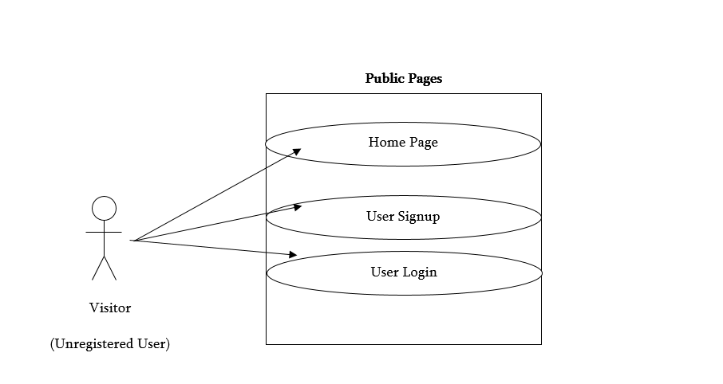
Use Case Diagram
Notes:
USECASE DIAGRAM: A Use case is a description of set of sequence of actions. Graphically it is rendered as an ellipse with solid line including only its name. Use case diagram is a behavioral diagram that shows a set of use cases and actors and their relationship. It is an association between the use cases and actors. An actor represents a real-world object. Primary Actor – Sender, Secondary Actor Receiver.

Slide 10
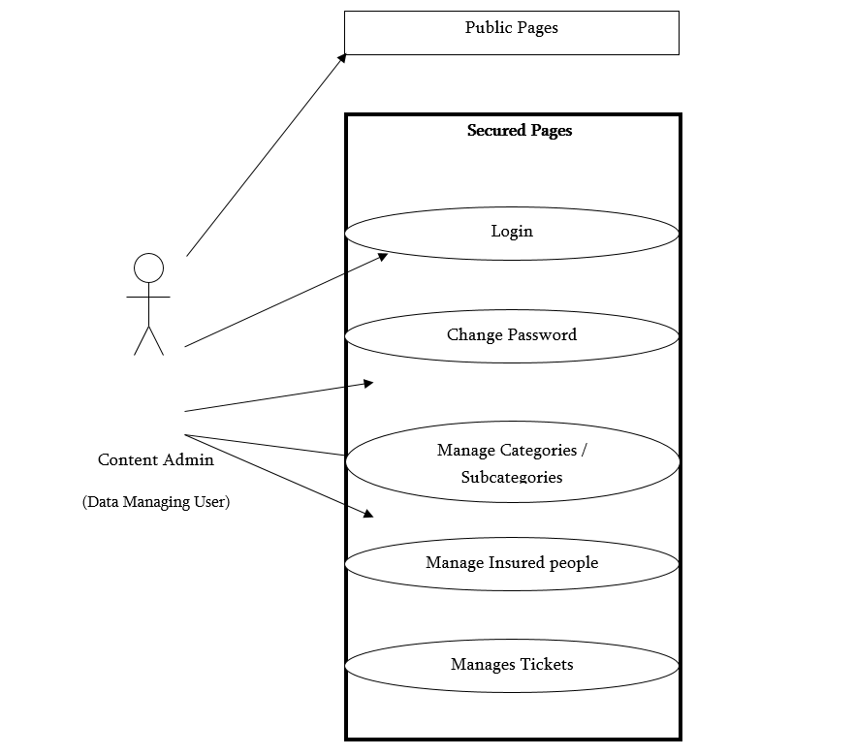

Slide 11
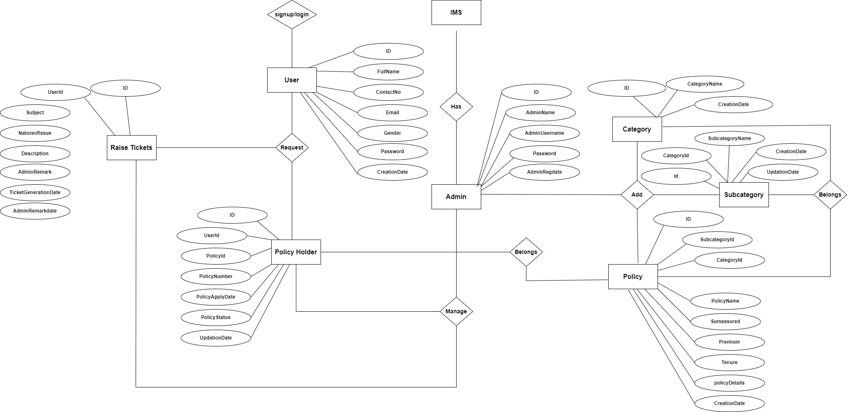
ER Diagram

Slide 12
Dataflow Diagrams (DFDs)
A Data Flow Diagram (DFD) is a traditional visual representation of the information flows within a system. A neat and clear DFD can depict the right amount of the system requirement graphically. It can be manual, automated, or a combination of both.
It shows how data enters and leaves the system, what changes the information, and where data is stored.
The objective of a DFD is to show the scope and boundaries of a system as a whole. It may be used as a communication tool between a system analyst and any person who plays a part in the order that acts as a starting point for redesigning a system. The DFD is also called as a data flow graph or bubble chart.

Slide 13
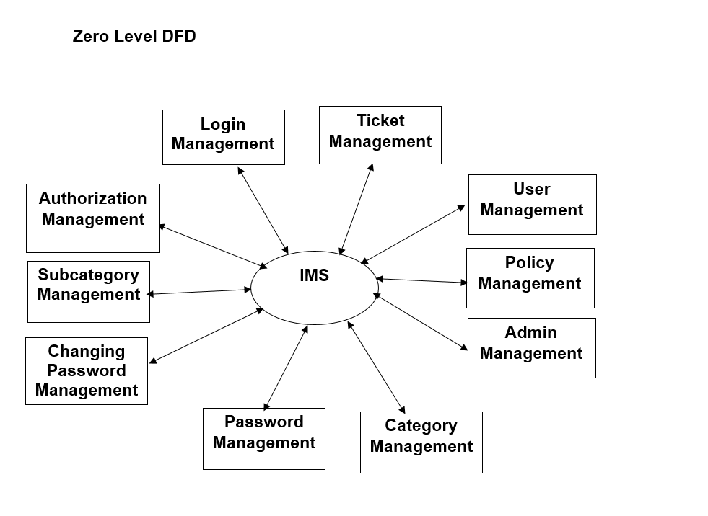

Slide 14
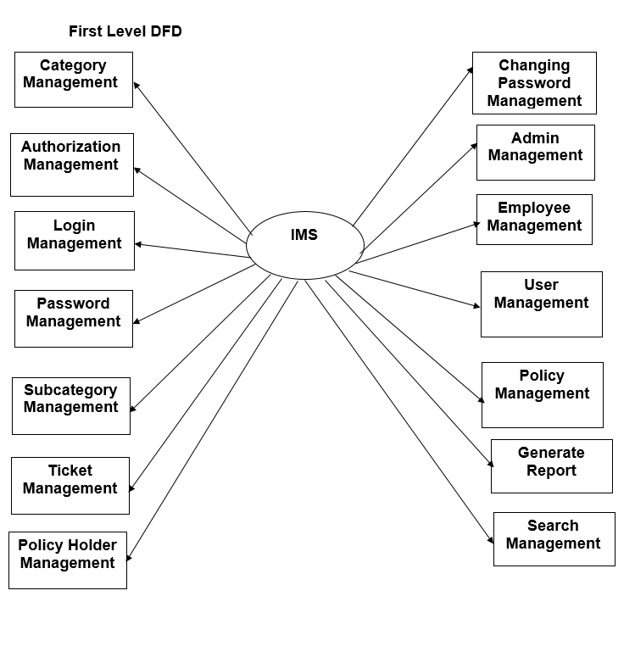

Slide 15
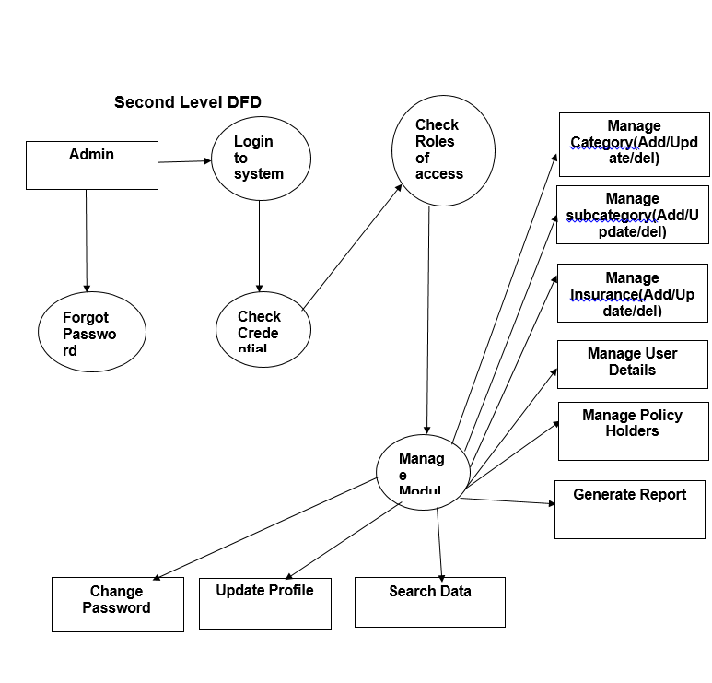

Slide 16
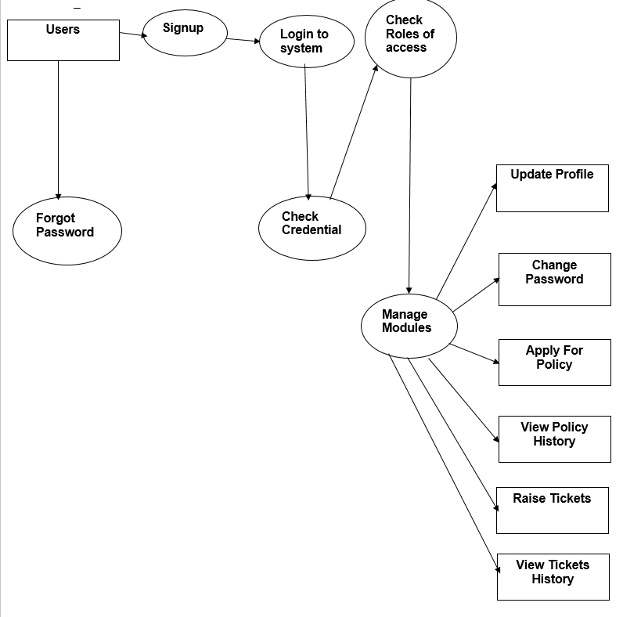

Slide 17
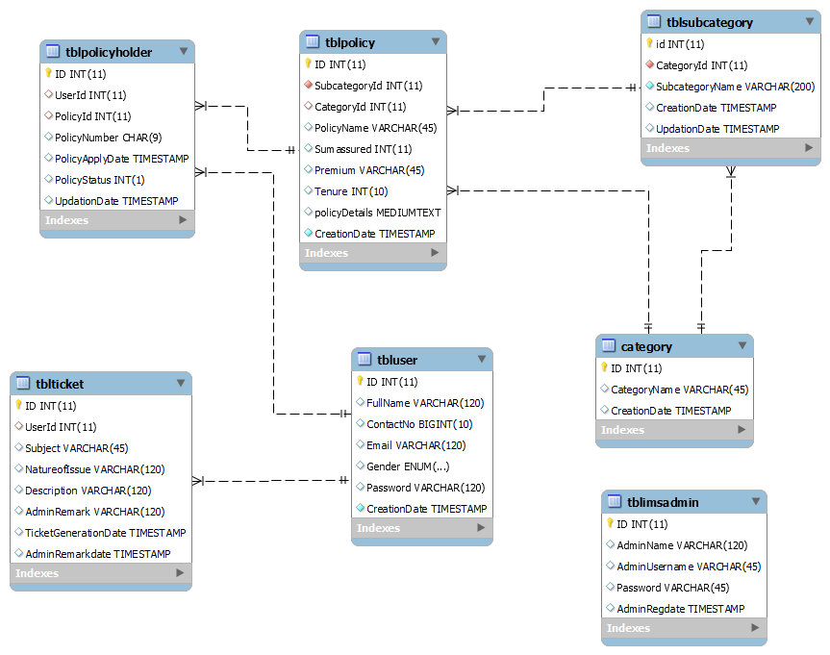
Class Diagram
Notes:
The class diagram shows a set of classes, interfaces, collaborations and their relationships.

Slide 18
Implementation and
System Testing
After all phase have been perfectly done, the system will be implemented to the server and the system can be used.
System Testing
The goal of the system testing process was to determine all faults in our project .The program was subjected to a set of test inputs and many explanations were made and based on these explanations it will be decided whether the program behaves as expected or not. Our Project went through two levels of testing
Unit testing
Integration testing

Slide 19
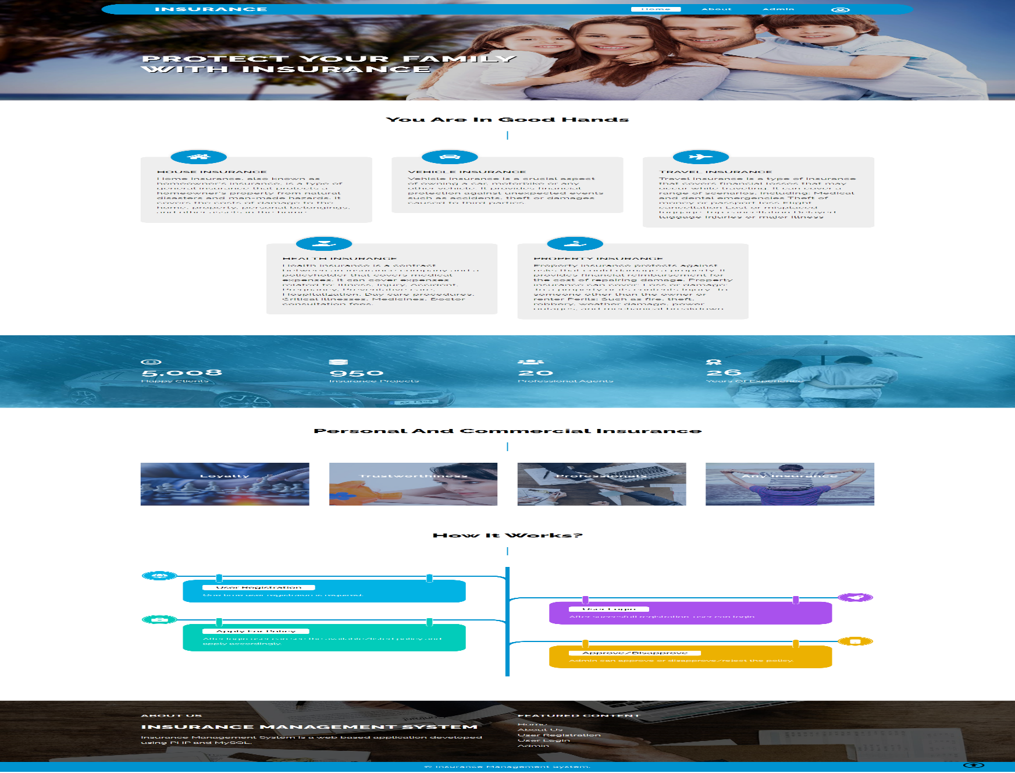
Project Screens

Slide 20
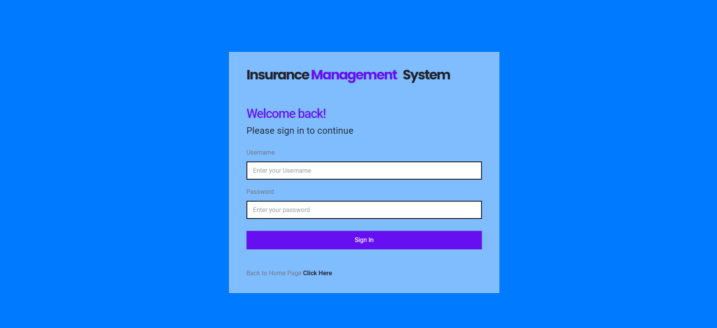
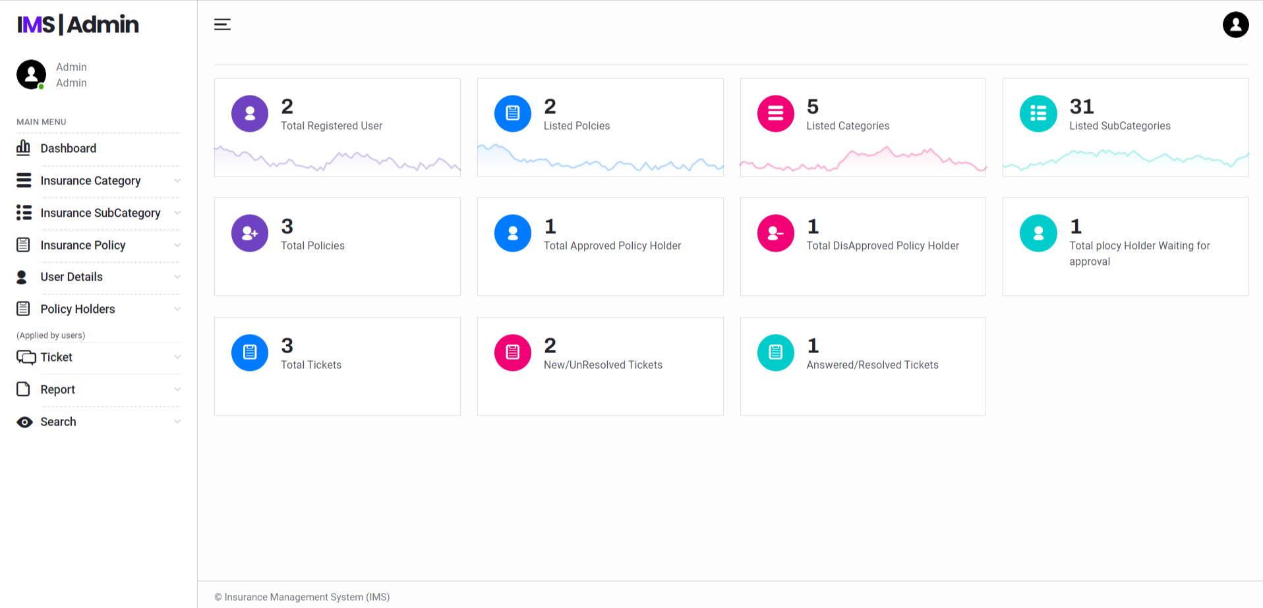

Slide 21
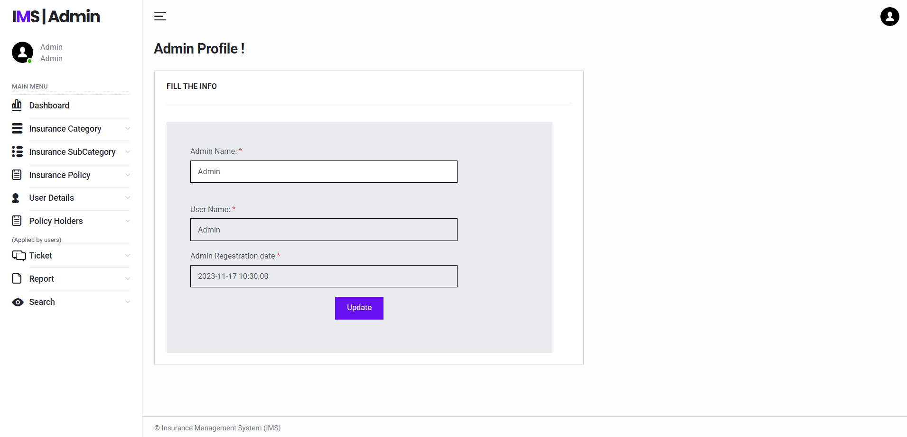
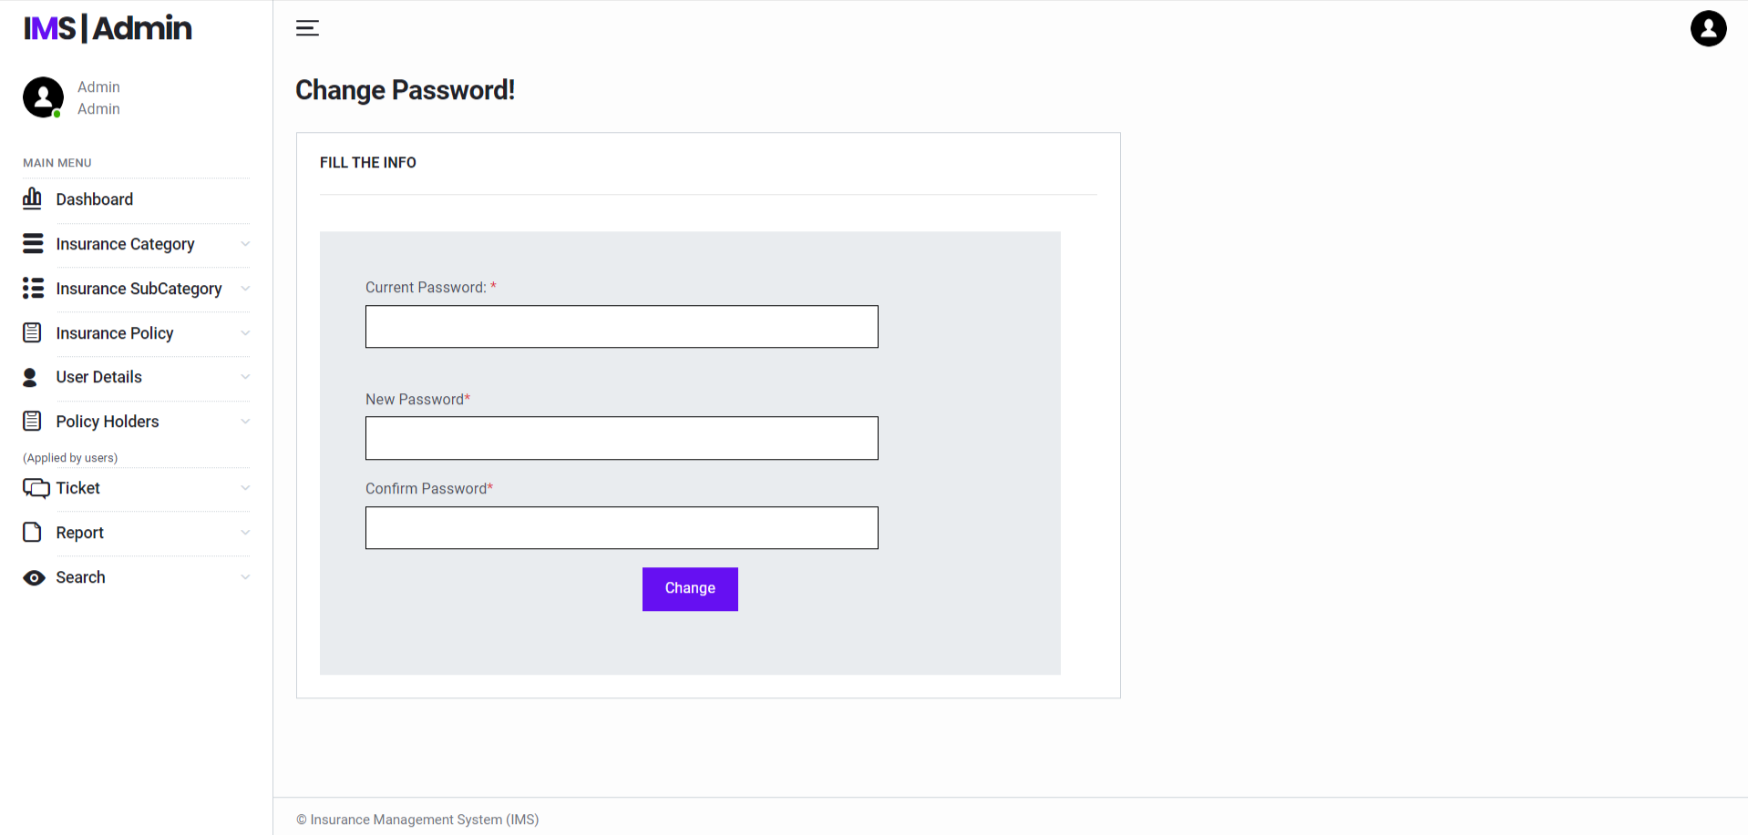

Slide 22
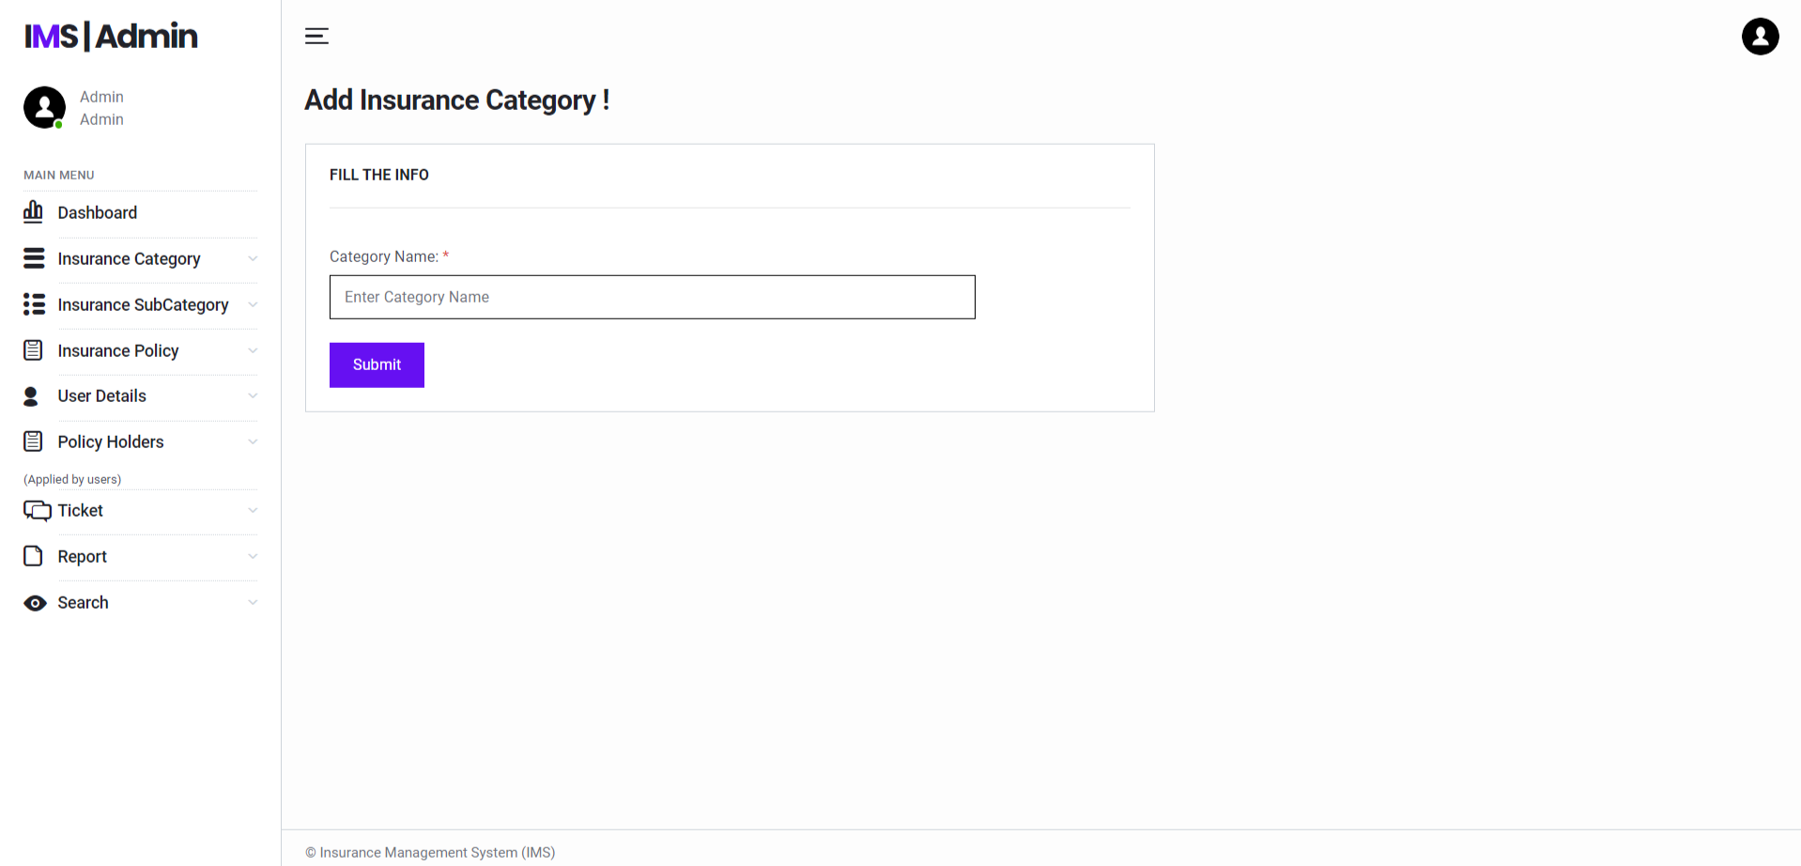
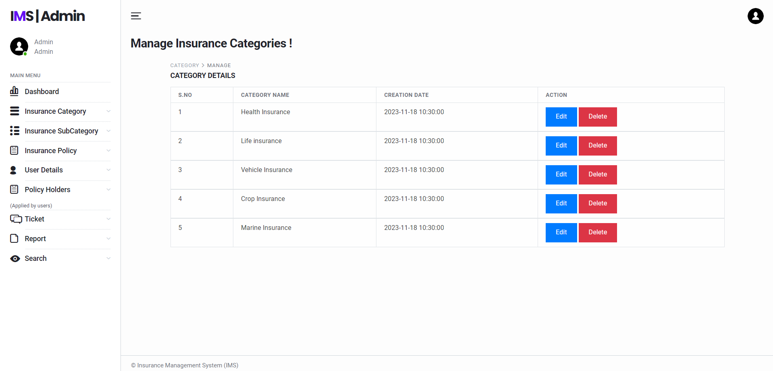

Slide 23

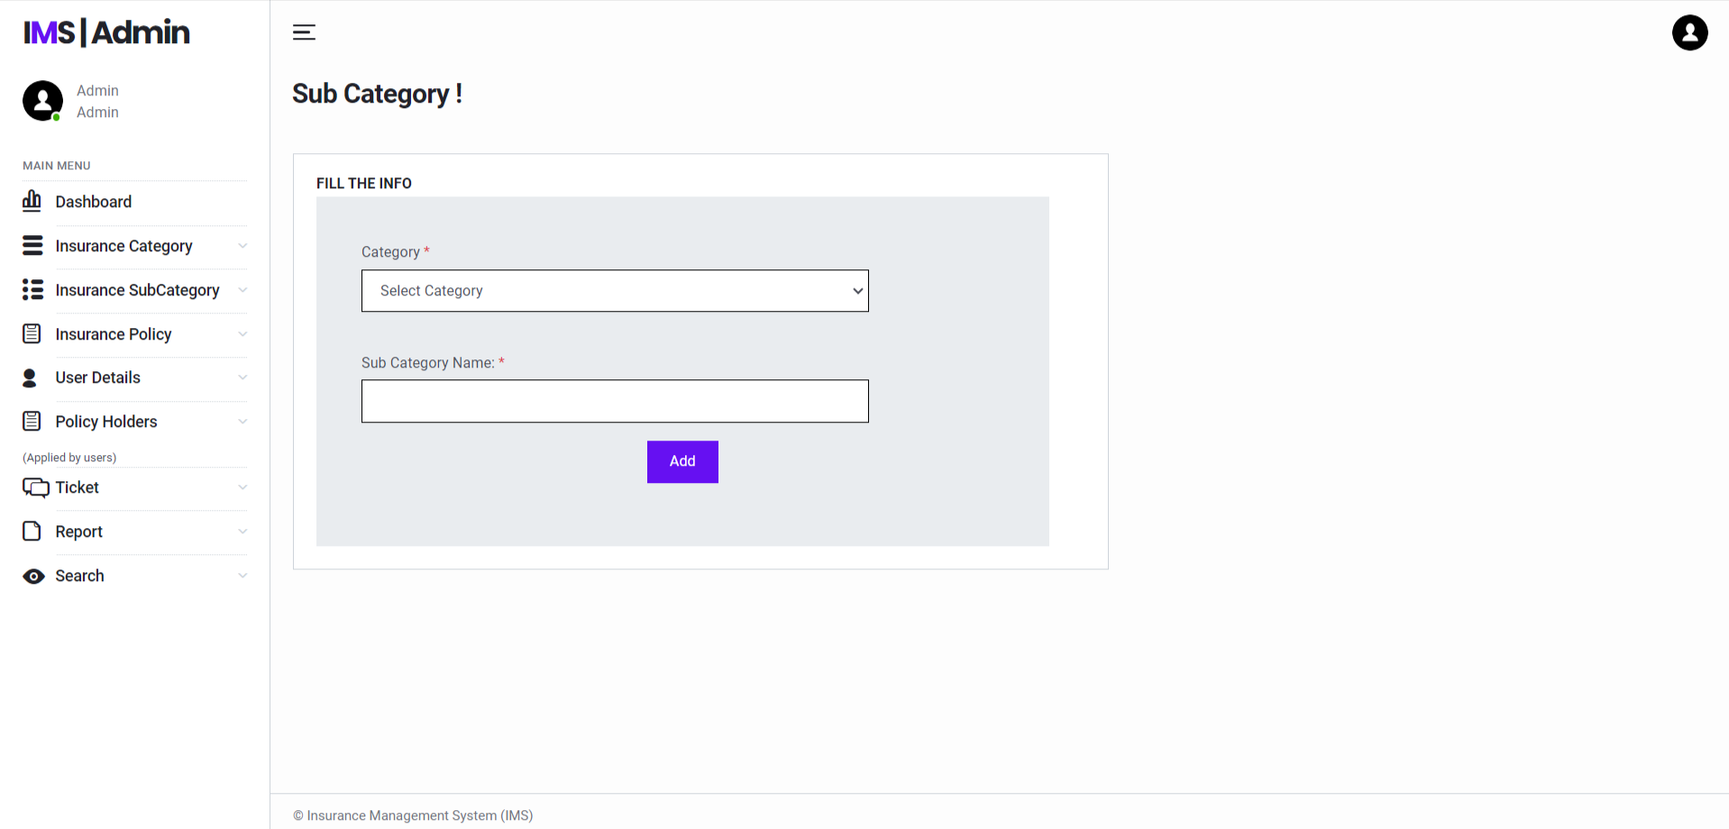

Slide 24
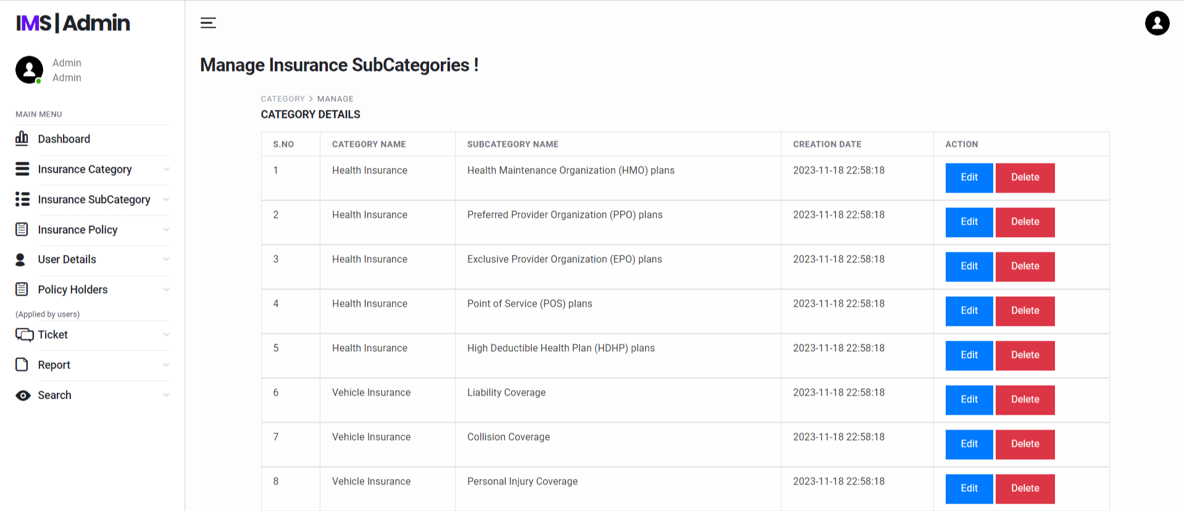
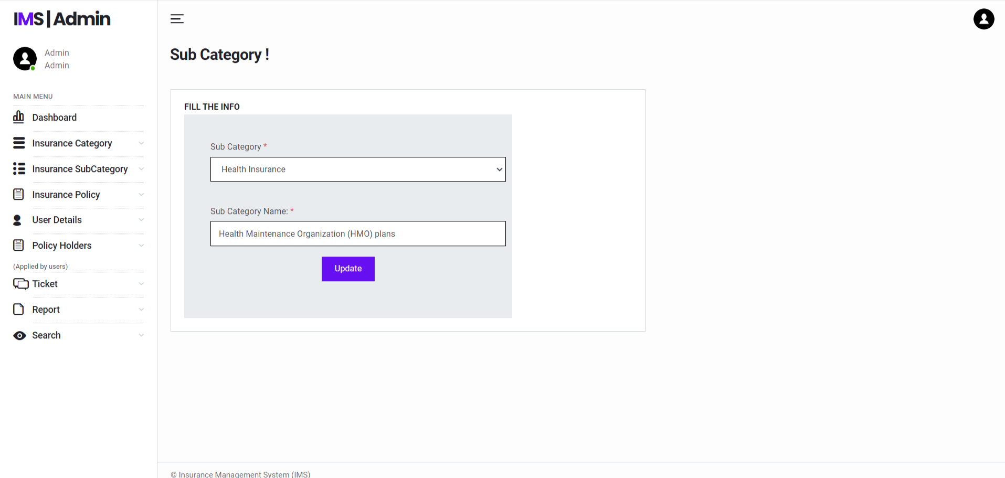

Slide 25
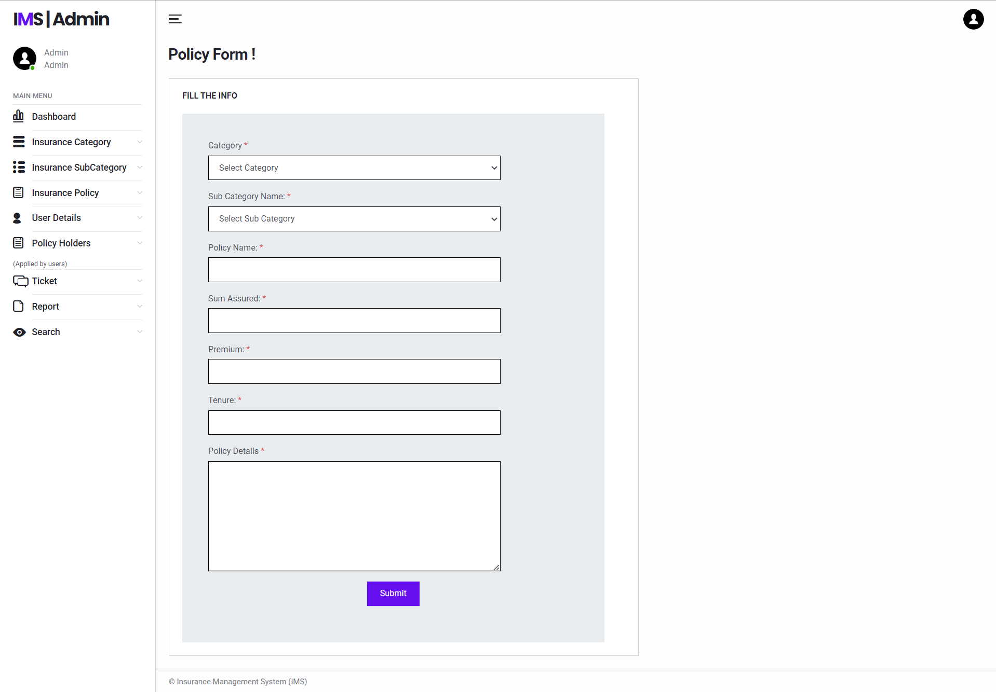
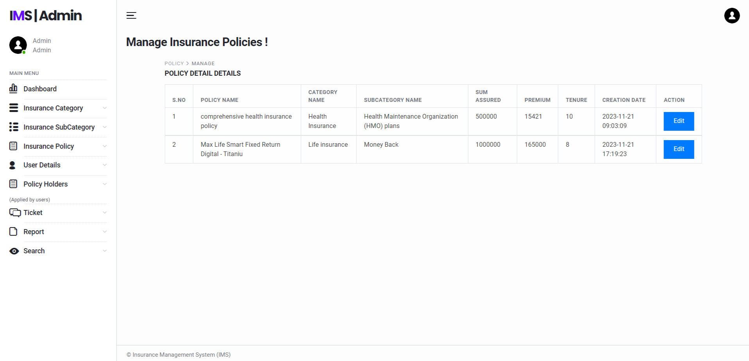

Slide 26
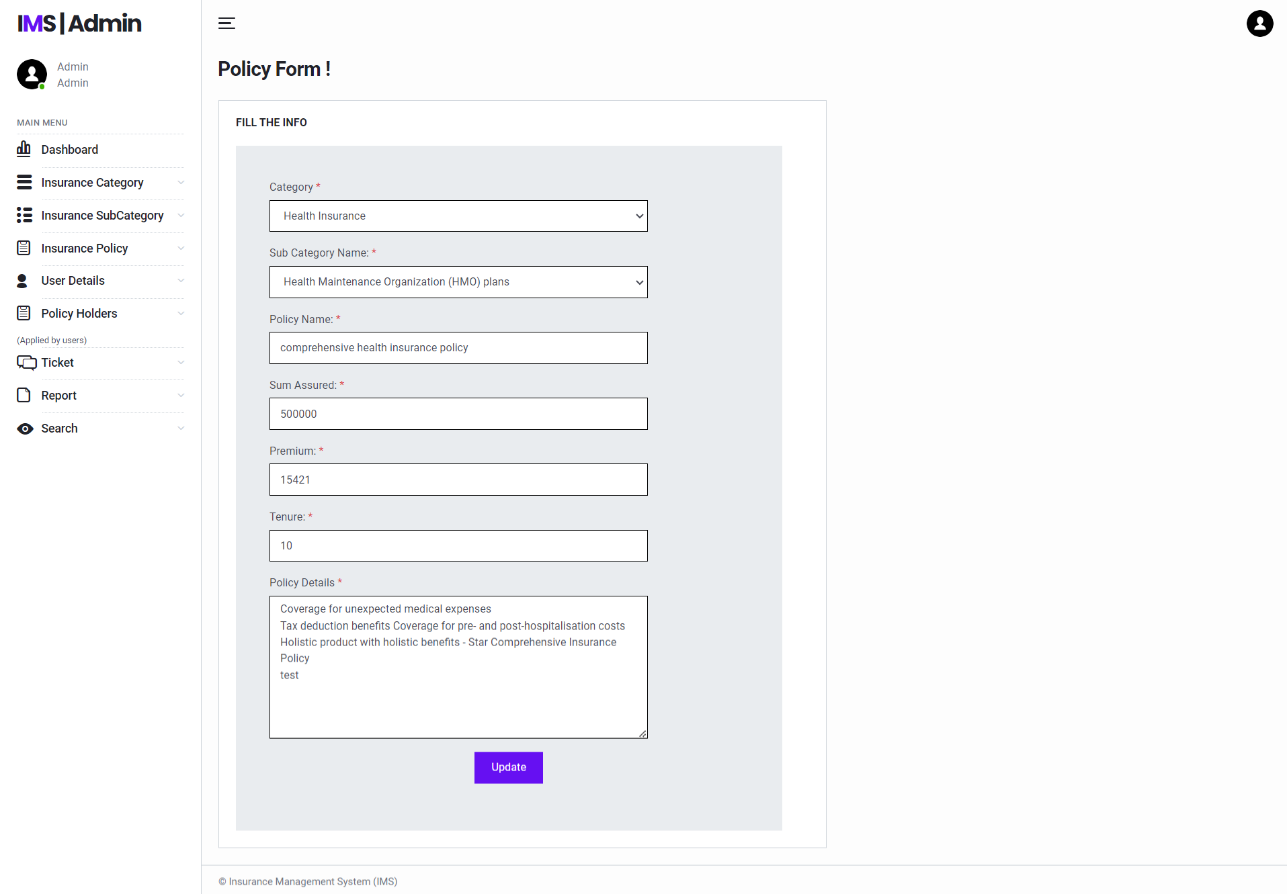
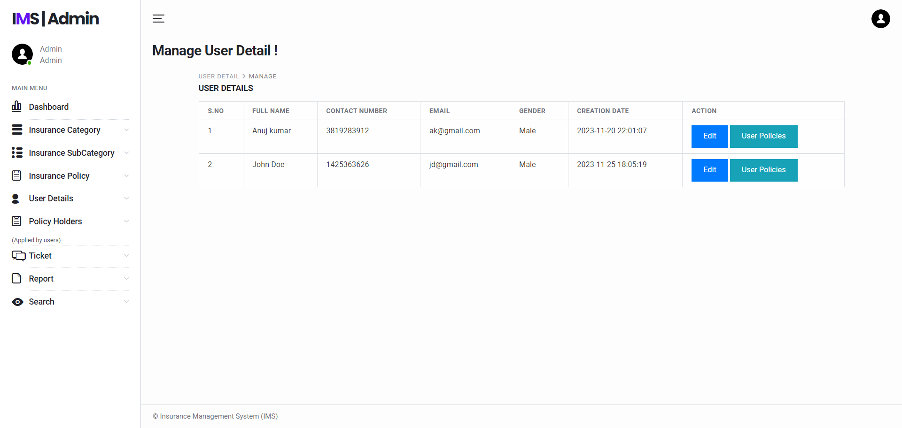

Slide 27
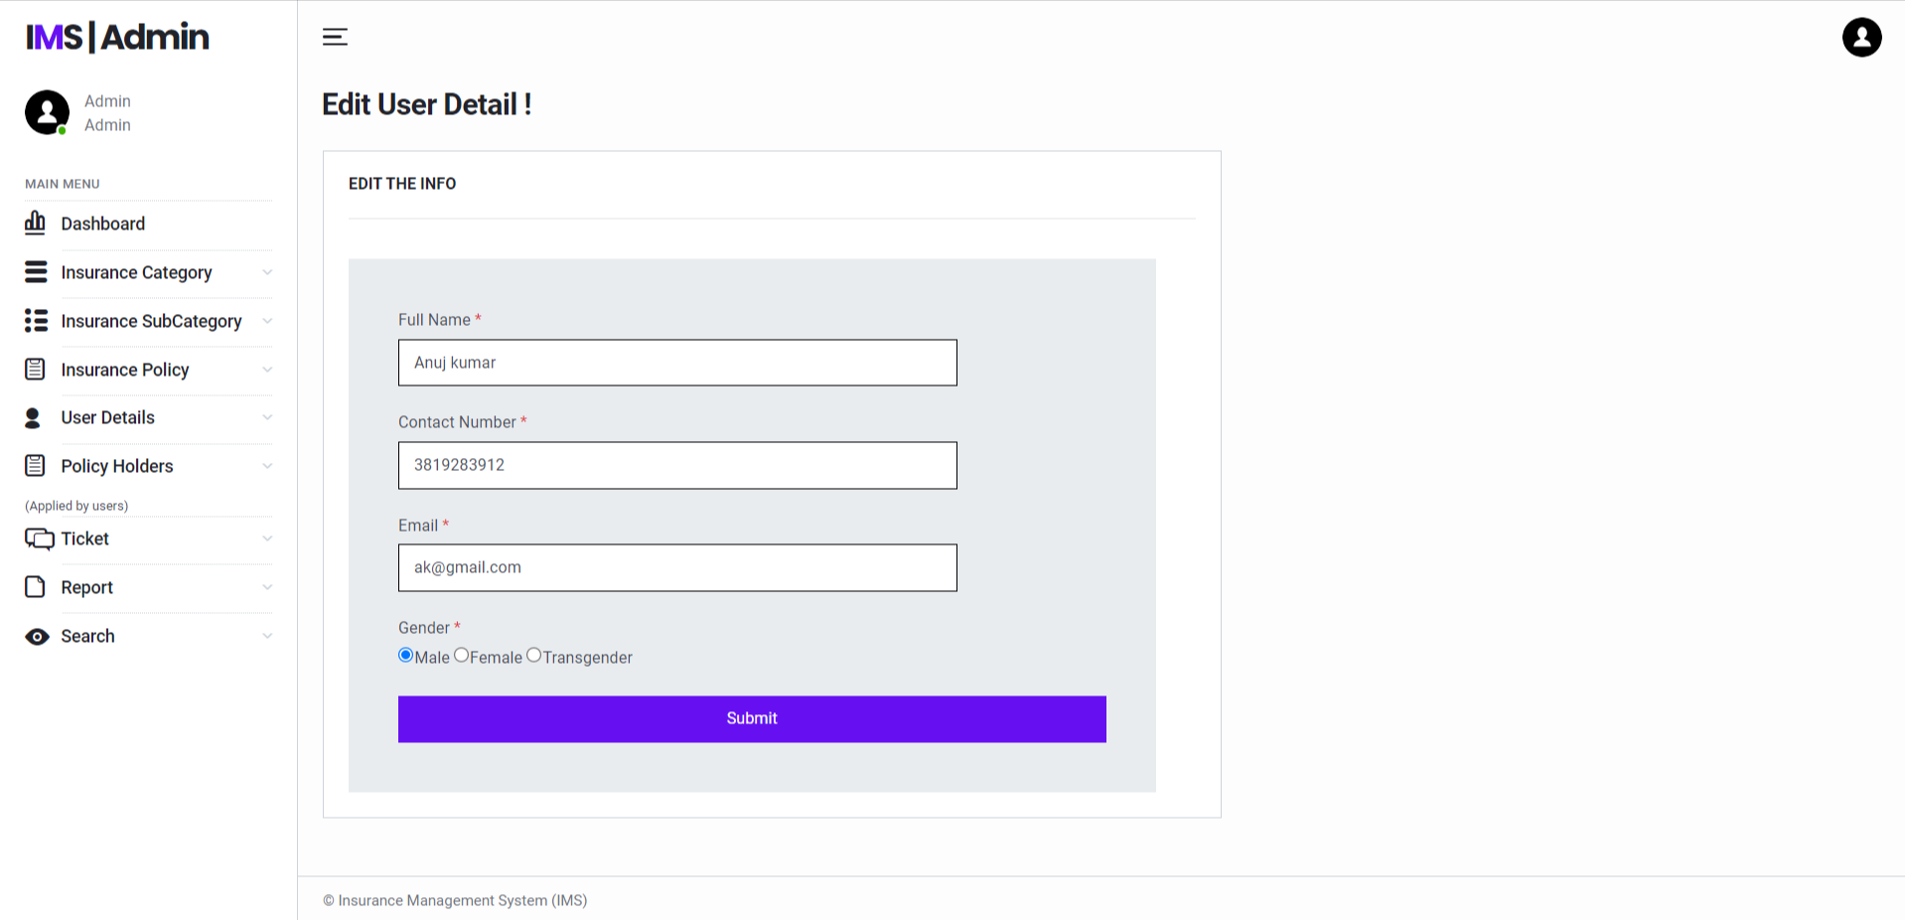
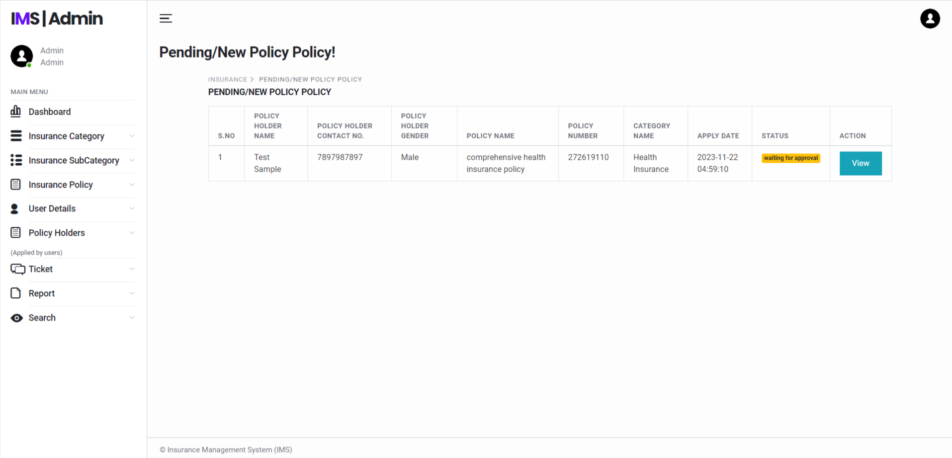

Slide 28
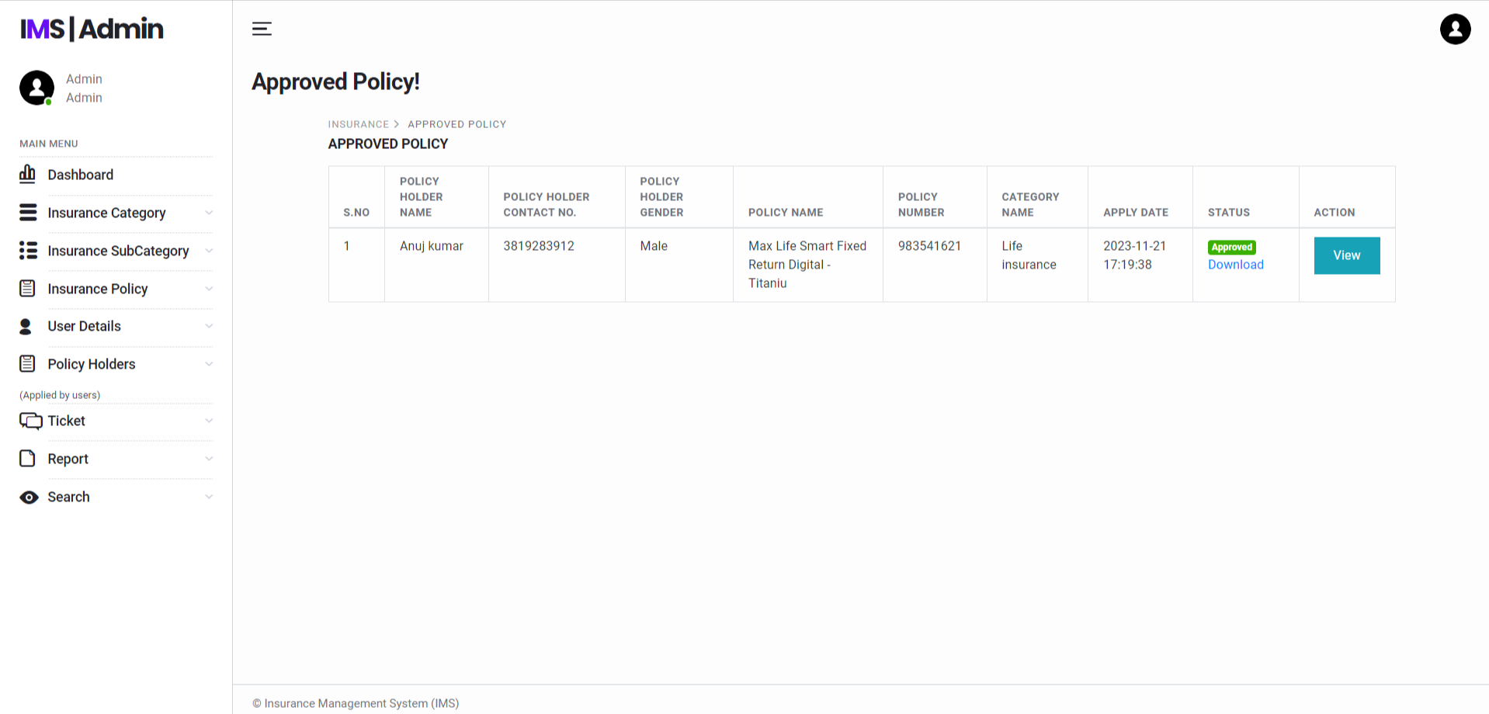
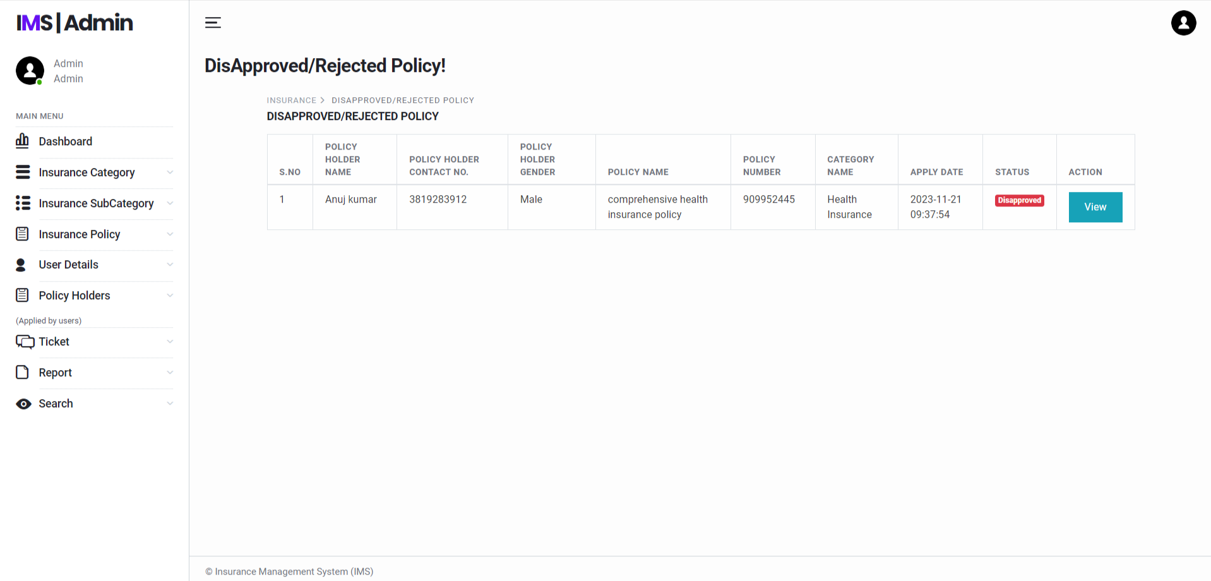

Slide 29
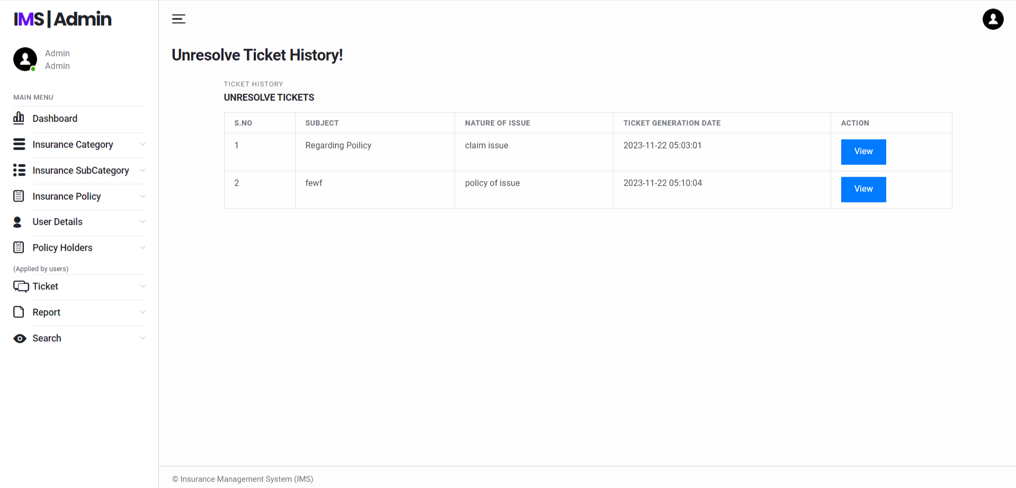
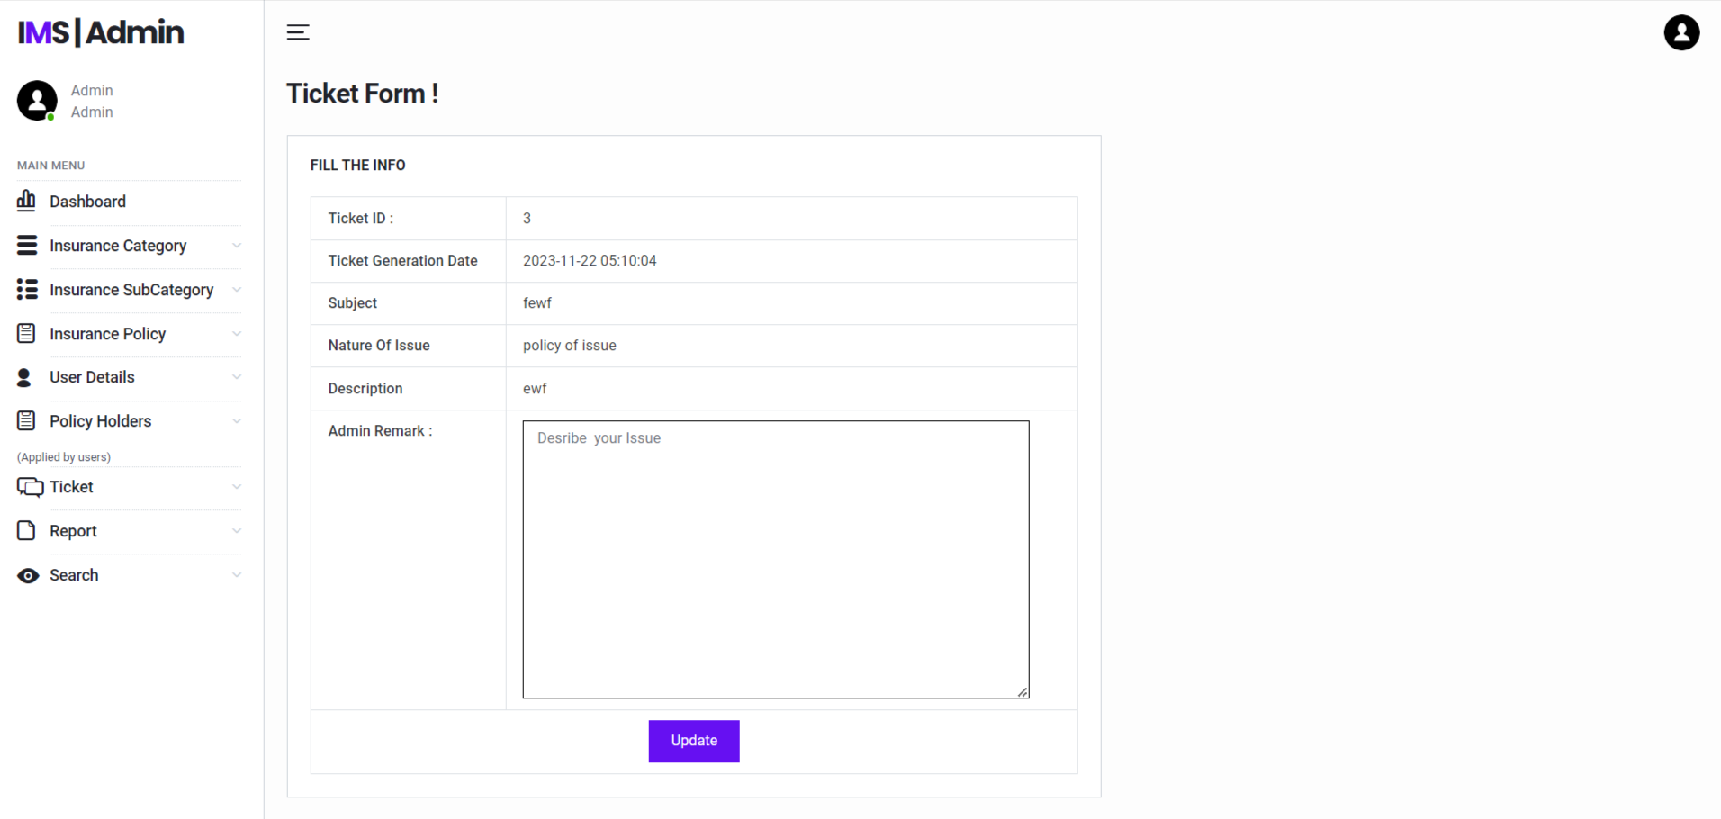

Slide 30
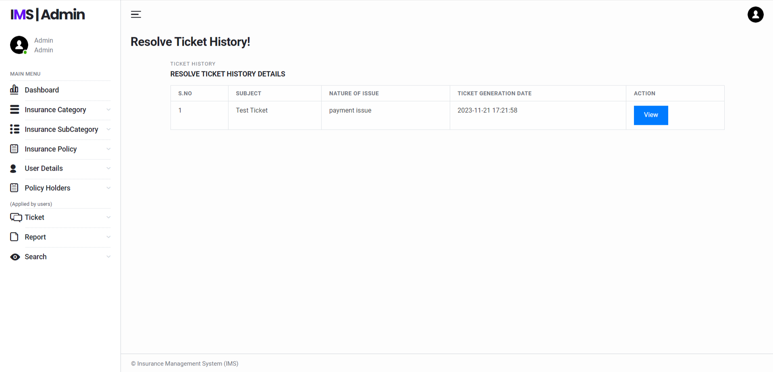
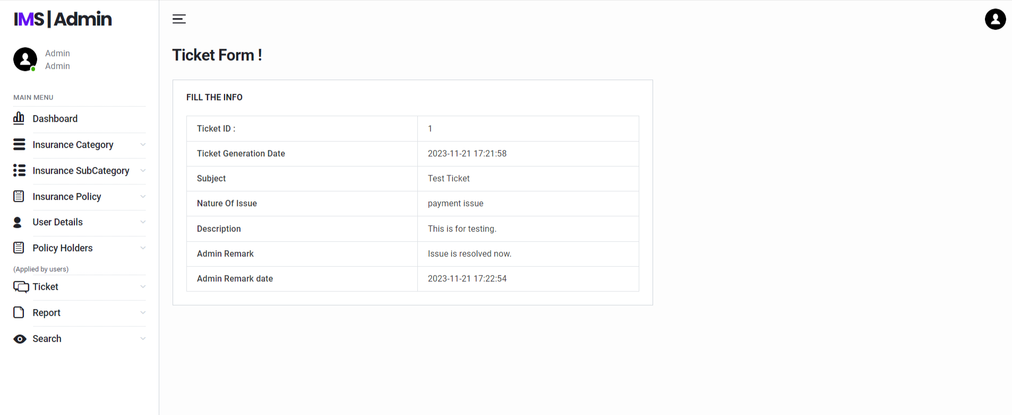

Slide 31
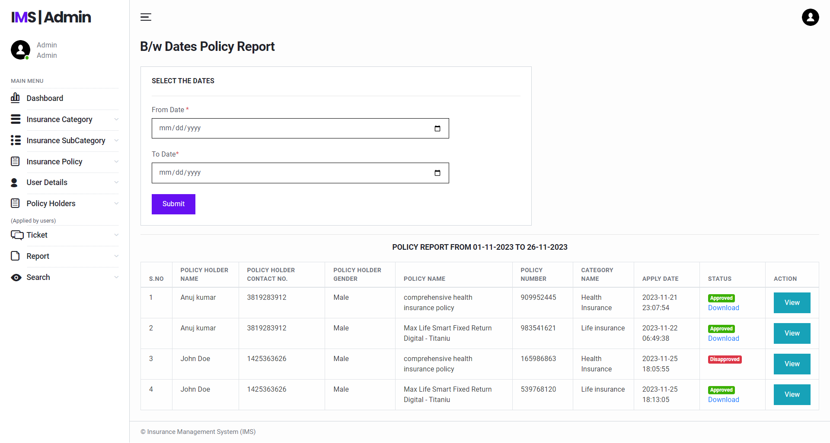
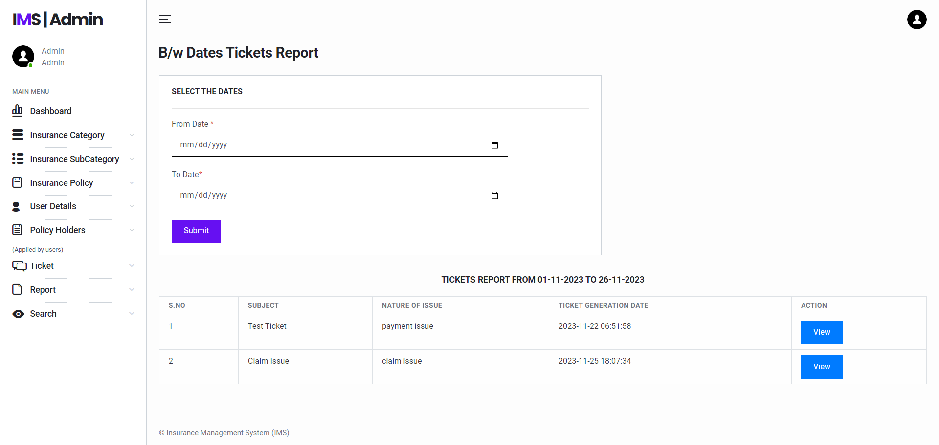

Slide 32
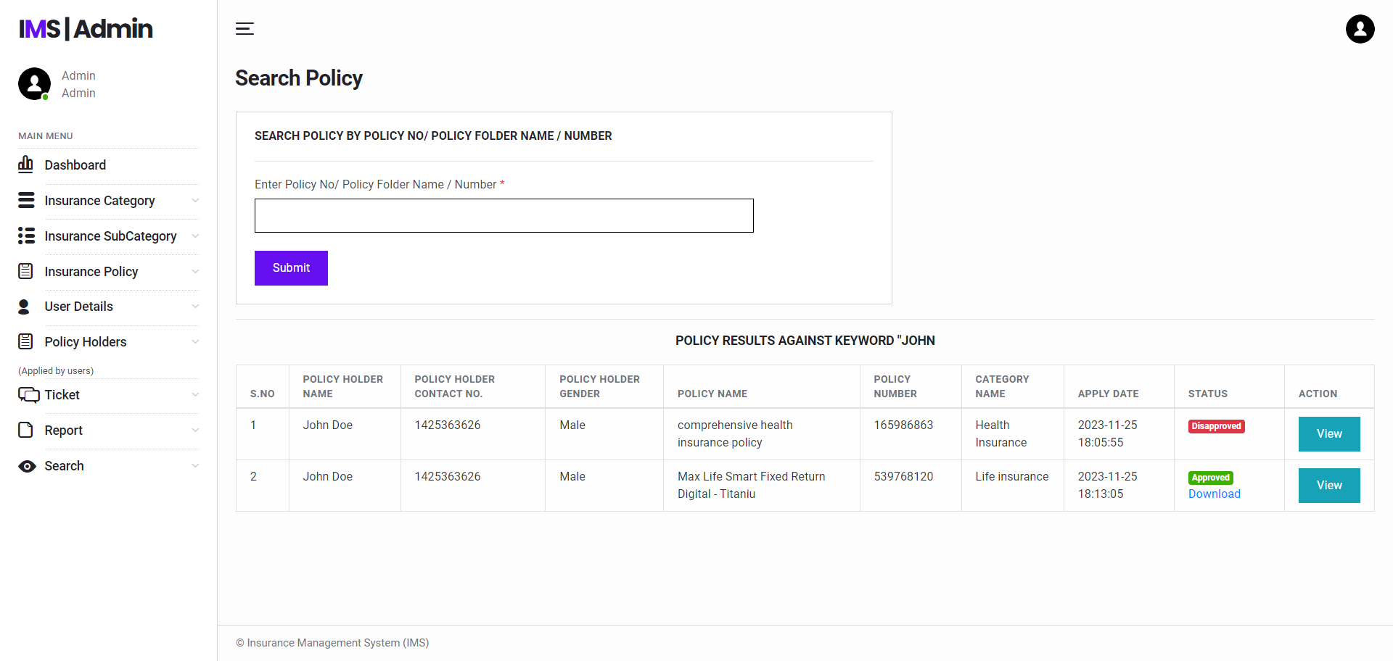
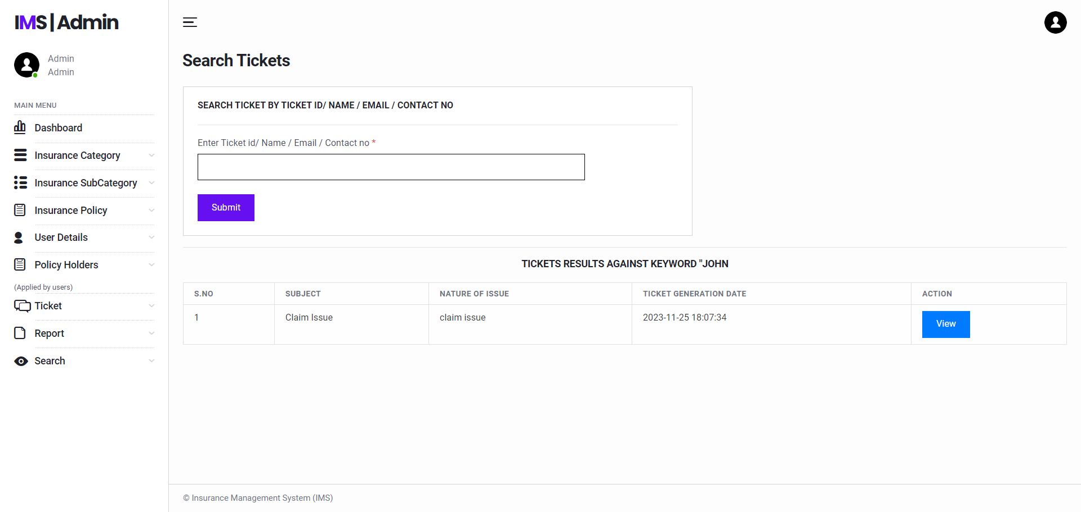

Slide 33
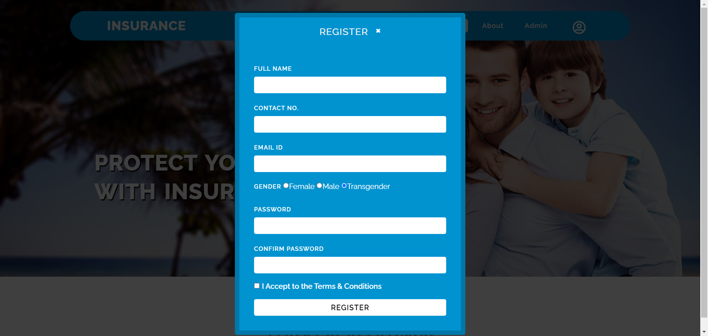
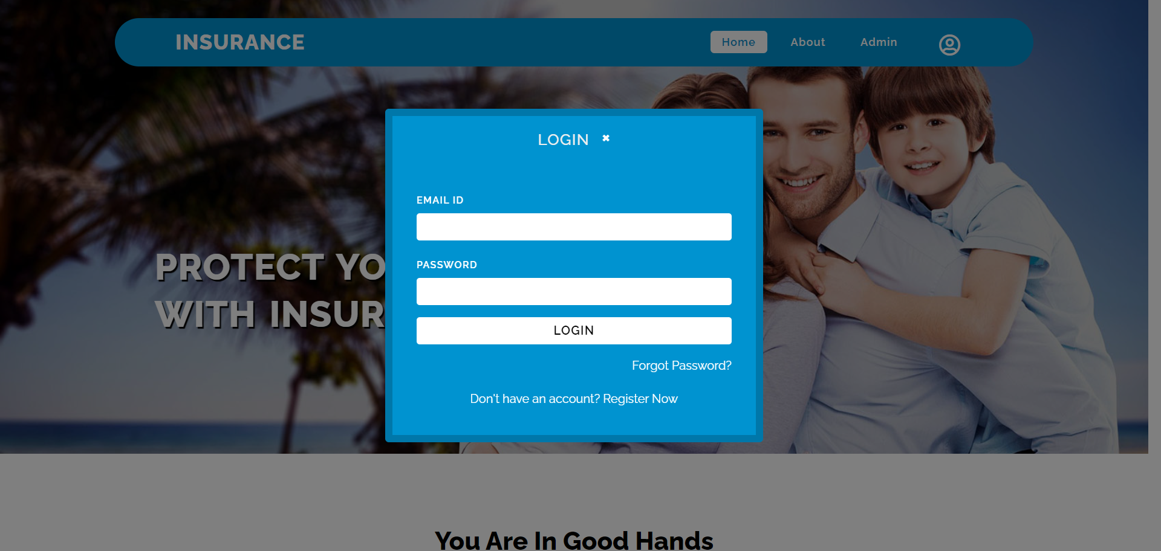

Slide 34
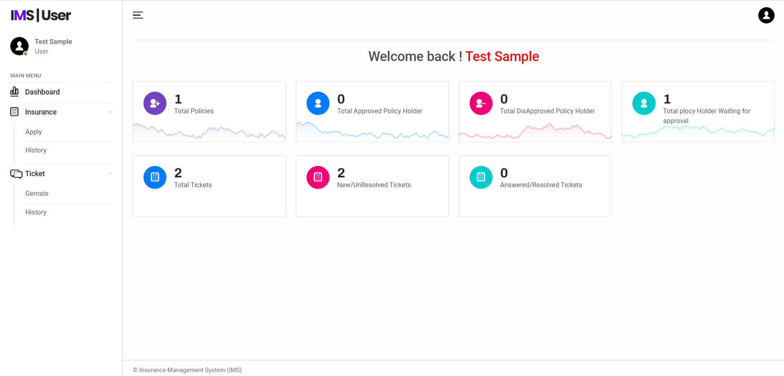
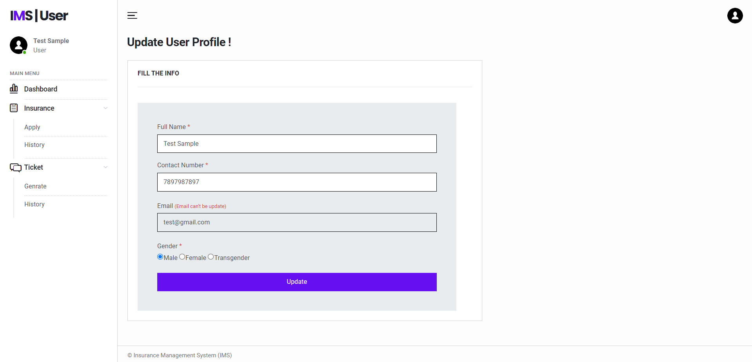

Slide 35
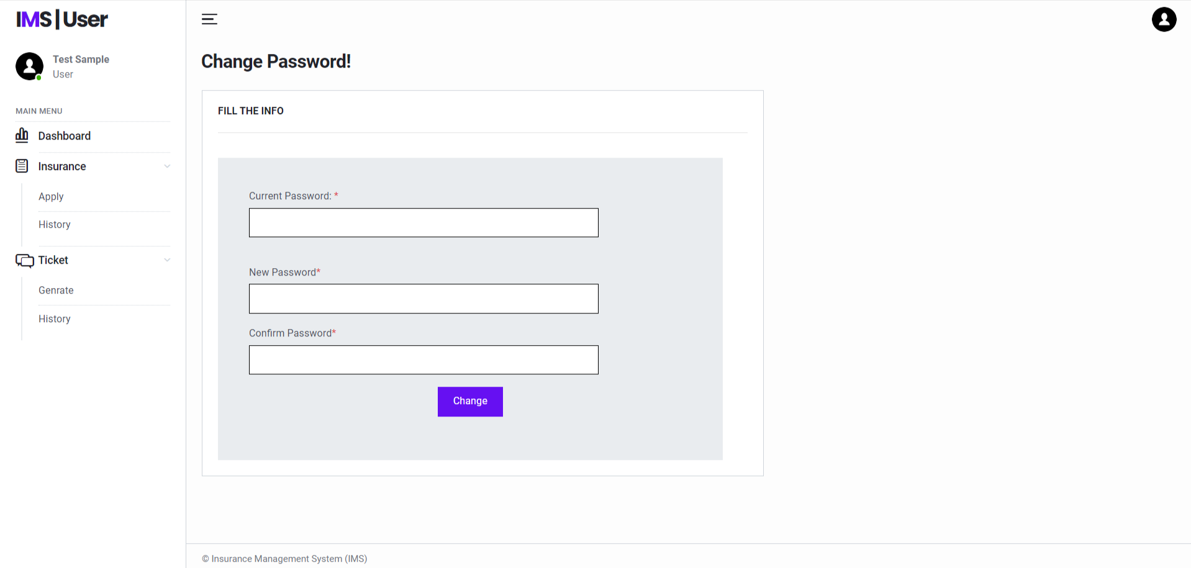
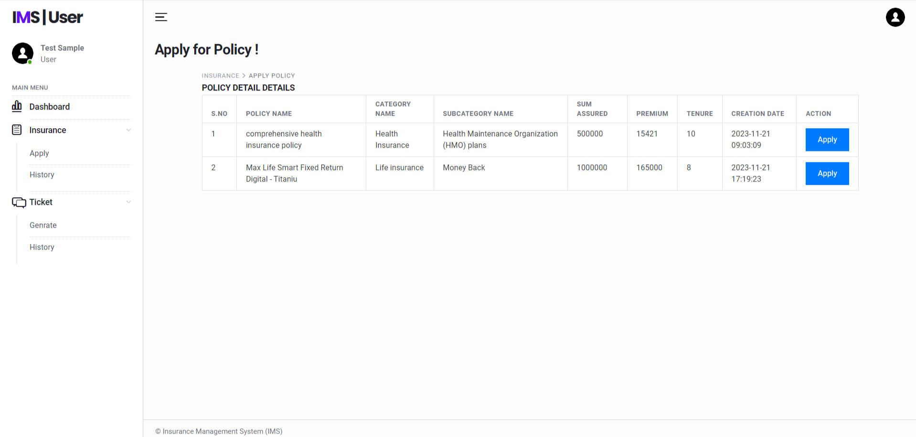

Slide 36
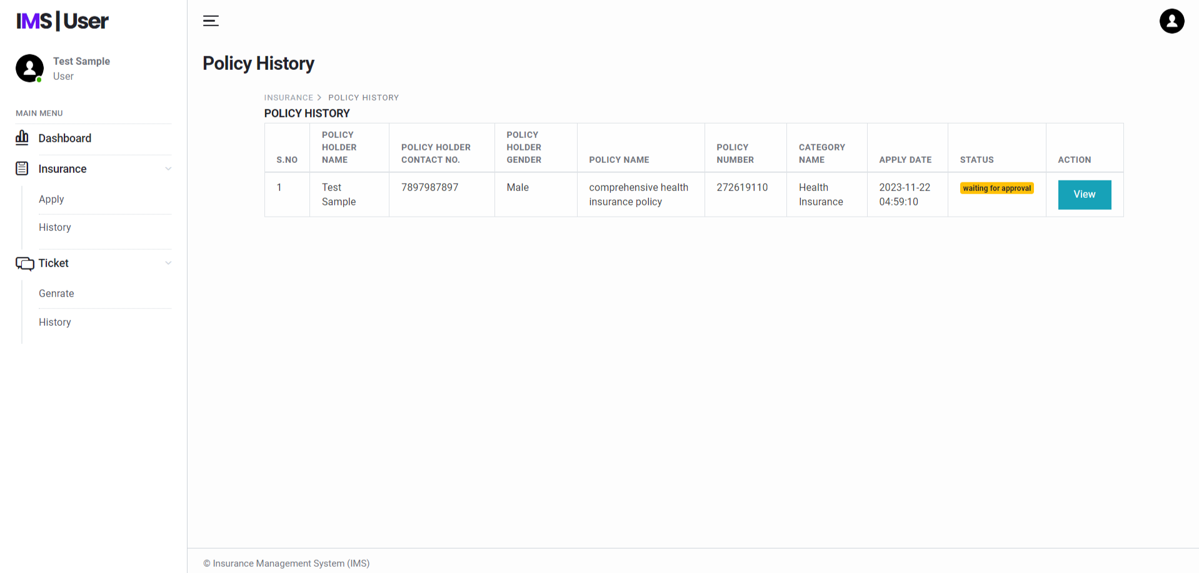
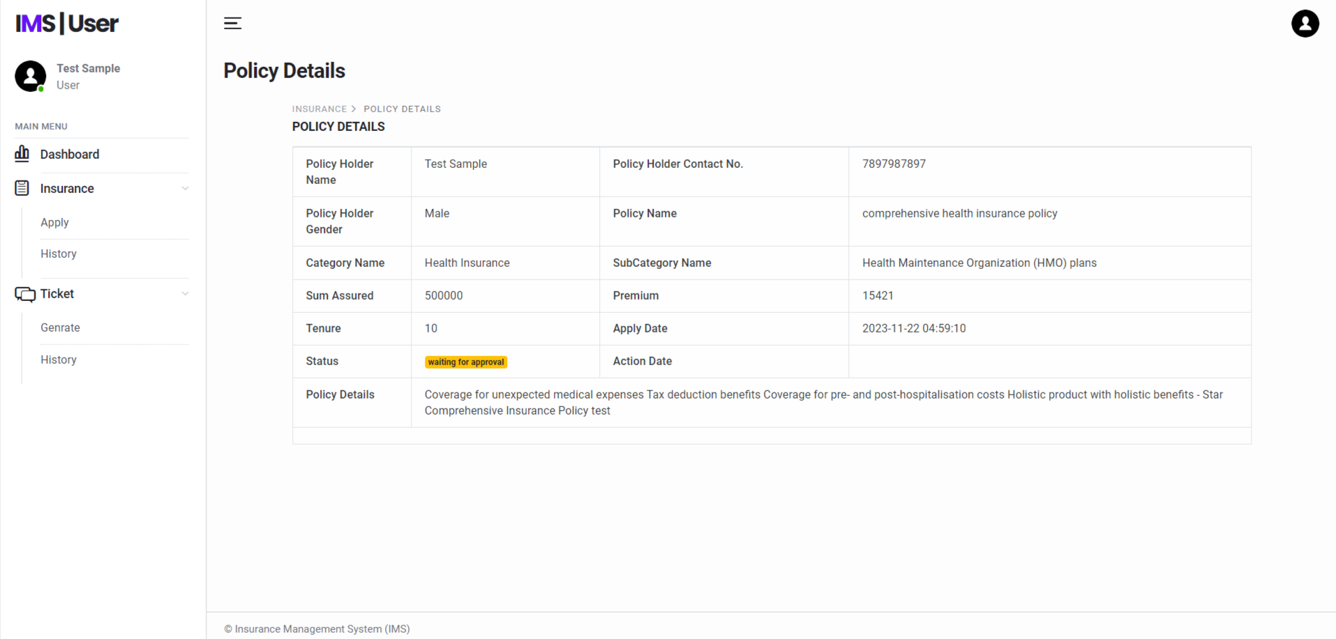

Slide 37
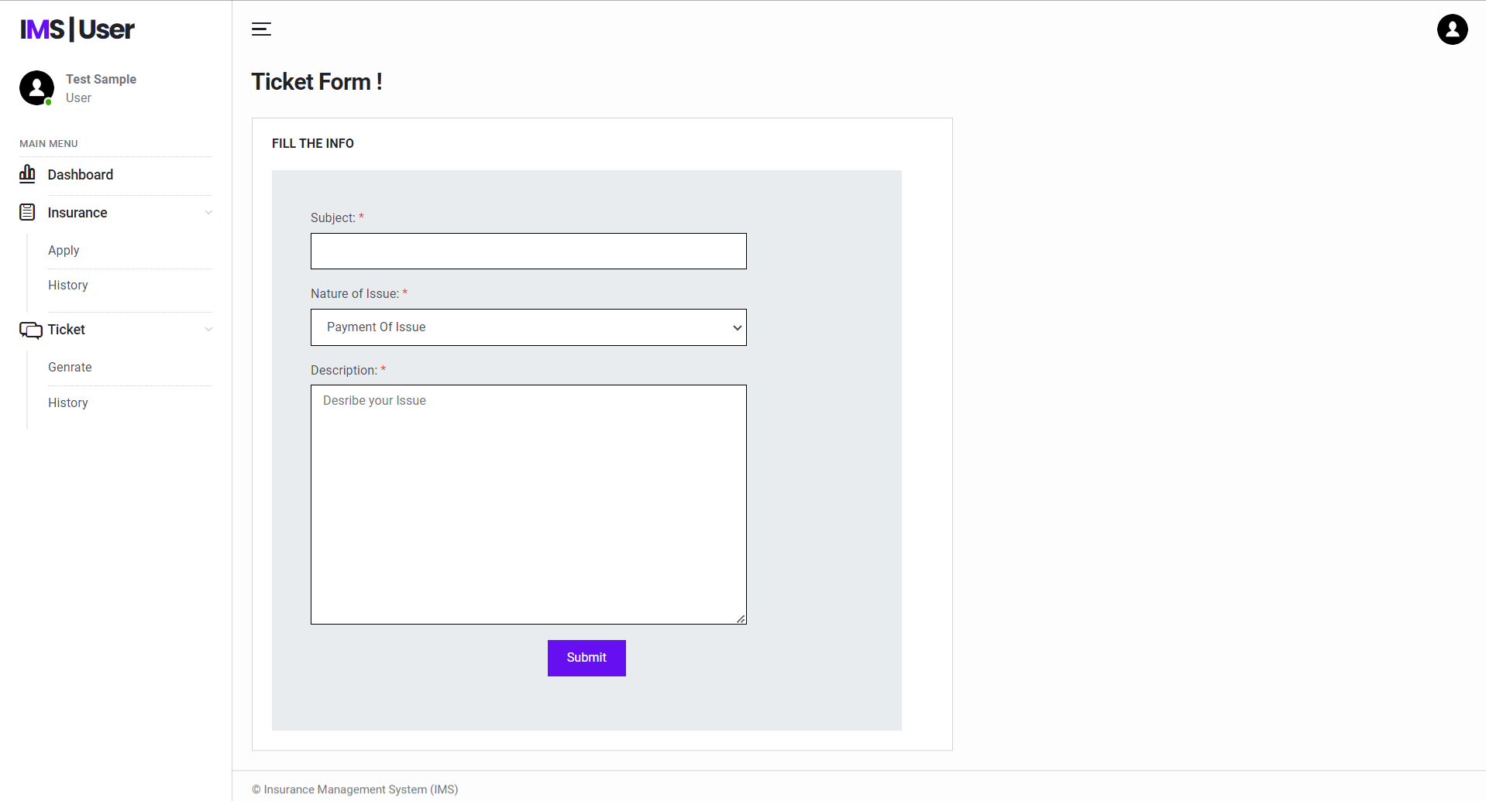
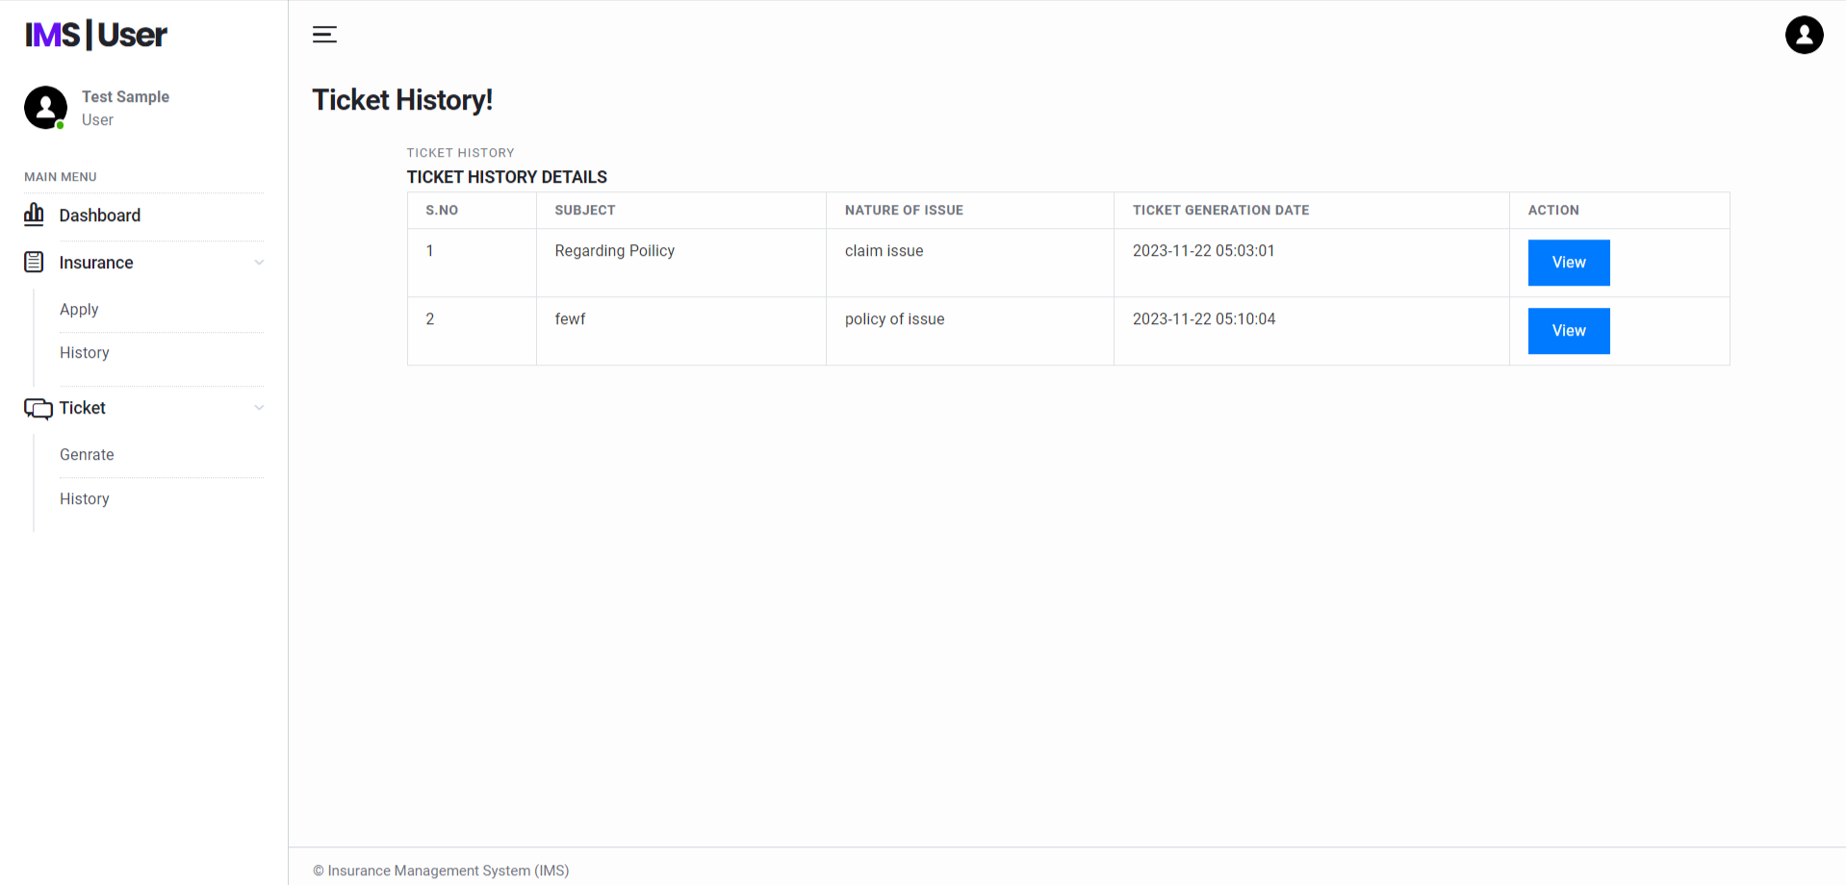

Slide 38
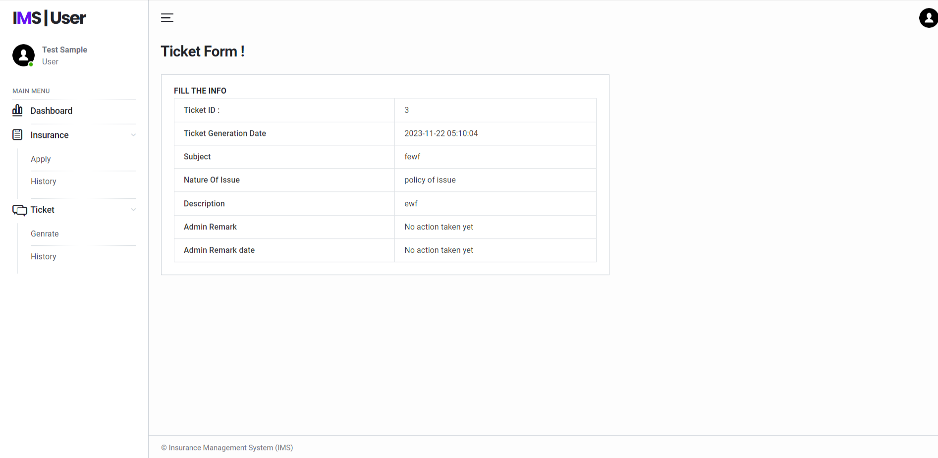

Slide 39
Conclusion
This Application provides a computerized version of Insurance Management System which will benefit the company.
It makes entire process online and can generate reports. It has a facility of user login where user can apply for policy and admin can approve/disapprove the policy.
The Application was designed in such a way that future changes can be done easily. The following conclusions can be deduced from the development of the project.
Automation of the entire system improves the productivity.
It provides a friendly graphical user interface which proves to be better when compared to the existing system.
It gives appropriate access to the authorized users depending on their permissions.
It effectively overcomes the delay in communications.
Updating of information becomes so easier.
System security, data security and reliability are the striking features.
The System has adequate scope for modification in future if it is necessary.

Slide 40
References
www.w3schools.com
in.php.net
en.wikipedia.org/wiki/PHP
www.hotscripts.com/category/php/
www.apache.org/
www.mysql.com/click.php?e=35050

Slide 41
Thank You

