Slide 1

Research Compass
Graph Neural Network System for Research Paper Classification
BY: AYUSH CHHOKER
To: Dr. Amir Manzour
CS 548 - Graph Neural Networks

Slide 2
Problem and Solution
The Challenge
What I Built
Keeping up with research is overwhelming. Thousands of papers get published every week, and traditional keyword searches miss the bigger picture - they ignore how papers connect through citations and collaborations.
Research Compass uses Graph Neural Networks to classify papers by learning from citation patterns. Upload a PDF, and the system predicts its research area using three different GNN architectures. The entire pipeline runs live on Streamlit, and you can trace exactly which papers influenced each prediction. This project started as coursework but became something I actually want to use.

Slide 3
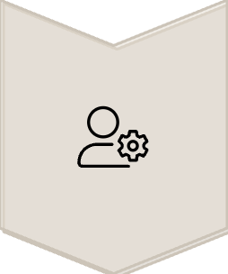

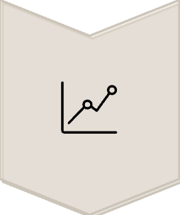
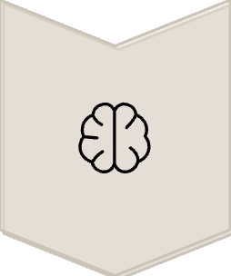
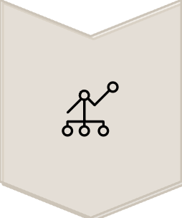
System Architecture and Pipeline
Upload a PDF or paste text through the Streamlit web interface
Extract text and convert it to numerical features using TF-IDF vectorization
Find the 10 most similar papers from the training dataset using K-nearest neighbors. This creates a local subgraph around your input paper.
Run one of three models (GAT, GCN, or GraphSAGE) to predict the topic based on the graph structure
Display top-5 predictions with confidence scores and show the interactive citation network that influenced the decision

Slide 4
Why Two Datasets? Testing GNNs Across Different Graph Structures
Dataset Comparison
OGB arXiv - Citation Network
AMiner - Collaboration Network
169,343 papers | 40 categories
10,000 authors | 8 fields
1.16M citation edges
120K collaboration edges
Papers → Papers (directed)
Authors ↔ Authors (undirected)
Clean, balanced data
Real-world, imbalanced data
Dense network (7 cites/paper)
Sparse network (12 collabs/author)
Testing on both reveals which GNN architectures are truly robust across different graph structures and data quality levels.

Slide 5
Why These Two Datasets Matter
Different Network Structures
Clean vs. Messy Data
Generalization Testing
Citations are directed (papers cite older work). Collaborations are undirected (symmetric relationships). GNNs behave very differently on these structures.
OGB is a curated benchmark. AMiner represents real-world data with class imbalance, noise, and sparsity. Testing both reveals if models generalize beyond benchmarks.
If a model only works on one dataset, it's overfitting to that specific graph structure. Testing both reveals which architectures are truly robust.
ML Models and Training
I tested three different architectures to see which works best:
Graph Attention Networks (GAT)
Graph Convolutional Network (GCN)
GraphSAGE
Uses attention mechanisms to weight neighbor importance. I configured it with 4 attention heads, 3 layers, and 128 hidden units for OGB. The idea is that attention should capture complex citation patterns better than simple averaging.
The simpler baseline - just averages information from all neighbors. Uses 2 layers with 256 hidden units for AMiner. Fast to train but I suspected it might struggle with noisy data.
Samples a random subset of neighbors instead of using all of them. This should scale better to large graphs. Honestly, I didn't expect this to be the winner, but it was.
All models trained with Adam optimizer (learning rate 0.01 for OGB, 0.005 for AMiner) and 0.5 dropout for regularization.

Slide 6
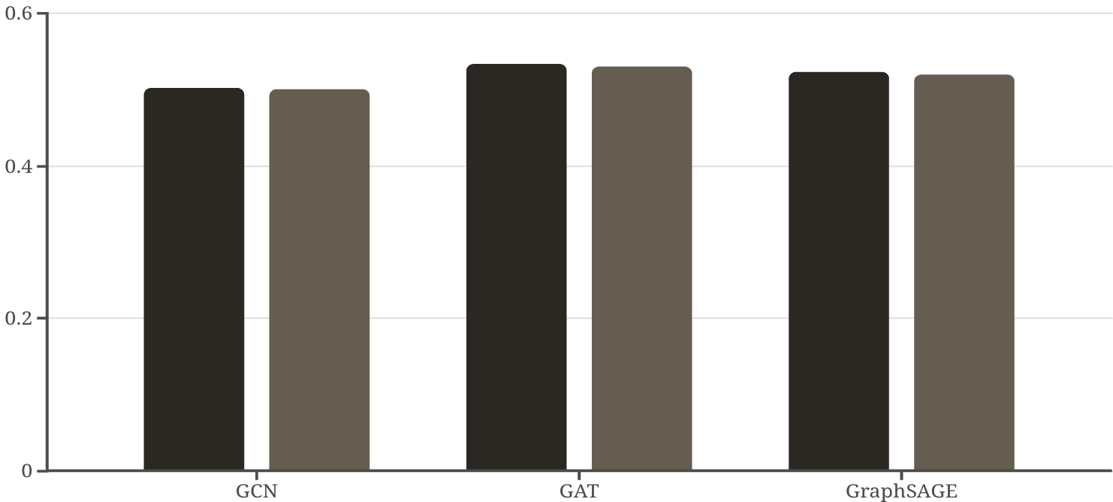

OGB arXiv: Model Choice Doesn't Matter Much
Let's dive into the performance on the OGB arXiv dataset, which is known for its clean and balanced nature.
Results Overview
On the OGB dataset, all three models achieved 50-53% accuracy. GAT was slightly better at 53.4%, but honestly the differences are minimal.
Key Takeaway
When you have a clean, well-balanced dataset with dense citation networks, model choice doesn't matter much. The data quality is more important than architecture.
Accuracy
F1-Score
Link Prediction Bonus: GCN absolutely crushed link prediction with 90.1% AUC - way better than its classification performance.

Slide 7
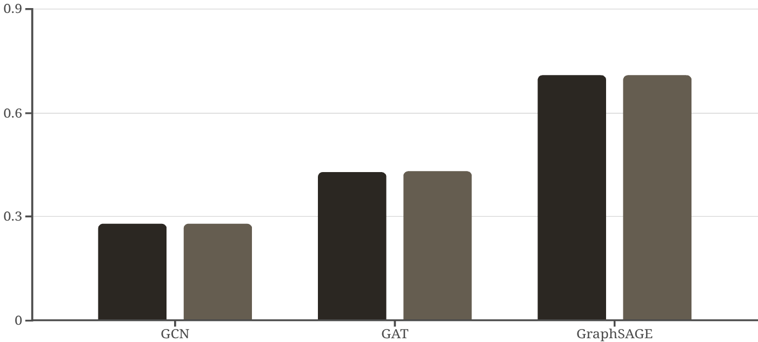

AMiner: Architecture Choice is CRITICAL
Let's look at the results from the AMiner dataset, where the model choice made a dramatic difference.
Why Such a Huge Gap?
AMiner has class imbalance and sparse features. GraphSAGE's sampling approach handles messy real-world data way better than attention (GAT) or averaging (GCN).
What I Learned
Don't assume fancier models (like attention) always win. Test everything, especially on real-world datasets.
Accuracy
F1-Score
Production Recommendation
Given its robustness, GraphSAGE is the clear choice for real-world datasets like AMiner.
GraphSAGE: 71.0% accuracy GAT: 42.8% accuracyGCN: 28.0% accuracy
This was the biggest surprise of the project. GraphSAGE demolished the other two models.

Slide 8
Deployment Challenges & Real-World Application
Deployment: From Notebook to Production
Getting It LiveI deployed Research Compass on Streamlit Cloud so anyone can use it without installation. The app is free, open-source, and accessible worldwide - no authentication required.
Technical Challenges I Solve
Challenge 1: Model Size
PyTorch models are huge (hundreds of MB). Streamlit has strict size limits, so I had to compress the models by saving only the weights and rebuilding the architecture at runtime.
Challenge 2: Dataset Access
Can't ship 169,000 papers with the web app. Solution: pre-computed the TF-IDF vectorizer during training and use it to project new papers into the same feature space.
Challenge 3: Graph Construction for New Papers
New papers don't have real citations yet. I build temporary K-NN graphs connecting them to similar papers from the training set based on content similarity.

Slide 9
Making Predictions Transparent
I wanted this system to be more than a black box. Here's what I built for interpretability:
Interactive Knowledge Graph
Confidence Scores
Citation Traceability
The system displays the top 5 predicted categories with probabilities. If it's only 35% confident, you know to take the prediction with a grain of salt. No false certainty.
You can trace back exactly which papers the model "consulted" before making its decision. For researchers, this is crucial - you need to validate predictions, not blindly trust them.
The interface shows which papers in the citation network actually influenced each prediction. You can see the 10 nearest neighbors and how they're connected. This lets you verify that the model is making decisions based on reasonable citations.
Why This Matters
In academic applications, explainability isn't optional. Researchers need to understand WHY a paper was classified a certain way to trust the system and catch errors.

Slide 10
Results Analysis & Next Steps
What the Results Tell Us
What I'd Improve Next
Finding #1: Clean Data Reduces Architecture Sensitivity
If I continue this project, here's my priority list:
On the well-curated OGB arXiv dataset, GAT, GCN, and GraphSAGE all achieved 50-53% accuracy. When your data is clean and balanced, you can focus on improving features rather than obsessing over model architecture.
Multi-label classification - Many papers span multiple fields (e.g., CV + ML)
Better text features - Replace TF-IDF with SciBERT embeddings for richer semantic understanding
Finding #2: Messy Data Demands Robust Architectures
Temporal analysis - Track how a paper's influence and citations evolve over time
On AMiner with its class imbalance and sparse features, GraphSAGE (71%) dramatically outperformed GAT (43%) and GCN (28%). Sampling-based aggregation proved more robust than attention mechanisms or simple averaging.
Production API - Build a REST API so other research tools can integrate with Research Compass
Finding #3: Explainability is Non-Negotiable
Researchers won't use black-box systems. The interactive graph visualizations and confidence scores were essential for building trust and enabling real-world adoption of the system.

Slide 11
Key Takeaways
Lesson 1: Data Quality > Model ComplexityClean your data first. On OGB arXiv, all three models performed similarly because the dataset was well-curated.
Lesson 2: Real-World Data is HumblingMy assumptions about which models would work best were completely wrong. Sometimes the simpler approach (GraphSAGE sampling) beats the fancier one (GAT attention).
Lesson 3: Explainability MattersBuilding visualization features took extra time but made the system actually useful. Without them, it would just be another black box.
The Bottom LineGNNs aren't just for research papers - they're practical tools for real applications when you handle the engineering challenges properly.

Slide 12

Final Thoughts
What I Built
A Graph Neural Network system that classifies research papers by learning from citation patterns. Achieved 71% accuracy on real-world data (AMiner) using GraphSAGE.
What Worked
GraphSAGE dramatically outperformed other GNNs on messy real-world data
K-NN graph construction enables predictions on papers without real citations
Transparency features (confidence scores, graph visualization) make the system trustworthy
End-to-end deployment on Streamlit proved GNNs can work in production
What I Proved
GNNs aren't just for research papers - they're practical tools for real applications when you handle the engineering challenges properly.
Try It Yourself
Questions?

