Slide 1
Supermarket Analysis

Slide 2
Objective: To leverage detailed sales data, encompassing order and customer attributes, to analyze key trends and performance metrics such as revenue, profitability, and customer segmentation. The analysis aims to identify:
Regional and segment-specific sales patterns.
High-performing product categories and sub-categories.
The impact of discounts and ship modes on profitability and sales volume.
𝗦𝗸𝗶𝗹𝗹𝘀 𝗔𝗰𝗾𝘂𝗶𝗿𝗲𝗱:
𝗗𝗮𝘁𝗮 𝗖𝗹𝗲𝗮𝗻𝗶𝗻𝗴: Power Query
𝗗𝗮𝘁𝗮 𝗠𝗼𝗱𝗲𝗹𝗶𝗻𝗴: Power Pivot
𝗔𝗱𝘃𝗮𝗻𝗰𝗲𝗱 𝗘𝘅𝗰𝗲𝗹: VLOOKUP, XLOOKUP, INDEX MATCH, if formula
𝗗𝗮𝘁𝗮 𝗔𝗻𝗮𝗹𝘆𝘀𝗶𝘀: Focused on consumer analysis, product category, preferences and customer segment
𝗥𝗲𝗽𝗼𝗿𝘁 𝗖𝗿𝗲𝗮𝘁𝗶𝗼𝗻: Built user-friendly and interactive reports

Slide 3
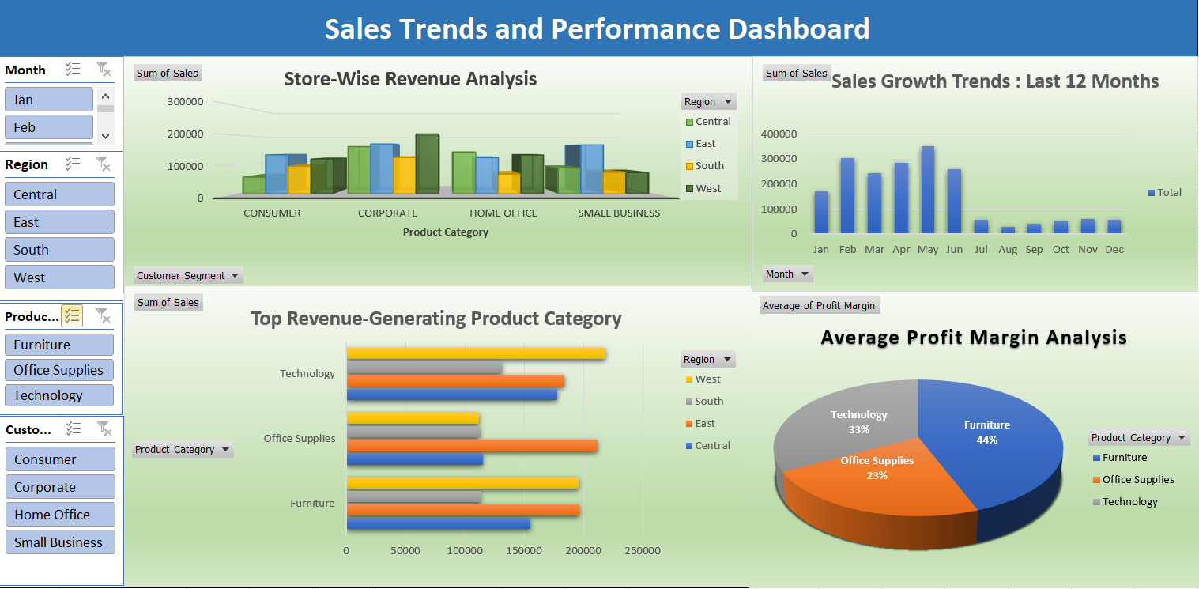

Slide 4
Insights:
The store generated a total revenue of $1,924,337.88, with the East region contributing the highest revenue and the South region the lowest.
Corporate is the top-performing segment while Small Business has the lowest contribution.
Technology is the highest-contributing category with total sales of $712,264.95, driven by strong performance in the West region ($218,867.52).
Furniture follows closely with $660,704.31, while Office Supplies contributes the least ($551,368.62).
Store experienced fluctuations throughout the year, with February ($305,508.35) and April ($284,890.72) also contributing strong sales.
With an average profit margin of $1,218.66, the furniture category has the largest profit margin, suggesting a more lucrative product line.
Office Supplies, on the other hand, has the lowest average profit margin, at $626.56, indicating room for cost control or price adjustments.

Slide 5
Recommendation:
Focus efforts on boosting sales in the South region and Small Business segment, as they contribute the least to total revenue.
Additionally, leverage the strong performance of the Corporate segment to identify successful strategies that can be replicated across other segments and regions.
To build on this impressive performance, concentrate on growing the Technology sector, which accounts for the largest portion of revenues, especially in the West.
Especially in the South and West, office supply sales are lagging behind both furniture and technology. Take into consideration ways to increase sales.
To address the significant drop in sales during July and August, consider targeted promotions or marketing campaigns during the summer months to boost sales
Put your attention on increasing Office Supplies' profitability by looking at ways to cut costs or by improving pricing to boost its profit margin.
To take advantage of the high-margin furniture category's high profitability, think about growing it as well.

