Slide 1
AI-Powered Product Feature Prioritization Framework
Tools- Excel | AI-assisted Analysis | Interactive HTML Dashboard
Name-Apeksha Ashok Bhoir
Education- MBA in Business Analytics

Slide 2
Business Problem
SaaS and technology companies receive numerous feature requests from customers, sales teams, support teams, product teams and management. Since engineering resources are limited, companies cannot build every requested feature. This project develops an AI-assisted feature prioritization framework to evaluate customer value, business value, development effort, technical risk and strategic alignment and convert these insights into product decisions and roadmap priorities.

Slide 3
Objective
Analyze customer feedback
Identify feature demand
Evaluate customer impact
Estimate business value
Analyze development effort and risk
Apply RICE, MoSCoW and Kano
Generate AI-assisted recommendations
Apply Product Manager judgment
Create a product roadmap

Slide 4
Data
The project uses a synthetic SaaS product feature-request dataset containing 100 feature requests and customer feedback from multiple sources.
Sources:-
Customers
Customer Support
Sales
Product Team
Engineering
Management
User Reviews
Competitor Research

Slide 5
Methodology
Customer Feedback
↓
Sentiment & Pain Analysis
↓
Feature Demand
↓
Business Value
↓
Effort & Risk
↓
RICE + MoSCoW + Kano
↓
AI Recommendation
↓
Product Manager Decision
↓
Roadmap

Slide 6
AI Methodology
AI was used as a decision-support mechanism rather than an autonomous decision-maker. AI-assisted analysis was used to identify customer sentiment, recurring themes, demand signals and initial feature priority recommendations. Final prioritization was validated using structured prioritization frameworks and Product Manager judgment.

Slide 7
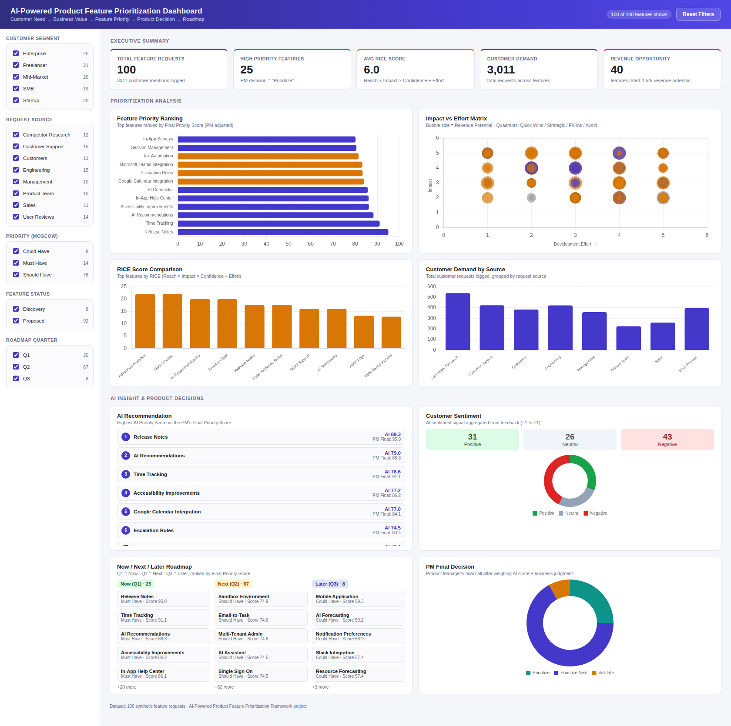
Dashboard-

Slide 8
Key Insights
Example:
Features addressing significant customer pain points receive stronger prioritization.
High customer demand alone does not guarantee high priority.
Development effort and technical risk can reduce feature priority.
Enterprise requirements such as security and integrations can support expansion opportunities.
AI recommendations help Product Managers analyze large amounts of feedback faster.
Final prioritization requires business strategy and Product Manager judgment.

Slide 9
Roadmap
NOW
High-impact + high-value + manageable effort features.
NEXT
Strategically important features requiring additional capacity or validation.
LATER
Low-impact/high-effort or lower-confidence opportunities.

Slide 10
Conclusion
The project demonstrates how Product Management frameworks and AI-assisted analytics can be combined to make structured, evidence-based feature prioritization decisions. The framework helps connect customer needs with business value and engineering considerations and translates analysis into actionable product roadmap decisions.

