Slide 1


THE NATIONAL INSTITUTE OF ENGINEERING
(An Autonomous Institution) • Mysuru, Karnataka
DEPARTMENT OF COMPUTER SCIENCE & ENGINEERING
IntelliTwin
AI-Powered Digital Twin Platform for Smart Building Monitoring,
Predictive Maintenance and Intelligent Energy Optimization
PHASE 1 PROJECT PRESENTATION • BATCH A7
PROJECT GUIDE
PRESENTED BY
Mr. Mohammed Adnan
Name | USN
Amulya Koundinya | 4NI23CS019
Anjana Suresh Kumar | 4NI23CS021
Apeksha N Gowda | 4NI23CS024
Divya Shree H S | 4NI23CS056
Assistant Professor, Dept. of CSE
PROJECT CO -GUIDE
Mrs. Veena Mohan
Assistant Professor, Dept. of CSE

Slide 2
Introduction
A Digital Twin is a virtual, continuously updated replica of a physical asset that mirrors its real-time state through streaming data.
Physical
Building
Smart buildings need digital twins because occupancy, equipment load and environmental conditions change continuously and interact in complex, non-linear ways.
real-time
sync
Existing monitoring systems mostly display live sensor values without correlating them to failure risk, energy trends or efficiency.
Digital
Twin
AI and predictive analytics close this gap — learning from historical data to forecast risks such as equipment failure or power draw surges.
IntelliTwin is a software-based Digital Twin platform that works entirely without physical IoT hardware, using a Virtual Sensor Simulator, ML models and a 3D dashboard.
IntelliTwin — Phase 1 Presentation
2

Slide 3
Objectives
1
Design a Virtual IoT Sensor Simulator that generates realistic, behaviourally-consistent sensor data without physical hardware.
2
Develop a full-stack platform (React, Node.js, MongoDB) to ingest, store and serve real-time simulated sensor data.
3
Build a Random Forest-based predictive maintenance model that estimates equipment failure probability.
4
Develop an AI-based energy consumption forecasting module to support intelligent energy optimization.
5
Develop an Isolation Forest-based anomaly detection module for real-time abnormal readings.
6
Design an interactive 3D Digital Twin dashboard (Three.js) for building / floor / room-level visualization.
IntelliTwin — Phase 1 Presentation
3

Slide 4
Existing System & Drawbacks
EXISTING SYSTEM
DRAWBACKS
Most BMS / IoT dashboards are limited to real-time data acquisition and visualization.
No predictive capability — failures are caught only after they occur.
Display temperature, humidity, occupancy and power readings without correlating them to failure risk or efficiency.
No energy forecasting or optimization recommendations.
No way to simulate future or hypothetical scenarios.
Maintenance is scheduled at fixed calendar intervals, or triggered only after a visible fault occurs.
Heavy reliance on costly physical IoT hardware.
Alerting is threshold-based, flagging values only once they cross a static limit.
Frequent false positives / negatives from threshold-based alerts.
Nearly all deployments are hardware-dependent — requiring procurement, installation and upkeep of physical sensors and gateways.
Purely tabular visualization, unsuited to multi-floor buildings; manual, time-consuming reporting.
IntelliTwin — Phase 1 Presentation
4

Slide 5
Proposed System & Advantages
ARCHITECTURE FLOW
Virtual
Sensor
Simulator
REST
API
Node.js
Backend
MongoDB
Python
AI Engine
React
Dashboard
3D Digital
Twin
ADVANTAGES
Eliminates hardware cost and installation complexity
Enables proactive maintenance via early failure prediction
Supports proactive energy optimization, not after-the-fact analysis
Improves alert accuracy via ML-based anomaly detection over static thresholds
Allows risk-free what-if scenario testing before real-world decisions
Intuitive 3D interface, easier to interpret than tabular dashboards
Role-based access for Admin, Manager and Technician workflows
Modular REST architecture — can accept real IoT hardware later without redesign
IntelliTwin — Phase 1 Presentation
5

Slide 6
Literature Survey (1/2)
1
A Comprehensive Review of Digital Twin Technology in Building Energy Consumption Forecasting
Authors: M. Boukaf, F. Fadli, N. Meskin
Published in: IEEE Access, vol. 12, pp. 187778–187799, 2024
2
A Review of Building Digital Twins to Improve Energy Efficiency in the Building Operational Stage
Authors: A. S. Cespedes-Cubides, M. Jradi
Published in: Energy Informatics, vol. 7, no. 1, 2024
3
Digital Twins for Reducing Energy Consumption in Buildings: A Review
Authors: B. Arsecularatne, N. Rodrigo, R. Chang
Published in: Sustainability, vol. 16, no. 21, Art. 9275, 2024
IntelliTwin — Phase 1 Presentation
6

Slide 7
Literature Survey (2/2)
4
Ontology-enabled AI Agent-driven Intelligent Digital Twins for Building Operations and Maintenance
Authors: S. Yoon, J. Song, J. Li
Published in: Journal of Building Engineering, vol. 108, Art. 112802, 2025
5
Energy Digital Twin Technology for Industrial Energy Management: Classification, Challenges and Future
Authors: W. Yu, P. Patros, B. Young, E. Klinac, T. G. Walmsley
Published in: Renewable and Sustainable Energy Reviews, vol. 161, Art. 112407, 2022
6
Real-World Anomaly Detection by Using Digital Twin Systems and Weakly-Supervised Learning
Authors: A. Castellani, S. Schmitt, S. Squartini
Published in: IEEE Transactions on Industrial Informatics, vol. 17, no. 7, pp. 4733–4742, 2021
IntelliTwin — Phase 1 Presentation
7

Slide 8
System Requirements Specification
SOFTWARE REQUIREMENTS
HARDWARE REQUIREMENTS
Frontend: React.js
No physical IoT sensors, microcontrollers, or field hardware required — a software-based Virtual IoT Sensor Simulator is used instead.
Styling: Tailwind CSS
3D Visualization: Three.js
Development laptop: minimum 8 GB RAM, Intel i5 processor (or equivalent).
Charts / Graphs: Chart.js
Backend: Node.js, Express.js
Authentication: JWT
At least 10 GB free disk space for dependencies, datasets and trained models.
Database: MongoDB
AI / ML: Python, Scikit-learn
Stable internet connection for package installation and optional cloud deployment.
Data Handling: Pandas, NumPy
Deployment (optional): Docker, AWS / Render
IntelliTwin — Phase 1 Presentation
8

Slide 9
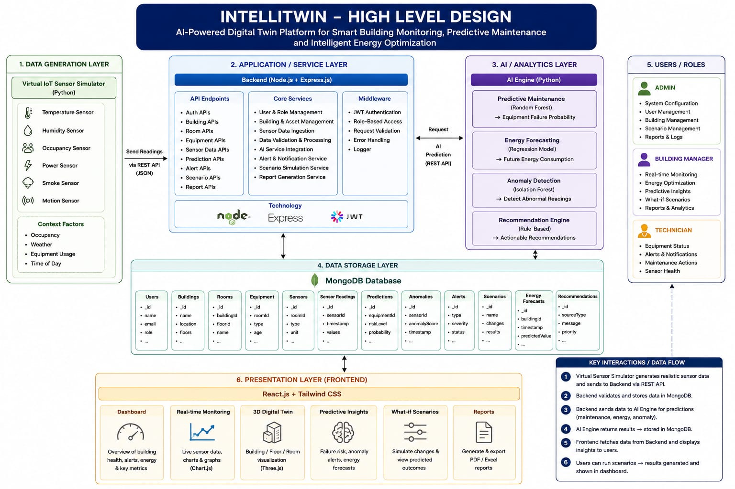
System Design
INSERT DIAGRAM HERE
Place your High-Level Design diagram here — e.g. overall module/architecture view showing the Virtual Sensor Simulator, Node.js backend, MongoDB, Python AI Engine, and React + 3D Digital Twin frontend.
IntelliTwin — Phase 1 Presentation
9

Slide 10
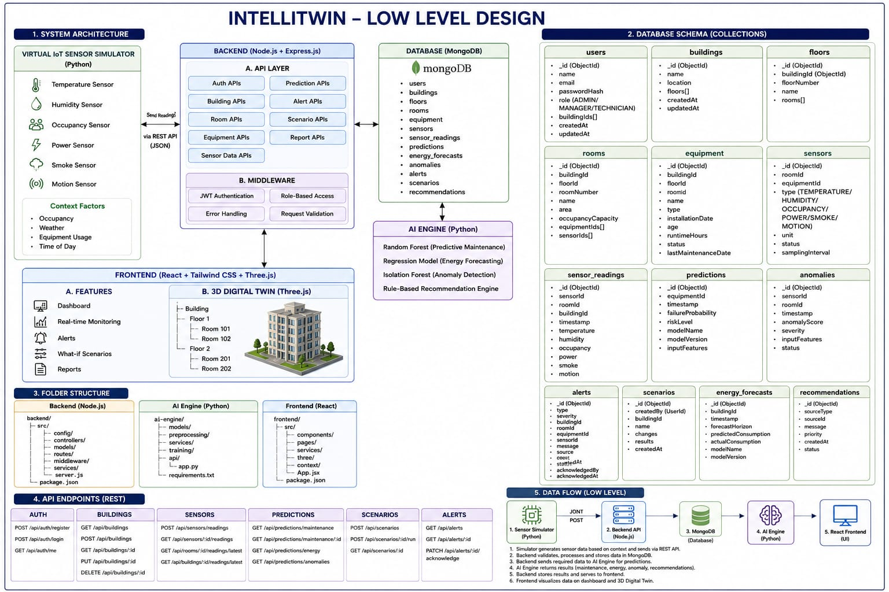
System Design
Low-Level Design (LLD)
INSERT DIAGRAM HERE
Place your Low-Level Design diagram here — e.g. class diagrams, sequence diagrams, database schema, or detailed module-level data flow.
IntelliTwin — Phase 1 Presentation
10

