Slide 1
Agile Methodology, Test Case (postman) & Data Validation
A strategic framework for delivering the WellBot AI Wellness System—ensuring privacy, reliability, and empathetic user engagement at scale.
Presented by: Apeksha Jain

Slide 2
Agile Methodology Establish the iterative framework for WellBot. Focusing on principles, frameworks, and practical implementation strategies that prioritize flexibility and user value.
Principle
Frameworks
Implementation

Slide 3
Agile Principles & Values Foundational mindset for the WellBot development process
Individuals & Interactions
Valued over processes and tools. Ensuring team communication flows freely.
Working Software
Valued over comprehensive documentation. Functional chatbots demonstrate real progress
Customer Collaboration
Valued over contract negotiation. Constant feedback loop with mental health experts
Responding to Change
Valued over following a plan. Adapting to user needs and safety protocols
Notes:
Explain how Agile differs from Waterfall model.

Slide 4
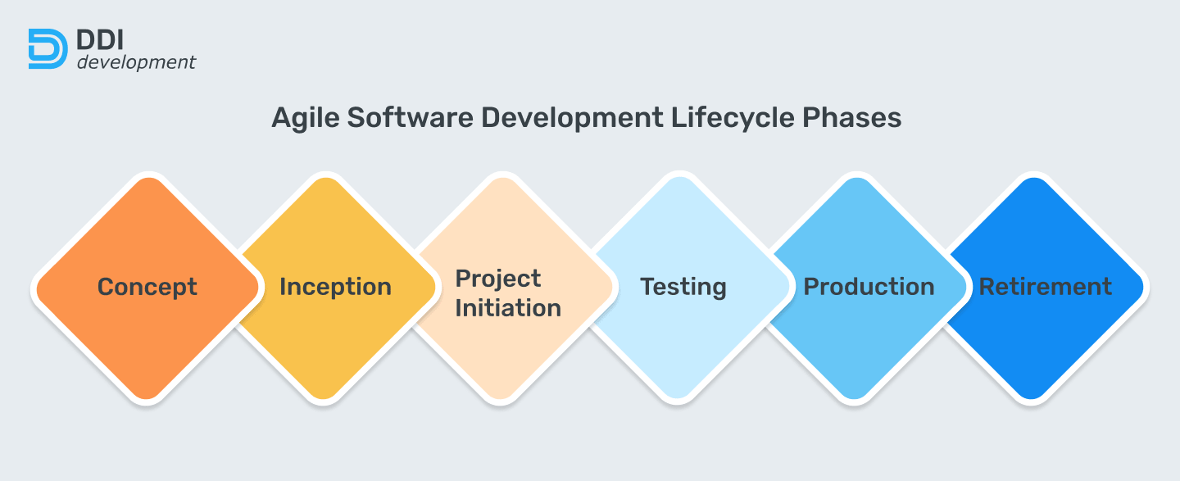
Agile Implementation Strategy

Slide 5
Key Principles of Agile
Individuals & interactions over processes & tools.
Working software over comprehensive documentation.
Customer collaboration over contract negotiation.
Responding to change over following a plan.
WellBot Application
"Agile allows us to accept late-breaking privacy requirements without derailing the entire release.“
Instead of rigid planning, we iterate on privacy protocols every sprint, ensuring compliance with new mental health data standards as they emerge.
Notes:
These principles are from the Agile Manifesto.

Slide 6
Data Validation Techniques
Format & Type
Verifying data types (int, string), regex patterns for emails, and enum constraints.
Core Validation Dimensions
Security & Privacy
Input sanitization to prevent injection, and PII detection/masking before storage
Consistency
Ensuring referential integrity and logical cross-field dependencies (e.g., dates)
Statistical
Monitoring for data drift and anomalies that could degrade AI model performance.

Slide 7
Importance of Data Validation
Ensures data accuracy & integrity.
Prevents invalid or malicious input.
Improves system reliability.

Slide 8
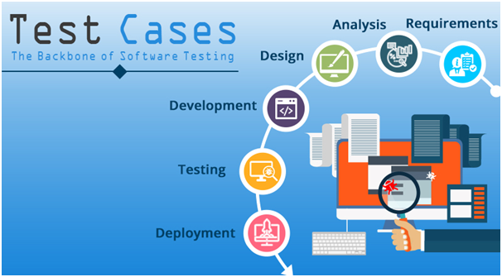
Test Case Design

Slide 9
Creating Test Cases
Write Test Scripts
Use JavaScript to write test scripts to validate responses.
Use Collection
Group related requests into collections for better organization.
Set Up Environment
Define your API environment, including variables for URLs and authentication.

Slide 10
Postman is a powerful tool for testing APIs. It allows users to create, share, and document API tests effectively.
Test APIs with Postman
Powerful API development & testing tool.
Create, share & document test cases.
Supports automation & scripting.

Slide 11
Postman Automation
Run bulk tests using Collection Runner.
Export collections for CI/CD pipelines.
Integrate with Jenkins/GitHub Actions.

Slide 12
Conclusion
Agile ensures adaptability.
Postman strengthens API quality.
Validation secures data integrity.
Together they deliver robust software.

Slide 13
THANK YOU

