Slide 1
Department of
ELECTRONICS AND COMMUNICATION ENGINEERING
FRUIT-PLUCKING- ROBOT
Dr.Anuradha M
Apeksha Gaonkar PES1201701562
P.Jahnavi Raman PES1201701152
Shamitha S PES1201701655

Slide 2
ABSTRACT
Automation has led to the growth of industries in recent years. For better performance of industrial process automated machines are used.
Image processing has led to advancements in applications of robotics and embedded systems .
Object sorting is one of the popular systems for industrial applications. Unlike the common sorting done by humans, this method is more efficient and less time consuming.
Object sorting robot uses image processing technique for colour detection. It has a robotic arm which picks and places the object in defined position. Image is captured in real time by webcam and then image processing is done for identification of colour .
The Proposed system deals with an automated material handling system. The aim of the project is classify the objects based on its colour .
2

Slide 3
INTRODUCTION
Robot is a mechanical device that is designed and programmed to carry out instruction and perform particular duties automatically, with speed and precision.
The research on automation and robotics has shown importance in industries, defence , surveillance and security using image processing.
The main objective of this project is to build a system which can detect and sort the objects placed based on its colour. Object Recognition is the most important task in the computer vision field. The goal of object recognition is to automatically detect the objects in the screen and classify the according to their properties.
This process has to be repeated for all the frames of the captured images. OpenCV (Open Source Vision Library) is used for image processing using with Python scripting language. OpenCV has powerful image processing functions which is suitable for real time.
Raspberry Pi is used as the controller of motors of the bot which makes it move in a particular path, that is ,follows a path with black line with the help of IR sensors. The Arduino is used to control the robotic arm’s motion and gripping. At basic level , the combination of all these processes helps in moving the bot in a direction ,look for the object ,detect it based on its properties, pick it and place it in the desired position.

Slide 4
The Arduino is used to control the robotic arm’s motion and gripping. At basic level , the combination of all these processes helps in moving the bot in a direction ,look for the object ,detect it based on its properties, pick it and place it in the defined position

Slide 5
LITERATURE SURVEY
Object Sorting Robot Based On the Shape Priya Vinayak Garad G. H Raisoni College of Engineering & Management, Pune.Impact factor: 4.295 (Volume3, Issue5).International Journal of Advance Research, Ideas and Innovations in Technology.
In a proposed system, three different keys are used for detection of three primary colour which is red, green and blue. Three servo motors is used in the construction of robotic arm. One stepper motor is used for moving robotic arm in a circular direction for placing the picked object in a particular color box. The camera is used to sense particular colour for picking and placing process. Image sensing using MATLAB is used in a system for detecting the colour of the object. ARM (LPC2138) is the central processing unit, used to control all the functions of other blocks in this robot system. The microcontroller takes or read data from colour from MATLAB software and controls all the other functions of the system by manipulating these data. Microcontroller control the motor on the robotic arm to pick a particular colour object, as per the signal from image processing ARM (LPC2138) can understand the colour of the object, it controls the arm motor to move towards the specified location, again control the gripper motor to release the object into that particular location. Servo motor is directly controlled by the ARM by PWM signal. PWM (Pulse width modulation) is a great method of controlling the amount of power delivered to load without dissipating any wasted power. Stepper motor is used for angular movement of the robotic arm. Stepper motor is a machine to convert pulse to angle displacement. So if we give stepper driver a certain pulse signal, it will drive motor to a certain angle.

Slide 6
Object Sorting Robot using Image Processing Lekha Bhausaheb Kachare ME Student (VLSI & Embedded system) Department of E & TC G.H. Raisoni COEM, Ahmednagar, India. International Journal of Engineering Science and Computing, June 2017
Traditionally, sorting of different types of objects was done by the operator manually. However, this method has some disadvantages such as increase in the cost of the product, slow, and inaccuracy due to the human mistake.But after many involvements in the field of robotics system, the automation industry has undergone a complete makeover and the technology of object recognition is used for such work. In many packaging industries, object counting and sorting is the major and important task that needs to be done. Existing sorting methods are used to set of inductive, capacitive and optical sensors do differentiate colour. Photodiode based color sensor are used for detection of colour. In this type of sorting method different colour sensors are attached with the robot for detecting the object of particular color. They measure color based on an RGB color model. A large percentage of the visible spectrum can be created using these three colors[1] but the disadvantages of this kind of system is sensor sensitivity range or affection of environmental conditions. In some kind of existing systems of sorting, objects are placed on conveyor belt and according to movement of that conveyor belt objects are get sorted[3][4], but the disadvantage of this system is that object which are not placed on conveyor belt are not considered in sorting process.

Slide 7
BLOCK DIAGRAMS
Image acquisition through webcam
Processing Image
Decision making robot
Motion Control

Slide 8
Start
Initialize the motors and IR sensors
Follows the path with black line ,i.e., line following
If all the IR sensors detect
Initialize the,camera and robotic arm.
Capture image of the object and verify using image processing
Is the required object
No
Yes
Activate the robotic clamper.
Pick the object and place it in the basket.
If any other object is detected.
Yes
No
Stop

Slide 9
METHODOLOGY
Movement of the robot:
The motion of the robot is controller by the DC motors programmed in Python through Raspberry pi 3.The IR sensors help in detecting the black line and sends the signals to pi which instructs the robot to follow the line. If all the right IR sensors detect the black the motors stop rotating and the control is moved to next step.
Working of Image Processing
Firstly, the image, that is captured by the camera is sent to the pi which is a RGB image. This RGB values are converted into grey scale values. Then this grey scale image is converted into binary image.

Slide 10
Working of the Robotic arm
The motor connecting the clamper moves to detect the object. Once it detects the servo motors attached to the clamper are activated and they clamp the object. The bottom most servo motor of the arm moves it near the basket and the clamper opens up to drop the object. It has 2 degrees of freedom.

Slide 11
RESULT
The design , development and construction of the bot and robotic arm using image processing has been done which selects red objects and places them in a basket.
The aim of this project is to design a basic model for the fruit plucker robot which sorts based on color and this target is achieved successfully.

Slide 12
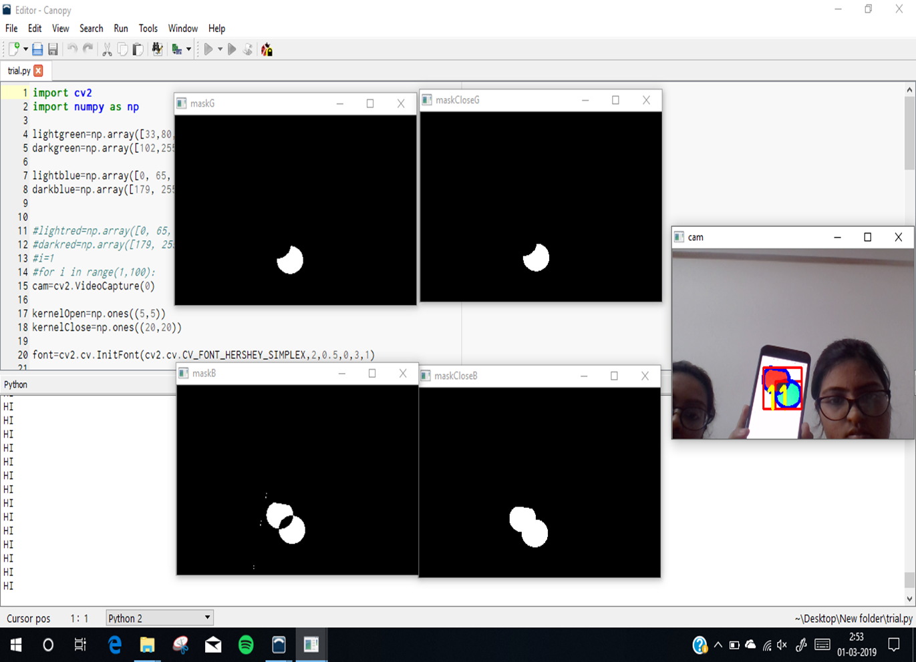

Slide 13
FUTURE SCOPE
With further enhancement in image processing like with the knowledge of CNN(Convolution Neural Networking) ,the model proposed can be used to read the text on objects and can be picked based on that criteria.
The robotic arm can be further designed to pick up heavy load objects.

Slide 14
CONCLUSION
The conclusions drawn from the results given by the object sorting robot using image processing is as follows:
1.The recognition of objects based on its colour which is red is successfully implemented.
2.The robot is following the given line with the help of sensors properly.
3.With the help of Arduino the robotic arm’s movement is being controlled.
4. Due to use of image processing in Open CV for colour determination, manual efforts are reduced which produces result in improving accuracy.

Slide 15
LITERATURE
[1] Object Sorting Robot using Image Processing Lekha Bhausaheb Kachare ME Student (VLSI & Embedded system) Department of E & TC G.H. Raisoni COEM, Ahmednagar, India. International Journal of Engineering Science and Computing, June 2017
[2] Object Sorting Robot Based On the Shape Priya Vinayak Garad G. H Raisoni College of Engineering & Management, Pune.Impact factor: 4.295 (Volume3, Issue5).International Journal of Advance Research, Ideas and Innovations in Technology.
[3] Object Sorting using Image Processing
Conference: 2018 3rd IEEE International Conference on Recent Trends in Electronics, Information & Communication Technology (RTEICT-2018)
[4]Survey Paper on Fruit Picking Robots Ashwini K Assistant Professor, Department of Information Science and Engineering, New Horizon College of Engineering. International Journal of Computer Science and Mobile Computing A Monthly Journal of Computer Science and Information Technology

Slide 16
THANK YOU

