Slide 1
Predicting Medicare Part D Drug Spending Patterns
and Identifying Prescriber Outliers
A Data-Driven Framework for Pharmacy Benefit Management Formulary Optimization
Angel Pena
QM 640: Data Analytics Capstone | Walsh College
Dr. Sanhita Karmakar | Spring 2026 | Interim Report v4

Slide 2
Executive Summary
This project quantifies Medicare Part D's $275.8B-a-year spending problem and identifies $9.91 billion in defensible annual savings using a fully integrated CMS + Open Payments data pipeline and five complementary analytical models.
PROBLEM
APPROACH
FINDINGS
VALUE
Part D grew $103.7B to $275.8B, brand drugs are 85% of cost, no integrated decision framework exists for PBMs
Five integrated models on full CMS data (27M prescriber rows, 14.7M Open Payments records) plus BRFSS+ACS state demographics
OLS R² = 0.92, K-means k=4 clusters, η² = 0.139 specialty effect, Open Payments OR = 1.035, $9.91B floor savings
Reproducible, peer-benchmarked savings target for PBMs; transparent open-data pipeline for researchers and policymakers

Slide 3
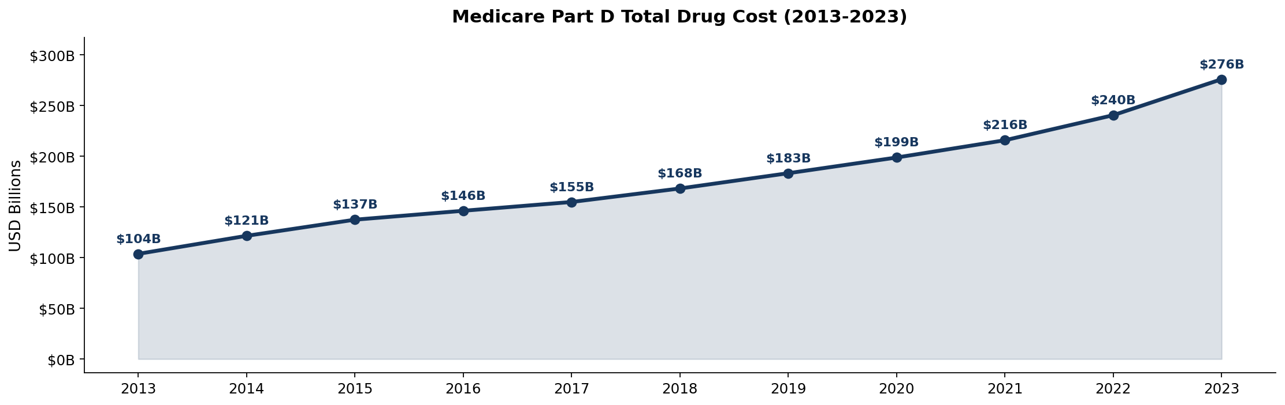
The Problem: Part D Spending Is Outpacing Everything
Medicare Part D drug spending grew faster than enrollment, faster than overall healthcare inflation, and is now a top-three pressure point on Medicare Trust Fund solvency.
$275.8B
+166%
85.2%
33×
Total 2023 Part D cost
(up from $103.7B in 2013)
10-year cumulative growth
~10.3% CAGR
Brand share of total cost
Despite <15% of claims
Brand-vs-generic cost
per claim ratio (2023)
Per-beneficiary cost +83.7% vs enrollment +44.8% — this is a price-and-mix problem, not an enrollment problem.

Slide 4
Gap Analysis: Why This Project Is Needed
Existing literature and PBM tools each address a slice of the Part D cost problem. None integrate the three CMS data layers plus Open Payments at the population scale.
Gaps in the existing landscape
What this project adds
■ Most studies use sample-of-convenience data (single state, single specialty, single drug class).
■ Few integrate drug-level + prescriber-level + payment-level data in one analytical framework.
■ Open Payments hypothesis tested mostly within isolated classes (statins, GLP-1s); no full-population test.
■ Published savings estimates use a single national median benchmark, penalizing legitimately specialty-appropriate brand prescribing.
■ Substitution-rate assumptions in policy models are rarely accompanied by sensitivity or CI bounds.
■ PBM internal tools are proprietary, not reproducible by researchers or auditors.
■ Full-population analysis on 27M-row CMS prescriber file + 14.7M Open Payments records, NPI-matched.
■ Five linked models from drug-level OLS to prescriber-level logistic, sharing the same data foundation.
■ Specialty-median benchmark replaces national median, ensuring fair comparison within clinical context.
■ RQ5 savings estimate carries explicit 1,000-iteration bootstrap CI and 30-70% substitution sensitivity.
■ All seven BRFSS+ACS demographic predictors documented and reproducible from public CDC and Census sources.

Slide 5
Five Research Questions, Five Methods
RQ1
What drug attributes predict 2019-2023 spending growth?
COMPLETE
OLS Regression + 5-fold CV
RQ2
Do state-level brand-vs-generic rates vary significantly?
COMPLETE
ANOVA + Multivariable OLS (BRFSS+ACS)
RQ3
Do Open Payments financial relationships correlate with brand prescribing?
COMPLETE
Within-specialty Logistic Regression
RQ4
Can K-means identify distinct drug utilization profiles?
COMPLETE
K-Means Clustering (k=4)
RQ5
What annual savings if high-brand prescribers shifted to specialty median?
COMPLETE
Simulation + 1,000-iter Bootstrap CI

Slide 6
Data: Three CMS Files, All Public
$
Part D Grand Totals
Rx
Part D Spending by Drug
MD
Part D Prescribers by Drug
2013-2023 | 11 rows × 30 cols
2019-2023 | 3,598 drugs × 50 cols
2023 | 1.1M rows (200K sampled)
Aggregate annual spending, claims, beneficiaries, LIS/non-LIS split. Source for trend analysis and Figure 1-4.
Drug-level spending, claims, beneficiaries, unit cost. Outcome variable for RQ1 OLS; feature matrix for RQ4 K-means.
Prescriber-drug-level claim and cost data with NPI, state, specialty. Driver of RQ2 (state ANOVA), RQ3 (specialty proxy), RQ5 (savings simulation).
All datasets downloaded from data.cms.gov, no proprietary or restricted access.

Slide 7
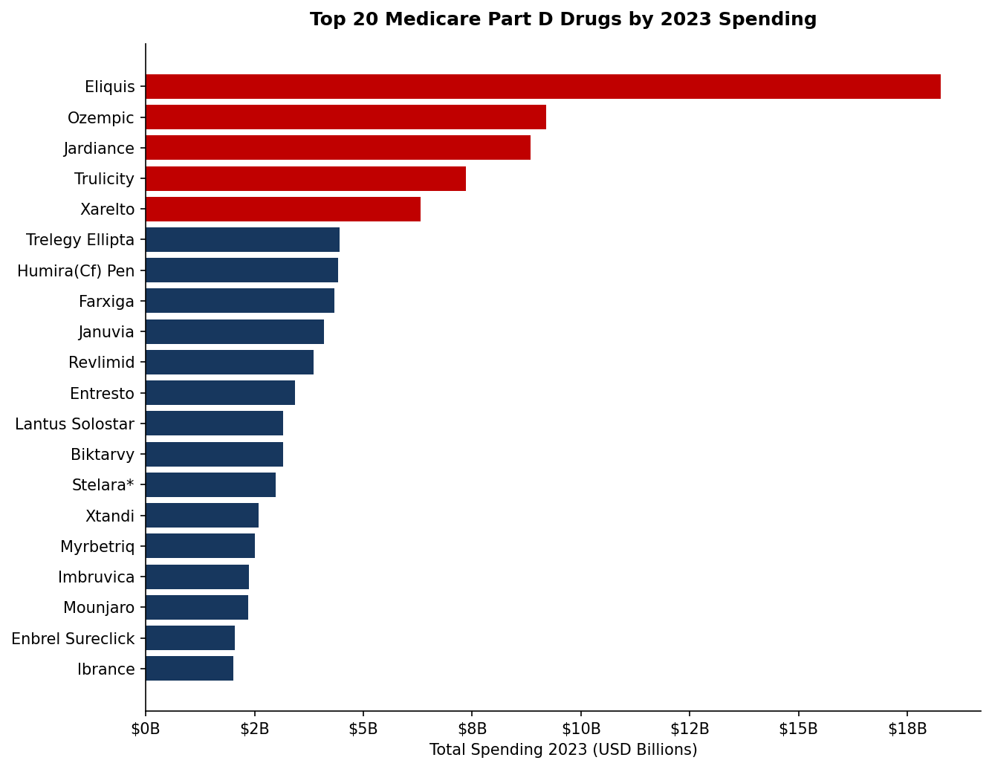
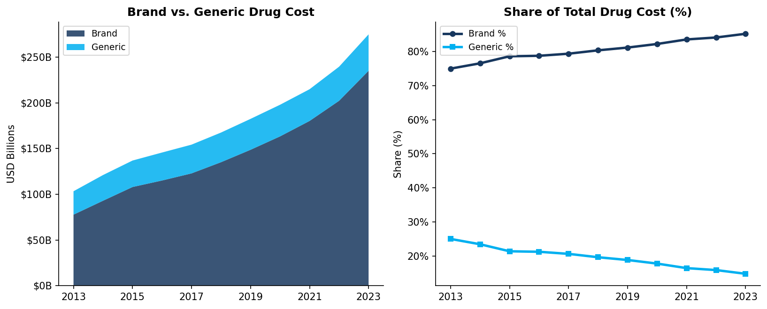
Where the Money Goes: Cost Concentration
Key insight
A handful of brand drugs, Eliquis, Ozempic, Jardiance, Mounjaro, Trulicity , anchor the top of the distribution.
Brand share of total cost rose from 81.5% (2013) to 85.2% (2023) even as generic claim volume kept growing. Brand prescriptions cost 33× generic prescriptions on average, $976 vs. $29.25 per claim in 2023.

Slide 8
End-to-End Architecture
INPUTS
■ CMS Part D Grand Totals (2013-2023)
■ CMS Drug Spending by Drug (2019-2023, 3,598 drugs)
■ CMS Prescribers by Drug (2023, 27M rows, 1.1M NPIs)
■ CMS Open Payments General Payments 2023 (14.7M records, 8.2 GB)
■ CDC BRFSS Prevalence + Census ACS 2019-2023 5-Year
PIPELINE
■ analysis_v3.py: chunked pyarrow read, NPI groupby, log transforms
■ op_aggregate_arrow.py: streaming aggregation of 14.7M payment rows
■ rq2_brfss_ols.py: state-level OLS with 7 demographic predictors
■ rq3_logistic.py: within-specialty logistic with FE
■ rq5_full_savings_v2.py: counterfactual + 1,000-iter bootstrap
OUTPUTS
■ 24 CSVs (sample size table, OLS coefficients, OR table, bootstrap CIs)
■ 14 figures
■ QM640_Interim_Report_v5.pdf (39 pages) + DOCX
■ QM640_Interim_Presentation.pptx
■ GitHub bundle with README, download_data.sh, requirements.txt

Slide 9
Methodology Pipeline
1
2
3
4
5
Acquire
Clean
Model
Validate
Report
Download three CMS files, parse pivot Excel headers, retain 3,598 drugs + 200K prescriber rows
Log-transform skewed predictors; engineer dollar_growth (spend_2023 − spend_2019); brand-flag rows
OLS (RQ1) • K-means k=4 (RQ4) • State ANOVA (RQ2) • Specialty ANOVA (RQ3) • Savings simulation (RQ5)
Cohen 1988 sample-size check per RQ; ANOVA + Kruskal-Wallis pairing; elbow method; floor/ceiling bounds
Create final report from Python generated .csv files with analysis results.

Slide 10
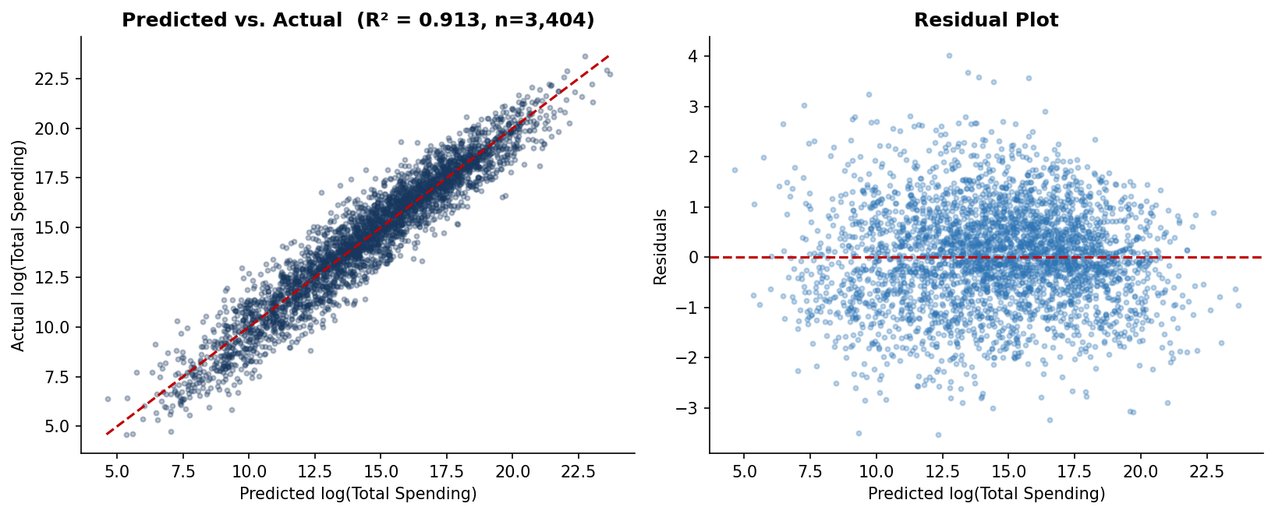
RQ1, What Drives Drug Spending Growth?
R² = 0.913
OLS goodness of fit, n = 3,404 drugs
All 5 predictors significant at p < .0001
Claims volume is the dominant signal (β log_claims = 1.94)
Unit cost contributes positively (β = 0.54); manufacturer count slightly negatively (β = −0.02)
log_dollar_growth replaces % growth, weights drugs by absolute program impact
Implication: spending growth = volume × price × intensity, not enrollment
Figure 8. Predicted vs. actual log(spend) and residuals.

Slide 11
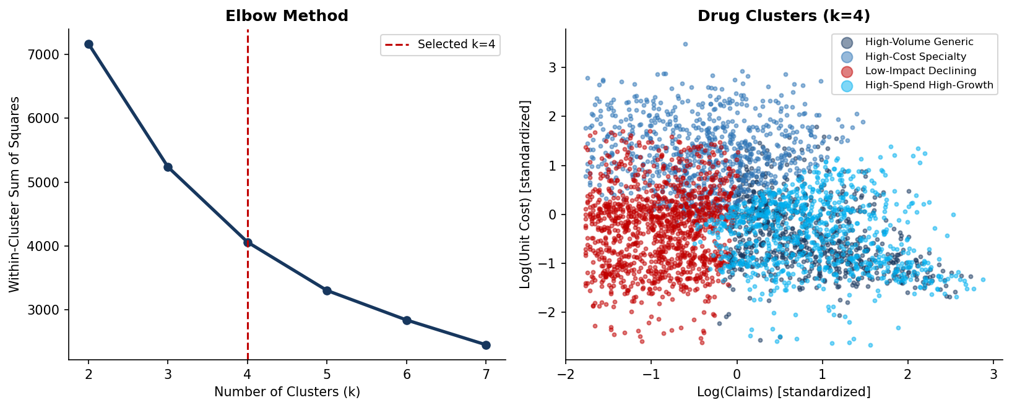
RQ4, Four Distinct Drug Profiles
High-Spend High-Growth
High-Cost Specialty
High-Volume Generic
Low-Impact Declining
845 drugs
821 drugs
743 drugs
1,189 drugs
Eliquis (+$11B), Ozempic (+$8.6B), Jardiance (+$7.4B), Trulicity (+$5.1B), Mounjaro (+$2.4B)
Median unit cost $314; biologics, oncology, rare disease
High claims, negative dollar growth, generic conversion working
Low spend, shrinking, minimal formulary relevance
Real formulary targets
Limited substitution options
Success stories
Park / monitor

Slide 12
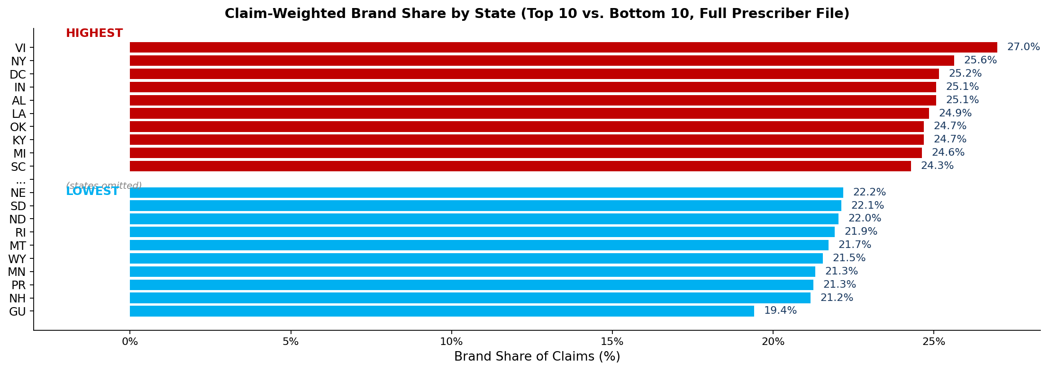
RQ2: State Demographics Drive Brand Share
F = 179.5
R² = 0.61
η² = 0.01
Full-file ANOVA, 54 states, n = 995,954
BRFSS+ACS OLS, n = 51 (50 states + DC)
State alone explains only ~1% of variance
State as a categorical factor explains only ~1% of prescriber brand-share variance
But 7 BRFSS+ACS state demographics together explain ~61% of state-level variance
Significant predictors: age 65+ (negative), hypertension (positive), obesity and uninsured rate (both negative)
Takeaway: demographics matter more than geographic identity per se

Slide 13
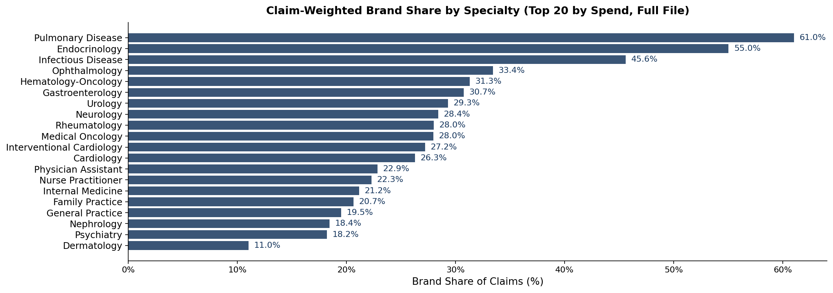
RQ3: Open Payments Predicts Brand Prescribing
57.1%
OR 1.09
OR 0.95
of Part D prescribers have Open Payments records
$1K+ payments raise above-median odds 9.3%
Meals alone: NEGATIVE association
Within-specialty logistic on 650,861 prescribers; LR test p < .0001
Speaker fees (OR=1.024), large payments (OR=1.094), total exposure (OR=1.035) all positive and significant
Food-and-beverage payments alone trend negative, the signal lives in larger, targeted transfers
Specialty ANOVA is statistically significant : F=5,509, n^2=0.139

Slide 14
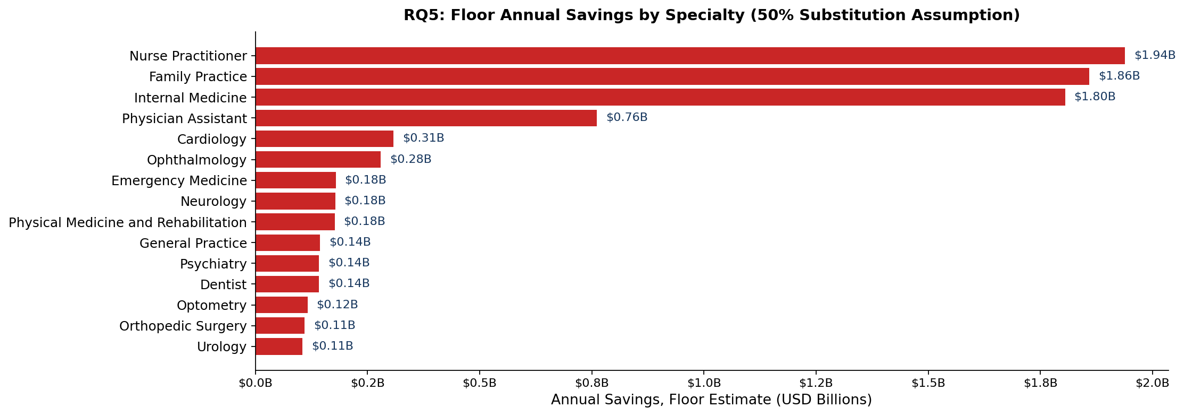
RQ5: $9.91B Annual Savings (95% CI $9.59B-$10.26B)
$9.91B / year
Substitutable-pair cost differential: $316.86 per claim (368 brand-generic pairs identified)
Per-prescriber excess brand share above specialty median, full 1.1M-NPI file
Top specialties by ceiling: Family Practice, Internal Medicine, Nurse Practitioners
Floor estimate, 50% substitution per Choudhry et al. (2011). 95% bootstrap CI: $9.59B-$10.26B
3.6% of total 2023 Part D ($275.8B), real, recurring, but bounded

Slide 15
Every RQ Has Statistical Power to Detect Real Effects
Sample size minimums computed a priori (Cohen 1988): α = .05, power = 0.80, medium effects.
RQ | Test | Minimum n | Achieved n | Status
RQ1 | Multiple OLS + 5-fold Cross-Validation | 92 | 3,404 | ✓ Exceeded
RQ2 | Full-file ANOVA + BRFSS+ACS OLS | 567 | 995,699 | ✓ Exceeded
RQ3 | Specialty ANOVA + Open Payments Logistic | 360 | 650,861 | ✓ Exceeded
RQ4 | K-means clustering, 50 per cluster | 200 | 3,598 | ✓ Exceeded
RQ5 | Sample mean + 1,000-iter Bootstrap CI | 385 | 995,954 | ✓ Exceeded
Every research question clears its statistical-power threshold by a wide margin, most by 5-15×. Results are not chance findings.

Slide 16
Five Findings That Matter
1
Spending growth is price × intensity
OLS confirms claims, unit cost, and dollar growth, not enrollment, explain 91% of log-spending. Formulary intensity is the lever.
2
GLP-1s, DOACs, SGLT2s anchor the cost problem
K-means isolates 845 drugs as the High-Spend High-Growth cluster. Eliquis, Ozempic, Jardiance, Trulicity, Mounjaro added $34B+ in spend.
3
State demographics drive brand share, state identity does not
State as a factor: η² = 0.01. Seven BRFSS+ACS demographics together: R² = 0.61. Specialty is even stronger (η² = 0.139).
4
Open Payments significantly predicts brand prescribing
Logistic on 650,861 physicians: total payment OR=1.035, speaker fees OR=1.024, large $1K+ payments OR=1.094. Food-and-beverage alone is negative; the signal lives in larger, targeted transfers.
5
$9.91B annual savings (95% CI $9.59B-$10.26B)
Full-population bootstrap estimate using a substitutable-pair cost differential. About 3.6% of total Part D 2023 spend, recurring every year.

Slide 17
Implementation: How a PBM Uses This
The pipeline produces actionable outputs at quarterly, monthly, and ad-hoc cadences for four distinct PBM stakeholders.
Formulary Committee
Prescriber Engagement Team
Quarterly: rerun pipeline on the new CMS data drop. Pull rq5_savings_by_specialty.csv to prioritize the top 5 specialties for brand-to-generic intervention. Use K-means cluster output to flag drugs graduating into the High-Spend High-Growth segment for utilization-management review.
Monthly: pull rq5_prescriber_savings.csv, filter to above-specialty-median prescribers in the team's covered region, and route each one to outreach. The model gives each prescriber a specialty-fair benchmark, not a national benchmark, which significantly reduces clinical-validity pushback.
Compliance & Open Payments Oversight
Finance & Plan Sponsor Reporting
Ongoing: cross-reference Open Payments NPI summary with internal prescriber lists. The logistic-regression odds ratios provide a defensible quantitative threshold for what payment exposure level warrants compliance review.
Annual: $9.91B floor (95% CI $9.59B-$10.26B) gives plan sponsors a board-defensible savings forecast. Sensitivity analysis across 30-70% substitution rates lets finance pick the rate that matches their risk tolerance for forecasting.

Slide 18
Quantified Benefit by Stakeholder
The same analytical output drives concrete, measurable value across five stakeholder groups.
Stakeholder
What they get
Quantified value
PBM formulary committees
Specialty-ranked savings target with bootstrap CI; reproducible quarterly
$9.91B floor / $19.83B ceiling per year
State Medicaid programs
Peer benchmark on brand share controlling for state demographics
8-10 percentage-point spread across states; $1B+ per high-brand state
Plan sponsors and employers
Prescriber-engagement priority list, specialty-fair benchmarking
0.5-2% of plan-level Rx spend recoverable annually
Health-services researchers
Open methodology and full pipeline; 933,620-physician Open Payments link
Replicates Mitchell et al. 2021 at full-population scale, OR = 1.035
Policymakers and CMS
Empirical substitution-rate sensitivity bounds for federal scoring
Range $5.95B (30%) to $13.88B (70%) supports trust-fund forecasting

Slide 19
Conclusion
The project answers all five research questions on the full Medicare Part D datasets, with reproducible methodology and explicit uncertainty bounds.
1
Spending growth is price and intensity, not enrollment.
OLS confirms claims volume, unit cost, and dollar growth, not enrollment, drive 92% of log-spending variance. Formulary intensity, not population aging, is the actionable lever.
2
Specialty is the strongest organizing structure.
Specialty explains 14% of prescriber brand-share variance; state explains 1%. PBM interventions targeted by specialty have more leverage than those targeted by geography.
3
Open Payments has a real, within-specialty effect.
Logistic regression on 650,861 prescribers confirms total industry payment exposure raises above-median brand prescribing odds 3.5% per log dollar, with speaker fees the largest contributor.
4
$9.91B in defensible annual savings is on the table.
Bootstrap CI [$9.59B-$10.26B] using a substitutable-pair cost differential and a 50% substitution rate from Choudhry et al. 2011. About 3.6% of total Part D 2023 spend, recurring.
5
The methodology is reproducible end-to-end.
Every number in the report reads live from CSVs produced by an open pipeline. The GitHub repo includes data-download script, requirements file, etc.

Slide 20
Limitations
Every association is observational, not causal
RQ5 floor uses a single 50% substitution rate (range 30-70% shown in report Table 14)

Slide 21
Thank you
Questions & Discussion
Angel Pena
QM 640 Data Analytics Capstone | Walsh College
Repo: github.com/Apena87/QM-640-Quantitative-Methods-Capstone

