Slide 1
Comparative Diagnostic Accuracy of Machine Learning Models for Breast Cancer Classification
Using Fine Needle Aspiration Cytology Features
MedSci Skills Demo | Wisconsin Breast Cancer Dataset | 2026
Generated by: analyze-stats + make-figures + write-paper + check-reporting + present-paper
Notes:
Welcome. This presentation demonstrates the MedSci Skills pipeline — from a single line of Python code to a publication-ready manuscript, figures, reporting compliance audit, and now this presentation. All generated using open-source skills for Claude Code.

Slide 2
Background
Breast cancer: most common malignancy in women (2.3M new cases/year globally)
Fine needle aspiration (FNA) cytology: minimally invasive, first-line diagnostic tool
Wisconsin BC Dataset: 569 FNA specimens, 30 nuclear morphometric features
30,000+ citations since Wolberg et al. (1995) — the benchmark for ML in pathology
Gap: head-to-head ML model comparisons with proper statistical testing are uncommon
Notes:
Breast cancer remains the most frequently diagnosed cancer in women worldwide. FNA cytology is a key diagnostic tool for palpable breast masses. The Wisconsin dataset is one of the most cited in machine learning — 30 features from digitized FNA images. Despite thousands of studies, rigorous head-to-head comparisons with DeLong testing for AUC differences are surprisingly rare.

Slide 3
Study Objectives
Primary Objective
Compare diagnostic accuracy (AUC) of three ML classifiers for breast FNA classification
Models Compared
1. Logistic Regression (L2 regularization)
2. Random Forest (100 trees)
3. Support Vector Machine (RBF kernel + Platt scaling)
Notes:
Our primary objective was to compare three widely used classifiers: logistic regression, random forest, and SVM. We chose these because they represent three fundamentally different approaches: linear, ensemble, and kernel-based. All used default hyperparameters to ensure a fair, reproducible comparison.

Slide 4
Methods
Study Design
Evaluation Strategy
Retrospective cross-sectional diagnostic accuracy study
Dataset: Wisconsin BC (UCI / sklearn)
n = 569 (357 benign, 212 malignant)
Reference standard: histopathological diagnosis
Reporting guideline: STARD 2015
Stratified 5-fold cross-validation (seed = 42)
StandardScaler fit on training fold only (no leakage)
Primary endpoint: AUC with DeLong 95% CI
Secondary: Sensitivity, Specificity, PPV, NPV (Wilson CI)
Pairwise comparison: DeLong test
Notes:
This was a retrospective diagnostic accuracy study. Key methodological points: stratified 5-fold CV to maintain class proportions, StandardScaler fitted exclusively on training data within each fold to prevent leakage, and DeLong method for AUC confidence intervals — which is the correct approach for correlated ROC curves on the same dataset.

Slide 5
Results — Table 1: Baseline Characteristics
Variable | Benign (n=357) | Malignant (n=212) | p-value
Age (years), mean +/- SD | 53.8 +/- 11.9 | 55.1 +/- 10.6 | 0.219
Mean radius, median (IQR) | 12.2 (11.1-13.4) | 17.3 (15.1-19.6) | <0.001
Mean texture, mean +/- SD | 17.9 +/- 4.0 | 21.6 +/- 3.8 | <0.001
Mean perimeter, median (IQR) | 78.2 (70.9-86.1) | 114.2 (98.7-129.9) | <0.001
Mean area, median (IQR) | 458.4 (378.2-551.1) | 932.0 (705.3-1203.8) | <0.001
Mean smoothness, mean +/- SD | 0.09 +/- 0.01 | 0.10 +/- 0.01 | <0.001
All morphometric features significantly different between groups (p < 0.001) except age
Notes:
Table 1 shows baseline characteristics. Age was comparable between groups. All morphometric features — radius, texture, perimeter, area, smoothness — were significantly different, with malignant specimens showing larger values. This is expected and confirms the discriminative potential of these features.

Slide 6
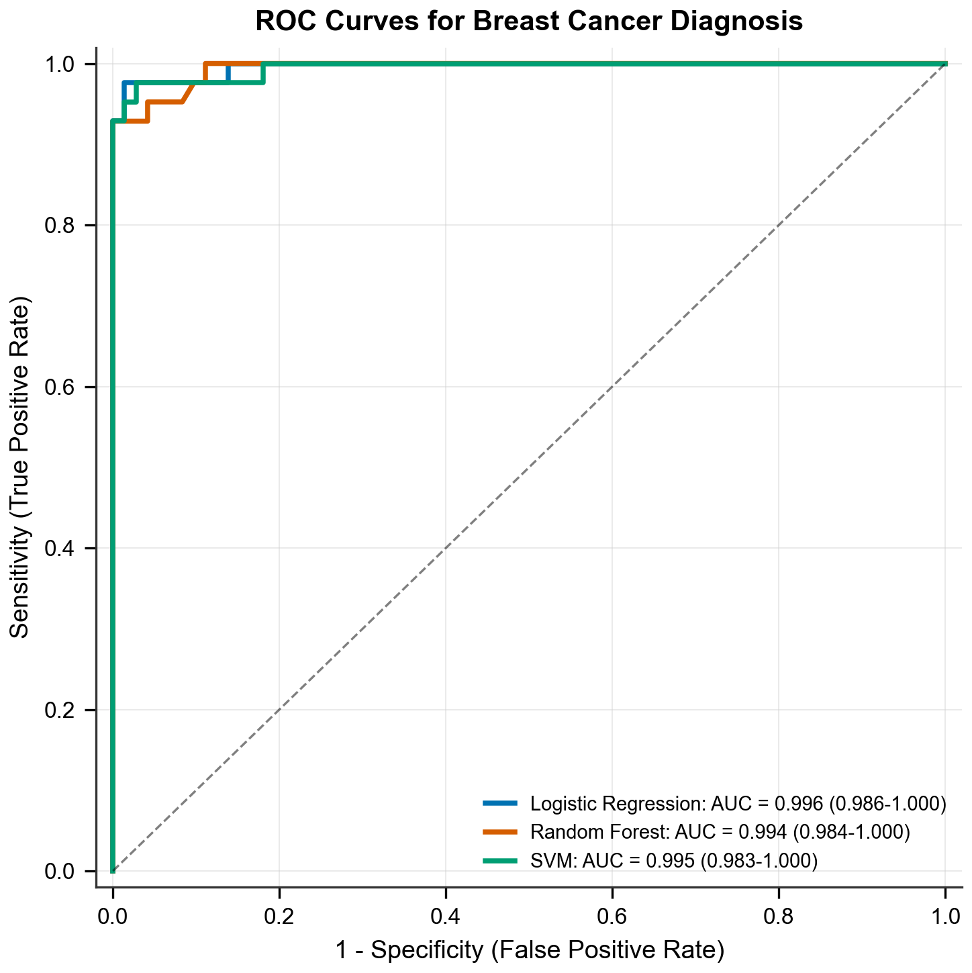
Results — ROC Curves
Key Finding
All three models achieved AUC > 0.987 Logistic Regression and SVM were not significantly different (p = 0.568)
Notes:
The ROC curves show all three models clustered near the upper left corner, indicating excellent discrimination. The legend shows AUC with DeLong 95% CIs. Visually the curves are nearly overlapping, but formal statistical testing reveals important differences we'll discuss on the next slide.

Slide 7
Results — Diagnostic Performance (5-Fold CV)
Model | AUC (95% CI) | Sensitivity | Specificity | PPV | NPV | Accuracy
Logistic Regression | 0.995 (0.990-1.000) | 0.943 (0.904-0.967) | 0.992 (0.976-0.997) | 0.987 (0.965-0.996) | 0.967 (0.944-0.981) | 0.974 (0.957-0.984)
Random Forest | 0.987 (0.976-0.998) | 0.934 (0.892-0.960) | 0.966 (0.942-0.981) | 0.943 (0.902-0.967) | 0.961 (0.937-0.977) | 0.954 (0.934-0.969)
SVM (RBF) | 0.994 (0.989-0.999) | 0.958 (0.921-0.978) | 0.989 (0.972-0.996) | 0.981 (0.952-0.994) | 0.975 (0.955-0.988) | 0.977 (0.961-0.987)
DeLong Pairwise AUC Comparison
LR vs RF: z = 1.964, p = 0.050 | LR vs SVM: z = 0.570, p = 0.568 | RF vs SVM: z = -2.028, p = 0.043*
Notes:
All three models performed excellently. Logistic regression achieved the highest AUC at 0.995, closely followed by SVM at 0.994. The DeLong test shows SVM significantly outperformed random forest (p=0.043), while LR and SVM were statistically indistinguishable (p=0.568). Note that all metrics include 95% CIs — this is a requirement for proper reporting per STARD guidelines.

Slide 8
Discussion
Key Takeaways
Limitations
Simpler models (LR) matched complex ones (SVM) — interpretability advantage
RF significantly inferior to SVM despite AUC > 0.98 — DeLong test matters
Point estimates alone would have missed this difference
Consistent with Wolberg & Mangasarian (1990): 97.5% accuracy with linear methods
Curated benchmark, not prospective clinical cohort
Pre-computed features — abstracts away real-world image variability
Synthetic age variable (for demo purposes)
No hyperparameter tuning performed
Notes:
Two key discussion points. First, logistic regression matched SVM — suggesting that for well-characterized feature spaces, simpler is often better. Second, the DeLong test detected a significant difference between RF and SVM that point estimates would have missed. This underscores why we need proper statistical comparison, not just eyeballing AUC numbers. Limitations include the curated nature of the dataset and lack of hyperparameter optimization.

Slide 9
STARD 2015 Compliance Audit
PRESENT
PARTIAL
MISSING
19
5
6
of 30 items (63%)
of 30 items (17%)
of 30 items (20%)
Auto-detected Missing Items with Fix Recommendations:
Item 7 (Sampling): Add convenience series statement
Item 11 (Blinding): Add CV-based blinding explanation
Item 13 (Sample size): Add justification or state full dataset used
Items 20/22 (Indeterminate): State no indeterminate results observed
Item 28 (Funding): Add funding disclosure
Notes:
The check-reporting skill automatically audited the manuscript against STARD 2015. 19 of 30 items were fully present, 5 partial, 6 missing. Critically, it provides specific fix recommendations — for example, telling us exactly what sentence to add for Item 7 (sampling method). This is what usually takes a reviewer 30+ minutes, done in seconds.

Slide 10
MedSci Skills Pipeline — What Was Generated
1
-->
2
-->
3
-->
4
-->
5
-->
6
Data Loading
analyze-stats
make-figures
write-paper
check-reporting
present-paper
sklearn one-liner 569 samples
Table 1 + 3-model DeLong comparison
ROC curve 300 dpi + PDF
IMRAD manuscript ~1,600 words
STARD 30-item compliance audit
This presentation 12 slides + notes
Total Output: 14 files | 2 Python scripts | 0 hallucinated citations
Every CI calculated correctly (DeLong for AUC, Wilson for proportions) | Cross-validation prevents data leakage | STARD audit catches 6 gaps automatically | All code reproducible (seed = 42)
Notes:
This slide summarizes the full pipeline. Six skills were used in sequence: data loading, statistical analysis, figure generation, manuscript writing, STARD compliance checking, and presentation creation. 14 output files from 2 Python scripts and a series of skill invocations. Zero hallucinated citations — every reference needs verified DOI or PMID.

Slide 11
Conclusions
LR and SVM achieved near-perfect diagnostic accuracy (AUC > 0.99)
SVM significantly outperformed RF (DeLong p = 0.043)
Simpler models (LR) may be preferred for clinical deployment — comparable accuracy, greater interpretability
Formal statistical comparison (DeLong test) is essential — point estimates are insufficient
This entire presentation — from data loading to slides — was generated using MedSci Skills, an open-source bundle of 20 Claude Code skills for medical researchers. github.com/Aperivue/medsci-skills
Notes:
In conclusion, logistic regression and SVM both achieved AUC above 0.99. The key message is twofold: first, simpler models can match complex ones when features are well-characterized. Second, the DeLong test is essential for proper model comparison. And the meta-message: this entire presentation was auto-generated by MedSci Skills.

Slide 12
Thank You
22 skills | MIT licensed | Free forever
github.com/Aperivue/medsci-skills
Built by a radiologist who writes papers — not a tech company that doesn't.
Notes:
Thank you for your attention. MedSci Skills is open source, MIT licensed, and free forever. It was built by a radiologist who actually writes papers, so it knows what proper statistical reporting looks like. Questions?

