Slide 1
Efficacy of BCG Vaccination for Prevention of Tuberculosis
A Meta-Analysis of Randomized Controlled Trials
MedSci Skills Demo
Based on Colditz et al. (1994) | 2026-04-14
Notes:
Welcome. This presentation summarizes a meta-analysis of 13 randomized controlled trials evaluating BCG vaccine efficacy for tuberculosis prevention. The analysis is based on the classic Colditz et al. 1994 dataset and serves as a teaching demonstration of meta-analytic methods.

Slide 2
Background
TB remains a leading infectious cause of death (1.3 million deaths/year)
BCG vaccine: only licensed TB vaccine, given to >100 million children annually
Reported efficacy ranges from 0% to >80% across studies
Landmark meta-analysis by Colditz et al. (JAMA 1994) identified geographic latitude as key moderator
Hypothesis: environmental non-tuberculous mycobacteria (NTM) exposure at lower latitudes attenuates BCG efficacy
Need: systematic quantification with modern meta-analytic methods
2 / 12
Notes:
Tuberculosis kills over a million people annually. BCG is the only licensed vaccine but its efficacy is highly variable. Colditz and colleagues published a seminal meta-analysis in 1994 showing that latitude strongly predicts vaccine efficacy. The leading explanation involves cross-reactive immunity from environmental NTM being more prevalent near the equator.

Slide 3
Objectives
1. Quantify the overall protective efficacy of BCG vaccination against tuberculosis
2. Assess the degree and sources of between-study heterogeneity
3. Evaluate the effect of geographic latitude on vaccine efficacy via meta-regression
4. Test the robustness of findings through sensitivity and publication bias analyses
3 / 12
Notes:
Our four objectives cover the full meta-analytic pipeline: pooled estimation, heterogeneity assessment, moderator analysis via meta-regression, and robustness checks including leave-one-out sensitivity and publication bias tests.

Slide 4
Methods
Data Source
13 RCTs from Colditz et al. (1994)
metafor::dat.bcg dataset
Published 1948-1980
Effect Measure
Risk Ratio (RR) from 2x2 tables
Log-transformed for analysis
Statistical Analysis
Random-effects model (REML)
Heterogeneity: Q, I-squared, tau-squared
Subgroup: allocation method
Meta-regression: absolute latitude
Publication bias: Egger, Begg, trim-and-fill
Sensitivity: leave-one-out
Software: R + metafor package
4 / 12
Notes:
We used the well-characterized dat.bcg dataset containing 13 RCTs. Risk ratios were computed from 2x2 tables and analyzed with a REML random-effects model. Our analysis pipeline includes heterogeneity assessment, subgroup analysis by allocation method, meta-regression with absolute latitude, and comprehensive publication bias and sensitivity analyses.

Slide 5
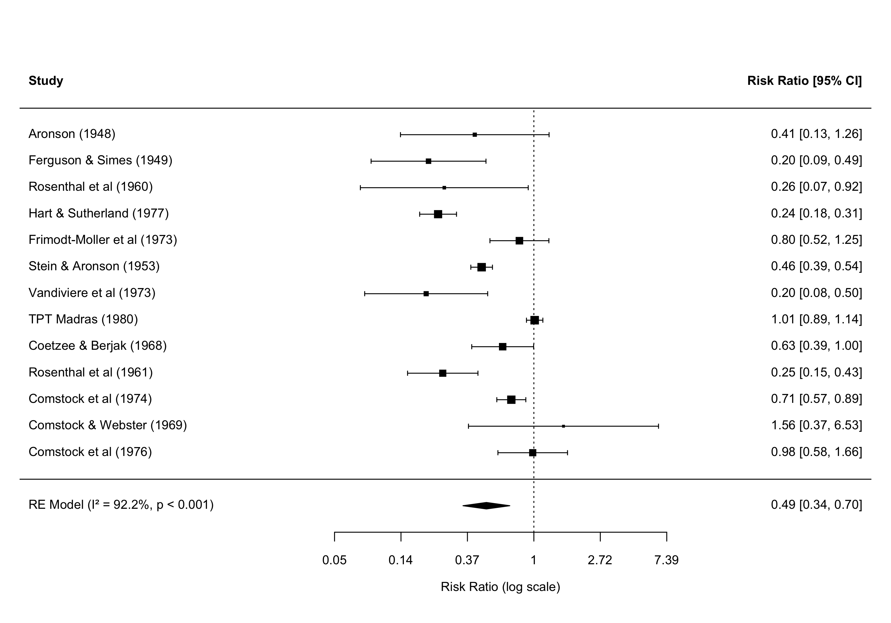
Results: Forest Plot
5 / 12
Notes:
The forest plot shows all 13 studies with their individual risk ratios and 95% confidence intervals. The pooled RR is 0.489, meaning BCG vaccination reduced TB risk by approximately 51%. Note the substantial variability across studies, with I-squared of 92.2%. The diamond at the bottom represents the pooled estimate under the REML random-effects model. Several studies, particularly TPT Madras and Comstock 1969/1976, show risk ratios near or above 1.0, indicating no protective effect in those settings.

Slide 6
Heterogeneity Assessment
Overall Pooled Estimate
RR = 0.489 (95% CI: 0.344 - 0.696)
Prediction interval: 0.155 - 1.549
Heterogeneity Metrics
Q = 152.23 (df = 12, p < 0.001)
I-squared = 92.2% (substantial heterogeneity)
Tau-squared = 0.3132
Subgroup Analysis (by allocation method)
Random (k=7): RR = 0.379 (0.221 - 0.650), I-squared = 89.9%
Alternate (k=2): RR = 0.582 (0.335 - 1.011), I-squared = 82.0%
Systematic (k=4): RR = 0.654 (0.323 - 1.324), I-squared = 86.4%
6 / 12
Notes:
Heterogeneity is substantial, with I-squared of 92.2%, meaning over 90% of variability is due to true differences between studies rather than sampling error. The prediction interval includes 1.0, cautioning that a future study might not show benefit. Randomly allocated trials showed the strongest protective effect, which may reflect better methodological quality. However, high residual heterogeneity persists within all subgroups.

Slide 7
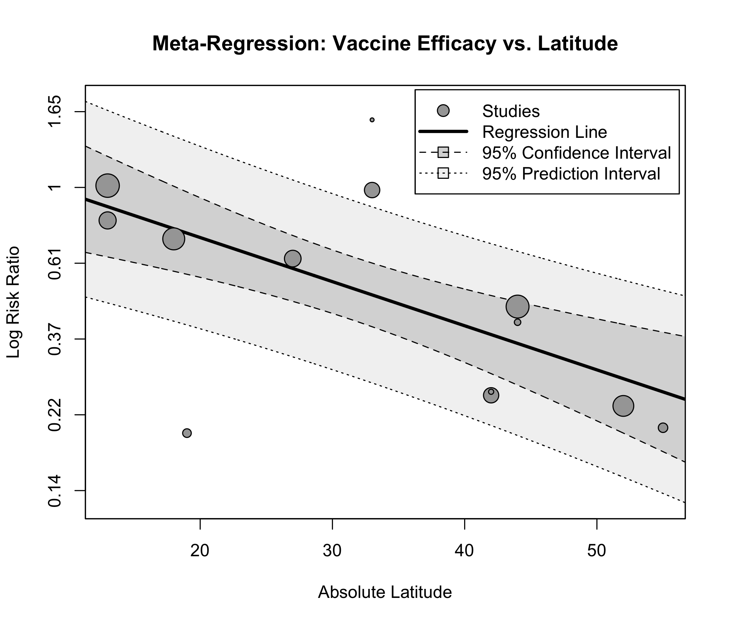
Meta-Regression: Latitude Effect
Key Findings
Coefficient: -0.0291
(SE = 0.0072, p < 0.001)
R-squared = 75.6%
Higher latitude
= greater efficacy
Consistent with NTM
exposure hypothesis
7 / 12
Notes:
The bubble plot demonstrates the strong negative relationship between latitude and log risk ratio. Each bubble is sized proportionally to study precision. The regression coefficient of -0.029 means that for each degree increase in latitude, the log RR decreases by 0.029, reflecting greater vaccine efficacy. Latitude alone explains 75.6% of between-study variance. This is consistent with the hypothesis that NTM exposure at lower latitudes provides partial cross-reactive immunity, reducing the incremental benefit of BCG.

Slide 8
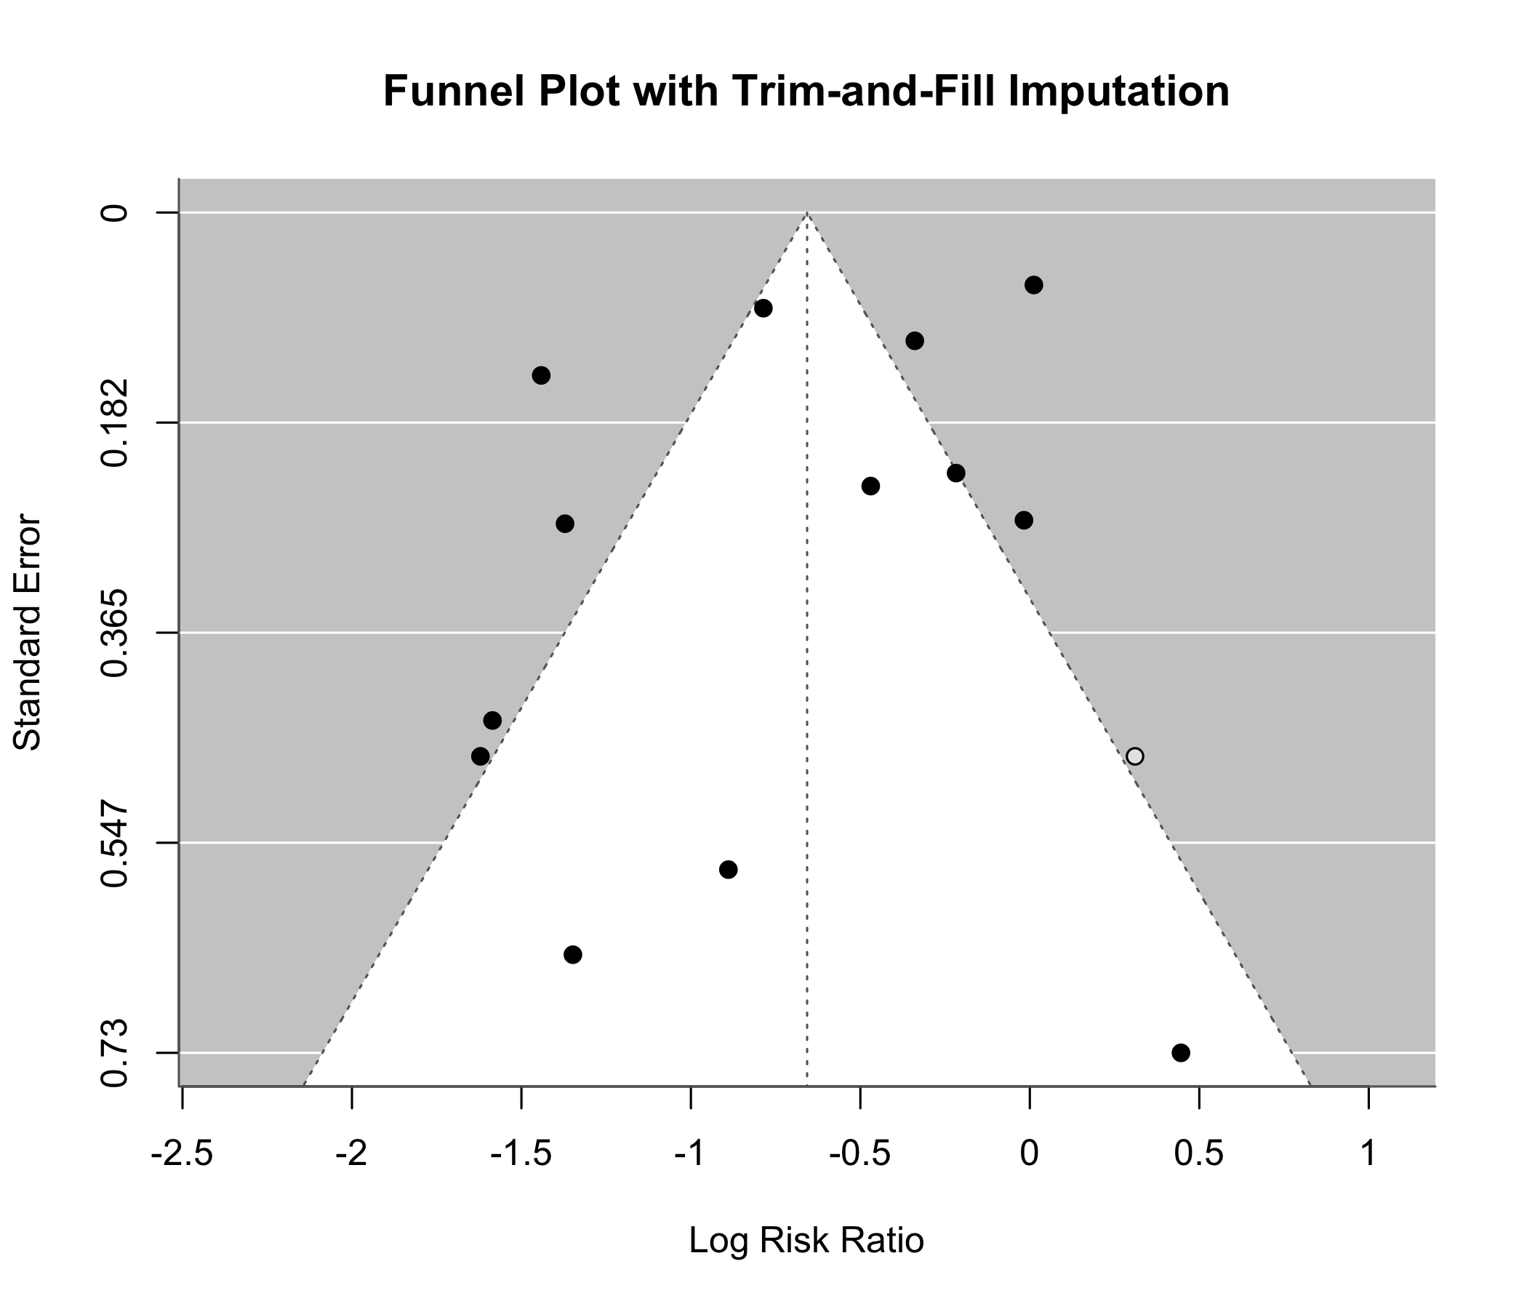
Publication Bias Assessment
Statistical Tests
Egger's test:
p = 0.189 (NS)
Begg's test:
p = 0.952 (NS)
Trim-and-fill:
1 study imputed
Adjusted RR = 0.518
(95% CI: 0.365-0.736)
No significant
publication bias detected
8 / 12
Notes:
Publication bias assessment is reassuring. The funnel plot shows reasonable symmetry. Both Egger's regression test and Begg's rank correlation test are non-significant. Trim-and-fill analysis imputed only one study, and the adjusted estimate of 0.518 is very close to the original 0.489, both remaining significant. However, with only 13 studies, these tests have limited statistical power.

Slide 9
Sensitivity Analysis: Leave-One-Out
Leave-One-Out Results
All 13 leave-one-out pooled RR estimates remain statistically significant
Range of pooled RR: 0.452 to 0.533
No single study reverses the overall conclusion
Influence Diagnostics
No studies with |externally standardized residual| > 2
No unduly influential individual studies detected
Interpretation
The protective effect of BCG vaccination is robust
Pooled estimate is not driven by any single trial
Results are stable across all sensitivity checks
9 / 12
Notes:
Leave-one-out analysis is a critical robustness check. By iteratively removing each study and re-fitting the model, we confirm that no single study unduly influences the pooled result. All 13 estimates remain significant, ranging from 0.452 to 0.533. No studies had large externally standardized residuals. This gives us confidence that the overall conclusion of BCG efficacy is robust.

Slide 10
Conclusions
1. BCG vaccination significantly reduces TB risk by ~51%
(RR = 0.489, 95% CI: 0.344-0.696)
2. Substantial heterogeneity (I-squared = 92.2%) driven primarily
by geographic latitude (R-squared = 75.6%)
3. Greater efficacy at higher latitudes, consistent with NTM
exposure hypothesis
4. No significant publication bias; results robust to
leave-one-out sensitivity analysis
5. Implications: continued BCG use justified, especially at higher
latitudes; novel vaccines needed for tropical regions
10 / 12
Notes:
In summary, BCG vaccination provides significant protection against TB with about 51% risk reduction. However, efficacy varies dramatically by latitude, with this single moderator explaining three-quarters of the heterogeneity. The findings support continued BCG use, particularly in temperate and high-latitude regions, while highlighting the urgent need for next-generation vaccines effective in tropical settings where NTM exposure attenuates BCG benefit.

Slide 11
Limitations
Historical dataset: trials conducted 1948-1980, evolving diagnostics and BCG strains
Aggregate data only: no individual patient data for within-study effect modification
Small number of studies (k=13): limits power for meta-regression and subgroup analyses
Teaching demonstration: uses curated dataset, not a de novo systematic review
No formal risk of bias assessment (RoB 2) or GRADE certainty evaluation
Wide prediction interval (0.155-1.549) includes 1.0, indicating uncertainty for new settings
11 / 12
Notes:
We should acknowledge several limitations. The data are historical, spanning a period when TB diagnostics and BCG manufacturing varied. We only have aggregate data, not individual patient data. With 13 studies, meta-regression power is limited. This is a re-analysis for teaching purposes, not a de novo systematic review. We also did not perform formal risk of bias or GRADE assessments, which would be required for a submission-ready manuscript.

Slide 12
Thank You
Questions?
Dataset: metafor::dat.bcg | Reference: Colditz et al. (JAMA 1994)
Generated with MedSci Skills | 2026-04-14
Notes:
Thank you for your attention. I am happy to take any questions. The full analysis code and outputs are available as part of the MedSci Skills demo package.

