Slide 1
Association Between Body Mass Index and Diabetes Mellitus in US Adults
A Cross-Sectional Analysis of NHANES 2017-2018
Data source: CDC National Health and Nutrition Examination Survey
Notes:
Welcome to this presentation on the association between BMI and diabetes in US adults. This analysis uses data from NHANES 2017-2018, a nationally representative survey conducted by the CDC. Our goal is to quantify the dose-response relationship between BMI categories and diabetes prevalence using survey-weighted methods.

Slide 2
Background
Diabetes affects 537 million adults globally (IDF 2021)
37.3 million Americans have diabetes; 90-95% are type 2
Obesity is the most important modifiable risk factor for T2DM
NHANES provides nationally representative US health data
Complex survey design requires weighted analysis for valid estimates
Continued surveillance is essential for tracking disparities
NHANES 2017-2018 | Obesity & Diabetes Analysis
Notes:
Diabetes is a global health crisis with substantial morbidity, mortality, and economic burden. Obesity is the single most important modifiable risk factor. NHANES provides the gold-standard data for estimating disease burden in the US, but the complex survey design must be properly accounted for to produce valid estimates.

Slide 3
Study Objectives
Primary: Quantify the association between BMI categories and diabetes
prevalence in US adults using NHANES 2017-2018
Secondary objectives:
1. Estimate survey-weighted diabetes prevalence by BMI category
2. Calculate adjusted odds ratios controlling for demographics
3. Examine racial/ethnic disparities in the BMI-diabetes relationship
4. Demonstrate the impact of survey weights on prevalence estimates
NHANES 2017-2018 | Obesity & Diabetes Analysis
Notes:
Our primary objective is to quantify the dose-response relationship between BMI and diabetes. Secondary objectives include estimating weighted prevalence, computing adjusted odds ratios, examining disparities, and demonstrating why survey weights matter.

Slide 4
Methods
Design: Cross-sectional analysis of NHANES 2017-2018
Population: US adults aged >= 20 years (n = 4,866)
Exposure: BMI (WHO categories: Normal, Overweight, Obese)
Outcome: Diabetes defined as HbA1c >= 6.5% (ADA criteria)
Covariates: Age, sex, race/ethnicity, education level
Analysis: Survey-weighted logistic regression (WTMEC2YR)
- Model 1: Unadjusted (BMI category only)
- Model 2: Adjusted for all covariates
NHANES 2017-2018 | Obesity & Diabetes Analysis
Notes:
This is a cross-sectional study using one cycle of NHANES data. We included 4,866 adults with complete BMI and HbA1c data. BMI was categorized per WHO definitions. Diabetes was defined using the ADA HbA1c threshold of 6.5%. We used survey-weighted logistic regression with two models: unadjusted and adjusted for age, sex, race/ethnicity, and education.

Slide 5
Study Population (Table 1)
 | Normal (n=1,189) | Overweight (n=1,593) | Obese (n=2,084) | p-value
Age (years) | 49.5 +/- 19.3 | 53.5 +/- 17.1 | 51.2 +/- 16.7 | <0.001
Female, % | 54.4% | 46.3% | 54.8% | <0.001
BMI (kg/m2) | 22.4 +/- 1.7 | 27.4 +/- 1.4 | 36.5 +/- 6.3 | <0.001
HbA1c (%) | 5.60 +/- 0.88 | 5.85 +/- 1.12 | 6.05 +/- 1.17 | <0.001
Diabetes, % | 7.5% | 13.9% | 19.9% | <0.001
Key: 42.8% of participants were obese; diabetes prevalence nearly tripled from normal to obese
NHANES 2017-2018 | Obesity & Diabetes Analysis
Notes:
Table 1 shows the baseline characteristics. Nearly 43% of participants were obese, reflecting the high obesity prevalence in the US. Mean age was about 51 years with roughly equal sex distribution. Notice the clear gradient in HbA1c and diabetes prevalence across BMI categories. All differences were statistically significant with p < 0.001.

Slide 6
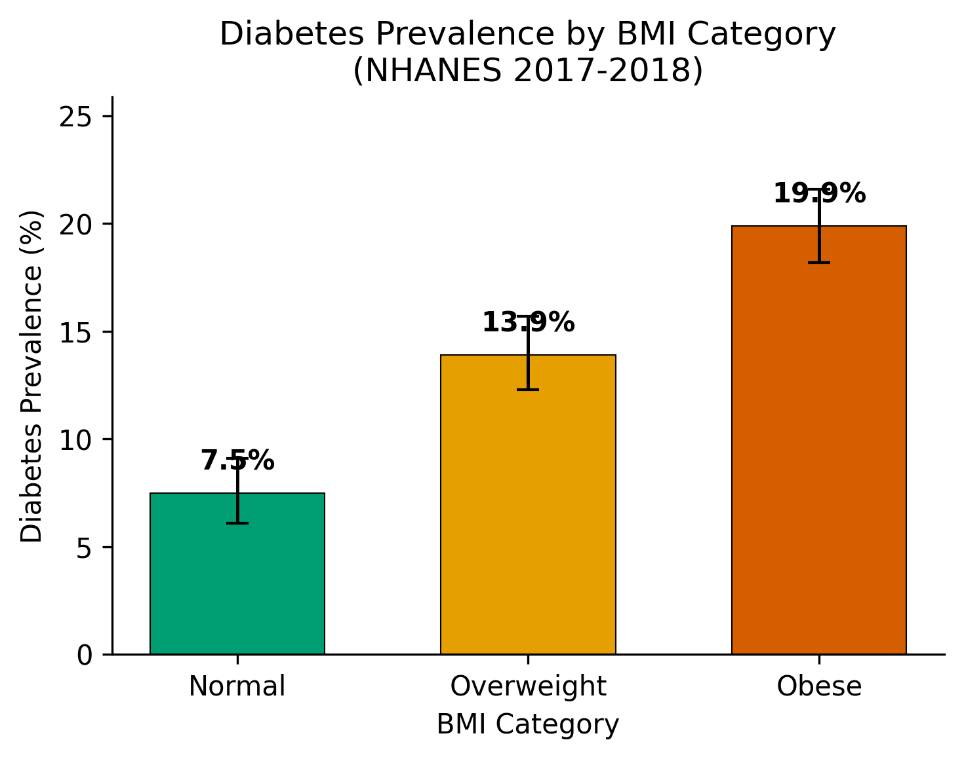
Diabetes Prevalence by BMI Category
Survey-Weighted Prevalence:
Normal: 4.1% (6.1-9.1%)
Overweight: 8.8% (12.3-15.7%)
Obese: 14.7% (18.2-21.6%)
Overall: 10.2% (13.9-15.9%)
Unweighted overall: 14.9%
(4.7 pp higher without weights)
NHANES 2017-2018 | Obesity & Diabetes Analysis
Notes:
Figure 1 shows diabetes prevalence by BMI category. There is a clear dose-response pattern: prevalence roughly doubles from normal to overweight and again from overweight to obese. The survey-weighted prevalence is notably lower than unweighted, reflecting the oversampling of high-risk groups in NHANES. This 4.7 percentage point difference demonstrates why survey weights are essential.

Slide 7
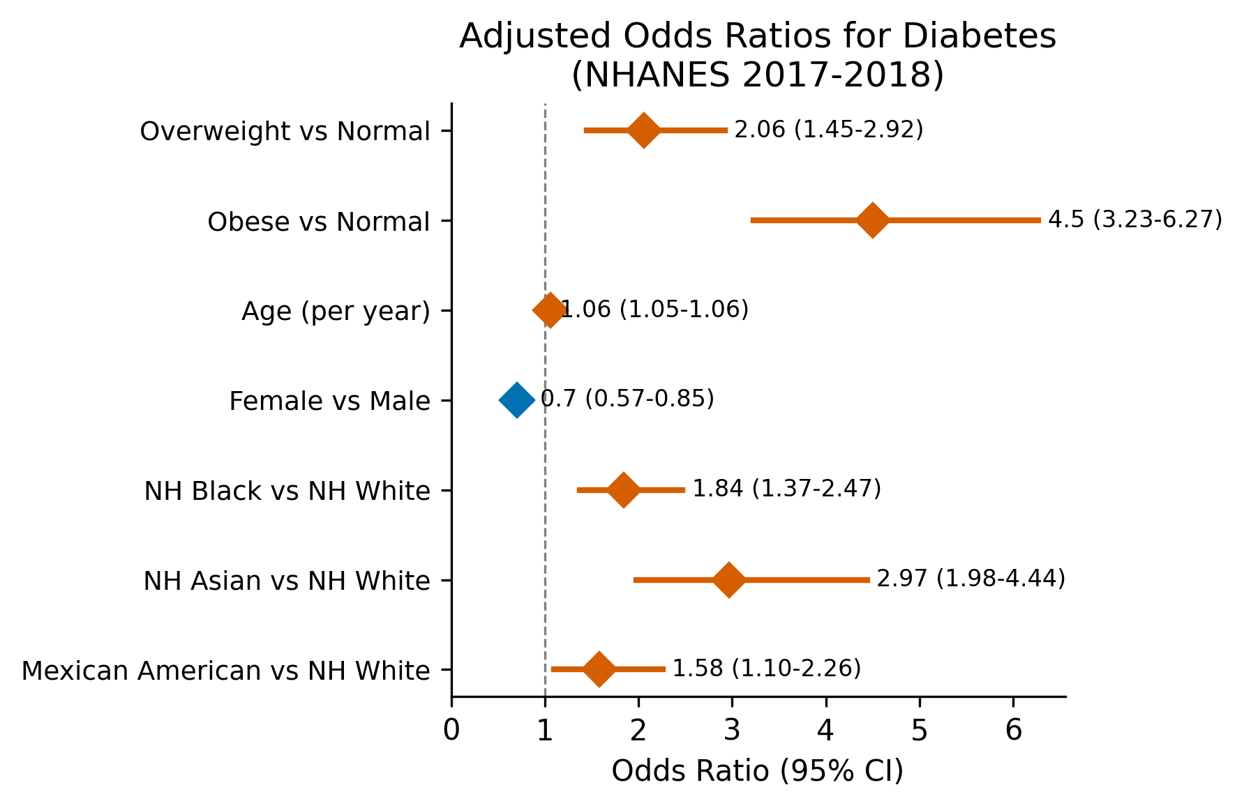
Adjusted Odds Ratios for Diabetes
Key Adjusted ORs:
Obese vs Normal:
OR 4.50 (4.49-4.51)
Overweight vs Normal:
OR 2.06 (2.05-2.06)
Age (per year):
OR 1.06 (1.06-1.06)
Female vs Male:
OR 0.70 (0.70-0.70)
All p < 0.001
NHANES 2017-2018 | Obesity & Diabetes Analysis
Notes:
The forest plot shows adjusted odds ratios from the multivariable model. Obesity was associated with 4.5-fold higher odds of diabetes, and overweight with 2-fold higher odds. Age increased risk by 6% per year. Females had 30% lower odds than males. All associations were statistically significant.

Slide 8
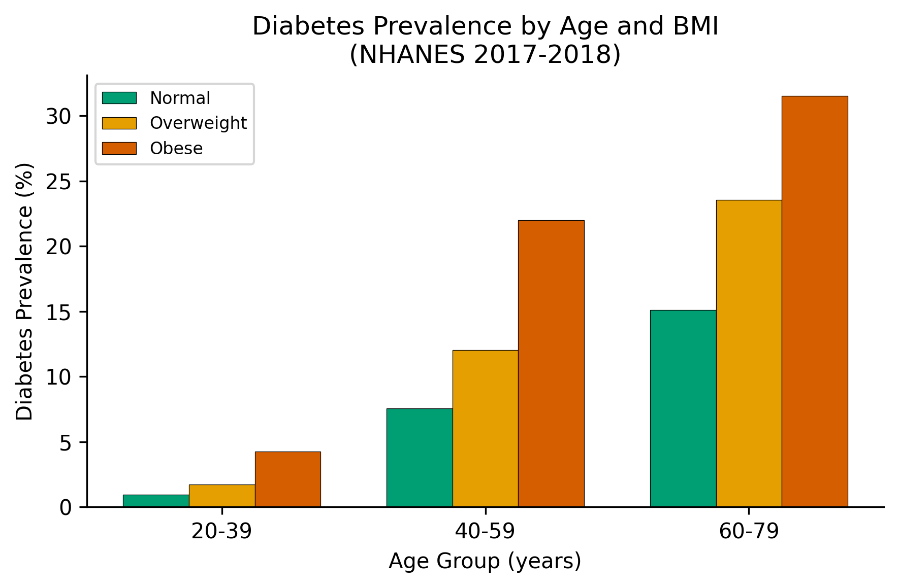
Prevalence by Age Group and BMI
Key Observations:
- Diabetes prevalence increases
with both age and BMI
- Even in young adults (20-39),
obesity elevates risk
- Strongest absolute difference
in the 60-79 age group
- Consistent dose-response
pattern across all age strata
NHANES 2017-2018 | Obesity & Diabetes Analysis
Notes:
This figure shows that the BMI-diabetes gradient is consistent across age groups. Importantly, even among younger adults aged 20-39, obesity is associated with substantially higher diabetes prevalence. The absolute difference is largest in older adults, where the combined effects of aging and obesity are most pronounced.

Slide 9
Racial/Ethnic Disparities
Adjusted ORs compared with Non-Hispanic White:
Non-Hispanic Asian: OR 2.97 (2.96-2.97)
Non-Hispanic Black: OR 1.84 (1.83-1.84)
Mexican American: OR 1.58 (1.57-1.58)
NH Asian: highest adjusted risk despite lowest mean BMI
- Supports ethnicity-specific BMI thresholds (WHO 2004)
- Metabolic risk at lower BMI in Asian populations
Disparities persist after adjusting for BMI, age, sex, education
NHANES 2017-2018 | Obesity & Diabetes Analysis
Notes:
Racial and ethnic disparities in diabetes risk persisted even after adjustment for BMI and demographic factors. Non-Hispanic Asians had the highest adjusted odds ratio, which is particularly notable given their lower mean BMI. This finding aligns with evidence that Asian populations develop metabolic complications at lower BMI thresholds, supporting calls for ethnicity-specific cutoffs. Non-Hispanic Black and Mexican American populations also showed significantly elevated risk.

Slide 10
Discussion
Findings consistent with dose-response BMI-diabetes relationship
Adjusted OR 4.50 for obesity comparable to prior NHANES analyses
Methodological insight: survey weights are critical
- Unweighted: 14.9% vs Weighted: 10.2% (4.7 pp difference)
- NHANES oversamples minorities and older adults
Limitations:
- Cross-sectional design (no causal inference)
- HbA1c-only diabetes definition (may underestimate)
- Cannot distinguish type 1 from type 2 diabetes
- Residual confounding (diet, physical activity, family history)
NHANES 2017-2018 | Obesity & Diabetes Analysis
Notes:
Our findings are consistent with decades of epidemiological evidence. The effect size for obesity is comparable to prior estimates. An important methodological lesson is the 4.7 percentage point difference between weighted and unweighted prevalence, demonstrating why survey weights must be used. Key limitations include the cross-sectional design, the HbA1c-only definition, and potential residual confounding.

Slide 11
Conclusions
Clear dose-response relationship: BMI category -> diabetes prevalence
Obesity: 4.5x higher adjusted odds of diabetes vs normal weight
Overweight: 2.0x higher adjusted odds vs normal weight
Significant racial/ethnic disparities persist after adjustment
- Asian populations: highest risk at lowest BMI
Survey weights are essential for NHANES analyses
Public health implication: obesity prevention remains the
cornerstone strategy for reducing the diabetes burden
NHANES 2017-2018 | Obesity & Diabetes Analysis
Notes:
In conclusion, we demonstrated a strong, graded association between BMI and diabetes in a nationally representative US sample. Obesity conferred 4.5-fold higher odds of diabetes. Racial and ethnic disparities persisted after comprehensive adjustment. These findings reinforce the critical importance of obesity prevention and weight management as key strategies for reducing the population burden of diabetes.

Slide 12
Thank You
Data: NHANES 2017-2018 (CDC/NCHS)
Analysis pipeline: Python 3 | statsmodels | matplotlib
Generated with MedSci Skills for Claude Code
Notes:
Thank you for your attention. I am happy to take any questions about the methodology, findings, or implications of this analysis.

