Slide 1


Session: 13
New Date and Time API

Slide 2


Objectives
Explain new classes of the Date and Time API in Java 8
Explain Enum and Clock types
Describe the role of time-zones in Java 8
Explain support for backward compatibility in the new API

Slide 3

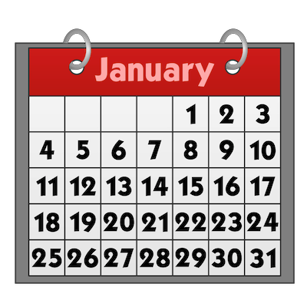





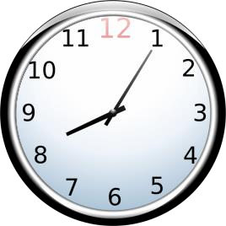
Introduction
New Date-Time API overcomes issues faced by earlier version of date and time library such
as:
Time-zone handling issue
Thread- safe issue
Poor design

Slide 4




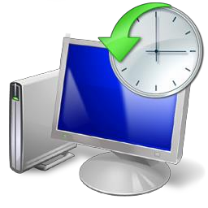
Classes in New Date and Time API 1/29
java.time package acts as a repository where all classes of new Date and Time API are located. Complete list of classes in API is:
Clock
Lo calDate OffsetTime Time
Du ration
LocalTime
Period
ZonedDate Time
Instant
MonthDay
Year
ZoneID
LocalDate
OffsetDate
YearMonth
ZoneOffset
Time

Slide 5


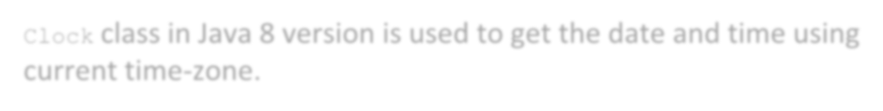


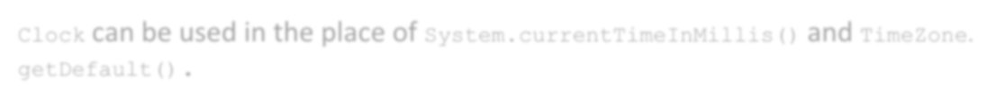
Classes in New Date and Time API 2/29
Clock class in Java 8 version is used to get the date and time using
current time-zone.
Clock
Clock can be used in the place of System.currentTimeInMillis() and TimeZone.
getDefault().

Slide 6

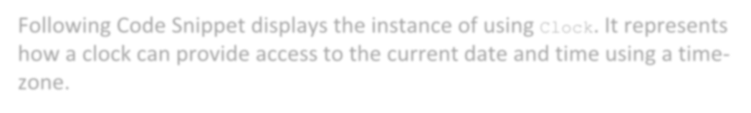

Classes in New Date and Time API 3/29
Following Code Snippet displays the instance of using Clock. It represents how a clock can provide access to the current date and time using a time- zone.
Clock
import java.time.*; // import the package for Date-Time API classes
…
// Creates a new Clock instance based on UTC.
…
Clock defaultClock = Clock.systemUTC(); System.out.println("Clock : " + defaultClock);
…
// Creates a clock instance based on system clock zone Clock defaultClock2 = Clock.systemDefaultZone(); System.out.println("Clock : " + defaultClock2);

Slide 7

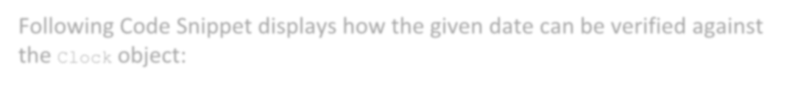
Classes in New Date and Time API 4/29
Following Code Snippet displays how the given date can be verified against
the Clock object:
Clock
public class MyClass { private Clock clock;
…
public void process(LocalDate eventDate) {
if (eventDate.isBefore(LocalDate.now(clock))) {
// logic
}
}
}

Slide 8

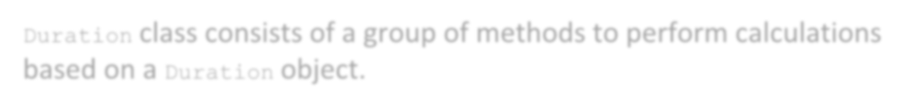






Classes in New Date and Time API 5/29
Duration class consists of a group of methods to perform calculations based on a Duration object.
Duration
plusNanos()
plusSeconds()
plusHours()
minusNanos()
minusSeconds()
minusHours()
plusMillis()
plusMinutes()
plusDays()
minusMillis()
minusMinutes()
minusDays()

Slide 9

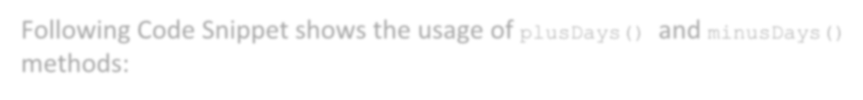
Classes in New Date and Time API 6/29
Following Code Snippet shows the usage of plusDays() and minusDays()
methods:
Duration
Duration present = ... // assume code is written to
// get a present duration
Duration samplePlusA = present.plusDays(3);
Duration sampleMinusA = present.minusDays(3);
Here, first line of code produces a Duration variable, present that will be used as the base of calculations. It is assumed that code to create the Duration object is added.
Code Snippet then produces two new Duration objects based on the present object. The second line generates a Duration, which is equivalent to present plus three days. The third line builds Duration that is equivalent to present minus three days.

Slide 10




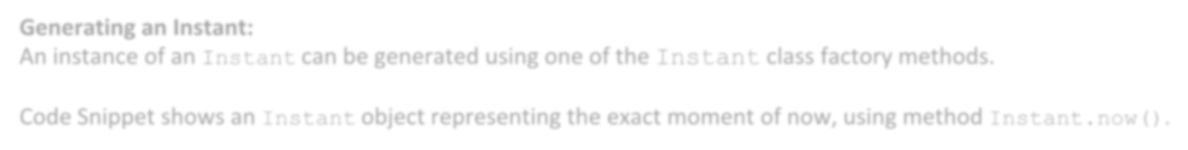
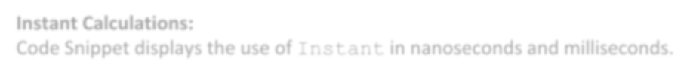
Classes in New Date and Time API 7/29
Instant (java.time.instant)
Instant class helps in time stamp creation.
Generating an Instant:
An instance of an Instant can be generated using one of the Instant class factory methods.
Code Snippet shows an Instant object representing the exact moment of now, using method Instant.now().
Instant sampleNow = Instant.now();
Instant Calculations:
Code Snippet displays the use of Instant in nanoseconds and milliseconds.
Instant sampleFuture = sampleNow.plusNanos(4);
// four nanoseconds in the future
Instant samplePast = sampleNow.minusNanos(4);
//four nanoseconds in the past

Slide 11




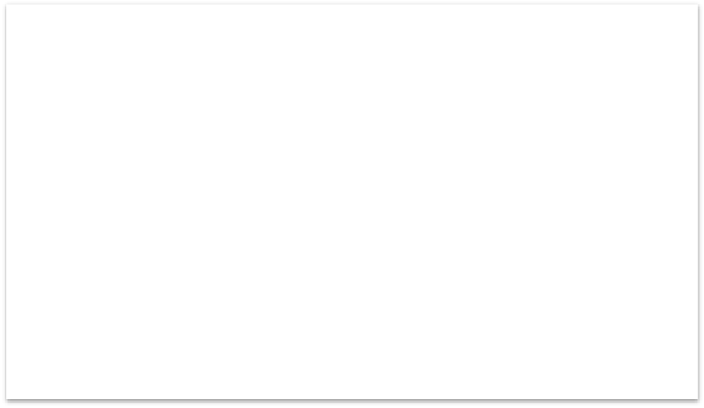
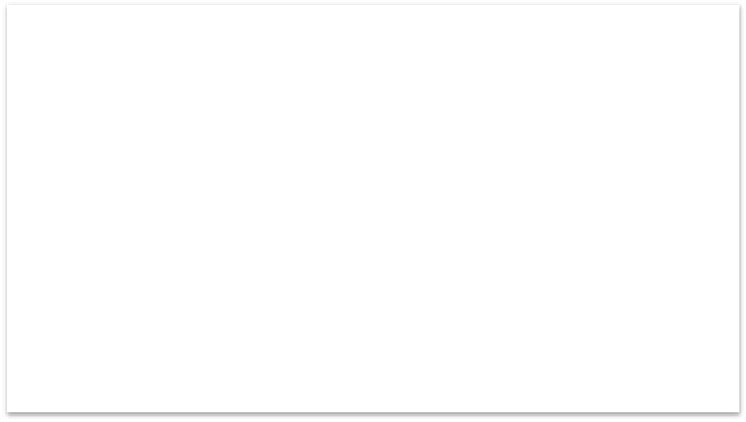


Classes in New Date and Time API 8/29
LocalDate class is bundled with the java.time package.
Creating a LocalDate:
LocalDate objects can be created using several approaches. The first approach is to
get a LocalDate equivalent to the local date of today.
Code Snippet shows creating a LocalDate
object using now().
Obtain a LocalDate:
To obtain a LocalDate, you can also create it from a specific year, month, and day information.
Code Snippet shows creating LocalDate
using of().
LocalDate sampleLocDaA =
LocalDate.now();
LocalDate sampleLocDaB =
LocalDate.of(2016, 07, 04);

Slide 12


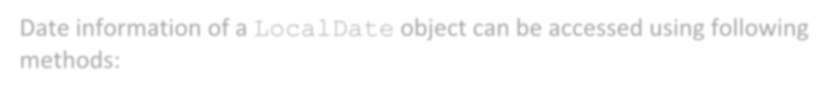






Classes in New Date and Time API 9/29
Date information of a LocalDate object can be accessed using following
methods:
LocalDate
getDayOfYear ()
getYear ()
getDayOfWeek
()
getMonth ()
getDayOfMonth ()

Slide 13

Classes in New Date and Time API 10/29
Following Code Snippet illustrates date information of a LocalDate.
int year = localDate.getYear();
int dayOfMonth = localDate.getDayOfMonth(); Month month = localDate.getMonth();
int dayOfYear = localDate.getDayOfYear(); DayOfWeek dayOfWeek = localDate.getDayOfWeek(); int monthvalue = month.getValue();
Notice how getMonth() and getDayOfWeek() methods return an enum instead of an int. These
enums can provide their data as int values by calling their getValue() methods.

Slide 14

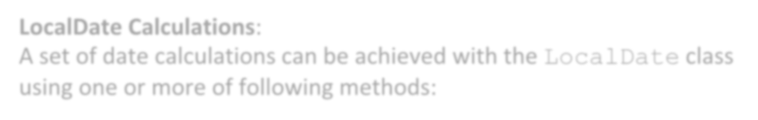












Classes in New Date and Time API 11/29
LocalDate Calculations:
A set of date calculations can be achieved with the LocalDate class
using one or more of following methods:
LocalDate
plusDays ()
minusDays ()
plusWeeks ()
minusWeeks ()
plusMonths ()
minusMonths ()
plusYears ()
minusYears ()

Slide 15

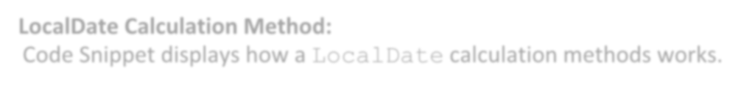
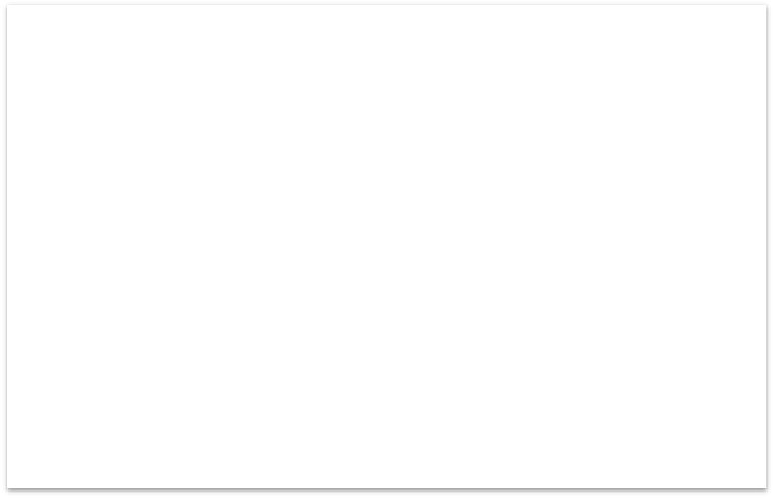


Classes in New Date and Time API 12/29
LocalDate Calculation Method:
Code Snippet displays how a LocalDate calculation methods works.
In the code, sampleLocDa, a new instance of LocalDate, is created using of() method. Then, the code builds a new LocalDate instance that represents the date four years later from the specified date. Finally, the code generates a new LocalDate instance that denotes the date four years earlier from the specified date.
LocalDate sampleLocDa = LocalDate.of(2016, 04, 30);
LocalDate sampleLocDaA = sampleLocDa.plusYears(4); LocalDate sampleLocDaB = sampleLocDa.minusYears(4);

Slide 16

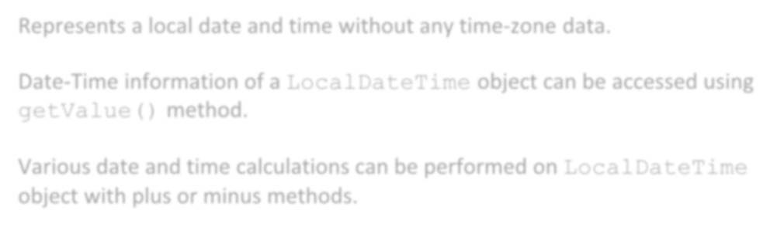

Classes in New Date and Time API 13/29
Represents a local date and time without any time-zone data.
Date-Time information of a LocalDateTime object can be accessed using
getValue() method.
LocalDateTime
Various date and time calculations can be performed on LocalDateTime
object with plus or minus methods.
Creating a LocalDateTime object based on a specific year, month, and day:
LocalDateTime sampleLocDaTiB = LocalDateTime.of (2016, 05, 07, 12, 06, 16, 054);
Parameters passed to of() are year, month, day (of month), hours, minutes, seconds, and
nanoseconds respectively.

Slide 17




Classes in New Date and Time API 14/29
Code Snippet illustrates how LocalDateTime calculation methods work.
LocalDateTime sampleLocDaTi = LocalDateTime.now(); LocalDateTime sampleLocDaTiA = sampleLocDaTi.plusYears(4); LocalDateTime sampleLocDaTiB = sampleLocDaTi.minusYears(4);
The code first creates a LocalDateTime instance sampleLocDaTi signifying the current moment.
Then, the code creates a LocalDateTime object that denotes a date and time four years later.
Finally, the code builds a LocalDateTime object that denotes a date and time four years prior.

Slide 18


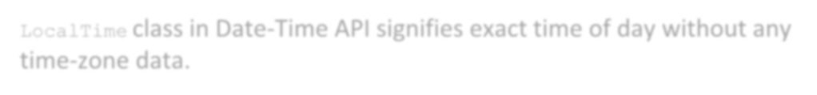


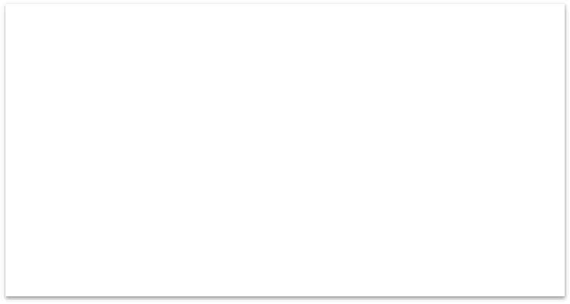




Classes in New Date and Time API 15/29
LocalTime
Class
LocalTime class in Date-Time API signifies exact time of day without any
time-zone data.
Creating a LocalTime Class:
A LocalTime instance can be generated using several approaches. The foremost approach is to create
a LocalTime instance that denotes the
exact time of now. Code Snippet shows the now() method.
Another approach to produce a LocalTime object is to create it from specific hours, minutes, seconds,
and nanoseconds. Code Snippet displays the of() method.
Code Snippet:
LocalTime sampleLocTiA =
LocalTime.now();
Code Snippet:
LocalTime sampleLocTiB =
LocalTime.of(12, 24, 33, 00135);

Slide 19


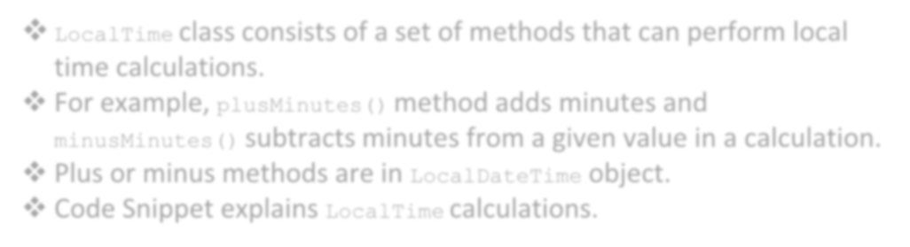



Classes in New Date and Time API 16/29
LocalTime class consists of a set of methods that can perform local time calculations.
For example, plusMinutes() method adds minutes and
minusMinutes() subtracts minutes from a given value in a calculation.
Plus or minus methods are in LocalDateTime object.
Code Snippet explains LocalTime calculations.
LocalTime Calculations
LocalTime sampleLocTi = LocalTime.of(12, 24, 33, 00135);
// current local time
LocalTime sampleLocTiFuture = sampleLocTi.plusHours(4);// future LocalTime sampleLocTiPast = sampleLocTi.minusHours(4);// past

Slide 20

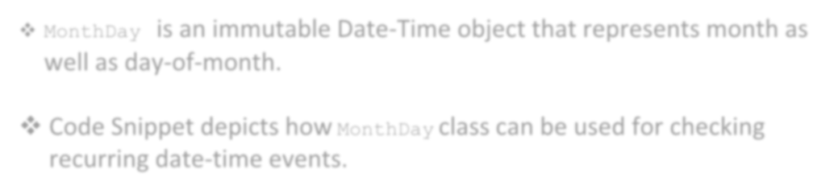




Classes in New Date and Time API 17/29
MonthDay is an immutable Date-Time object that represents month as well as day-of-month.
MonthDay
Class
Code Snippet depicts how MonthDay class can be used for checking recurring date-time events.
…
// Code to display Birthday wishes
LocalDate dateOfBirth = LocalDate.of(2006, 02, 24);
MonthDay bday = MonthDay.of(dateOfBirth.getMonth(), dateOfBirth. getDayOfMonth());
MonthDay currentMonthDay = MonthDay.from(today); //assume today is defined
if(currentMonthDay.equals(bday)){
System.out.println("**Colorful Joyful Birthday Buddy**");
}
else{
System.out.println("Nope, today is not your B'day");
}

Slide 21


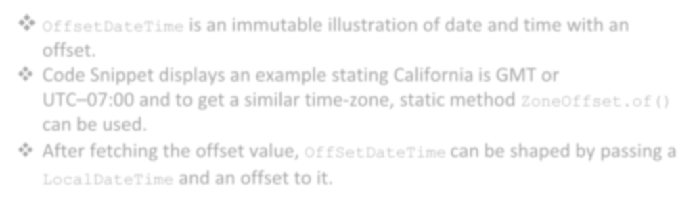



Classes in New Date and Time API 18/29
OffsetDateTime is an immutable illustration of date and time with an
offset.
Code Snippet displays an example stating California is GMT or
UTC–07:00 and to get a similar time-zone, static method ZoneOffset.of()
can be used.
After fetching the offset value, OffSetDateTime can be shaped by passing a
LocalDateTime and an offset to it.
OffsetDate Time Class
LocalDateTime datetime = LocalDateTime.of(2016, Month.FEBRUARY, 15, 18, 20);
// to display the result using Offset
ZoneOffset sampleoffset = ZoneOffset.of("-07:00"); OffsetDateTime date = OffsetDateTime.of(datetime, sampleoffset);
System.out.println("Sample display of Date and Time using time-zone
offset : " + date);

Slide 22

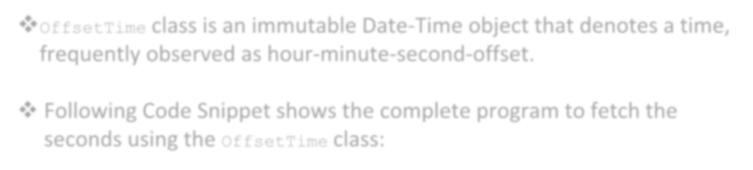







Classes in New Date and Time API 19/29
OffsetTime class is an immutable Date-Time object that denotes a time,
frequently observed as hour-minute-second-offset.
OffsetTime
Class
Following Code Snippet shows the complete program to fetch the
seconds using the OffsetTime class:
import java.time.OffsetTime;// Class to show the result by using
// OffsetTime class method public class MinuteOffset {
public static void main(String[] args) { OffsetTime d = OffsetTime.now();
int e = d.getMinute();
System.out.println("Minutes: " + e);
}
}
Output:
Minutes: 49

Slide 23


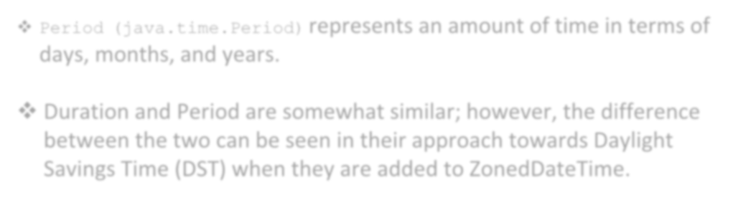

Classes in New Date and Time API 20/29
Period (java.time.Period) represents an amount of time in terms of
days, months, and years.
Period
Class
Duration and Period are somewhat similar; however, the difference between the two can be seen in their approach towards Daylight Savings Time (DST) when they are added to ZonedDateTime.

Slide 24

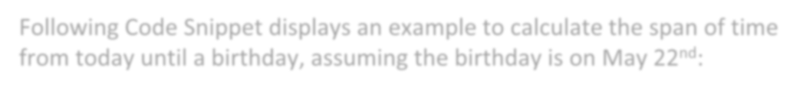
Classes in New Date and Time API 21/29
Period
Class
Following Code Snippet displays an example to calculate the span of time
from today until a birthday, assuming the birthday is on May 22nd:
import java.time.LocalDate;// Class to get the present day
import java.time.Month; // Class to get month related calculations import java.time.Period;//Class to calculate the time period between two
//time instances
import java.time.temporal.ChronoUnit;
public class NextBday {
public static void main(String[] args) { LocalDate presentday = LocalDate.now();
LocalDate bday = LocalDate.of(1983, Month.MAY, 22); LocalDate comingBDay = bday.withYear(presentday.getYear());
// To address the belated b'day celebration.
if (comingBDay.isBefore(presentday) || comingBDay.isEqual(presentday))
{
comingBDay = comingBDay.plusYears(1);
}
Period waitA = Period.between(presentday, comingBDay);
long waitB = ChronoUnit.DAYS.between(presentday, comingBDay);

Slide 25




Classes in New Date and Time API 22/29
System.out.println("Totally, I need to wait for " + waitA.getMonths() + " months, and " +
waitA.getDays() + " days to celebrate my next B'day. (" +
waitB + " days in total)");// to display the waiting time for B'day Bash
}
}
Output:
Totally, I need to wait for 0 months and 22 days to celebrate my next B'day. (22 days in total)

Slide 26


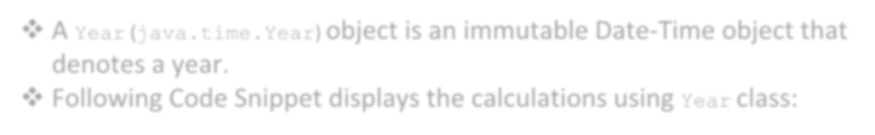




Classes in New Date and Time API 23/29
A Year (java.time.Year) object is an immutable Date-Time object that denotes a year.
Following Code Snippet displays the calculations using Year class:
Year Class
import java.time.Year;// Class to use Year values in calculations public class SampleYear {
public static void main(String[] args) { System.out.println(" The Present Year():"+Year.now()); System.out.println("The year 2002 is a Leap year :"+
Year.isLeap(2002));// to display whether the year 2002 is a leap
// year or not
System.out.println("The year 2012 is a Leap year :"+ Year.isLeap(2012));
// to display whether the year 2012 is a leap year or not
}
}
Output:
The Present Year (): 2016 The year 2002 is a Leap year: false
The year 2012 is a Leap year:
true

Slide 27


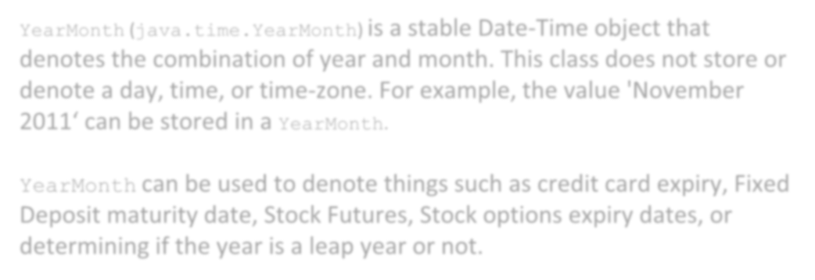


Classes in New Date and Time API 24/29
YearMonth (java.time.YearMonth) is a stable Date-Time object that denotes the combination of year and month. This class does not store or denote a day, time, or time-zone. For example, the value 'November
2011‘ can be stored in a YearMonth.
YearMonth
YearMonth can be used to denote things such as credit card expiry, Fixed Deposit maturity date, Stock Futures, Stock options expiry dates, or determining if the year is a leap year or not.

Slide 28




Classes in New Date and Time API 25/29
YearMonth
Following Code Snippet shows the YearMonth calculations:
import java.time.YearMonth;// to use the Year and Month info public class YearMonth {
public static void main(String[] args) { System.out.println("The Present Year Month:"+YearMonth.now());
// To display present year and month System.out.println("Month alone:"+YearMonth.parse("2016- 04").getMonthValue()); // To display only the month value System.out.println("Year alone:"+YearMonth.parse("2016-04"
).getYear());// to display the year value alone System.out.println("This year is a Leap year:"
+YearMonth.parse("2016-04").isLeapYear());// leap year check
}
}
Output:
The Present Year Month: 2016- 05
Month alone: 4
Year alone: 2016
This year is a Leap year: true

Slide 29




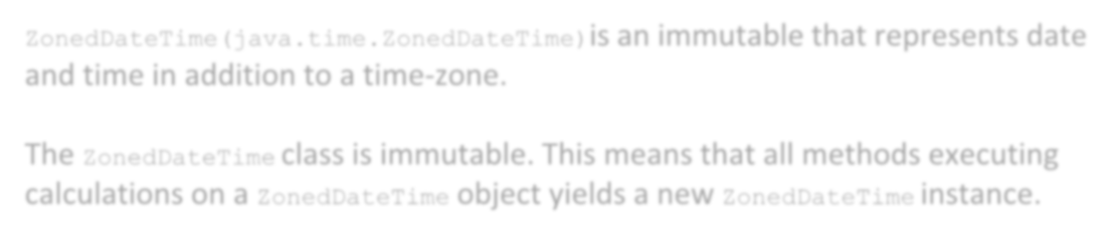
Classes in New Date and Time API 26/29
ZonedDateTime
ZonedDateTime(java.time.ZonedDateTime)is an immutable that represents date and time in addition to a time-zone.
The ZonedDateTime class is immutable. This means that all methods executing calculations on a ZonedDateTime object yields a new ZonedDateTime instance.

Slide 30






Classes in New Date and Time API 27/29
ZonedDateTime
Following example depicts the usage of methods to get year, month, day, hour, minute, seconds, and zone offset:
import java.time.ZonedDateTime;// to access Zoned Date Time public class ZoneDT {//Class ZoneDT refers to ZonedDateTime public static void main(String[] args) {
Output:
2016-05-
06T06:03:51.787+08:00[Etc
/UTC]
Present day of the year: 94 Present year: 2016
System.out.println(ZonedDateTime.now());
ZonedDateTime sampleZoDT = ZonedDateTime.parse("2016-04-
03T10:15:30+08:00[Asia/Singapore]");
System.out.println("Present day of the year:"+sampleZoDT. getDayOfYear());
System.out.println("Present year:"+sampleZoDT.getYear());
}
}

Slide 31

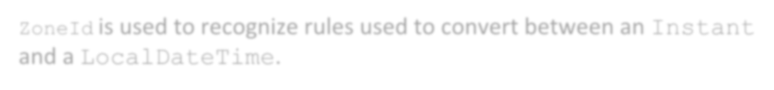



Classes in New Date and Time API 28/29
ZoneId is used to recognize rules used to convert between an Instant
and a LocalDateTime.
ZoneID
The two different ID types are as follows:
Fixed offsets
Geographical regions

Slide 32

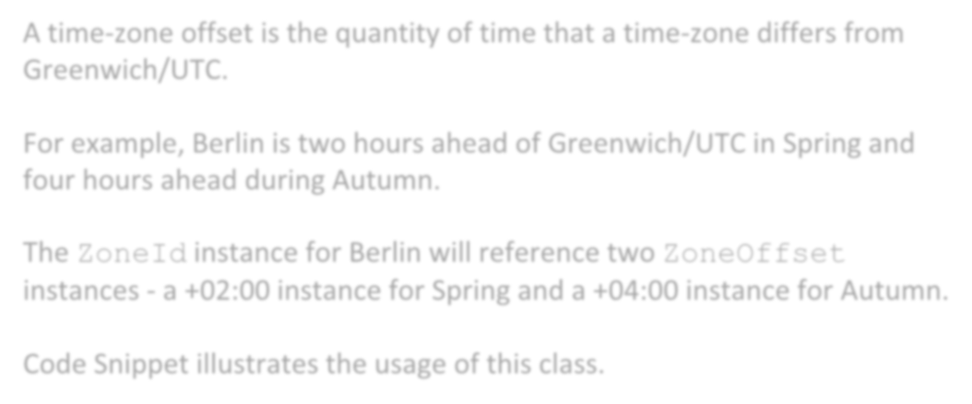




Classes in New Date and Time API 29/29
A time-zone offset is the quantity of time that a time-zone differs from Greenwich/UTC.
For example, Berlin is two hours ahead of Greenwich/UTC in Spring and four hours ahead during Autumn.
ZoneOffset
The ZoneId instance for Berlin will reference two ZoneOffset
instances - a +02:00 instance for Spring and a +04:00 instance for Autumn.
Code Snippet illustrates the usage of this class.
ZoneOffset sampleOffset = ZoneOffset.of("+05:00");

Slide 33


Enums In Java 8 1/3
Benefits of using Enums in Java:
Enum
Enum
Enum
Enum
Type Safe
Has its own name space
Used inside switch statements
New constants can be added without breaking the existing code

Slide 34

Enums In Java 8 2/3
ChronoUnit enumeration is used in following Code Snippet:
import java.time.LocalDate;
import java.time.temporal.ChronoUnit; public class EnumDateCalculation{
public static void main(String args[]){ EnumDateCalculation java8enum = new EnumDateCalculation (); java8enum.enumChromoUnits();
}
public void enumChromoUnits(){
// To display the current date LocalDate today = LocalDate.now();
System.out.println("Current date: " + today);
// To display the result 2 weeks addition to the current
date
LocalDate nextWeek = today.plus(2, ChronoUnit.WEEKS); System.out.println("After 2 weeks: " + nextWeek);
// To display the result 2 months addition to the current
date
LocalDate nextMonth = today.plus(2, ChronoUnit.MONTHS);
System.out.println("After 2 months: " + nextMonth);
// To display the result 2 years addition to the current

Slide 35


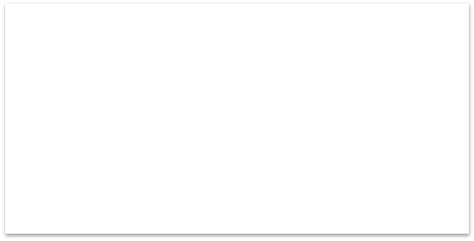

Enums In Java 8 3/3
date
LocalDate nextYear = today.plus(2, ChronoUnit.YEARS); System.out.println("After 2 years: " + nextYear);
// To display the result 20 years addition to the current
date
LocalDate nextDecade = today.plus(2, ChronoUnit.DECADES);
System.out.println("Date after twenty year: " + nextDecade);
}
}
Output:
Current date: 2016-04-07
After 2 weeks: 2016-04-21
After 2 months: 2016-06-07
After 2 years: 2018-04-07
Date after twenty year: 2036-04-07

Slide 36






Temporal Adjusters 1/3
Temporal Adjuster acts as a key tool in modifying the Temporal Object.
Temporal Adjuster is a functional interface that uses adjustInto (Temporal) method to return a copy of Temporal object with unchanged field value.
A Temporal Adjuster can be used to perform complicated date 'math' that is popular in business applications.
For example, it can be used to
find 'first Thursday of the
month' or 'next Tuesday’.
java.time.temporal
Date-Time objects
FirstDayOfMonth ( )

Slide 37

Temporal Adjusters 2/3
Following Code Snippet shows how to find the first day of a month using a specified date:
import java.time.LocalDate;
import java.time.temporal.TemporalAdjusters; import java.time.DayOfWeek;
public class TemporalAdj {
public static void main(String args[]){ TemporalAdj TemporalAdj = new TemporalAdj(); TemporalAdj.sampleAdj();
}
public void sampleAdj(){
// To display the current date LocalDate sampledateA = LocalDate.now();
System.out.println("Current date: " + sampledateA);
// To display the next Wednesday from current date LocalDate nextWednesday = sampledateA.with(TemporalAdjusters.next(DayOfWeek. WEDNESDAY));

Slide 38




Temporal Adjusters 3/3
System.out.println("Next Wednesday on : " + nextWednesday);
// To display the second Sunday of next month LocalDate firstInYear = LocalDate.of(sampledateA.getYear(),sampledateA. getMonth(), 1);
LocalDate secondSunday = firstInYear.with(TemporalAdjusters. nextOrSame(DayOfWeek.SUNDAY)).with(TemporalAdjusters.next(DayOfWeek. SUNDAY));
System.out.println("Second Sunday on : " + secondSunday);
}
}
Output:
Current date: 2016-04-07
Next Wednesday on: 2016-04-13 Second Sunday on: 2016-04-10

Slide 39







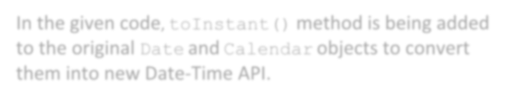

Backward Compatibility with Older Versions 1/3
Date sampleDate = new Date();
Instant sampleNow = sampleDate.toInstant(); LocalDateTime dateTime = LocalDateTime.ofInstant(sampleNow, myZone); ZonedDateTime zdt = ZonedDateTime.ofInstant(sampleNow, myZone);
toInstant()
In the given code, toInstant() method is being added to the original Date and Calendar objects to convert them into new Date-Time API.
Instant, ZoneId

Slide 40

Backward Compatibility with Older Versions 2/3
ofInstant(Instant, ZoneId) method is used to get a LocalDateTime or ZonedDateTime
object.
import java.time.LocalDateTime;// to initiate local date and time import java.time.ZonedDateTime; // to initiate zoned time
import java.util.Date; import java.time.Instant; import java.time.ZoneId;
public class BWCompatibility {
public static void main(String args[]){
BWCompatibility bwcompatibility = new BWCompatibility(); bwcompatibility.sampleBW();
}
public void sampleBW(){
// To display the current date Date sampleCurDay = new Date();
System.out.println(" Desired Current date= " + sampleCurDay);
// to display result
// To display the instant of current date Instant samplenow = sampleCurDay.toInstant(); ZoneId samplecurZone = ZoneId.systemDefault();

Slide 41




Backward Compatibility with Older Versions 3/3
// To display the current local date
LocalDateTime sampleLoDaTi = LocalDateTime.ofInstant(samplenow, samplecurZone);
System.out.println(" Desired Current Local date= " + sampleLoDaTi);
// To display result
// To display the desired current zoned date
ZonedDateTime sampleZoDaTi = ZonedDateTime.ofInstant(samplenow,
samplecurZone);
System.out.println(" Desired Current Zoned date= " + sampleZoDaTi);
// To display result
}
}
Output:
Desired Current date= Fri May 06 07:32:58 EDT 2016 Desired Current Local date= 2016-05-06T07:32:58.769 Desired Current Zoned date= 2016-05-06T07:32:58.769- 04:00[America/New York]

Slide 42

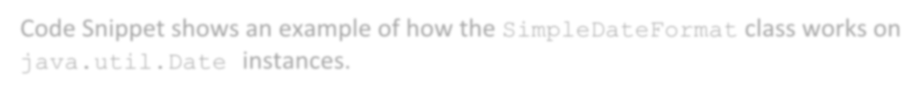

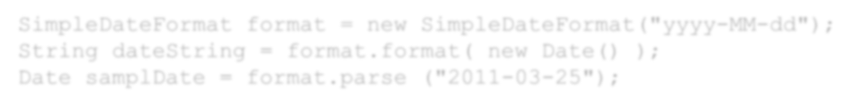
Parsing and Formatting Dates
Parsing dates from strings and formatting dates to strings is possible with the
java.text.SimpleDateFormat class.
Code Snippet shows an example of how the SimpleDateFormat class works on
java.util.Date instances.
SimpleDateFormat format = new SimpleDateFormat("yyyy-MM-dd"); String dateString = format.format( new Date() );
Date samplDate = format.parse ("2011-03-25");

Slide 43









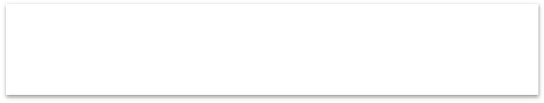




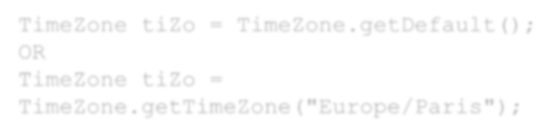
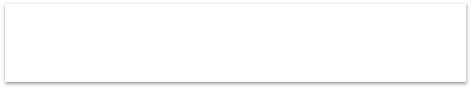


TimeZone (java.util.TimeZone) 1/2
TimeZone (java.util.TimeZone) is used in time-zone bound calculations.
Code Snippet displays a simple example of how to get the time-zone from a Calendar.
Calendar cal = new GregorianCalendar(); TimeZone tiZo = cal.getTimeZone();
Code Snippet displays a simple example of how to set time-zone.
cal.setTimeZone(tiZo);
Code Snippet shows two ways to obtain a TimeZone instance.
TimeZone tiZo = TimeZone.getDefault(); OR
TimeZone tiZo = TimeZone.getTimeZone("Europe/Paris");

Slide 44


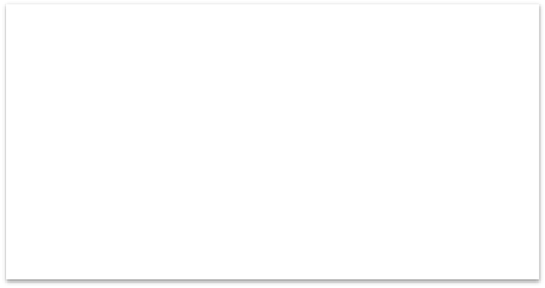

TimeZone (java.util.TimeZone) 2/2
Following Code Snippet shows a sample of time-zone:
import java.time.ZonedDateTime;
import java.time.ZoneId;
public class Java8CurTZone {
public static void main(String args[]){ Java8CurTZone = new Java8CurTZone(); java8curtzone.sampleZDTime();
}
public void sampleZDTime(){
// To display the current date and time ZonedDateTime dateA = ZonedDateTime.parse("2016-04- 03T10:15:30+08:00[Asia/Singapore]"); System.out.println("dateA: " + dateA);
// To display the zoneId
ZoneId sampleidA = ZoneId.of("Asia/Singapore"); System.out.println("ZoneId: " + sampleidA);
// To display the current Zone
ZoneId samplecurrentZoneA = ZoneId.systemDefault(); System.out.println("CurrentZone: " + samplecurrentZoneA);
}
}
Output:
dateA: 2016-04-03
T10:15:30+08:00[Asia/Singapore] ZoneId: Asia/Singapore CurrentZone: Etc/UTC

Slide 45


SUMMARY
The new Date-Time API introduced in Java 8 is a solution for many unaddressed drawbacks of the previous API.
Date-Time API contains many classes to reduce coding complexity and provides various additional features to work on date and time.
Enum in Java denotes fixed number of well-known values.
TemporalAdjuster is a functional interface and a key tool for altering a
temporal object.
Java TimeZone class is a class that denotes time-zones and is helpful when doing calendar arithmetic across time-zones.
A time-zone offset is the quantity of time that a time-zone differs from Greenwich/UTC.

