Slide 1
Artificial Intelligence
Matej Slivka, Stepan Barta, Karel Srna

Slide 2
DATASET
Our dataset is mushrooms
Our goal was to predict whether mushroom is edible or poisonous based on statistical data and trained AI models
In dataset there was 4208 edible and 3916 poisonous mushrooms

Slide 3
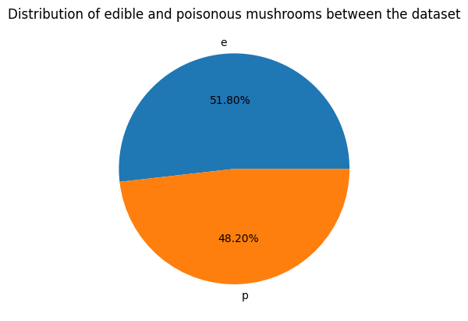

Slide 4
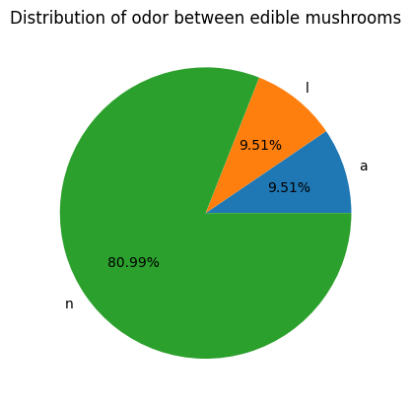
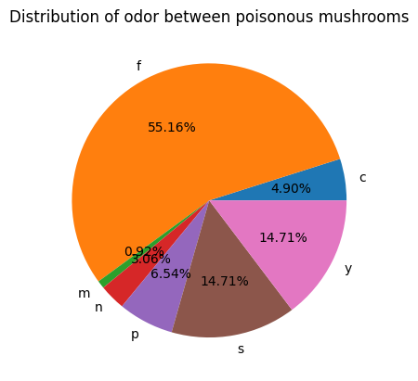
odor
Legend: a-almond, l-anise, c-creosote, y-fishy, f-foul, m-musty, n-none, p-pungent, s-spicy.

Slide 5
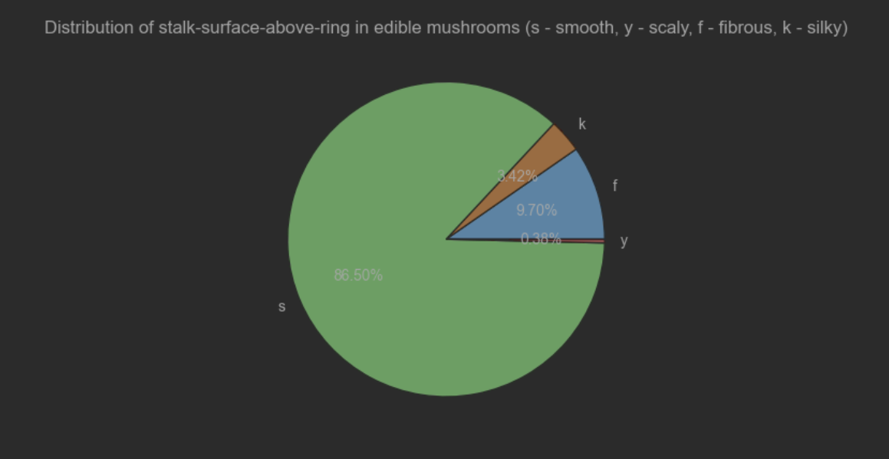
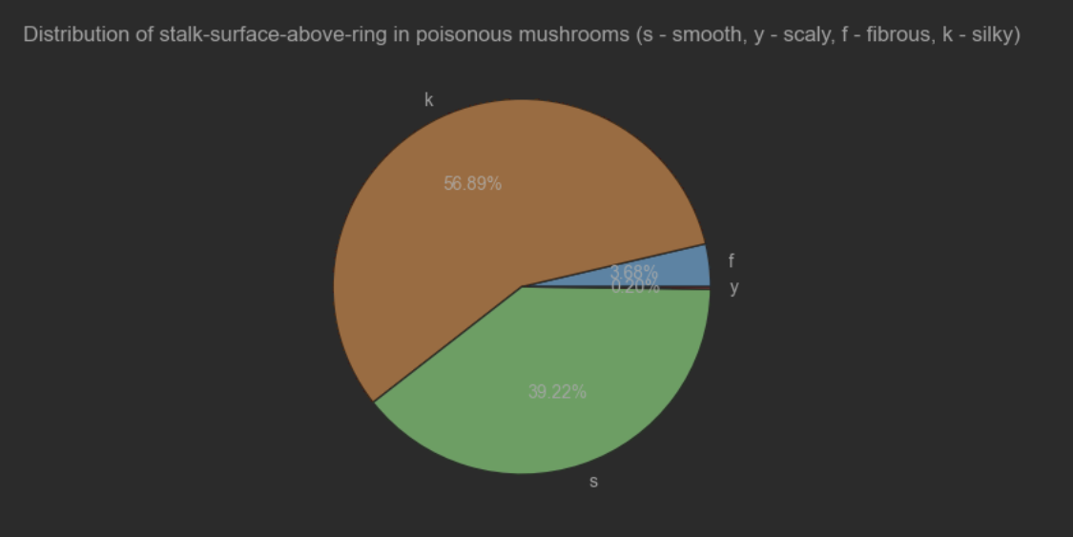
Stalks
Most important stalk is stalk-surface-above-ring which can be fibrous, scaly, silky and smooth.
Most important atribute is silky because of its high probability of predicting whether the mushroom will be edible or poisonous.
From 2372 mushrooms with silky only 144 are edible.

Slide 6
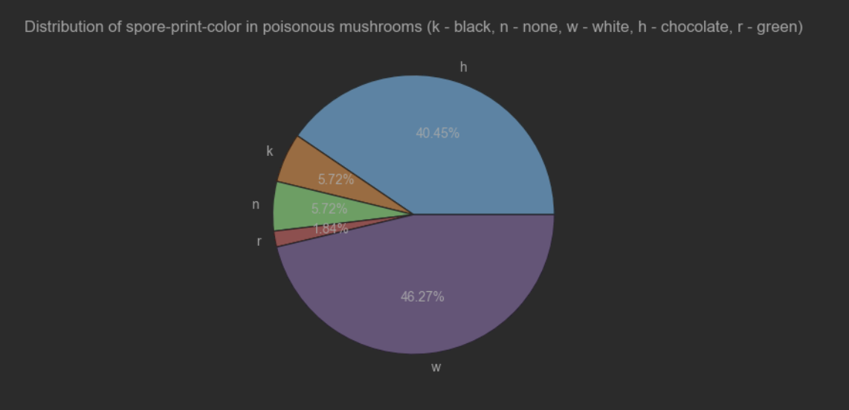
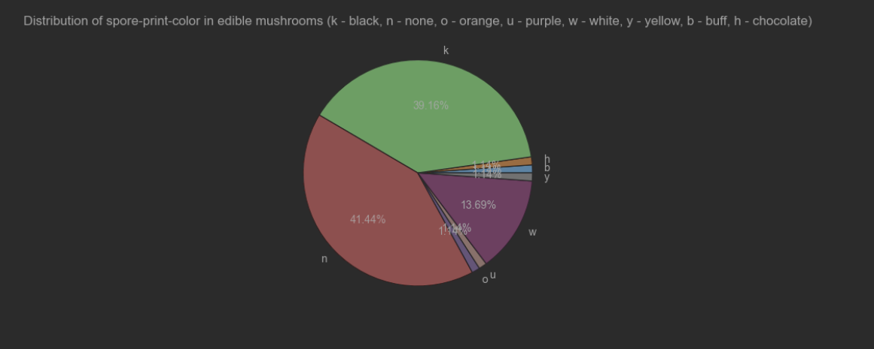
Spore print color

Slide 7
Training models
We used h2o as it was recomended tool for creating AI models
This library offers a variety of algorithms from which we sorted those suitable for our task. We were looking for supervised classification algorithms.
First we trained models and compared their metrics

Slide 8
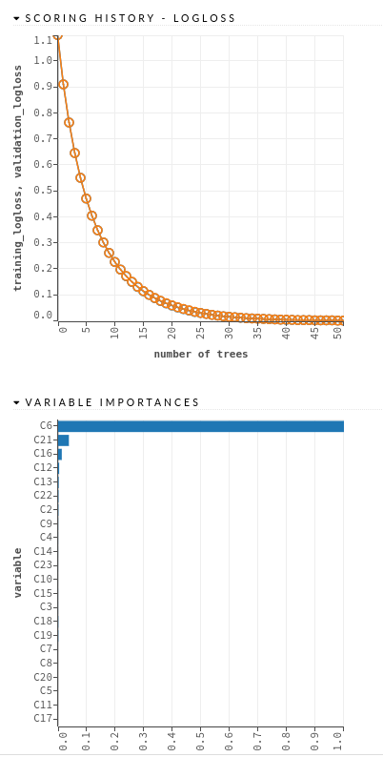
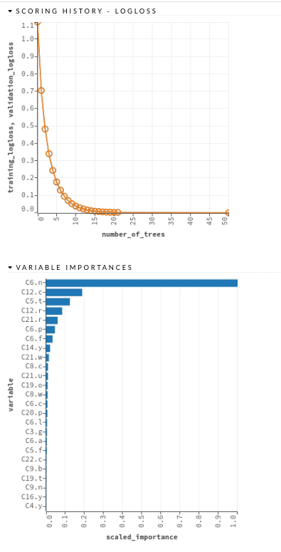
GBM
XGBoost

Slide 9
experiments

Slide 10
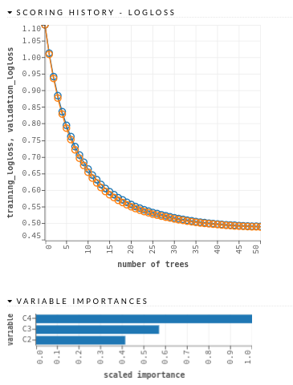
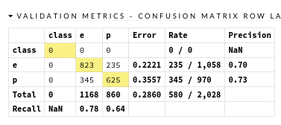
only cap related columns

Slide 11
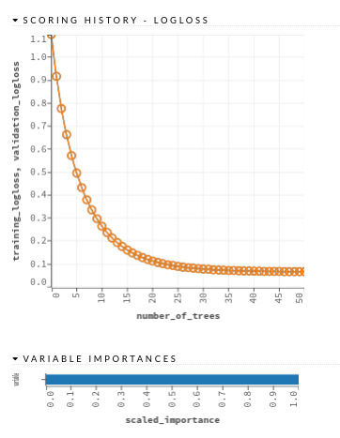
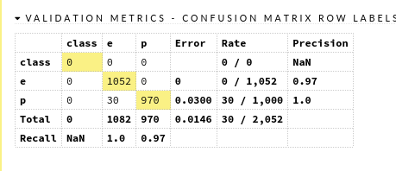
ODOr only

Slide 12
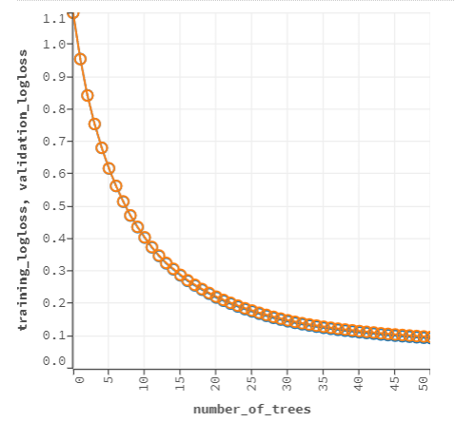
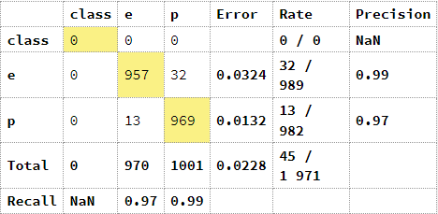
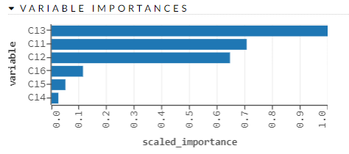
stalks only

Slide 13
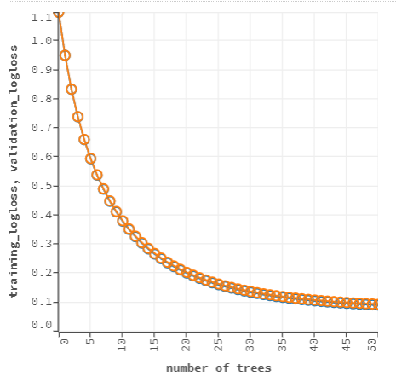
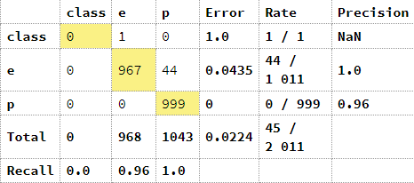
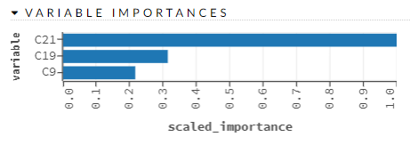
Lowest number of columns

