Slide 1
Practical AI Literacy
Notes:
A hands-on lab for developers. We'll make AI behavior visible—through live examples in VS Code with GitHub Copilot. By the end, you'll recognize where tokens matter, how context shapes answers, why hallucinations happen, and how to build safer agentic workflows.

Slide 2

Four Mental Models to Keep in Mind
Probabilistic
AI doesn't "know" things—it predicts the most likely next tokens.
Context-Bound
Only what fits in the context window is visible. Everything else is invisible.
Token-Priced
Every interaction has a cost: input tokens, output tokens, and hidden overhead.
Requires Validation
Confident outputs can be wrong. Always verify—especially when it sounds certain.

Slide 3
Large Language Models vs Small Language Models
Characteristics of Large Models
Large language models excel at general reasoning and cross-domain tasks but have higher latency and cost implications.
Advantages of Small Models
Small models are faster, cheaper, and optimized for specific tasks with predictable outcomes in narrow domains.
Blended Model Use Cases
Enterprises combine large and small models, routing tasks based on complexity to balance cost and performance.
Choosing Model by Purpose
Model selection depends on task requirements, cost, and quality goals rather than size alone.
Notes:
Understanding the distinction between large language models (LLMs) and small language models (SLMs) is essential for making informed architectural decisions.
LLMs are typically trained on massive, diverse datasets and excel at general-purpose reasoning, language understanding, and cross-domain tasks.
They are flexible but often come with higher latency, greater token costs, and broader behavior that may need tighter constraints in enterprise settings. SLMs, by contrast, are smaller, faster, and cheaper, often optimized for specific domains or tasks such as classification, summarization, or code completion within a narrow scope.
While SLMs may lack the broad reasoning ability of LLMs, they can be more predictable and cost-effective when the problem space is well defined.
In practice, many enterprise tools, including developer assistants, blend these approaches by routing tasks to different models based on complexity and risk.
For example, a large model might be used to reason about architectural changes, while a smaller model handles routine refactoring or formatting.
This slide emphasizes that choosing a model is not about size alone but about fitness for purpose.
Developers should consider factors such as response variability, context requirements, cost constraints, and validation needs. By recognizing that not every task requires a large model, teams can design systems that are both efficient and safer, reducing unnecessary expense while maintaining acceptable quality and control.

Slide 4
Lab 1: LLM vs SLM

Slide 5
Tokens Are Not Words
A token is not a word. Depending on the tokenizer, a word, symbol, or code fragment may split differently. English, Spanish, JSON, and source code all tokenize uniquely—consuming context at different rates.
[</>]
English
Spanish
Code
~100 tokens ≈ 60–80 words
Longer words → more tokens per sentence
Identifiers, symbols, and braces split unpredictably
Notes:
Tokenization is a foundational concept that directly impacts cost, context limits, and model behavior, yet it is often misunderstood.
A token is not the same as a word; it is a unit defined by the model’s tokenizer, which may split text into subwords, symbols, or character sequences.
As a result, the same idea expressed in different languages or formats can consume very different numbers of tokens.
English text tends to be relatively token-efficient, while languages such as Spanish may use more tokens for the same semantic content due to morphology and vocabulary differences.
Source code, JSON, logs, and long identifiers are often even more token-intensive because punctuation, casing, and symbols are frequently split into separate tokens.
This matters in practice because context windows and pricing are measured in tokens, not characters or words.
Developers may be surprised when seemingly small code snippets consume large portions of the available context or increase cost significantly.
This slide prepares participants for the live tokenization demo by establishing the intuition that structure and format matter. It also explains why copying entire files, verbose logs, or multilingual data into prompts can quickly exhaust context limits.
Recognizing tokenization effects allows developers to be more deliberate, trimming unnecessary content and focusing on the minimum information needed to achieve accurate results. This awareness is a key step toward predictable, cost-aware AI usage.

Slide 6
Lab 2: Tokenization

Slide 7
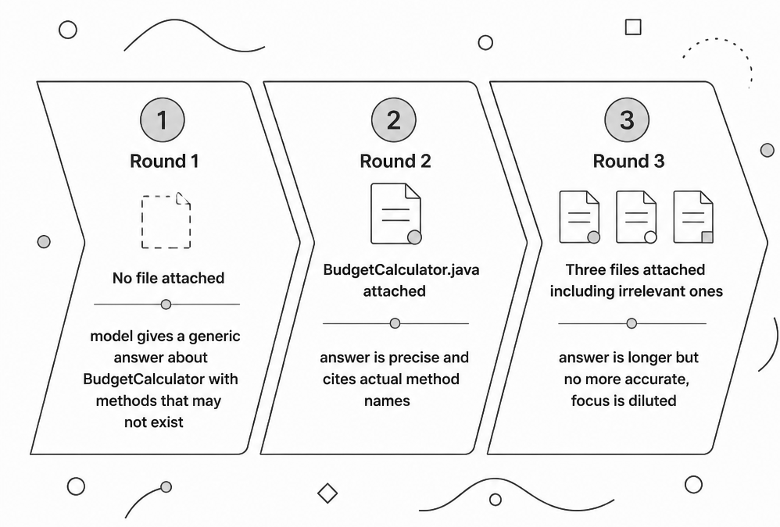
The Context Window Has a Ceiling
Copilot builds a single prompt before sending your request. Everything outside that prompt is invisible. Old files drop out silently as the conversation grows. More context is not always better—it dilutes the signal.
Rule of thumb: Attach the minimum set of files needed to answer the question. Precision beats volume.

Slide 8
Lab 3: Context Window and Memory Limit

Slide 9

Hallucination: Causes and Mitigation
Nature of Hallucination
Hallucination happens when AI outputs plausible yet incorrect information with high confidence due to missing context.
Causes of Hallucination
Probabilistic token prediction and ambiguous or missing context leads the model to fill information gaps with learned patterns.
Mitigation Strategies
Grounding with explicit sources, constraining responses, citing lines, and validation reduce hallucination risks effectively.
Managing Impact
Designing interactions to predict and manage hallucinations ensures human oversight and verification remain central.

Slide 10
Lab 4: Hallucination Reduction

Slide 11
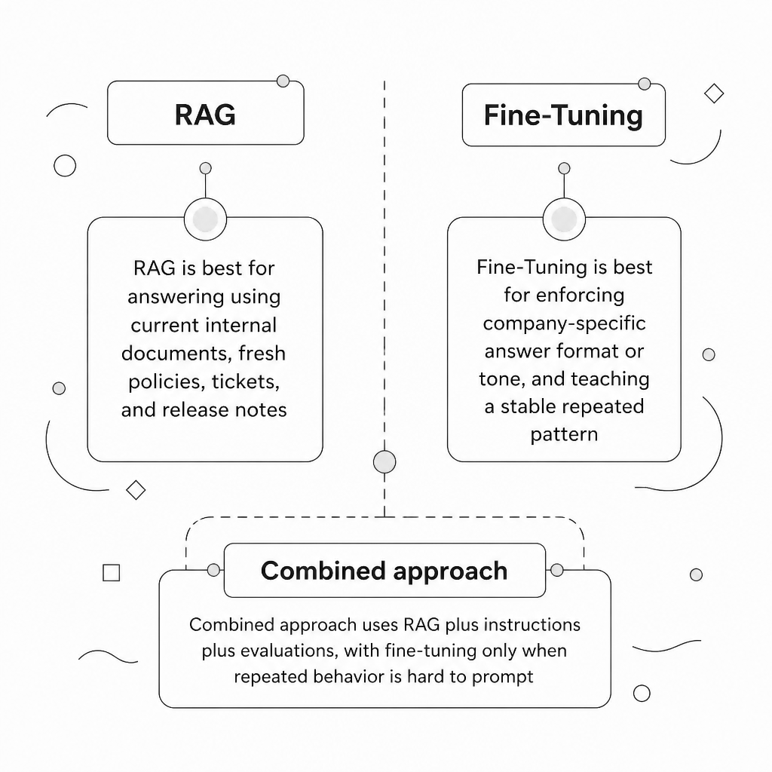
RAG vs. Fine-Tuning
RAG retrieves current documents at query time—ideal for policies, tickets, and release notes. Fine-tuning teaches a stable, repeated behavior pattern. Most enterprise systems combine both with instructions and evaluation.
Best enterprise pattern: RAG + instructions + evals. Fine-tune only when repeated behavior is hard to prompt.

Slide 12
Lab 5: RAG vs Fine-Tuning
Notes:
How Fine-Tuning Works
Foundation models (like those used for generative AI) are originally trained on vast amounts of internet data to learn general logic, language, and facts. Fine-tuning takes this "fluent generalist" and reshapes its internal parameters by showing it thousands of examples tailored to a specific domain.
For example:
Legal: Teaching a general language model to understand case law and draft contracts.
Healthcare: Adapting an AI to become a specialized diagnostic assistant using medical literature.
Customer Service: Training a chatbot to respond in your company's exact brand voice and adhere to internal policies.
Why Businesses Fine-Tune
Improved Accuracy: Reduces "hallucinations" and increases reliability for specific industries.
Cost Efficiency: It is significantly cheaper and faster to adjust an existing model than to train a billion-parameter model from scratch.
Custom Behavior: Allows the AI to adopt specific formatting, tone, or response lengths.
Common Techniques
Full Fine-Tuning: Updates all the parameters of the original model. This is highly effective but requires massive amounts of computing power.
Parameter-Efficient Fine-Tuning (PEFT): Methods like LoRA (Low-Rank Adaptation) freeze the original model's main knowledge base and train only a tiny fraction of new parameters. This makes the process much faster and cheaper.

Slide 13
Agents and Agentic Workflows
Definition of an Agent
An agent is a goal-driven model with structured instructions and tool access, not an autonomous entity.
Agentic Workflow Steps
Agentic workflows include inspecting code, planning, modifying files, testing, and summarizing results.
Human Responsibility and Safeguards
Agents shift human effort to review and decision-making with safeguards like clear instructions and validation.
Integration into Existing Processes
Framing agents as workflows ensures safe integration with transparency and control in development environments.

Slide 14
Lab 6: Agentic Copilot Workflow

Slide 15

The Practical Takeaway
Don't ask AI to be correct by hope. Give it context, constrain the source, ask for assumptions, validate with tools, and keep humans in the review loop.
Give Context
Attach the right files—not everything.
Constrain Source
Use RAG or file context to prevent guessing.
Validate Outputs
Run tests. Check assumptions. Stay in the loop.

Slide 16
Thanks

