Slide 1

Advanced Real Estate Price Prediction
Team: The Outliers
Institution: BITS Pilani Digital
Course: Advanced Apex Project 1 (2025-26)
Objective: Robust ML pipeline for Ames housing price prediction

Slide 2
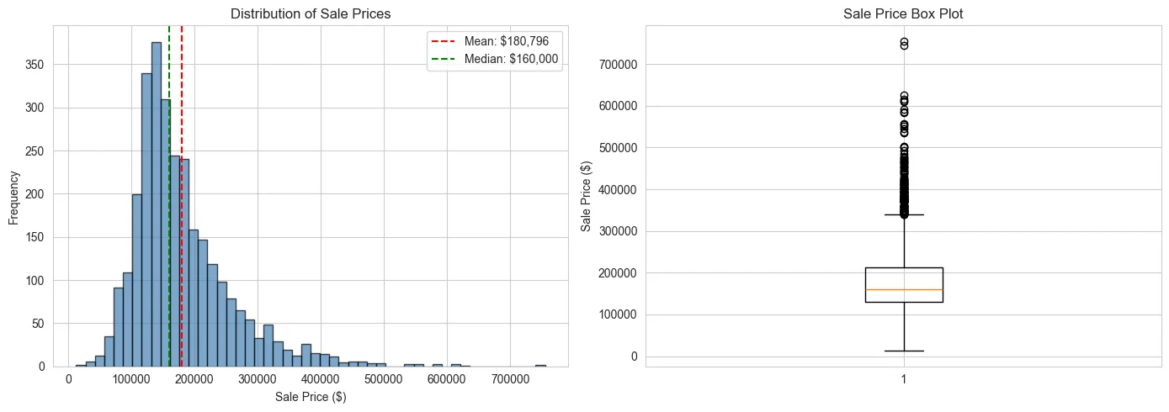
Problem Statement & Business Goal
The Challenge:
• Real estate valuation is subjective and relies on heuristics
• Accurate prediction is critical for homeowners, buyers, and investors
Business Goal:
• Develop a data-driven model to minimize prediction error (RMSE)
• Provide interpretable insights into key value drivers

Slide 3
Methodology & Workflow
1. Data Acquisition:
Extracted Ames Housing dataset (2930 records, 82 features)
2. Preprocessing:
Imputed missing values (LotFrontage median) and removed outliers (IQR method)
3. Feature Engineering:
Created 'Total_SF', 'Total_Bath', 'House_Age' and log-transformed target variable
4. Modeling:
Trained Linear, Ridge, Lasso, ElasticNet. Selected Ridge Regression (Alpha=1.0) for stability

Slide 4
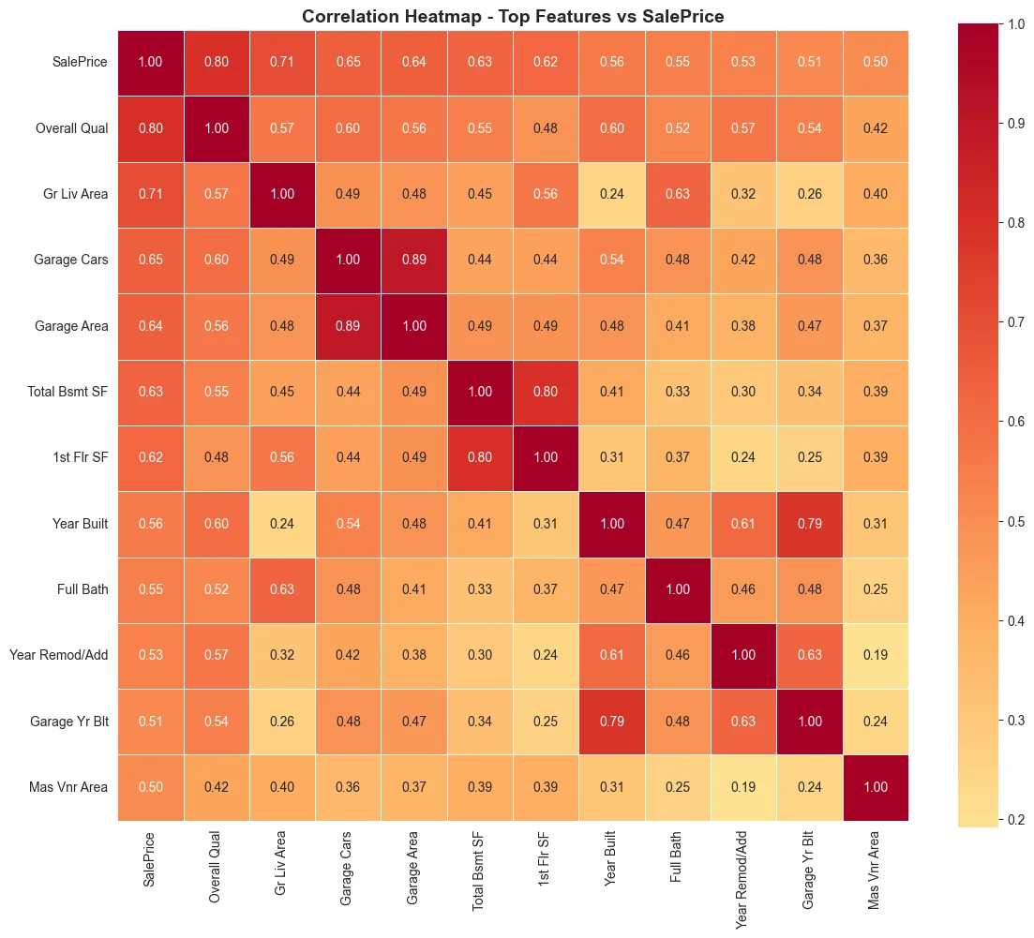
Key Insights & Results
Model Performance:
• Best Model: Ridge Regression
• R-squared: ~0.85 (85% of variance)
• RMSE: ~$34,746
Top Drivers of Price:
1. Overall Quality (Corr: 0.80)
2. Total Sq Ft (Corr: 0.78)
3. Neighborhood premium

Slide 5
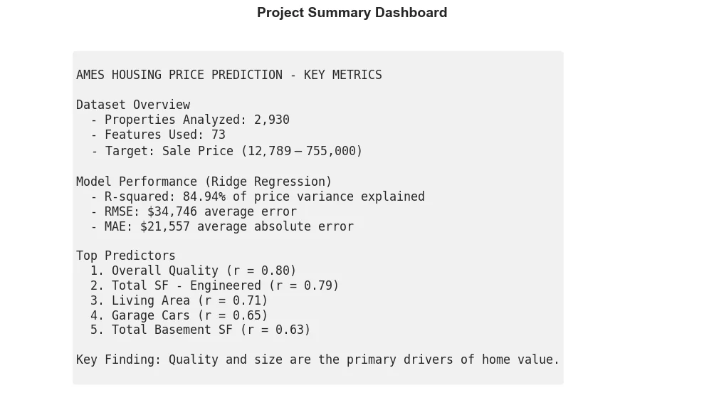
Conclusion & Future Work
Conclusion:
• Model estimates prices within ~12% margin of error
• Quality and Condition are the ultimate differentiators
Recommendations:
• Sellers: Renovate for 'Overall Quality' ROI
• Buyers: Seek older homes in developing areas
Future Work:
• Incorporate external economic data (interest rates, inflation)
• Experiment with XGBoost/Gradient Boosting

