Slide 1

Advanced Physics Lab Presentation
Batch 1, Group C
Dharaneesh Panneer Selvam
Garry Perumal Roy
Jyotiraditya Cheemakurthi
Dharshani Swagandhi S
Gangesh Rameshkumar

Slide 2
AGENDA
Introduction
Title and Aim
Technologies and Requirements
Techniques and Methodologies
Probable Outcomes
Summary

Slide 3
Introduction
Voice recognition is a technology that allows a computer or device to interpret and understand spoken language. It involves converting spoken words into written text or carrying out specific commands based on the spoken input. Voice recognition is needed for several reasons:
1. Convenience: Easier for users to interact with devices and software without the need for typing or physical input.
2. Accessibility: Voice recognition technology is essential for individuals with disabilities.
3. Efficiency: Enhances productivity by enabling hands-free operation of devices and applications. This is particularly valuable in environments where manual input is cumbersome or unsafe, such as when driving or in healthcare settings.
4. Automation: Voice recognition is a critical component of automated customer service and virtual assistants, allowing businesses to provide better service.
5. Multimodal Interfaces: Voice recognition can be integrated with other technologies, like natural language processing and machine learning, to create more sophisticated and user-friendly interfaces, such as smart home systems and virtual reality.

Slide 4
Title: Voice Recognition – Fourier Transforms
Aim:
Take in input voice data and enhance it for clarity
Process the data for identifying features and convert these into vectors by using various algorithms such as FFT and DCT.
Use a GMM Model to classify, distinguish and identify different voice signatures according to their characteristic features, expressed as vectors.
4

Slide 5
Technologies and Requirements
Technologies:
Python(Free 3rd Party modules)
AI/ML based voice recognition model
Hardware:
Microphone with Audio Filter(2-3k INR)
Advanced Physics Lab Presentation
54

Slide 6
Libraries Used
Pandas
Numpy
OS
Seaborn
Matplotlib
Librosa
Keras.models, Keras.layers
Random
Time
Scipy
Noisereduce
Matplotlib.pylab

Slide 7
Techniques and Methodologies
MFCC
Mel-Frequency Cepstral Coefficients
The main method behind voice recognition. A feature extraction technique widely used in speech and audio signal processing.
FFT
Fast Fourier Transform
An algorithm for computing the Discrete Fourier Transform (DFT) of a signal. It transforms a signal from the time domain into the frequency domain.
DCT
Discrete Cosine Transformation
A mathematical transformation used in signal processing and image compression. It focuses on representing the signal in terms of its cosine components.
GMM
Gaussian Mixture Models
A probabilistic model used mainly in clustering and classification tasks. They have applications in areas like speech recognition, image processing, etc.
7

Slide 8
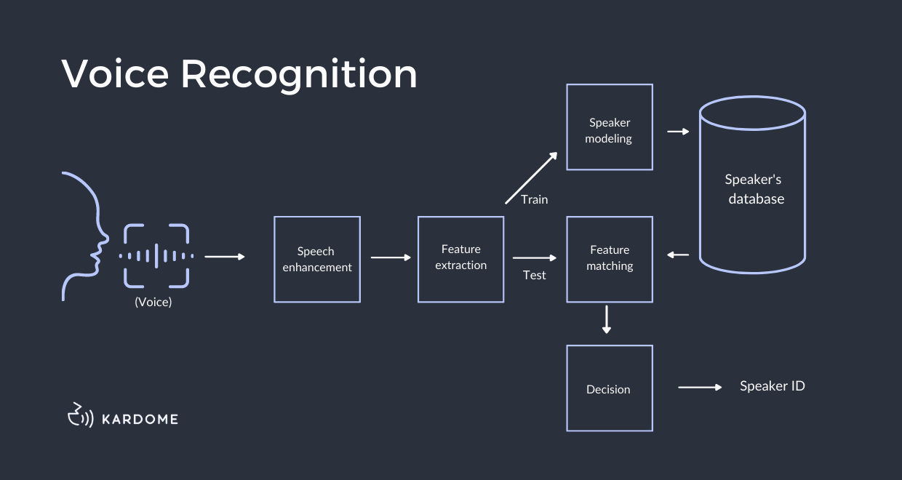
Probable Outcomes
Using the algorithms previously mentioned, we will be able to distinguish between and identify the voices of different users accurately and quickly.
8

Slide 9
THANK YOU

