Slide 1

Introduction to Big Data, Artificial Intelligence and Digitalized Educational Assessment
Akinyele O. Ariyo President, International Association for Innovations in Educational Assessment, Abuja. Nigeria.
aoariyo@yahoo.com +2348034292924
A paper presented at the 7th IAIIEA Annual Conference @ UBEC Digital Resources Centre, Kado- Kuchi, Jahi, Abuja, Nigeria. From 5th – 8th November 2024

Slide 2
Food for Thought
State the Statistics of Countries that have employed digitalized mode of assessment
List the names of Examination in Nigeria that have digitalized assessment
Evaluate the level of literacy of Digitalized Assessment in Africa
What are your recommendations in order to achieve digitalized assessment in Africa and beyond.

Slide 3
Outlines
Big Data, Artificial Intelligence and Digitalized Assessment: Definitions and Explanations.
Traditional Compared to Emerging Models of Assessment.
The Process of Digitalized Assessment (Constructing Test Items).
Guidelines for Developing Good Online Assessments.
Relationship Between Big Data and Assessment.
Prospects of Big Data for learners and researchers.

Slide 4
Introduction
The rapid changes in the 21st century brought about by technological advancement is knowledge – driven which calls for new skills development.
The concept of Big data, artificial intelligence and digital assessment are associated with advancement in computer science
Digital technologies are the driving force behind the current industrial revolution.
Big data phenomenon is the brain behind digital technologies.
Most activities done in the real world have been programmed to mimic human by artificial intelligence for enhancement of productivity and efficiency.

Slide 5
Introduction to Big Data
Big Data is high-volume, high-velocity and/or high-variety information assets that demands cost-effective, innovative forms of information processing that enable enhanced insight, decision-making, and process automation (Gartner, 2015).
Following this definition, the unique feature of big data would result from its size, increasing rate and range of formats, which together require digital and automated computer processing.
In other words, big data production does not refer to static, sporadic calculations, but instead relies on databases, which are simultaneously standardized (hence constantly processible) and dynamic in the sense of interoperable

Slide 6
Introduction to Big Data Cont’d
Big data is a term that is used to describe data that is high in volume, high in velocity, and/or high in variety which requires new technologies and techniques to capture, store, and analyze it.
It is used to enhance decision making, provide insight and discovery, and support and optimize processes.

Slide 7
Sources of data
Social data source: Tweets and retweets, comments, video uploads, and general media that are uploaded and shared via the world’s favorite social media platforms. This kind of data provides invaluable insights into students’ behavior and sentiment and can be enormously influential to educational assessment analytics. The public web is another good source of social data, and tools like Google Trends can be used as good effect to increase the volume of big data.
Machine data source: Machine data refers to as information which is generated by industrial equipment, sensors that are installed in machinery, and even web logs which track user behavior. This type of data is expected to grow exponentially as the online assessment grows ever more pervasive and expands around the world. Sensors such as assessment devices, smart meters, CCTV cameras, satellites, games and the rapidly growing internet of things will deliver high velocity, value, volume and variety of data in the very near future.
Transactional data source: Transactional data is generated from all the daily transactions that takes place both online and offline. Invoices, change of course payments, school fees payment orders, storage records, delivery receipts, all are characterized as transactional data, yet data alone is almost meaningless, and most organizations struggle to make sense of the data that they are generating and how it can be put to good use.

Slide 8
Introduction to Artificial Intelligence
Artificial Intelligence refers to the simulation or approximation of human intelligence in machines.
It enables a computer to think or act in a more 'human' way by taking in information from its surroundings and deciding its response based on what it learns or senses. The goals of AI include computer-enhanced learning, reasoning, and perception.
In order words, Artificial Intelligence is simulation of human intelligence by software-coded heuristics.
AI research began in the 1950s and was used in the 1960s by the United States Department of Defense when it trained computers to mimic human reasoning (Scott, 2024).

Slide 9
Types of Artificial Intelligence
Narrow AI: Also known as Weak AI, this system is designed to carry out one particular job. Weak AI systems include video games like personal assistants like Amazon's Alexa and Apple's Siri. Users ask the assistant a question, and it answers it for you.
General AI: This type includes strong artificial intelligence systems that carry on the tasks considered to be human-like. They tend to be more complex and complicated and can be found in applications like self-driving cars or hospital operating rooms.

Slide 10
Historical Background of Artificial Intelligence
1950s–1970s
Neural Networks
Early work with neural networks stirs excitement for “thinking machines.”
1980s–2010s
Machine Learning
Machine learning becomes popular.
2011–2020s
Deep Learning
Deep learning breakthroughs drive AI boom.
Present Day
Generative AI
Generative AI, a disruptive tech, soars in popularity

Slide 11
How Artificial Intelligence (AI) Works
Artificial intelligence commonly brought to mind the implementation of robots. As technology evolved, previous benchmarks that define artificial intelligence became outdated. Technologies that enable Artificial Intelligence include:
Computer vision enables computers to identify objects and people in pictures and photos.
Natural language processing (NLP) allows computers to understand human language.
Graphical processing units are computer chips that help computers form graphics and images through mathematical calculations.
The Internet of Things is the network of physical devices, vehicles, and other objects embedded with sensors, software, and network connectivity, that collect and share data.
Application programming allows two or more computer programs or components to communicate with each other.
Artificial Intelligence (AI) is an evolving technology that tries to simulate human intelligence using machines. AI encompasses various subfields, including machine learning (ML) and deep learning, which allow systems to learn and adapt in novel ways from training data. It has vast applications across multiple industries, such as healthcare, finance, and transportation. While AI offers significant advancements, it also raises ethical, privacy, and employment concerns.

Slide 12
How Artificial Intelligence (AI) Works
Artificial intelligence commonly brought to mind the implementation of robots. As technology evolved, previous benchmarks that define artificial intelligence became outdated. Technologies that enable Artificial Intelligence include:
Computer vision enables computers to identify objects and people in pictures and photos.
Natural language processing (NLP) allows computers to understand human language.
Graphical processing units are computer chips that help computers form graphics and images through mathematical calculations.
The Internet of Things is the network of physical devices, vehicles, and other objects embedded with sensors, software, and network connectivity, that collect and share data.
Application programming allows two or more computer programs or components to communicate with each other.

Slide 13
Digitalized Assessment
To enhance assessment in institutions of learning is the employment of digitalized, electronic, technology-based or computer based modes of assessment.
The following questions are worthy of note on strategies of adoption digitalized assessment:
What assessment type fits institutional contextual factors?
Which assessment methods would allow teachers and lecturers to comprehend how well students are achieving learning outcomes?
Did you include various types of assessment methods in the course assessment plan?
What needs to be graded versus ungraded?
What type of assessment is appropriate and complete?
What can be done in and out of lecture rooms?
How much time will the grading of results take to release to students?
Are course assessments practicable in terms of students’ and instructors’ workload?
What are the loads on students in their other courses?

Slide 14
Digitalized Assessment Cont’d
Bearing these questions in mind will enable assessors to determine appropriate assessment strategies.
Major assessment types that offer prospects for involving online approach for higher education are adaptive quizzes, group work, presentation of ideas, and presentation to panel, portfolio, role-play, authentic case study and reflection.
Table 1 shows the strategies of assessment and the academic discipline for which they were developed. A range of disciplines were chosen with the type of assessment strategies match each discipline.

Slide 15
Table 1: Academic discipline and corresponding assessment strategies
Academic Discipline | Assessment strategies
Agriculture | Essay, Field notes, Diary documents
Arts/Languages | Reflection, Essay, Dialogue, Objective, Debate, Book review
Education | Portfolio, Authentic case study, Essay, Dialogue, Objective
Engineering | Design presentations, Technical reports, Laboratory practical
Law | Essay, Dialogue, Debate, Case analysis, Client report
Health Sciences | Essay, Case analysis, Laboratory practical, Client report
Sciences | Essay, Objective, Charts & graphs, Laboratory practical, Scientific reports
Management | Adaptive quiz, Group work business, Essay, Client report
Social sciences | Role play, Essay, Objective, Map reading,

Slide 16
Academic discipline and corresponding assessment strategies Cont’d
Each of these assessment strategies could be digitalised using appropriate hardware and software tools.

Slide 17
Tools for Comprehensive Digitalised Assessment
Many digital tools are available to assist educators to assess their students. Students’ assessment can be formative and summative.

Slide 18
(i) Digitalised Formative Assessment Tools
Formative assessment diagnoses learning problems of students and give feedback on the academic progress.
Digital tools that students and lecturers in higher institutions can use are multi-various. The one to employ depends on the purpose for which the assessment is given.
Agarwal, D’Antonio, Roediger, McDermott and McDaniel (2014) emphasized that each formative assessment tool should foster instant feedback and this is made possible using technology.

Slide 19
Digitalised Formative Assessment Tools Cont’d
The following digitalized tools are therefore appropriate for formative assessment:
Retrieval Practice is an assessment tool that takes place during the learning process to help build knowledge networks in students’ minds and help reinforce their learning.
It allows the educator to continuously gauge student learning while making it effortful and challenging.
Retrieval practice focuses on helping students retrieve information out of their heads, instead of focusing on pouring knowledge into their heads. It allows the educator to ensure that accurate questions and assessment tools are being utilized to effectively analyze student learning. Instant feedback may be gathered on an individual basis or as a group, depending on the dynamics of the classroom.
Socrative, Kahoot, Quizziz, and Quizlet are all examples digitalized tools that allow lecturers and students to attain instant results on the learning taking place. The students may access the system using a variety of different technological tools.
They might use the tool from within a learning management system (LMS), or on a mobile device. Lecturers can have students work through retrieval practice together (such as when using a polling tool like PollEverywhere or a game-like tool like Kahoot).

Slide 20
Educational Technology Tools
There are also educational technology tools that are more self-paced and provide opportunities for learners to work at their own pace.
Many of these services are starting to allow for either approach to be used. Quizlet flashcards and some of their games such as Scatter, Match, and Gravity can be used in a self-directed way by students.
Quizlet also has a game called Quizlet Live that can be used with a group of students at one time for retrieval practice.

Slide 21
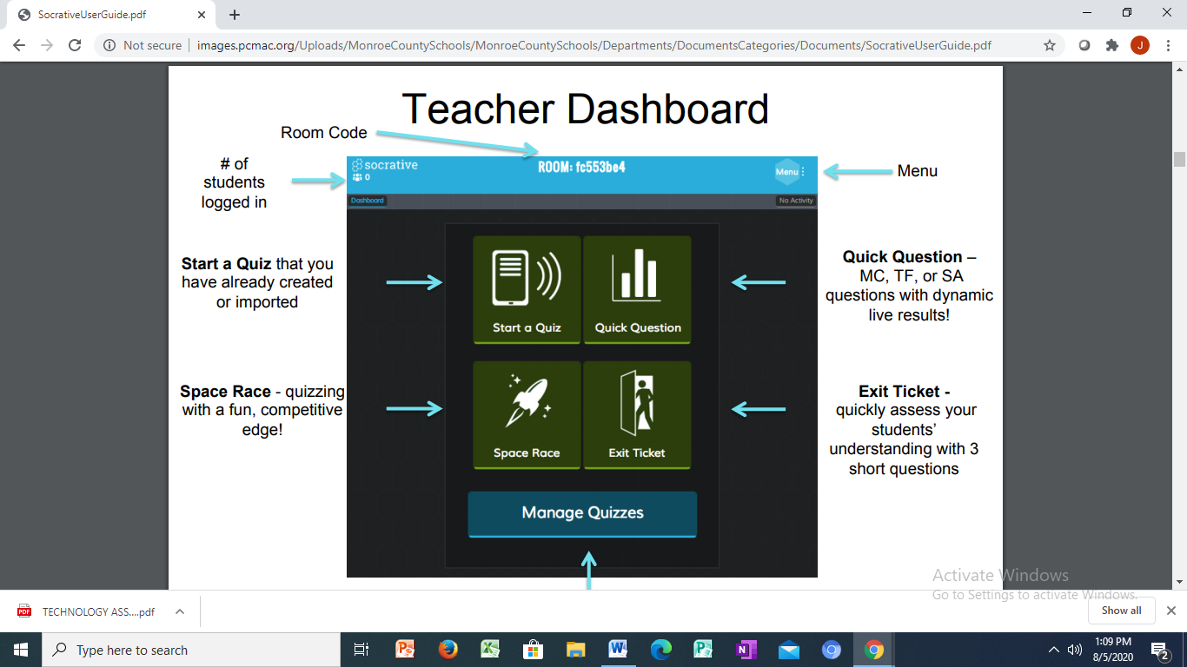
Retrieval shows Practice App

Slide 22
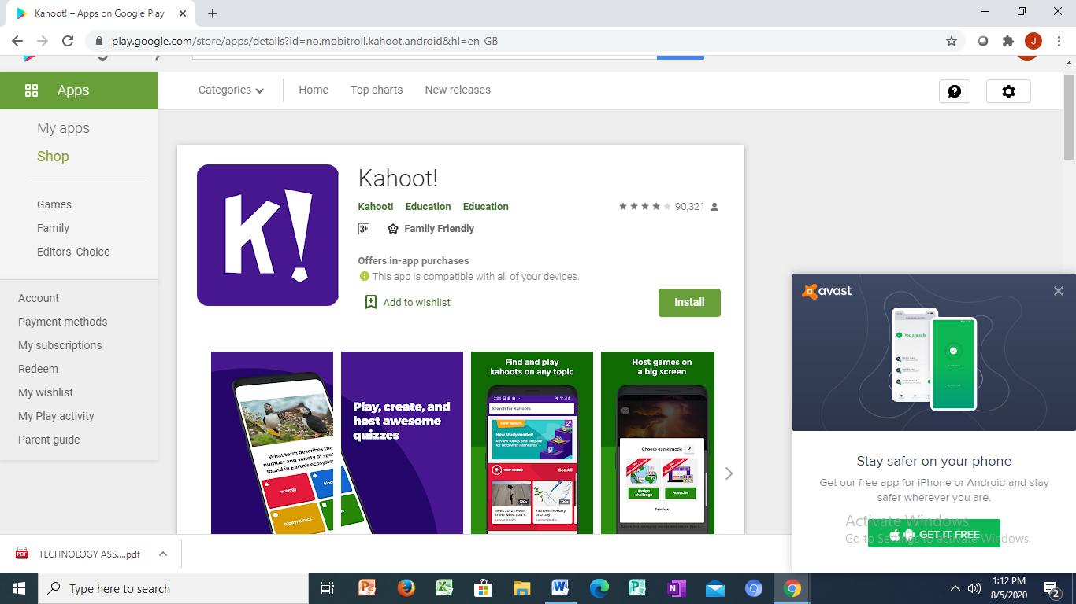
Kahoot App

Slide 23
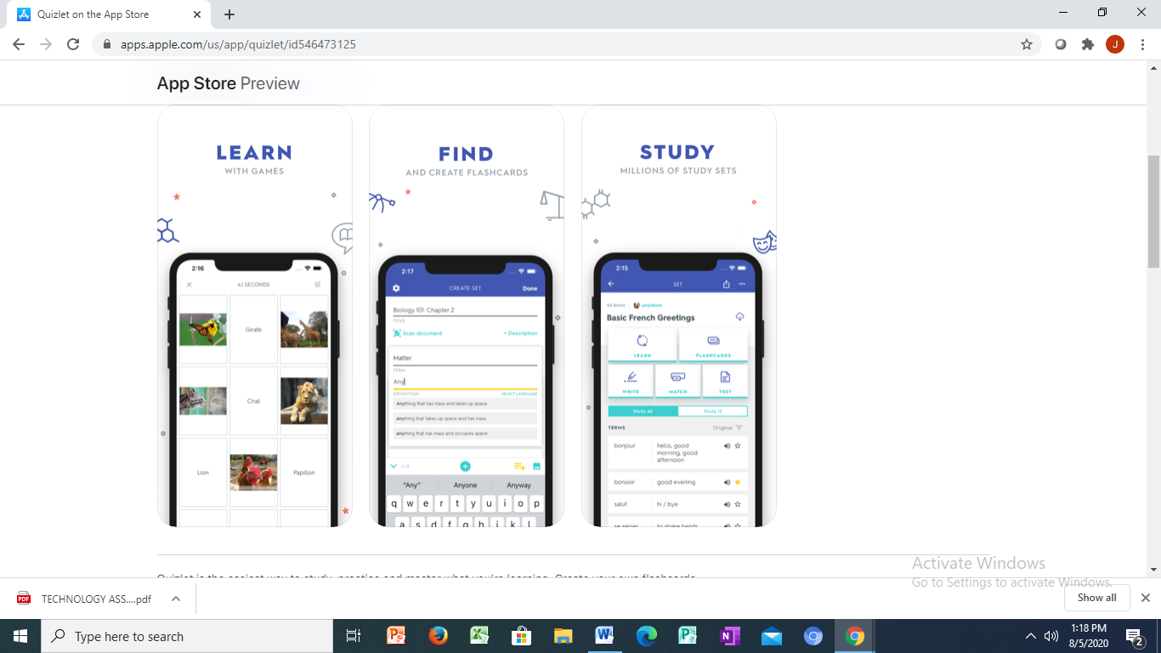
Quizlet App

Slide 24
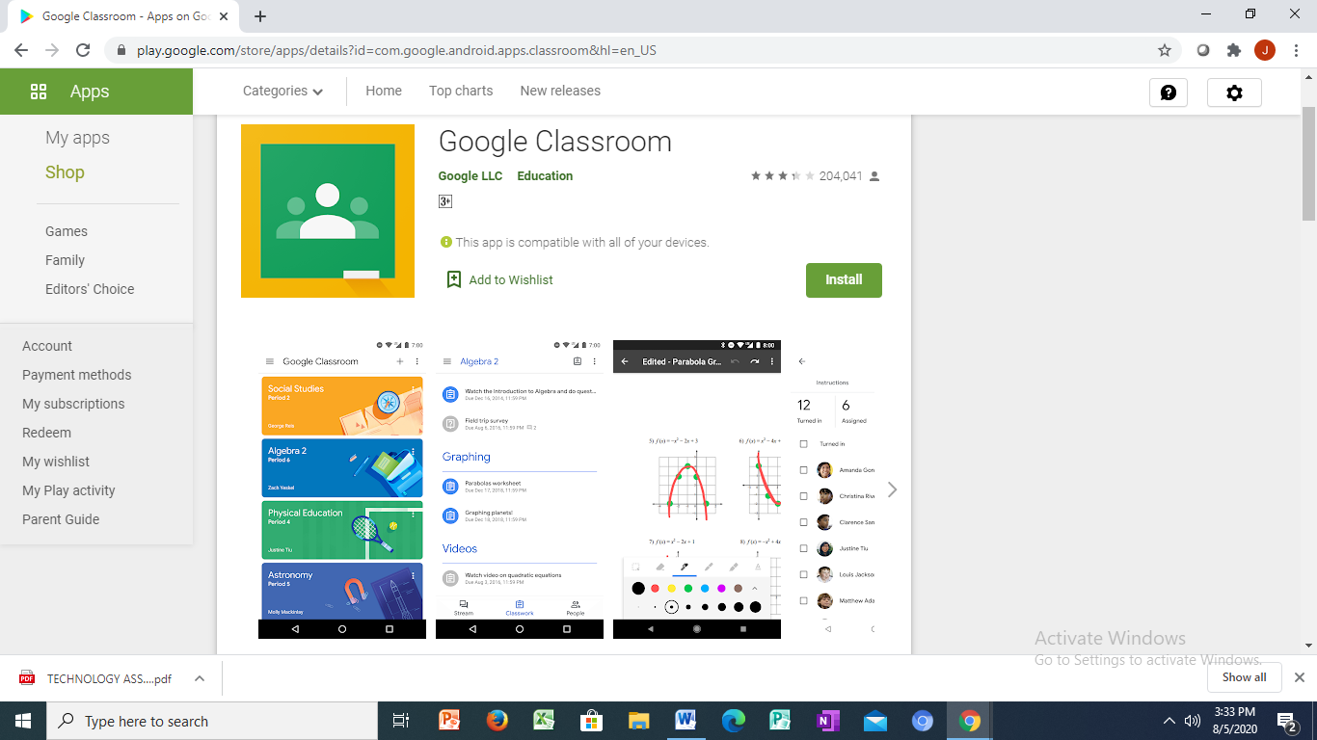
Google Classroom

Slide 25
(ii) Digitalised Summative Assessment Tools
Summative assessment tools allow lecturers to analyze the overall achievement of students.
Two broad methods for using digitalised summative assessment are the Learning Management System (LMS) and electronic portfolios (e-Portfolios).

Slide 26
Learning Management System (LMS)
A learning management system (LMS) is often considered the linchpin of a lecturer’s summative assessment tool in higher education.
Accessibility is a central part to using both formative and summative assessment tools electronically.
Steele (2015) emphasized that digitalised must have dedicated technology tools that are aligned with student learning outcomes and that allow the effective gauging of student learning.
Most Learning Management Systems have embedded tools that allow for the ease-of-access by most lecturers, their technology familiarity notwithstanding.

Slide 27
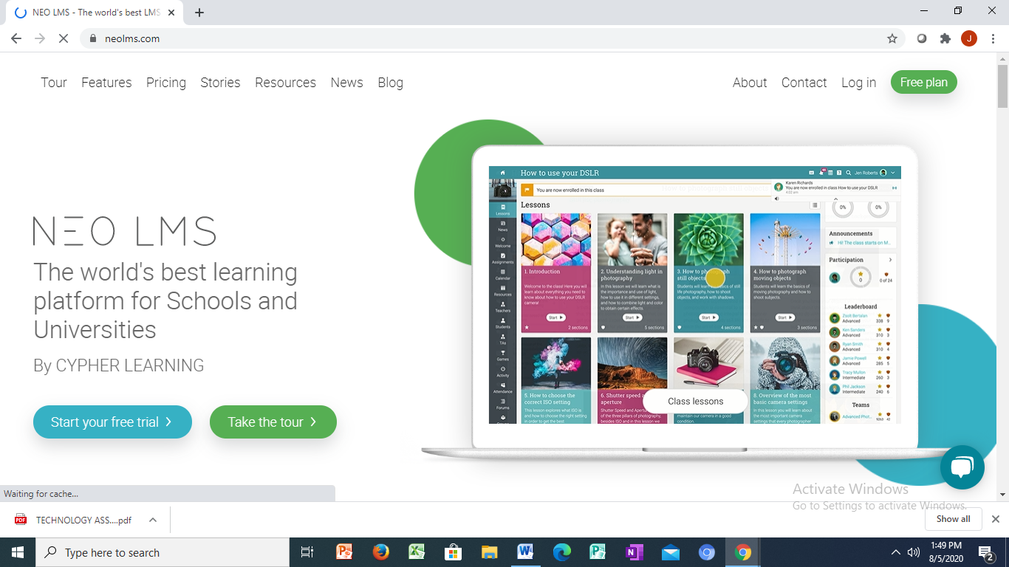
NEO LMS

Slide 28
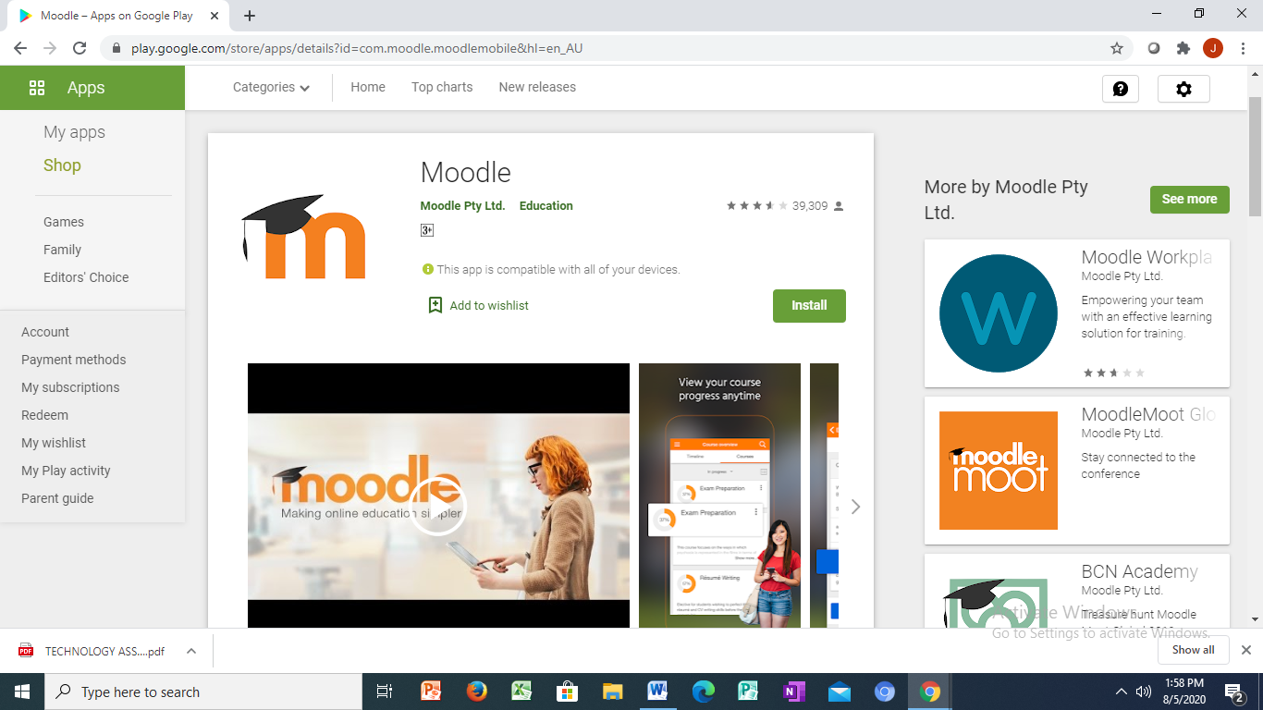
Moodle

Slide 29
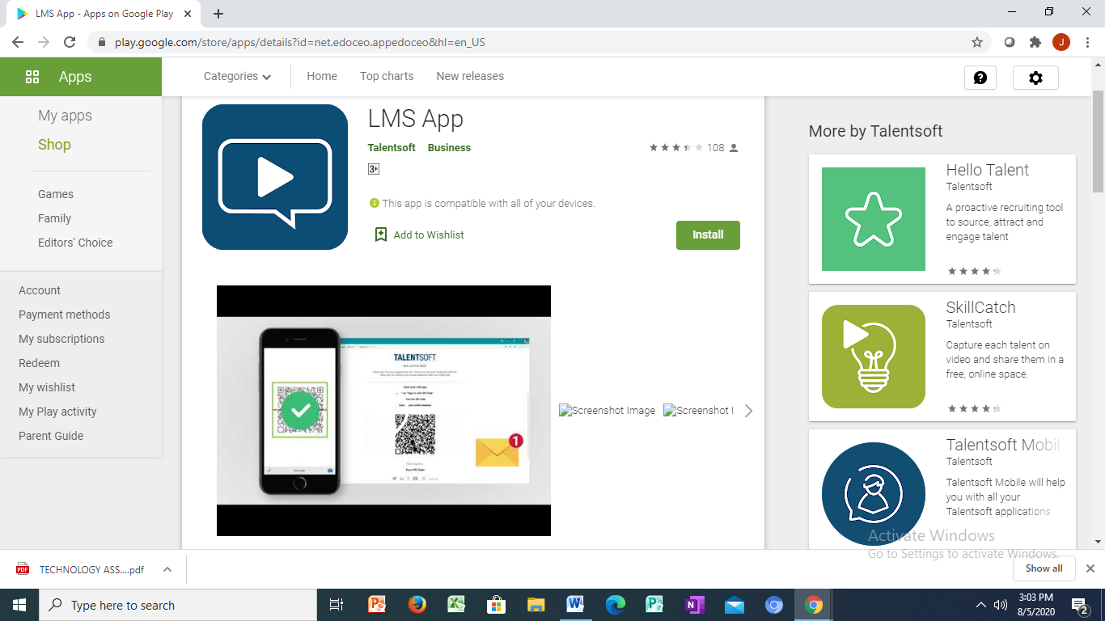
Talent LMS App

Slide 30
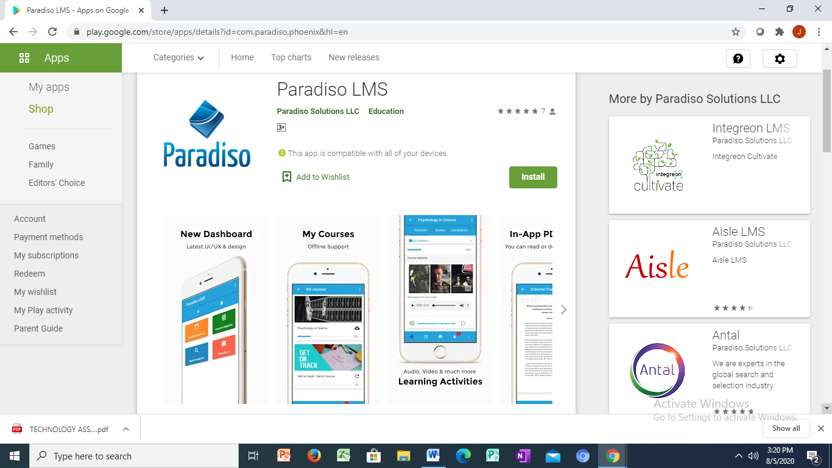
Paradiso LMS App

Slide 31
Electronic Portfolios
Strategies to make higher education students demonstrate global learning is through the use of an e-portfolio.
According to Harring and Luo (2016), e-portfolio is an electronic account of student work/progress used at all educational levels from early education through higher education. E-portfolios assist deep learning and reflective practices across various learning contexts as they facilitate overall learning.
The e-portfolio allows for students to reflect on and integrate their work to view overall learning progress and have become a successful assessment tool is because they require significant and purposeful work from the student. When students develop e-portfolio process students may experience student–faculty interaction, which allows students to evaluate and discuss their own learning over time (Garrett, 2011).
This tool is most effective it connected to the LMS already being used utilized by the institution.

Slide 32
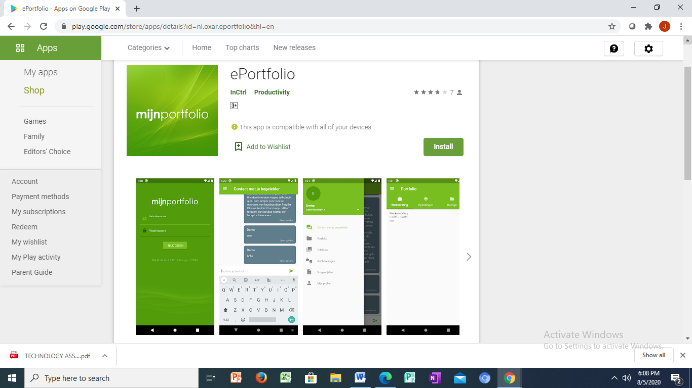
MijnePortfolio App

Slide 33
The Process of Digitalized Assessment (Constructing Test Items)
The process of test construction and validation for digitalized assessment are as follows:
Identifying and stating the educational objectives and domains of learning to be measured.
Drawing a Table of Specification or Testblueprint.
A large item or pull of items construction on predetermined content areas.
Moderation of test items by subject experts. Pilot testing of moderated items. Data collections from responses to the pretested items.
Data cleaning. Item Analysis in order to provide the psychometric properties of each item.
Item Calibration (determination of item parameters).
Item Optimization. Electronic Item Bank. Items deployment.

Slide 34
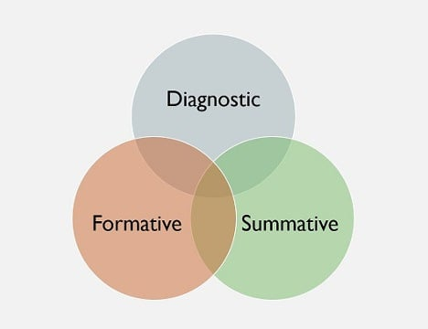
Guidelines for Developing Good Online Assessments 1. Remember The Before, During and After of Assessment

Slide 35
2. Know Why We Want To Assess
Assessments should really be about measuring learning outcomes.
Learning outcomes should be about students demonstrating what they know, and more importantly, what they can do (skills).
Learning outcomes can be low-level (recalling information) or high-level (analyzing information). A great, time-tested resource to help us understand the various levels of learning, which we can then assess, is Bloom’s Taxonomy. (See Figure 2)

Slide 36
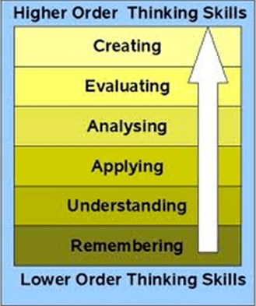
Bloom's Taxonomy of Cognitive Domains of Learning: Anderson’s Version

Slide 37
3. Choose The Right Tool To Assess The Right Set Of Skills
There are many different types of assessments, from tests to projects to performance-based tasks to essays, etc.
Every one of these has a particular function and thus may be appropriate or inappropriate depending on what we want to assess. So choosing the right assessment tool or method is paramount

Slide 38
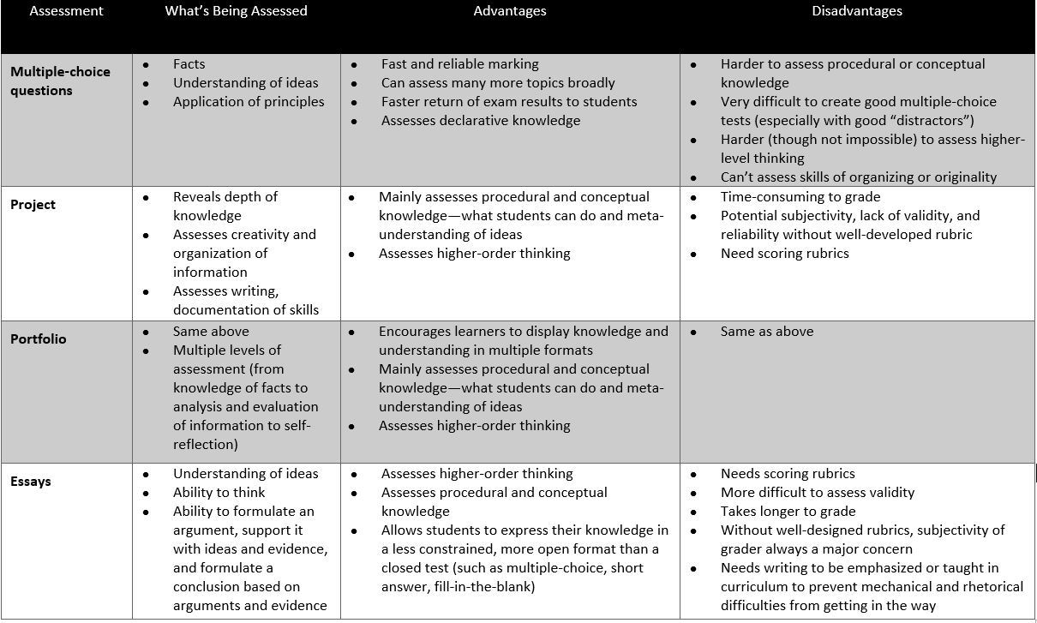
Common Types of Assessments and Their Advantages and Disadvantages (Adapted from Commonwealth of Learning & Asian Development Bank, 2008: 4–13, 4–14)

Slide 39
3. Remember, It’s Either "Open" Or Closed"
There are broadly two types of assessment methods—select response methods and constructed response methods.
With select response methods, our online learners "select" answers from a selection. True/False and Multiple Choice are the most common select response methods. Select-response items are good for recall/recognition of facts, limited types of reasoning. They are not good at all for assessing student skills.
With a constructed response method, our learners "construct" or "supply" their response. Constructed response items are good for descriptions/explanations. Simple constructed response items (fill-in-the-blank) still measure fairly low-level skills. However, more open constructed response assessments (like essays) can assess deeper knowledge and student thinking.
Learning Management System assessments and those of content development tools, like Articulate 360, do a far better job with select, versus constructed, response items.

Slide 40
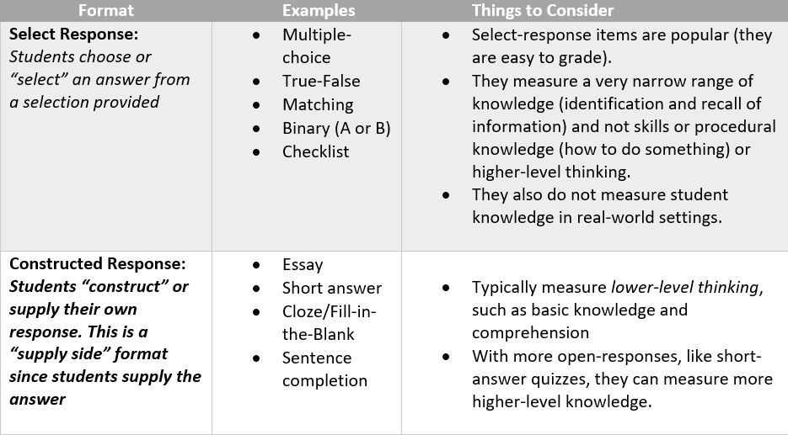
Select vs. Constructed (or "Supply") Responses

Slide 41
Benefits and Ways of Using Digital Assessment Tools
1. Gamifying The Answers
One of the most popular tools for digital assessments is Kahoot! This gamification platform helps teachers build the learning process in a form of a game by creating multiple choice questions or using already existing games. The teacher can upload media files and images to create a unique game, or download ready-made stuff. Though every student needs to work on their personal computer to pass the test, this is a great group activity, as all questions are shown on a shared screen and may be discussed if needed. According to the feedback from US teachers, Kahoot! provides 100% engagement in the class, as students totally plunge into the competitive atmosphere wanting to win.
The ideal solution to get a brief and to-the-point feedback from a group of learners is AnswerGarden. This simple online tool is focused on the (quick) question-answer interaction between learners and their teacher. After the teacher has shared a question in the class, students can either start forming an answer or choose the right one from a multiple choice provided by the teacher. The speed of collecting data is really impressive in AnswerGarden, but unfortunately it has limited online time. Therefore, this tool is not suitable for all types of questions: Teachers should avoid too long questions, as they demand even longer answers.

Slide 42
Benefits and Ways of Using Digital Assessment Tools
2. Giving Instant Feedback
A great tool for free stuff lovers is Socrative. This software is equipped with various features that can be used by educators for many different purposes. It also includes activities like quizzes, quick questions, exit tickets, etc. Socrative has an intuitive colorful and easy interface and apps for both students and teachers. The tool allows educators to get immediate insight into their student understanding in real-time, as they can create quizzes in seconds and also share them with other teachers.
3. Tracking Progress
Plickers is another real-time educational software allowing to get data for an assessment. It is a comprehensive tool that helps teachers understand exactly where their students are in terms of progress. Though Plickers is a serious tool for digital assessing, many students consider it to be a fun game, what makes the studying process even easier. The results may be seen in two modes: Students mode and Graph mode. The Graph mode allows a teacher to explore how learners make their decisions, while the Students mode helps learners track their correct and incorrect answers.

Slide 43
Benefits and Ways of Using Digital Assessment Tools
4. Creating Survey-Based Assessments
A widely-used tool for student assessments is Google Forms. Google Forms allows teachers to create multiple choice questions in the form of a survey and enhance it with images and videos in a few minutes. They can also add collaborators to their Google Forms and work on a survey together.

Slide 44
Relationship Between Big Data and Assessment
By leveraging AI, educators can provide more personalised feedback and support, helping students to achieve their full potential. Students, on the other hand, could benefit from more engaging and meaningful assessment experiences. AI can provide immediate feedback, allowing students to learn from their mistakes and make improvements in real-time.
There is intense interest in AI applications for education (e.g., see Tuomi et al., 2018; UNESCO, 2019) and as this grows, increasing interest is being shown in applications for educational assessment. The essence of artificial intelligence (AI) in both summative and formative contexts is the concept of machine ‘learning’ – where the computer is ‘taught’ how to interpret patterns in data and ‘trained’ to undertake predetermined actions according to those interpretations. This machine intelligence has arguably facilitated many of the huge step-changes underpinning the transformation to the 21st century's information society – in all areas including commerce, manufacturing, health and the relatively new phenomenon of social media.

Slide 45
Relationship Between Big Data and Assessment
In fact, it continues to impact upon almost every aspect of life in countries and communities where economic affluence enables people to exploit its many applications – with major economic blocs investing heavily in AI applications and talent development (see Castro et al., 2019).
Using today's massive computational power, large data sets –Big Data – are captured from online processes involved in every aspect of modern living (e.g., technology, medicine, environment, commerce) and are subjected to a variety of essentially correlational and probabilistic analyses to identify patterns of prior behaviour and to predict or propose next actions. The computer learns the strength of the associations in these Big Data sets and, whether its next action is to propose an aerodynamic refinement for an aircraft wing, remand a crime suspect in custody to protect the public (see Partnership on AI, n.d.), link two ‘lonely hearts’ together or predict the likelihood of a typhoon event in the Philippines, it continues to learn from new data.

Slide 46
Conclusion
Now, in our transformation drive, the right way to go is harness the services of Big Data and Artificial Intelligence in learning, teaching, assessment and research.

Slide 47
End of Slides
Thank you for listening to me.

