Slide 1

Charlotte Income vs. Commuting Analysis
Project by:
Bandana Deo
CaItlin Smith
Hunter Johnson
John Falcone

Slide 2
Charlotte Income and Commuting Analysis:
With Charlotte being one of the largest growing metro areas in the United States, our team felt it would be a good idea to look at some population metrics and find a correlation between household income and commuting to work.
Hoping to find a large correlation between higher paying jobs in the Charlotte metro area, and single person commuting.
Along with more people in poverty having a diverse set of ways to get to work other than single person car commuting.

Slide 3

Initial Exploration Questions:
1. Do people with higher paying jobs tend to commute alone more?
2. Do people with lower paying jobs tend to use a more varied array of ways to get to work?
3. Where is the area with the lowest average income and their preferred method of commuting?
4. Where is the area with the highest average income and their preferred method of commuting?
5. Where is an area with the closest to city wide average income and their preferred method of commuting?
6. What do these metrics tell us about the city of charlotte?
7. Are there more people that live and work in the same area when that area is closer to uptown/ do more people walk to work the closer they live to uptown?
8. Do rural areas have more single occupancy commuters?
9. Where is the biggest change in commuting style in the blocks?

Slide 4
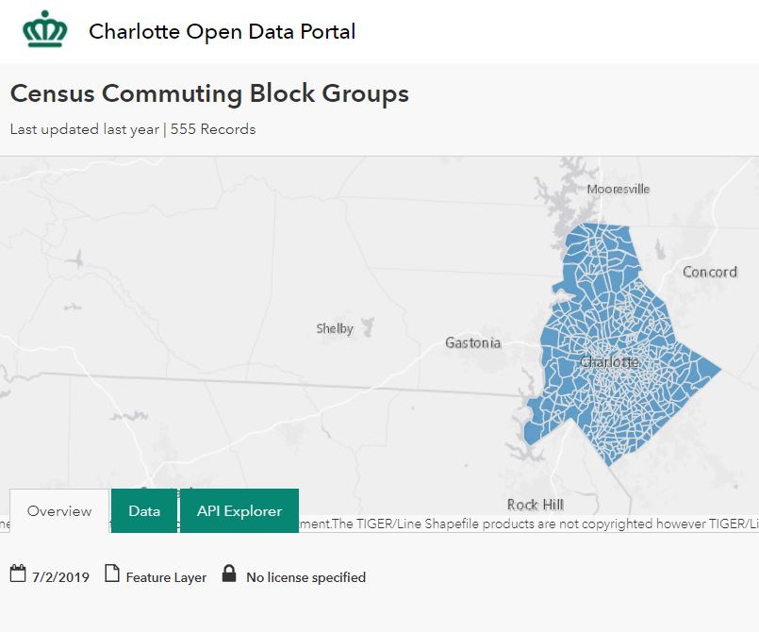
Where did we get our data?
Charlotte NC has its own API’s available for free to use by anyone, these data sets are both for years 2011-2015, so while not a current analysis it should be enough data to see trends and analyze for the future. This API uses census data
https://data.charlottenc.gov/datasets/census-commuting-block-groups
https://data.charlottenc.gov/datasets/census-household-income-block-groups?geometry=-83.097%2C34.866%2C-78.516%2C35.651

Slide 5
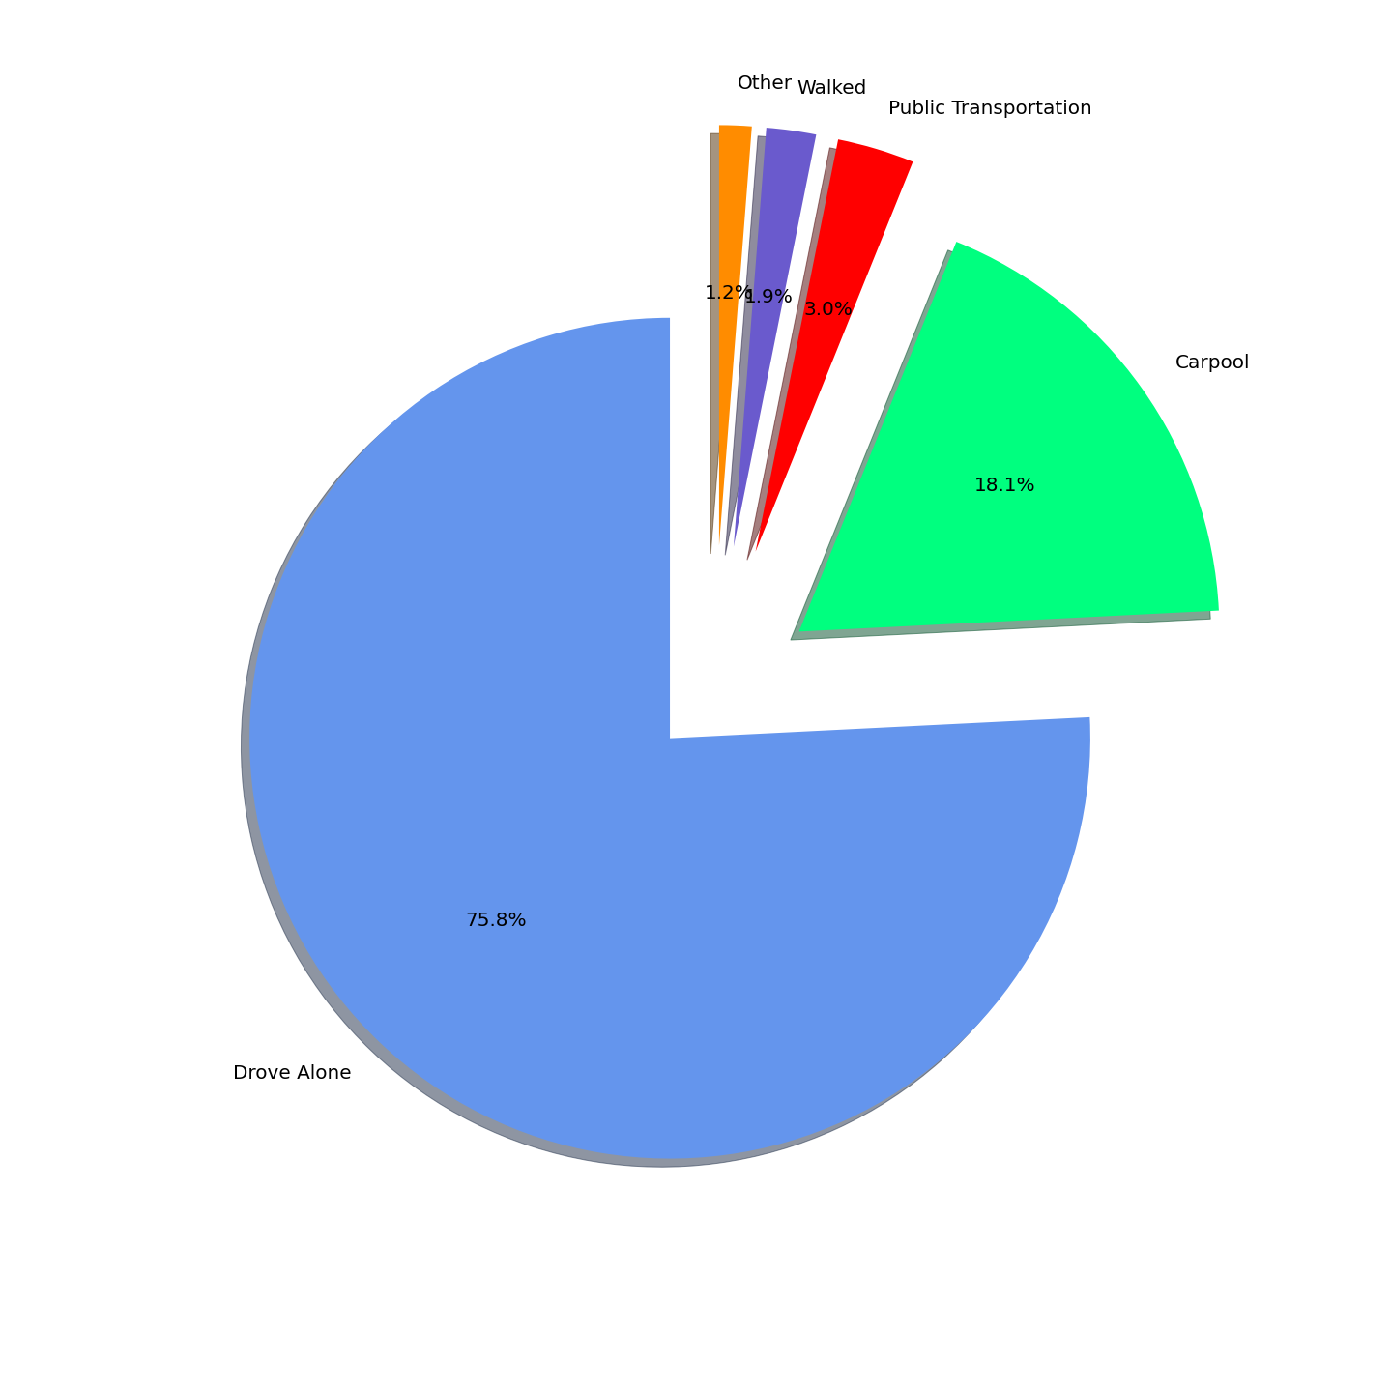




How does Mecklenburg move?

Slide 6
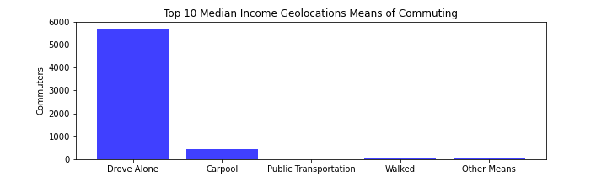
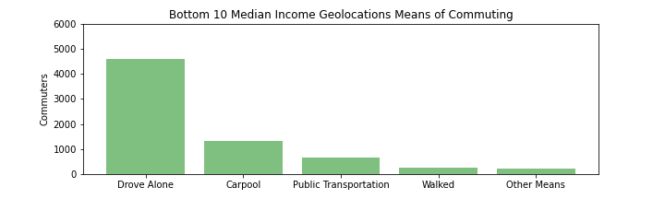
Top 10 vs Bottom 10 Median Household Income
In our first two charts we can see that even in comparison between the lowest median income areas and the highest, driving alone is still the largest metric in the Charlotte metro area by a wide margin.
Notes:
Talking points: Carpooling, Public transportation, and walking are utilized more in the bottom 10 geographic locations compared to the top 10, which are barely used.
Research the GEOIDs to be able to identify locations vs popular work locations (i.e. Uptown, Ballantyne, Wells Fargo Campus on WT Harris)

Slide 7
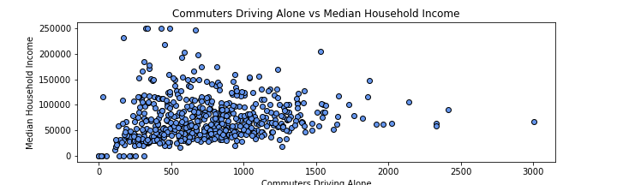
Charlotte is mostly single car commuters!
The most widely used form of transport in the Charlotte metro area by far, with metrics that give us an idea that only the lowest income brackets are resorting to other means.
Notes:
Talking points: The majority of geolocations commuting alone are in the 0-100k range. Again, research the top 10 GEOIDs to be able to give other options. Are they close to work? Are they on the outskirts and telecommute much more often?

Slide 8
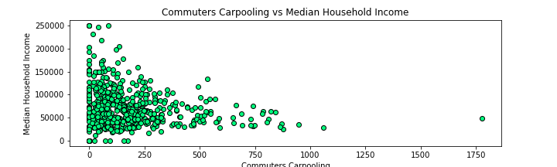
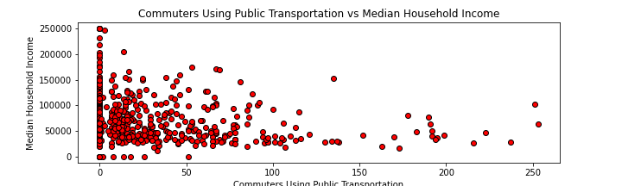
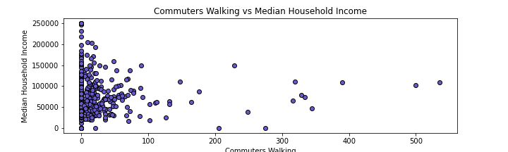
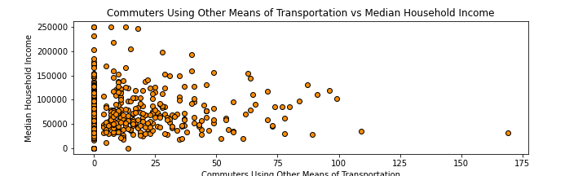
Then there’s the rest….
With more block groups reporting 0 for most of these other metrics, its easy to see that the individual person driving a single car is the most likely form of transportation in Charlotte, no matter what income bracket you are a part of! But still it would seem that having an income lower than 100K a year brings more variety in the ways you get to work in Charlotte!
Notes:
Talking points: Most walking commuters are in the 0-50k median household income range. Carpooling is popular in the 50k to 100k income range. What could other means of transportation include? Uber, biking?

Slide 9
Results:
1. Car crazy!
2. Carpooling better than the bus?
3. Where is the public transport?
As initially speculated the city of Charlotte and more even greater Mecklenburg county, uses single occupancy car commuting more than any other form of transport.
Even minding average income and searching for the 10 highest median income blocks and the 10 lowest median income blocks returned a similarly varied data set only mildly higher for lower income areas in other forms of transport.
The second largest transportation style being carpooling shows that more people prefer to have some sort of ride share compared to using public transport.
We were unable to find if this metric includes the ridesharing services such as Uber and Lyft, but other sources seem to indicate they arrived in the city around 2014, so their drivers might be mislabeled in some parts of the data leading to maybe even more “carpoolers” than thought.
This data does not include the recent expansion of the Lynx train to UNCC main campus in university city.
While public transport is one of the smaller metrics in the data at only 3% of the total population surveyed, the new line reaches more areas than the previous south boulevard line, which in turn one would infer to more usage overall.
This expansion was not completed till March of 2018.
Notes:
https://www.bizjournals.com/charlotte/blog/bank_notes/2013/09/inside-scoop-uber-arrives-in.html uber arrival
https://charlottenc.gov/cats/transit-planning/blue-line-extension/Pages/default.aspx Expansion date

Slide 10
Speculations
Minding that this data is from 2011 to 2015 we might begin to speculate how these numbers have changed in 2020 with the pandemic and more people working remotely than ever before.
Same being said for a likely drop in the data for 2020 in public transport and carpooling due to the pandemic as well, and people not using due to working remote or health concerns.
Most of the top and bottom 10 median income areas are both near or located in uptown, one can assume there is a higher level of income inequality in smaller neighborhoods closer to the city than farther away from it in areas such as Ballantyne or Mint Hill.
While more likely to use varied transportation the lower the income these metrics don’t include people from out of county commuting into Charlotte, since 2002 out of county commuting has grown 167% in North Carolina.
Notes:
https://ui.uncc.edu/story/Carolinas-urban-rural-connections-commuting-charlotte-region county commuting statistic

Slide 11
Conclusions
Charlotte being a one of the larger metro areas in the United States and one of the fastest growing as well needs more options for people to commute. The recent expansion of the light rail line into the university area is a start but the underlying problem in Charlotte is that there is no one area where all the people live, or all the Jobs are at so public transport will always be a smaller option in the grand scheme of the city as a whole.
The data proves we as a city and most likely as a society that we are mostly about the personal freedom of having your own car to be able to do with what you please. It will be interesting to see how this data changes in the future with new technologies in self driving cars as well as the changing world with covid-19 being a major concern.

