Slide 1

Charlotte Income vs. Commuting Analysis
Project by:
Bandana Deo
CaItlin Smith
Hunter Johnson
John Falcone

Slide 2
Charlotte Income and Commuting Analysis:
With Charlotte being one of the largest growing metro areas in the United States, our team felt it would be a good idea to look at some population metrics and find a correlation between household income and commuting to work.
Hoping to find a large correlation between higher paying jobs in the Charlotte metro area, and single person commuting.
Along with more people in poverty having a diverse set of ways to get to work other than single person car commuting.

Slide 3

Initial Exploration Questions:
1. Do people with higher paying jobs tend to commute alone more?
2. Do people with lower paying jobs tend to use a more varied array of ways to get to work?
3. Where is the area with the lowest average income and their preferred method of commuting?
4. Where is the area with the highest average income and their preferred method of commuting?
5. Where is an area with the closest to city wide average income and their preferred method of commuting?
6. What do these metrics tell us about the city of charlotte?
7. Are there more people that live and work in the same area when that area is closer to uptown/ do more people walk to work the closer they live to uptown?
8. Do rural areas have more single occupancy commuters?
9. Where is the biggest change in commuting style in the blocks?

Slide 4
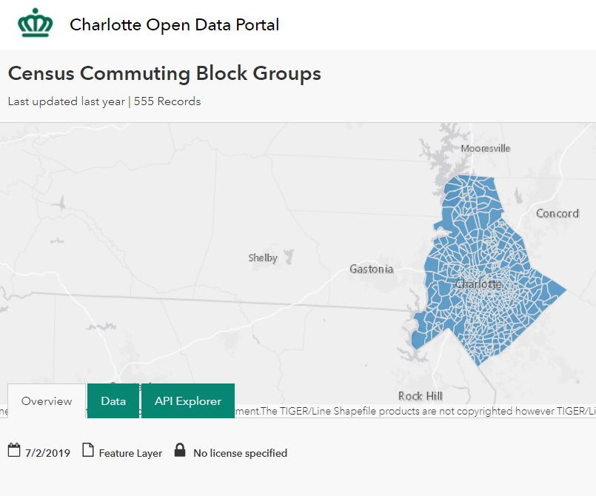
Where did we get our data?
Charlotte NC has its own API’s available for free to use by anyone, these data sets are both for years 2011-2015, so while not a current analysis it should be enough data to see trends and analyze for the future. This API uses census data
https://data.charlottenc.gov/datasets/census-commuting-block-groups
https://data.charlottenc.gov/datasets/census-household-income-block-groups?geometry=-83.097%2C34.866%2C-78.516%2C35.651

Slide 5
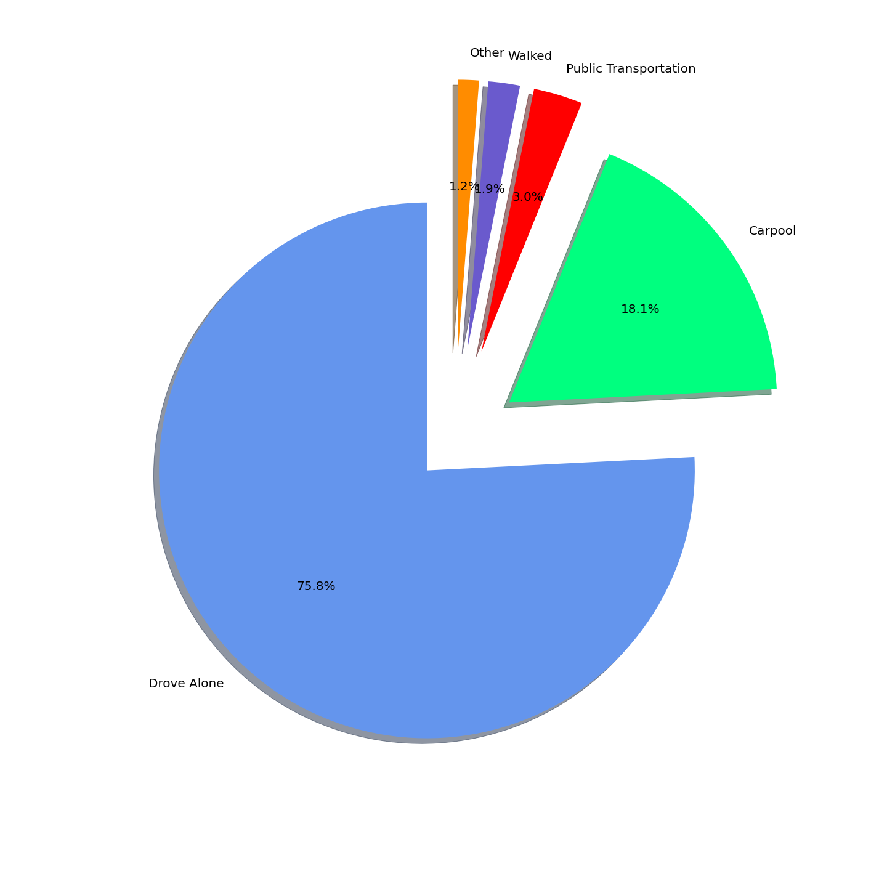




How does Mecklenburg move?

Slide 6
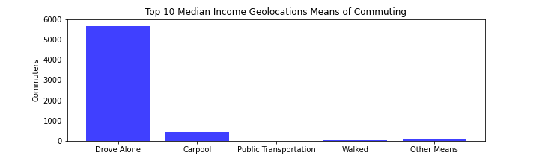
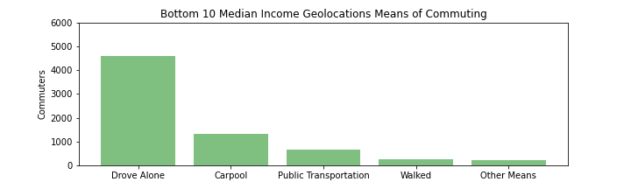
Top 10 vs Bottom 10 Median Household Income
In our first two charts we can see that even in comparison between the lowest median income areas and the highest, driving alone is still the largest metric in the Charlotte metro area by a wide margin.
Notes:
Talking points: Carpooling, Public transportation, and walking are utilized more in the bottom 10 geographic locations compared to the top 10, which are barely used.
Research the GEOIDs to be able to identify locations vs popular work locations (i.e. Uptown, Ballantyne, Wells Fargo Campus on WT Harris)

Slide 7
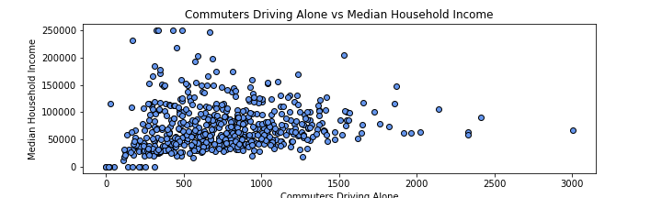
Charlotte is mostly single car commuters!
The most widely used form of transport in the Charlotte metro area by far, with metrics that give us an idea that only the lowest income brackets are resorting to other means.
Notes:
Talking points: The majority of geolocations commuting alone are in the 0-100k range. Again, research the top 10 GEOIDs to be able to give other options. Are they close to work? Are they on the outskirts and telecommute much more often?

Slide 8
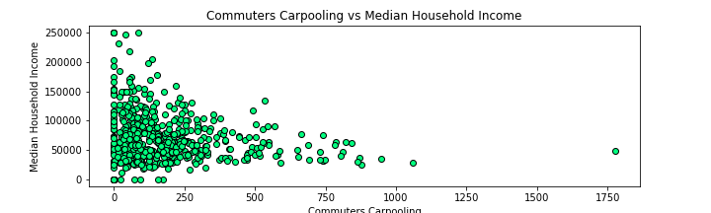
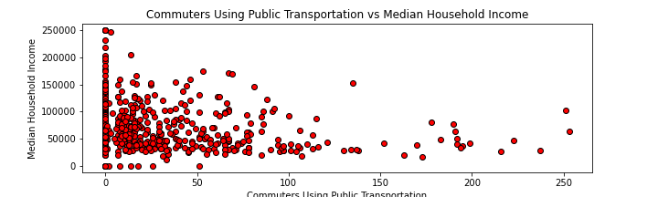
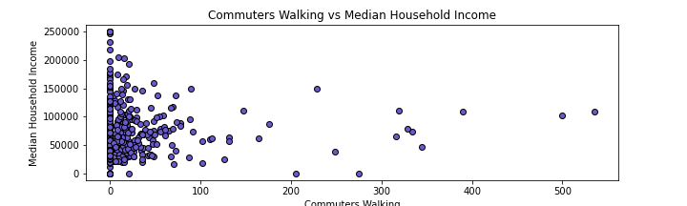
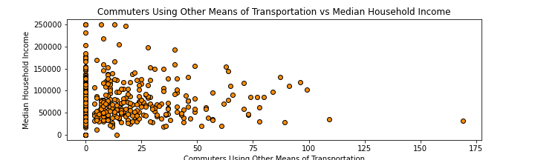
Then there’s the rest….
With more block groups reporting 0 for most of these other metrics, its easy to see that the individual person driving a single car is the most likely form of transportation in Charlotte, no matter what income bracket you are a part of! But still it would seem that having an income lower than 100K a year brings more variety in the ways you get to work in Charlotte!
Notes:
Talking points: Most walking commuters are in the 0-50k median household income range. Carpooling is popular in the 50k to 100k income range. What could other means of transportation include? Uber, biking?

