Slide 1
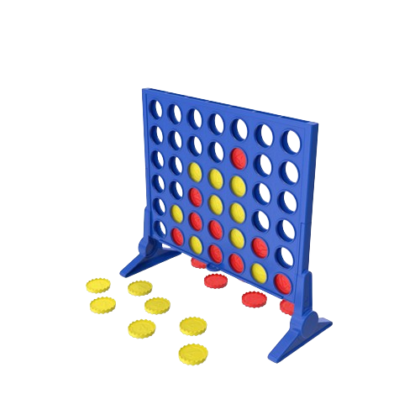
DIP392-Presentation
Connect 4
Wilfried Ruiz ; Kevin Randrianimanana ;
Elias Cremniter ; Guy-Leonard Kamga-Fotso-Wafo

Slide 2

Summary
1. Requirements Analysis
3. Design
4. Implementation
5. Testing
6. Démo

Slide 3
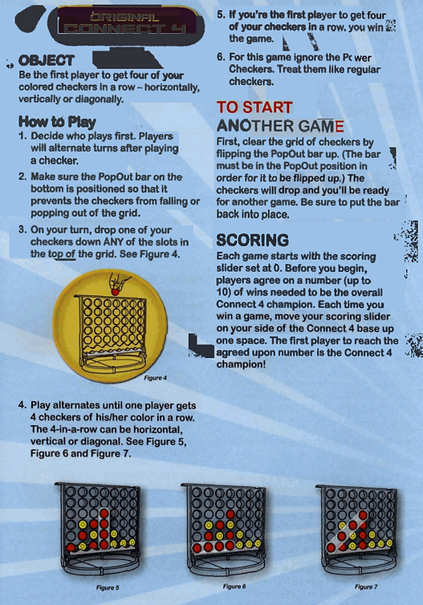
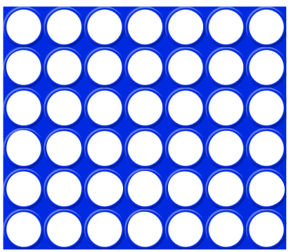
Requirements/Analysis
Project Overview:
- A 6x7 gameboard
- 2 players' game
- Win condition = 4 tokens aligned
- 21 token per player
- 2 token color : Red and yellow
6
7

Slide 4
Requirements/Analysis
Project Requirements
1. The game must allow two players to take turns.
2. Players must be able to place their token in a non-full column of the grid.
3. The game must detect and signal when a player aligns four tokens.
4. The game must end when the grid is full or when a player aligns four tokens.
5. The game must clearly display the current state of the grid after each move.
6. Players must be able to start a new game after the end of the previous one.
7. The game must include a user-friendly interface for players to select columns to place their tokens.
8. The game must handle draw cases when the grid is full without any player aligning four tokens.
9. The program must be developed in an appropriate programming language with suitable data structures to represent the grid and tokens.

Slide 5
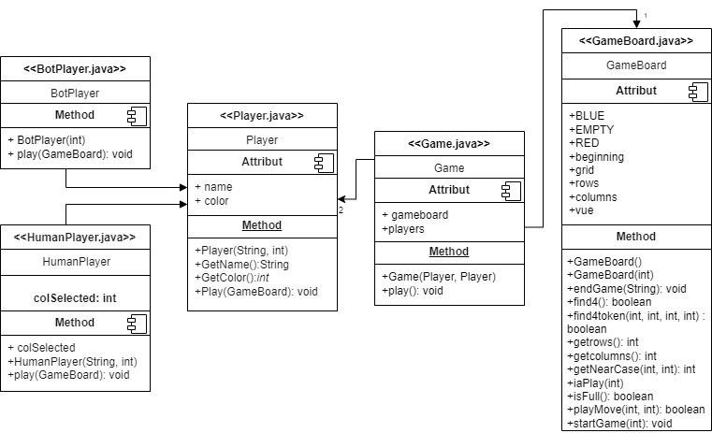
Design
Classe : Game, GameBoard, Player, BotPlayer, HumanPlayer
MVC Pattern
Pro : code reuse through inheritance, extensibility Cons : complexity in inheritance hierarchy

Slide 6

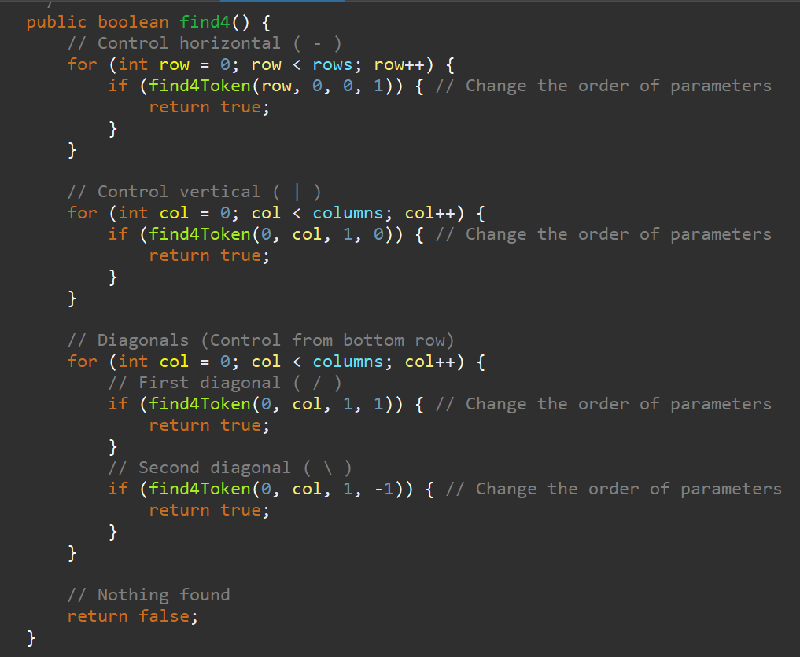
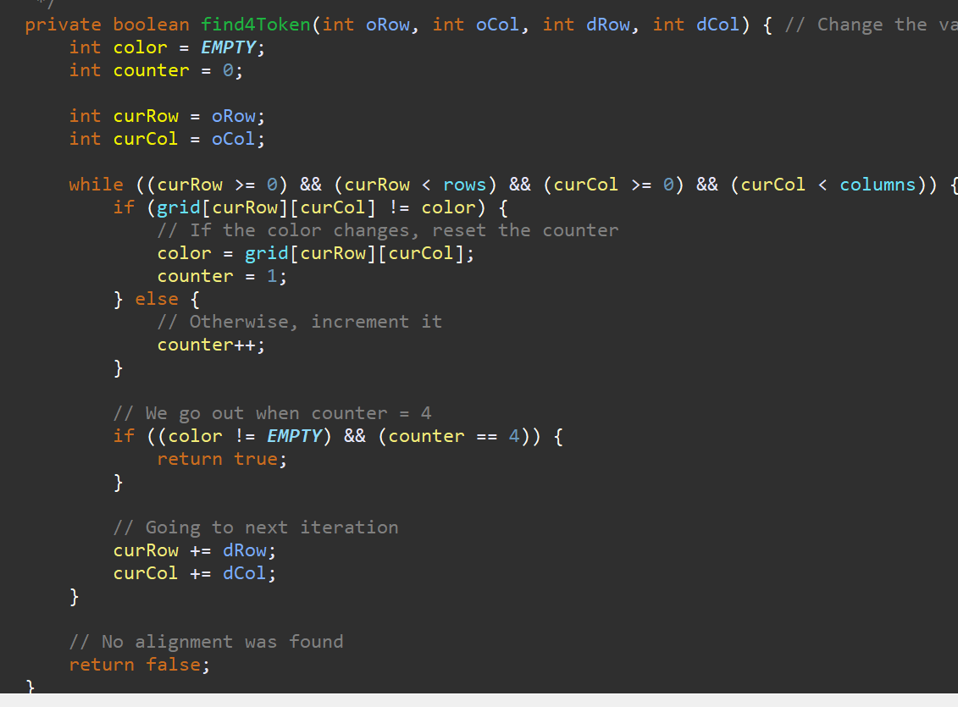
Implementation

Slide 7

Testing
Test Cases:
Test ID 1: Disc placement in a specified column.
Test ID 2: Turn-taking between two players.
Test ID 3: Response to placing a disc in a full column.
Test ID 4: Detection of a full board (draw condition).
Test ID 5: Identification of a winning condition when four discs are aligned.

Slide 8
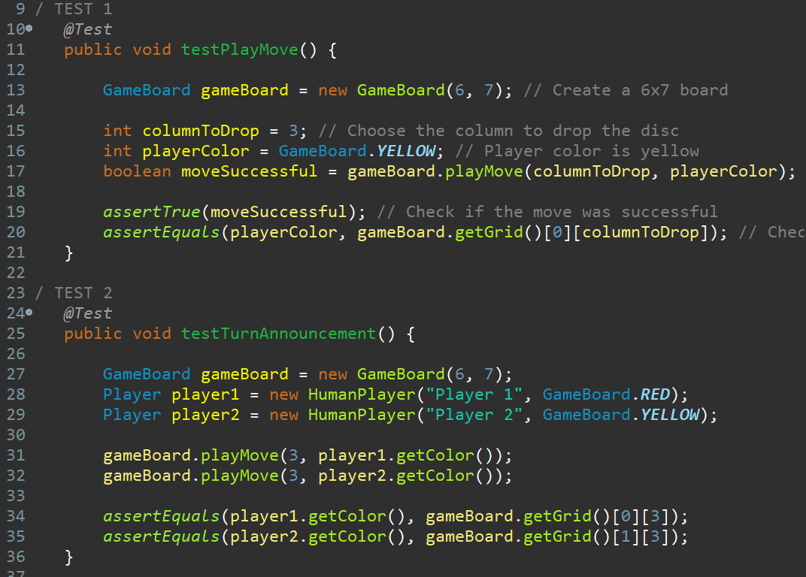
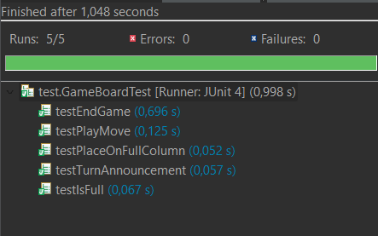
Testing

Slide 9
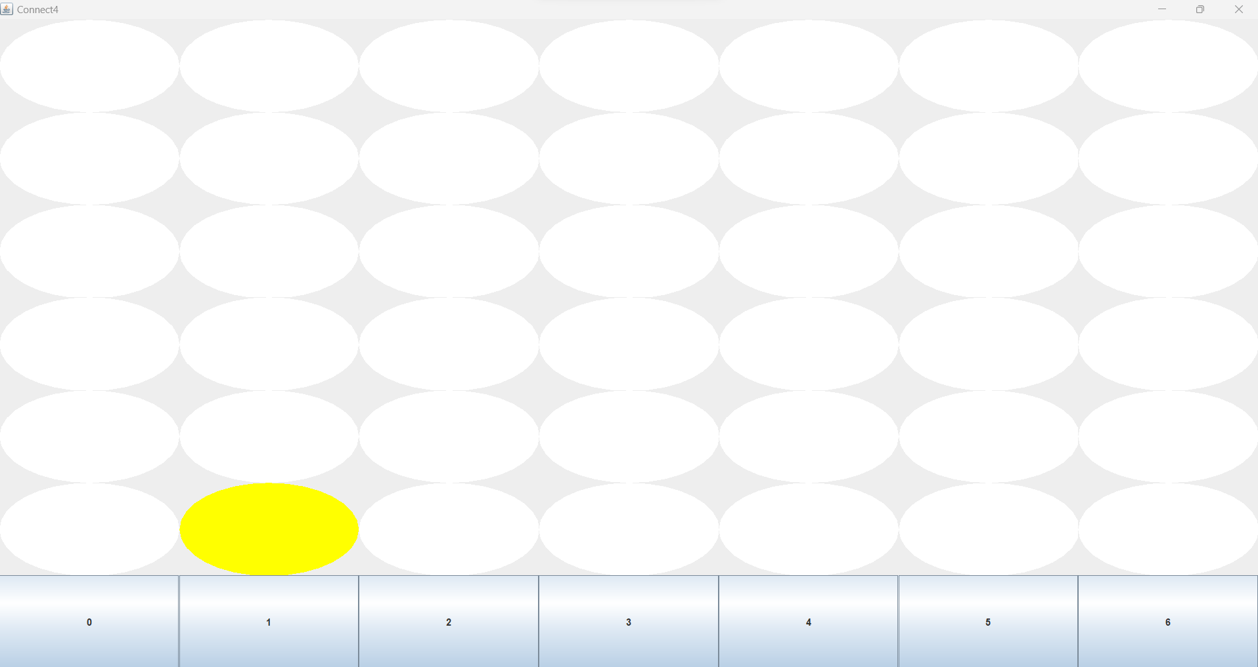
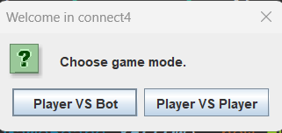
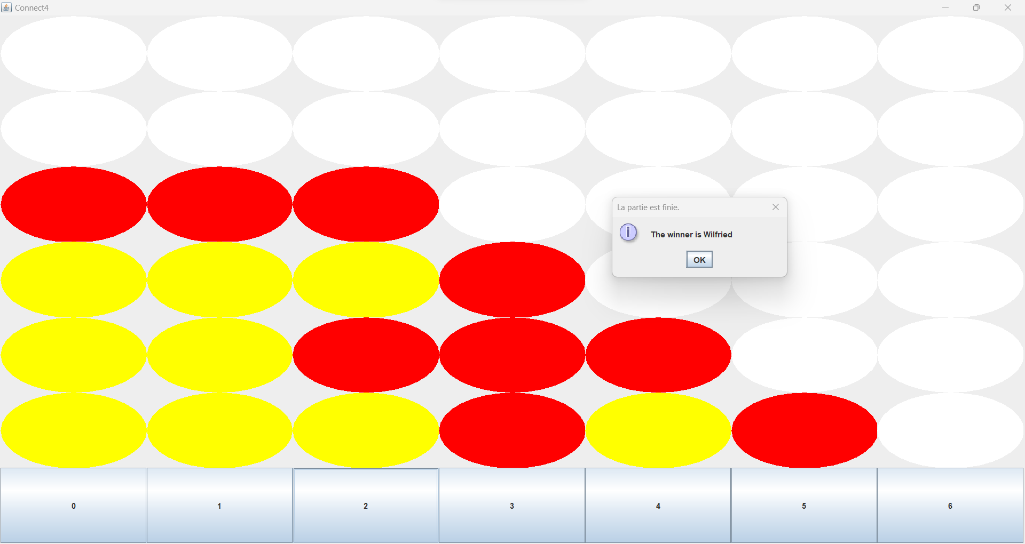
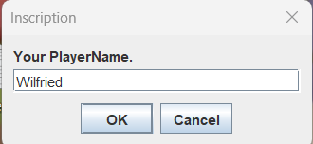
Demo

Slide 10
thank you for listening to us !

