Slide 1
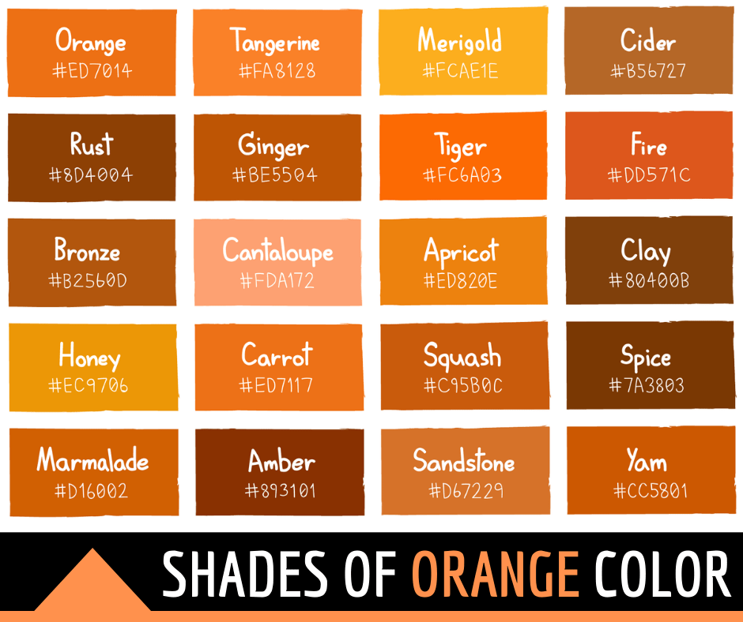

Slide 2

Rounder

