Slide 1
Multi-Threading in Java
By:-Himanshu Laghwe & Shreya Poharkar

Slide 2
What is Multithreading ??
A thread is a lightweight sub-process, the smallest unit of processing.
Multithreading is a conceptual programming model where program is divide into two or more subprograms which are simultaneously executed by one processor.
class A{ ............. }
The Above program is an example of single thread similar to a program that a single flow control.
It has beginning,a body and an end and exeuctes all lines of body sequentially.

Slide 3
Main Thread
(Main method)
The diagram shows that there is a main program and three sub program.
The three subprogram shares the same memory space and resources of main program.
Thread A
Thread B
Thread C

Slide 4
Multithreading is powerful programming tool that makes java distinctly different from other programming languages.
Multithreading enables programmers to do multiple things at a one time.
Main method is also a thread.

Slide 5
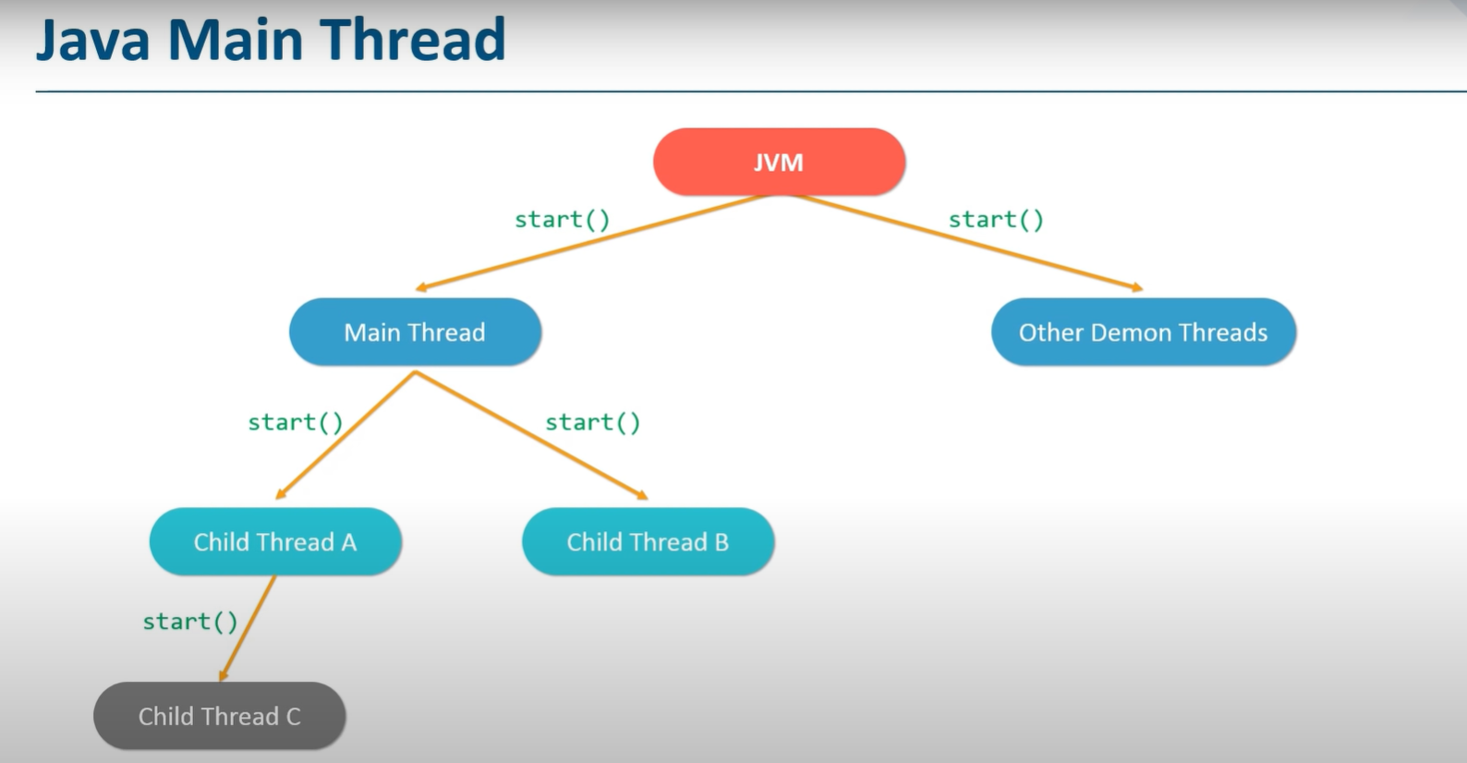
Java Main Threads
JVM has 2 threads :-
1)Main thread
2)Daemon threads
Main thread is then divided in child/worker threads resp.
Daemon threads provide service to user threads.

Slide 6
Advantages of Multithreading
It Reduces the compilation time.
Improves performance of an application.
Threads share same address space so it saves the memory.
Context switching between threads is usually less expensive than between processes.
Cost of Communication between threads is relatively low

Slide 7

How does Threading saves time?
Let us consider that we have an octa-core processor.
Let us consider we have to perform an operation where we have to multiply all elements of this array {1,2,3,4....80} with 2.
So our resultant array is {2,4,6,8....160} . If we perform this operation let us assume it takes 8 sec to process the answer and the operation is done on one of the cores of processor
To make this process efficient and time efficient we use threads in this process and try to utilize every core on the processor , Resulting in processing this set of operation in just 3 sec respectively
Let us assume here main method(Main string) is calling these 8 threads respectively.
Using single core
for processing
Using every core
for processing
of array by
breaking
it in peices like t1,t2,t3...t8
where every peice
is a thread
Here t1={1,2,...10}
t2={11,12....20}
: : :
t8 = {71,72,.....80}

Slide 8
Creation of Thread
In Java ,an object of Thread class can be represent a thread.Thread can be implemented through anyone of two ways:
Extending the java.lang.Thread Class.
Implementing the java.lang.Runnable Interface.
Thread
extends
implements
Thread
Runnable
@Override
run()

Slide 9
1.Extending the java.lang.Thread Class
Extend the java.lang.Thread Class.
Override the run() method int the subclass from the thread class to define the code executed by the thread.
Create an instance of this subclass.This subclass may call a Thread class constructor by subclass constructor.
Invoke the start() method on the instance of the class to make the thread eligible running.

Slide 10
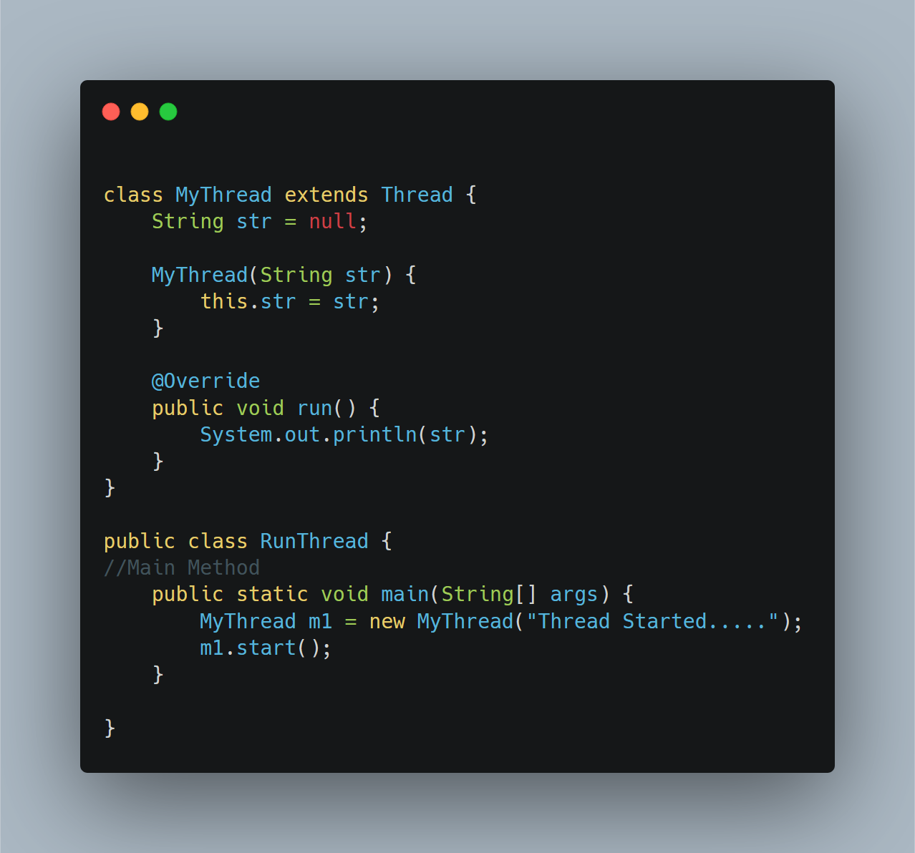
Program using Thread class

Slide 11
2.Implementation using the java.lang.Runnable Interface
A Class implements the Runnable Interface ,override the run() method to define the code executed by thread. An object of this class is Runnable Object.
Create a Object of Thread class by passing a Runnable Object as argument.
Invoke the start() method on the instance of the Thread class.

Slide 12
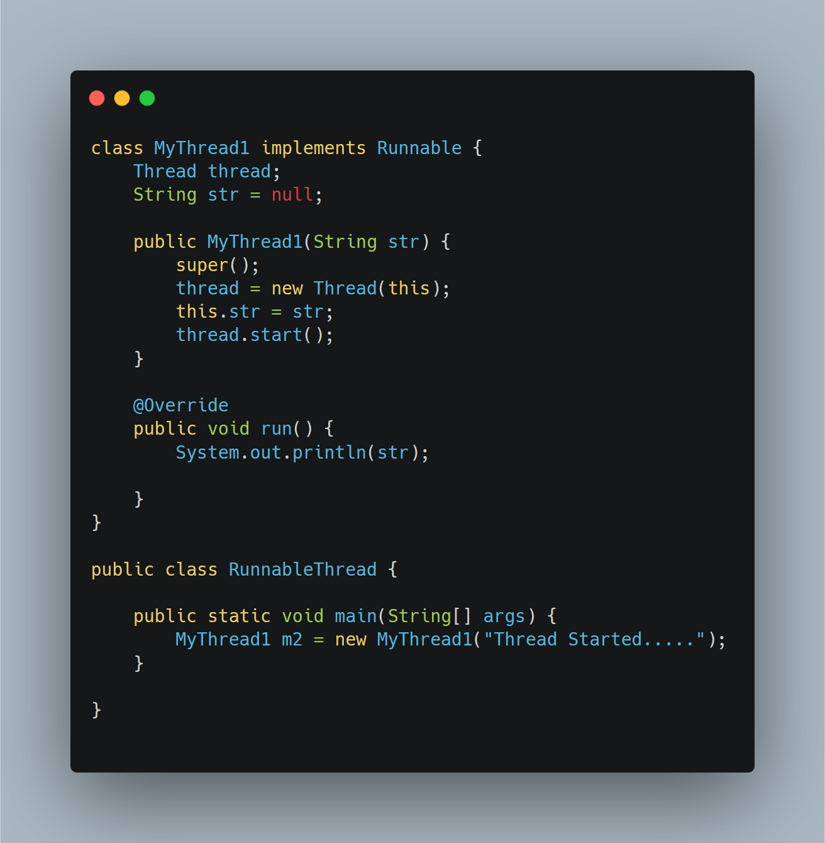
Program using Runnable Interface

Slide 13
Difference between Thread class and Runnable Interface
Thread class | Runnable Interface
1. Thread is a class. It is used to create a thread . | 1.Runnable is a functional interface which is used to create a thread.
2.It has multiple methods including start() and run(). | 2.It has only abstract method run().
3.Each thread creates a unique object and gets associated with it. | 3.Multiple threads share the same objects.
4.More memory required. | 4.Less memory required.
5.Multiple Inheritance is not allowed in java hence after a class extends Thread class, it can not extend any other class. | 5.If a class is implementing the runnable interface then your class can extend another class.

Slide 14
Life Cycle of Thread
A thread can has five different state,during its life time a thread is always in anyone of these state and can move from one state to another state.
1.Newborn state
2.Runnable state
3.Running state
4.Blocked state
5.Dead state

Slide 15
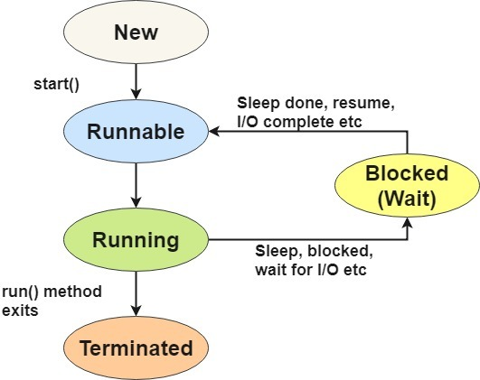
Life Cycle of a Thread

Slide 16
1.Newborn State
A newborn state is a state when a thread object is created and is not yet scheduled for running. At this state,we can do the following:
Schedule it for running using start() method.
          OR
Stop the thread using stop() method this is a premature death of thread,Otherwise it will move to runnable state.

Slide 17
2.Runnable State
The Runnable state means the thread is ready for the execution and is waiting for the availability of the processor
The Thread has joined the queue of thread that are waiting for the execution and if all threads have equal priority then they are given time slots on First Come First Serve(FCFS) basis.
At this stage programmer can transfer control from one thread to another thread using yield() method.

Slide 18
3.Running State
In this stage the processor has given the time to the thread for execution .At this Stage we can use following methods.
suspend()-Due to this processor will stop execution for sometime and we can continue it using resume() .
sleep()-Put the Thread into sleep mode for a specified period .Specify time in miliseconds .It will continue the thread automatically when the time is elapsed.
wait()- The current thread to wait until another thread invokes the notify() or notifyAll() methods .
notify()- This method wakes up a single thread that is waiting on that object’s monitor.
notifyAll() - The notifyAll() method wakes up all threads that are waiting on that object’s monitor.

Slide 19
4.Blocked state
If we prevent the thread from entering into runnable/running state then this state is called as blocked state.
We can do this using some methods like wait(),sleep(),suspend() etc.

Slide 20
5.Dead State
When a thread has completed its execution using run() method it is called the natural death.
And when we stopped or moved a thread to dead state by calling stop() method it causes a premature death.

Slide 21
Life Cycle of Thread

Slide 22
Methods
static int activeCount():-Returns an estimate of the number of active threads in the current thread's thread group and its subgroups.
void checkAccess():-Determines if the currently running thread has permission to modify this thread.
static Thread currentThread():-Returns a reference to the currently executing thread object.
long getId():-Returns the identifier of this Thread.
String getName():-Returns this thread's name.
int getPriority():-Returns this thread's priority.
Thread.State getState():-Returns the state of this thread.
void interrupt():-Interrupts this thread.
static boolean interrupted():-Tests whether the current thread has been interrupted.
void start():-Causes this thread to begin execution; the Java Virtual Machine calls the run method of this thread.
static void yield():-A hint to the scheduler that the current thread is willing to yield its current use of a processor.

Slide 23
Methods
boolean isAlive():-Tests if this thread is alive.
boolean isDaemon():-Tests if this thread is a daemon thread.
boolean isInterrupted():-Tests whether this thread has been interrupted.
void join():- Waits for this thread to die.
void join(long millis):-Waits at most millis milliseconds for this thread to die.
void join(long millis, int nanos):-Waits at most millis milliseconds plus nanos nanoseconds for this thread to die.
void run():-If this thread was constructed using a separate Runnable run object, then that Runnable object's run method is called; otherwise, this method does nothing and returns.
void setName(String name):-Changes the name of this thread to be equal to the argument name.
void setPriority(int newPriority):-Changes the priority of this thread.

Slide 24
Thread Priority
Each java thread has its own priority which decides the order of thread to be schedule. The Thread of equal priority will be given same treatment by java scheduler.And they will follow the FCFS algorithm.
User can also set the priority of thread by using the setPriority() method as follow:
ThreadName.setPriority(int number);
Here the number is intege value between 1 to 10,Here 1 is minimum priority and 10 is maximum priority.
The Thread class defines few priority constants:
MIN_PRIORITY=1
NORM_PRIORITY=5
MAX_PRIORITY=10

Slide 25
In any the default priority is NORM_PRIORITY.
In Multithreading by assigning priority we can answer an input as quickly as we want.
Whenever more than one Thread are ready to run java system select the highest priority thread and execute it.
If another thread of high priority comes the running thread will be preempted by the incoming thread and current thread will move to runnable state.

Slide 26
Synchronization
In all the examples thread uses their own data and method defined inside their run methods.
But the problem may occur when they try to use data and methods for outside
Eg. One thread may try to read a record from a file while another is still writing to same file. To Overcome this problem synchronization technique is used.
The keyword synchronized helps to solve such problems by keeping a watch on such locations.
Eg . A method will information from a file and the method that will update the same file may be declared as synchronized.

Slide 27
Synchronized void update()
{
................. //(code here is Synchronized)
..................
}
When we declare a method synchronized. Java creates a “moniter” and hands it over to the thread that calls the method first time. As long as the thread holds the monitor,no other thread can enter the synchronized section of code.

Slide 28
Java Executor Framework
The Executor Framework contains a bunch of components that are used to efficiently manage multiple threads. It was released with the JDK 5 which is used to run the Runnable objects without creating new threads every time and also mostly re-using the already created threads.
This Executor API de-couples the execution of a task from the actual task to be executed with the help of an Executor. This is centered around the Executor interface and its sub-interface ExecutorService and the class ThreadPoolExecutor.
By using this executor, only one has to implement the runnable objects and send them to the executor for execution.

Slide 29
Types of Executor Service
There are mainly 4 types of Executors available. They are namely:
SingleThreadExecutor
FixedThreadPool
CachedThreadPool
ScheduledExecutor

Slide 30
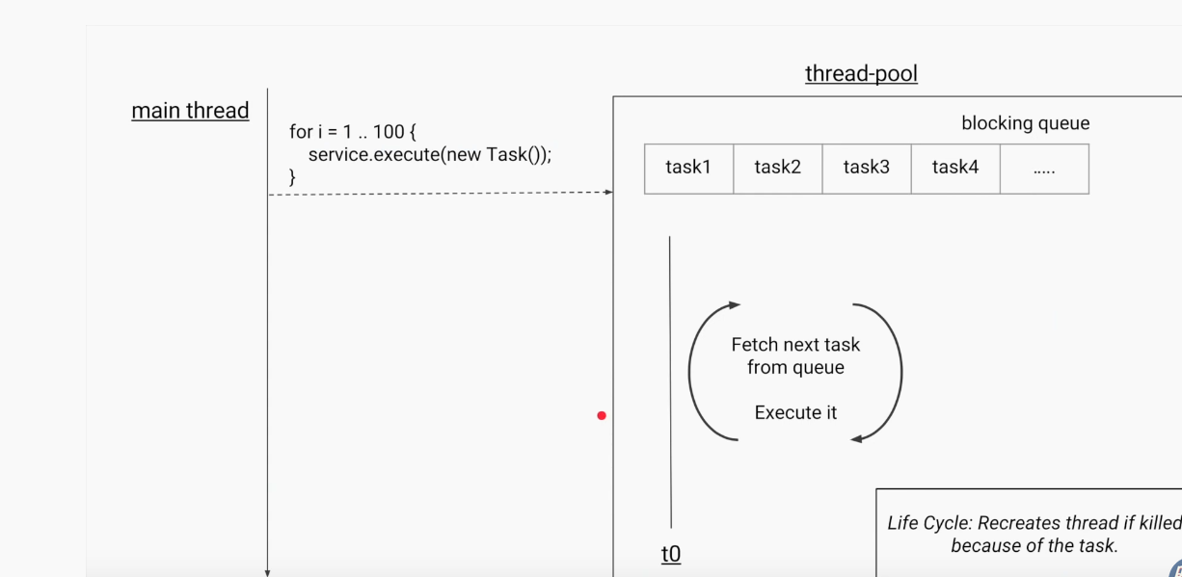
SingleThreadExecutor
This executor has only one thread and is used to execute tasks in a sequential manner. If any thread dies due to an exception while executing the task, a new thread is created to replace the old thread and the subsequent tasks are executed in the new thread.

Slide 31
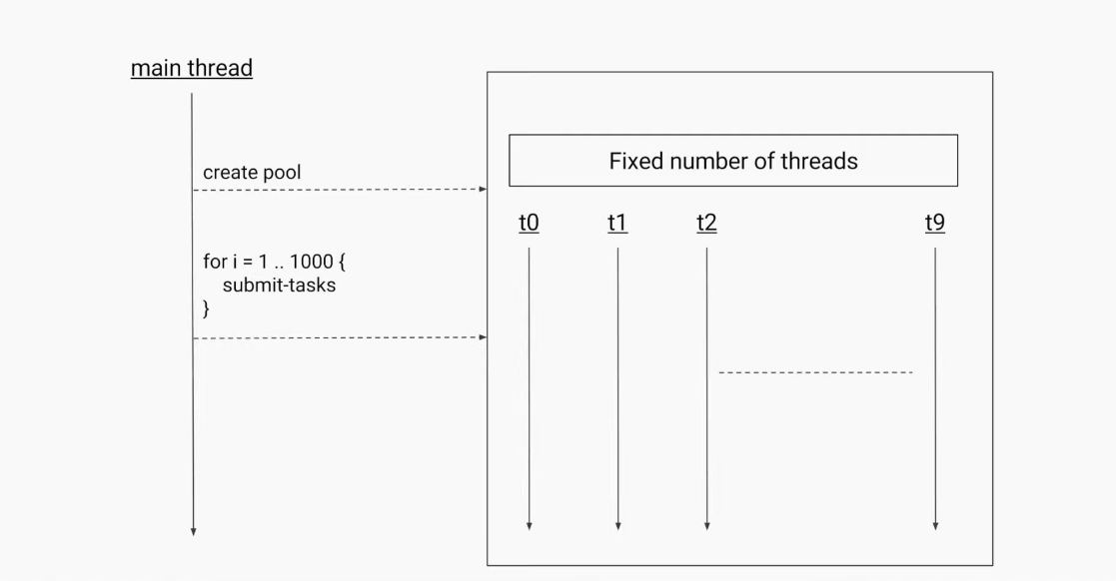
Fixed Pool Thread
This is a pool of a fixed number of threads. The tasks submitted to the executor are executed by the “n” threads and suppose if there is more task to finish, they are stored on a LinkedBlockingQueue.

Slide 32
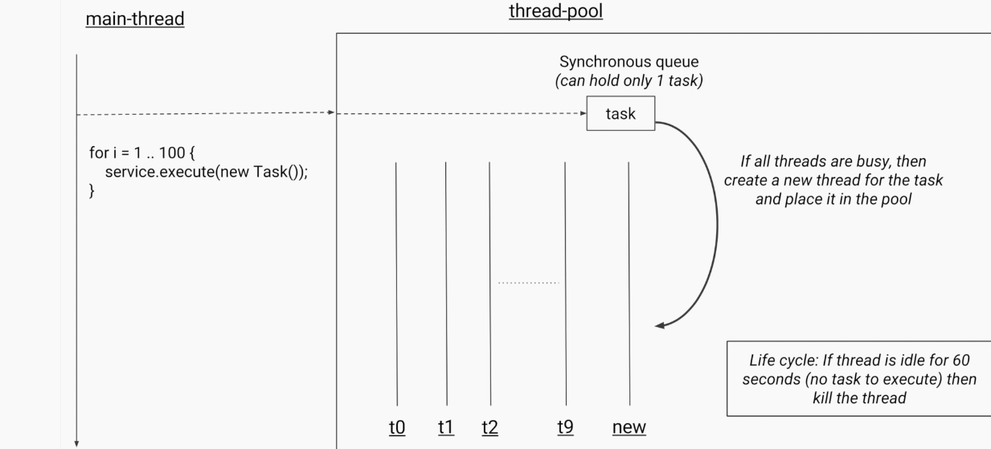
CachedThreadPool
This is mainly used when there are lots of short-lived parallel tasks on the line waiting to be executed. When compared with the fixed thread pool, here, the number of threads of this executor pool is not bounded. If all the threads are busy executing the assigned tasks and when there is a new task, it will create and add a new thread to the executor. If a thread remains idle for close to sixty seconds, they are terminated and removed from the cache.

Slide 33
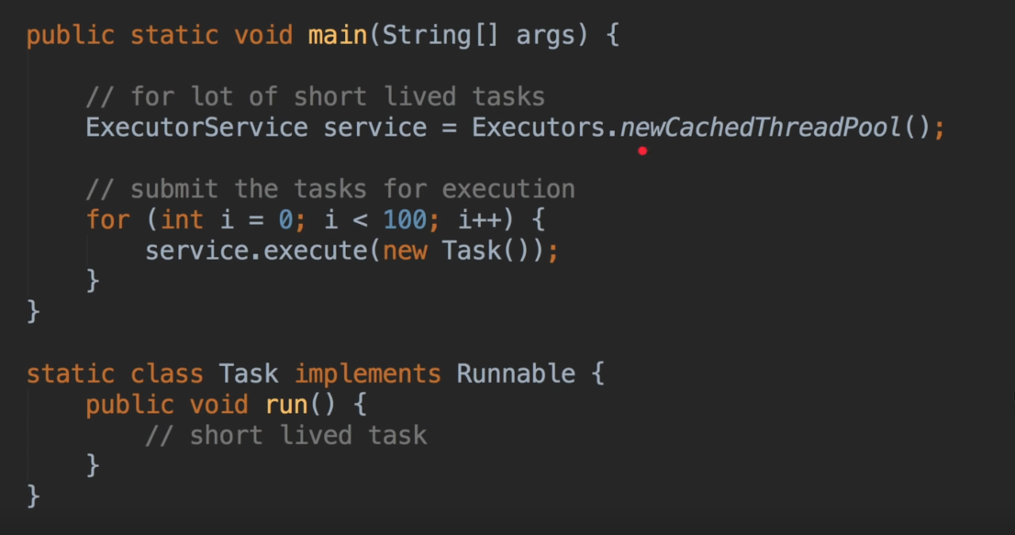

Slide 34
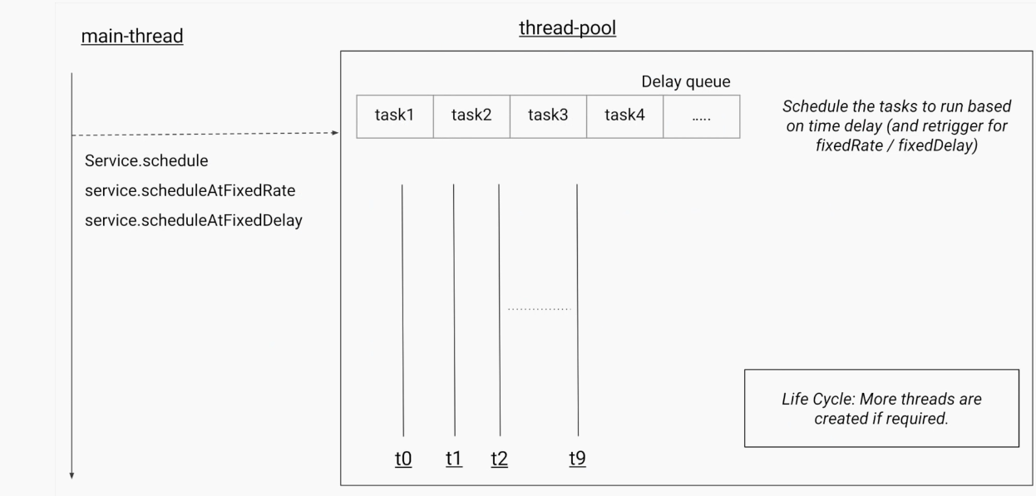
ScheduledExecutor
This executor is used when you have a task that needs to be run at regular intervals or if in case you wish to delay a certain task. The tasks can be scheduled in ScheduledExecutor using either of the two methods scheduleAtFixedRate or scheduleWithFixedDelay.

Slide 35
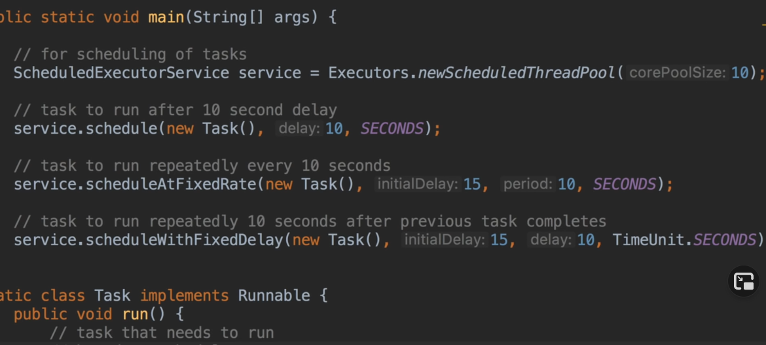

Slide 36
Thank You

