Slide 1

Introduction
QA strategy for the next 12-months

Slide 2
The current assumed situation
The Clients Linux Box Distribution:
20,000 Linux Boxes in the retail stores spread worldwide.
Each store is equipped with 5 DECT base units and 50 headsets.
Variations:
Three versions of headsets.
Three versions of Linux boxes.
Five firmware versions for each DECT base unit.
Ten software versions on each linux box.
Independent Operation:
Linux Boxes are unaware of each other.
They are inaccessible from the outside except by SSH and MQTT.
Each QA engineer has their own Linux box for development/Testing.
Manual QA:
Despite having a large and complex system, no automated testing is in place.
All QA work is done manually, which is time-consuming and prone to human error.
Third-Party Design and Manufacturing:
the challenge of integrating third-party manufactured and designed DECT base units and headsets into the overall system.

Slide 3
My Goals
Reduction of Manual Testing: Our primary goal is to substantially minimize the amount of manual testing performed by the client. With the help of automation, We aim to reduce the time and resources spent on repetitive tests, streamline the testing process, and increase the reliability of test results.
Increasing Test Coverage: Given the variations in hardware and software in the clients systems,weaim to ensure maximum test coverage. My goal is to cover all possible scenarios and test cases in the suite to provide a comprehensive evaluation of the clients systems.
Continuous Integration and Delivery: We aim to implement a Continuous Integration/Continuous Delivery (CI/CD) pipeline. Our goal is to have a system that can automatically build, test, and deploy changes, accelerating the release cycle and improving the quality of software.
Quality Assurance of Third-Party Products: As DECT base units and headsets are designed and manufactured by a third party, we need to ensure their compatibility and performance within the clients systems. Our goal is to create a robust strategy to effectively test and integrate these third-party components.
Improved Customer Relationships: By providing reliable, thoroughly tested products, we aim to improve the relationship with the clients customers. We seek to build confidence in the products, leading to increased customer satisfaction and loyalty.
Upskilling QA Team: We aim to transform the QA team into SDETs (Software Development Engineer in Test) who can write scripts for automated testing. By doing so, we can combine the efforts of developers and testers to achieve higher software quality and reduce the software delivery time.
Remember, these goals are not just desired outcomes but also guiding principles for the QA strategy we will be discussing in the following slides.

Slide 4
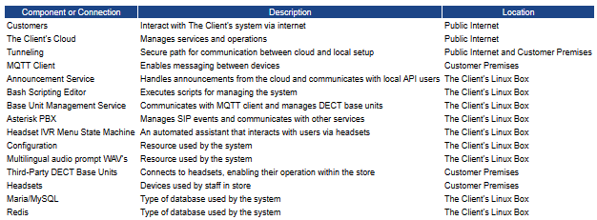
Existing System Overview
A complex system where different components work together to provide the functionality needed by the customers and staff within a store. The system allows for remote management and control from the the client's cloud, all while operating numerous services and interacting with third-party devices within the customer's premises.

Slide 5
Our Short-term Goals (1-4 months)
Unit Testing: In the initial phase, the focus will be on setting up robust unit testing practices. Unit tests help us validate each piece of the system operates as expected. This includes testing different versions of headsets, the client's Linux boxes, DECT base units, and their corresponding firmware and software. By addressing issues at this fundamental level, we minimize bugs in the later stages of development, saving time and effort.
Security Testing: Given the vast distribution of the the client's Linux boxes across retail stores worldwide, security testing is of paramount importance. The goal is to identify and rectify vulnerabilities early in the development process to prevent potential breaches. This involves performing tests like SSH and MQTT protocol security checks and HTTPS communication validation.
Upskilling QA Engineers: The immediate short-term goal includes initiating a training program for QA engineers in JavaScript and TypeScript - the languages used for software development in the systems. The upskilling would allow the QA engineers to understand the system better, write their own test scripts, and even contribute to the development process. The end goal is to transition them towards becoming Software Development Engineers in Test (SDET), bridging the gap between development and testing.
Beginning Test Automation: As we upskill the QA engineers, we should also start developing automated test scripts for some basic functionalities using simple test automation tools. The focus should be on automating repetitive manual tests, freeing up the QA engineers to focus on more complex testing scenarios.
By focusing on these short-term goals, we will establish a strong foundation for the comprehensive and effective QA strategy. This sets the stage for the medium and long-term goals, which will build on this foundation to further improve the processes and outcomes.

Slide 6
Our Mid-term Goals (5-8 months)
Integration Testing: As the team grows more familiar with automated testing and the suite of unit tests expands, the mid-term goal is to implement integration testing. These tests will focus on the interactions between different subsystems - such as the the client's Linux Box, DECT Base Units, and Headsets. Given the intricate system interactions presented in the diagram, we want to ensure that these subsystems cohesively work together as expected. Automated integration testing will help detect issues that might arise when these subsystems interact, reducing potential system-wide failures.
Load/Stress Testing: With 20,000 the client's Linux Boxes spread across various retail stores worldwide, it is vital to test how the system performs under load. Load/Stress testing aims to identify the system's breaking point or any performance bottlenecks, ensuring it can handle the load when all retail stores operate simultaneously. This includes stress-testing the SSH and MQTT communication channels and ensuring the the client's Cloud can manage the load from all retail stores.
Test Plan Structuring: In the mid-term phase, as we start implementing different kinds of testing, we need a structured and well-documented test plan. This test plan should outline the testing scope, approach, restheces, schedule, deliverables, and risks. It will ensure clear communication across teams, set realistic expectations, and provide a roadmap for the testing activities.
Automating More Complex Tests: Building upon the short-term goal of automating basic functionality tests, we should aim to automate more complex test scenarios during this period. This step will involve training the upskilled QA engineers to write and manage complex test scripts.
These mid-term goals will help ensure that the software operates reliably and robustly, even in real-world conditions and under heavy load. At the same time, they will continue to reduce the manual testing burden on the QA team, allowing them to focus more on developing new skills and improving the testing processes.

Slide 7
Our Long-term Goals (9-12 months)
System Testing: After thoroughly covering unit, integration, and load testing, the natural next step is to focus on system testing. This type of testing allows us to test the system in its entirety, verifying the end-to-end functioning of our entire the client's ecosystem, including all Linux Boxes, DECT Base Units, and Headsets. We aim to automate this process as much as possible, minimizing manual input and ensuring that our system works seamlessly as a whole, from the user interface down to the database operations.
Automated Testing Pipeline: A crucial long-term goal is to create a fully automated testing pipeline. This pipeline will automatically trigger the execution of our testing suite whenever changes are made to our codebase, providing immediate feedback to our developers about the impact of their changes. This pipeline will ensure more frequent testing, reduce the turnaround time for detecting and fixing issues, and ensure high-quality, reliable software releases.
Transition of QA Engineers to SDET roles: As the QA team becomes more adept at coding in JavaScript and TypeScript and writing automated tests, we want to further their transition into Software Development Engineer in Test (SDET) roles. This transition involves a shift in focus from manual testing towards software development specifically for testing. SDETs can contribute to both the development and testing phases, building robust testing frameworks and tools, and writing automated tests at all levels of the system.
Maintainability and Scalability: A longer-term focus will be on ensuring the maintainability and scalability of our testing framework as our system and team grow. This means continuously improving the readability and modularity of our test scripts, optimizing test execution times, and ensuring our framework can handle additional tests as our system's complexity increases.
Our long-term goals seek to establish a fully automated, efficient, and reliable testing process that can ensure the quality of our software as we scale up our operations. With QA engineers transitioning into SDET roles, we're positioning our team to be agile, proactive, and more capable of maintaining high software quality in the face of future challenges.

Slide 8
Handling New Firmware Releases
Immediate Action - Regression Testing: Whenever a new firmware release is announced, the first step we should take is to carry out regression tests. Regression testing ensures that the new firmware hasn't adversely impacted the functionality that was working fine previously. These tests are necessary to maintain the integrity of the DECT base units and to avoid any unexpected behavior or malfunctions in stores.
Security Testing: Firmware updates often come with security patches to vulnerabilities found in previous versions. As security is a crucial aspect of the the client's system, it's essential to validate that these updates indeed fix the known security issues and don't introduce any new ones. This process involves testing the firmware against known vulnerabilities, conducting penetration testing, and checking for any potential security breaches.
Integration Testing: A crucial part of handling firmware updates is ensuring that they don't disrupt the harmony between different components of our system. We'll perform integration tests to verify that the new firmware can communicate effectively with our Linux Boxes and Headsets. These tests also validate that all internal and external dependencies, like the MQTT Client and Announcement Service, are functioning correctly after the firmware update.
Load/Stress Testing: It's equally important to make sure the new firmware can withstand the anticipated load in the stores. We'll simulate high traffic conditions and check if the firmware update influences the system's performance.
Pilot Testing: Before a full-scale rollout of the new firmware to all stores,werecommend conducting pilot testing in a controlled subset of stores. This approach provides an additional safety net, enabling us to evaluate the firmware in a real-world scenario while limiting the potential negative impacts if unexpected issues arise.
Documentation and Training: It's important to update our internal documentation with details about the new firmware and any changes in the test cases. Training sessions should be organized for all relevant personnel, ensuring they understand the changes brought by the new firmware and how to handle potential issues.
Our approach to handling new firmware releases is systematic and thorough, aimed at minimizing risk and ensuring a seamless transition for our stores and, ultimately, customers.

Slide 9
Ideal Customer Relationships
In the pursuit to deliver the best possible product and service, it is imperative that we establish a strong and positive relationship with customers. Here is how we propose to do this:
Service Level Agreements (SLA): A detailed Service Level Agreement will be the foundation of our contractual relationship. It will clearly stipulate the levels of availability and performance customers can expect from our systems, as well as response times in the event of any technical issues.
Regular Communication: Regular and open communication channels will be maintained for seamless interaction, reporting, and feedback. Quarterly reviews will be organized to address any concerns, discuss system performance, and plan for any potential updates.
Co-creation and Collaboration: Customers will be involved in our product development process where feasible. This will ensure that we understand their needs thoroughly and can tailor our products accordingly. It will also allow customers to have a sense of ownership and involvement in the product they use.
Flexible Contracts: Our contracts will be designed to be flexible to adapt to changing customer needs. If customers need more headsets or additional features, we should be able to accommodate these needs.
Proactive Support: We aim to transition from reactive problem-solving to proactive problem avoidance. SDET roles will be key in achieving this by identifying and addressing potential issues before they impact our customers.
Remember, happy and satisfied customers are the best promoters for business. So, let's work together to create a fantastic customer experience!

Slide 10
Automating Headless Software Testing (1-4 months)
The goal of automating headless software testing is to reduce manual effort, expedite testing, and increase reliability. Here's our approach categorized into short, medium, and long-term phases:
Our immediate focus will be on establishing a solid foundation for automation. We'll develop a thorough understanding of the application and its behavior. We will:
Create Unit Tests: We'll initiate the development of a suite of unit tests. As the software in the the client's Linux Boxes is written in JavaScript and TypeScript, we'll use testing libraries like Jest and Mocha.
Implement Static Analysis Tools: These tools will help us catch potential bugs in the codebase before they become a problem. ESLint, a static analysis tool for JavaScript and TypeScript, is a great place to start.
All three of the tools mentioned here, Jest, Mocha, and ESLint, are essential in maintaining high code quality and ensuring our software performs as expected.

Slide 11
Automating Headless Software Testing (5-8 months)
The mid-term strategy focuses on expanding the testing suite and bringing more complexity into testing scenarios.
Introduce Integration Tests: We'll start developing an integration testing suite. This will test how different components of the software work together. Tools like Jest along with Supertest can be used for this purpose.
Establish Load/Stress Testing: We'll incorporate load and stress testing to ensure our software can handle the high-volume workload during peak times. Tools like Artillery or K6 can be used for these types of tests.

Slide 12
Automating Headless Software Testing (9-12 months)
The long-term goal is to ensure we have a comprehensive, automated testing suite that covers every aspect of the software's functionality.
System Testing: We'll conduct system tests to check the complete system's functionality and ensure that it works as expected in real-world scenarios.
Automated Testing Pipeline: The ultimate goal is to establish an automated testing pipeline that runs with every update to the codebase. We can use a continuous integration tool like Jenkins or GitLab CI for this purpose.
In summary, my approach is to start small with unit tests, expand to integration tests, and eventually work towards a complete automated testing pipeline, ensuring the reliability and robustness of our headless software in the the client's Linux Boxes.

Slide 13
Automating Headless Software Testing (The Tools Page 1)
Jest: Jest is a JavaScript testing framework developed by Facebook. It is known for its zero-configuration testing experience, its "batteries-included" approach. Some of its outstanding features include:
Snapshot Testing: It can capture "snapshots" of your application's state and compare them to reference snapshots during subsequent test runs.
Parallel Test Execution: It runs tests in parallel, which means it's faster, especially for large test suites.
Mocking and Spy Capabilities: Jest has rich features for mocking JavaScript functions, including automatic mock creation and manual mocks.
Mocha: Mocha is another JavaScript testing framework. It's flexible and allows for greater customization. It is often used in conjunction with assertion libraries such as Chai. Key aspects of Mocha include:
Flexibility: It offers greater flexibility by allowing you to choose assertion libraries, choose whether to run tests synchronously or asynchronously, and more.
Detailed Reporting: Mocha has a good system for signaling test successes and failures, which can be helpful in CI/CD environments.
ESLint: ESLint is a static code analysis tool for identifying problematic patterns found in JavaScript code. It doesn't perform testing but helps to maintain code quality and prevent bugs:
Customization: ESLint is fully pluggable, giving you the freedom to write your own rules or modify existing ones.
Code Consistency: It ensures your code adheres to style guidelines, leading to more readable and consistent code.
Catch Potential Errors Early: ESLint can catch potential errors and bugs at the development stage, long before the code goes into production.

Slide 14
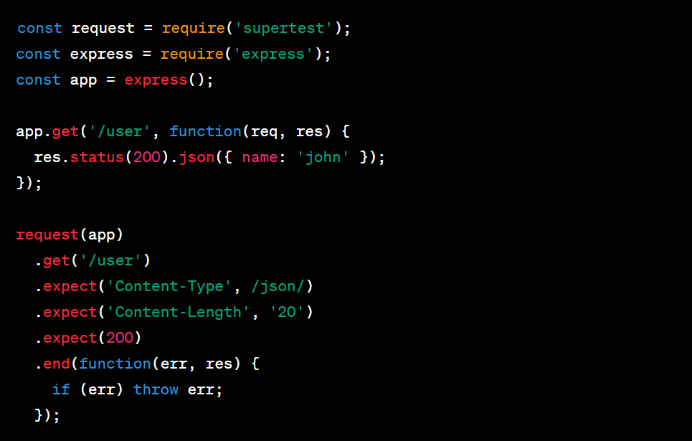
Automating Headless Software Testing (The Tools Page 2)
Supertest:
Supertest is a high-level abstraction for testing HTTP protocols, often used in conjunction with libraries such as Mocha or Jest in Node.js applications. It is designed to make it easy to test your HTTP endpoints, and it is compatible with any testing framework. Supertest allows you to easily send GET, POST, PUT, DELETE requests and much more, and it provides a fluent and intuitive API for making assertions about the HTTP responses you receive.
For example, with Supertest, you can test an express application's endpoint like this:

Slide 15
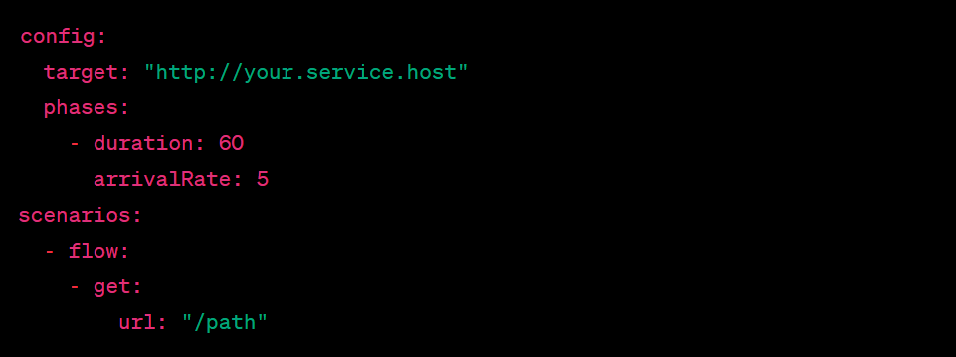
Automating Headless Software Testing (The Tools Page 3)
Artillery:
Artillery is a modern, powerful, and flexible load testing toolkit used for testing the performance of backend systems. It is designed to help developers and SREs who work on systems that need to be able to handle high amounts of traffic.
Artillery supports HTTP/S, WebSocket and Socket.io out of the box, and custom engines can be written to generate load using other protocols. Artillery's core is written in Node.js, but Artillery can load test any backend regardless of the language or technology used to implement it.
An example configuration for a simple load test with Artillery might look like this:

Slide 16
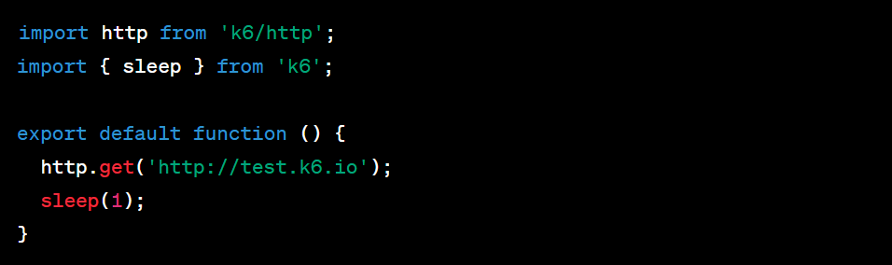
Automating Headless Software Testing (The Tools Page 4)
K6:
K6 is a developer-centric, free and open-source load testing tool built for testing the performance of your backend infrastructure. It offers the flexibility of scripting tests in JavaScript, allowing for complex scenarios to be created that mimic real-world use of your system.
K6 allows you to test systems with HTTP/1.1, HTTP/2, and WebSocket protocols and it integrates well into CI/CD pipelines. It also provides detailed metrics for analyzing test results and can output those to various backends (e.g., InfluxDB, Datadog, and more) for long-term storage and analysis.
A simple K6 test script might look like this:

Slide 17
Automating Headless Software Testing (The Tools Page 5)
Jenkins
Jenkins is an open-source automation server that allows developers to reliably build, test, and deploy their software. It's highly extensible with a vast ecosystem of plugins, making it easy to create a continuous integration (CI) pipeline and even extend into continuous delivery and continuous deployment. Jenkins supports version control tools like Git, SVN, and Mercurial and can execute Apache Ant and Apache Maven-based projects as well as arbitrary shell scripts and Windows batch commands. The server is built in Java and can be run in any operating system that runs Java. Jenkins key features include:
Support for Build Pipelines and delivery pipelines as code.
Automated build, test, and deployment.
Distributed builds - the ability to run jobs on different machines.
Extensibility with over a thousand plugins available.
User interface customization with custom views and filters.
GitLab CI
GitLab CI/CD is a tool built into GitLab for software development through the continuous methodologies. GitLab CI/CD is used to manage projects/codebases and is very similar to GitHub. It features a continuous integration system that's very easy to use, even for beginners. In GitLab CI, you can create a file called .gitlab-ci.yml in the root directory of your project, and this file is used to configure the tasks you want to be automated. These tasks can include software building, testing, and deployment. GitLab CI key features include:
Pipelines: Create sophisticated pipelines easily with GitLab CI's out-of-the-box templates.
Docker Support: Build and test Docker images or use Docker in your build process.
Auto DevOps: Automatically set up pipelines based on best practices.
Parallel execution: Run numerous jobs concurrently to reduce cycle time.

Slide 18
Important Subsystems & Integration Testing
Given the complexity of the the client's system and the variety of components it involves, selecting the most crucial subsystems for integration testing is challenging. However,wehave identified the following key subsystems, considering their roles, interactions, and potential impact on overall system performance:
the client's Linux Box and its internal services: Given that this box houses multiple services like the Announcement Service, Base Unit Management Service, and MQTT Client, it's critical to ensure these services are communicating seamlessly. Furthermore, the connection with databases (MariaDB/MySQL and Redis) needs thorough testing.
the client's Linux Box and Third-Party DECT Base Units: As the link connecting the the client's system with the headsets, we must ensure reliable communication between these components, testing how changes in one affect the other.
Our integration test suite will focus on these identified subsystems, verifying the smooth exchange of data and correct functionality when these subsystems interact.
What Does The Suite Test?
Our test suite will assess the functioning of various service components inside the the client's Linux Box, ensuring they correctly interact with databases and with each other. It will also validate the communication between the the client's Linux Box and the Third-Party DECT Base Units.
Examples:
Verify that the Announcement Service correctly retrieves and updates data from the MariaDB/MySQL database.
Confirm that the the client's Linux Box successfully manages the DECT base units and responds correctly to updates or changes.

Slide 19
Important Subsystems & Integration Testing
Architectural Design & Technologies
Ideally we’d leverage test-driven development using Jest and Supertest for unit testing and integration testing, respectively. For load testing, we'll utilize tools like Artillery or K6.
Running the Tests
The tests will be executed as part of the CI/CD pipeline using Jenkins or GitLab CI, enabling us to catch issues early and ensuring a stable build.
Training Less Technical Colleagues
We'll conduct a series of training sessions, detailing the test suite's structure, its functioning, and how to interpret the results. Our goal is to empower every team member, regardless of their technical skills, to understand, adapt, and extend our testing mechanisms. This shared understanding and collaboration will be critical to our long-term success.

Slide 20
Sharing the Test Suite with All Developers
Version Control and Code Reviews: The test suite should be checked into version control (e.g., Git) along with the application code. This enables all developers to access, update, and extend the tests. Additionally, it allows for code review processes to be applied to test code, ensuring quality and consistency.
Collaboration and Knowledge Sharing: Encourage developers to work together on creating and maintaining the tests. This fosters a team-wide understanding of the test suite, promotes the exchange of ideas, and helps distribute knowledge and expertise among the team.
Continuous Integration: Incorporate the test suite into the CI/CD pipeline. This means tests will be run automatically on each commit, keeping the entire team informed about the status of the test suite and the application it tests.
Documentation: Maintain good documentation of the test suite, including information about what each test covers, how to run the tests, and how to add or modify tests. This makes the test suite more accessible to all team members, including those less familiar with the testing framework.
Training and Mentoring: Provide training sessions to help all developers understand the test suite. Pair programming and mentoring can also be beneficial for getting everyone up to speed.
Open Communication: Foster an environment where questions, suggestions, and discussions about the test suite are welcomed. This will help the entire team stay engaged and contribute effectively to the testing process.

Slide 21
The Plan Summarised
Upskill and Learning
Establish Structure
Automation and Transformation
CI/CD
Adaptation and Learning
Collaborative Testing Environment
Continuous Improvement

Slide 22
Conclusion & Next Steps
Recap of the Strategy: Over the next 12 months, we will transition from a primarily manual testing process to a more automated one. We will start by focusing on unit and security testing, gradually adding integration, load/stress, and system testing. At each stage, we will ensure our QA engineers are upskilled appropriately, ultimately transforming them into SDETs.
Upskill and Automate: Encouraging our QA engineers to learn and use JavaScript and TypeScript in their test design is key to our transition. The goal is to have them creating automated tests with tools like Jest, Mocha, Supertest, and Artillery or K6, ensuring the quality of the the client's Linux Boxes, the interaction with the DECT base units, and the various services running on the boxes.
Continuous Integration and Sharing: With Jenkins or GitLab CI, we aim to introduce a continuous integration (CI) pipeline, which will automatically run our tests, facilitating the detection and correction of bugs early in the development process. We will share the test suite with all developers, promoting collaboration, knowledge sharing, and test ownership.
Handling New Firmware Releases: With a structured plan to conduct regression, security, and integration tests, we can confidently roll out new firmware releases to all stores.
Future Customer Relationships: Our ideal contractual relationship with customers will be based on trust and transparency, providing them with regular updates on software improvements, and ensuring minimal disruptions in services during updates.
Next Steps: Our immediate next step is to begin the upskilling process and design our unit tests. We will continuously review and adapt our plan as we progress, maintaining an agile approach to our QA transformation.
Team Transition: The transition to this new QA strategy is a team effort. Through collaboration, communication, and continuous learning, we will work together to increase our test efficiency and ensure the high quality of our products.

Slide 23
Envisioning Success
Accelerated QA cycle: The QA cycle for hardware and software releases will dramatically decrease, facilitating regular releases of our complex products. Our understanding of what needs testing and when will be significantly enhanced.
Reduced regression testing times: The implementation of automated testing systems for our hardware devices and Linux machines will greatly cut down regression testing times, enabling faster deployment of changes.
Maximized throughput and quality: We will review and refocus testing practices across all engineering teams to ensure we maximize throughput without compromising on quality.
Streamlined testing processes: The deployment of new testing software will help all teams to organize and streamline their testing processes.
Effective resource allocation: As a result of an organized community of practice, QA resources will be predictably allocated across all engineering teams according to skill and focus areas.
On-track product roadmap: The product roadmap will remain on track, and our company's growth goals will be met.
Improved uptime and fewer support calls: Customers will experience an uptime of 99.5% for our hardware devices and fewer support calls will be required to manage our hardware.
Expansion into new markets: The implemented solutions will allow the company to grow into new markets and regions.
Improved consistency: The improvements to the consistency of configuration of our hardware will free our customer liaison teams from chasing bugs.
Team growth and upskilling: Colleagues will grow in skill and confidence as a result of our influence and our team will expand through successful recruitment.

Slide 24
Q&A
Questions: At this point,we would like to open the floor for any questions you may have about the strategy presented today. Please feel free to ask about anything that might not have been clear or any part of the strategy you'd like to delve deeper into.
Discussion: Further, if you have any thoughts or suggestions, I'd be more than happy to discuss those. This strategy will only be successful with the cooperation and input of everyone, so your ideas are invaluable.
The outlined strategy will be refined as we move forward. The details of each slide will be expanded upon and meticulously implemented to provide a robust testing framework. The key benefits of this strategy, as we've discussed, are increased testing efficiency, early bug detection, and reduced manual labor.
Thank you.

