Slide 1
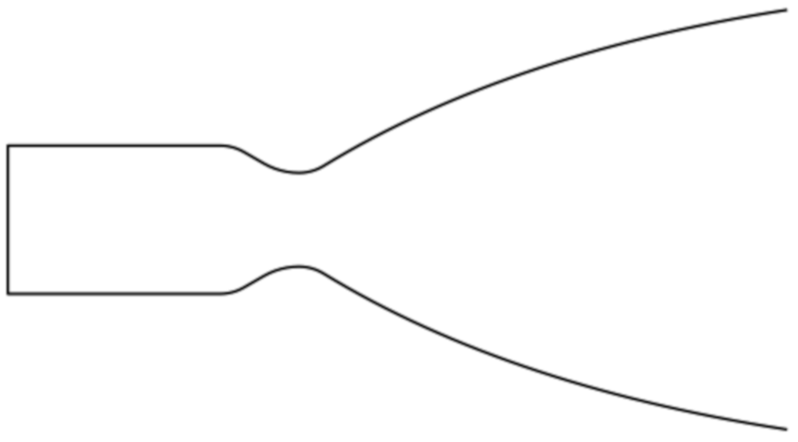
Lnoz
exit_angle
Lcham
Lcham_cyl
Lcham_conv
entrance_angle
Rexit
RchmConv
Rinj
Rthrt
cham_conv
RupThroat
RdwnThroat
CR = (Rinj / Rthrt)**2
eps = (Rexit / Rthrt)**2

Slide 2
wdot_Ox_Entrained
MRbarrier = -----------------------------------------------
(wdot_Fuel_Entrained + wdot_FFC)
Barrier Stream Tube
MRffc = 0
MRbarrier
Entrained Core Gases
Core Stream Tube
MRcore
Barrier Stream Tube
MRthruster = Mrcore * (1 - %FFC/100)

