Slide 1
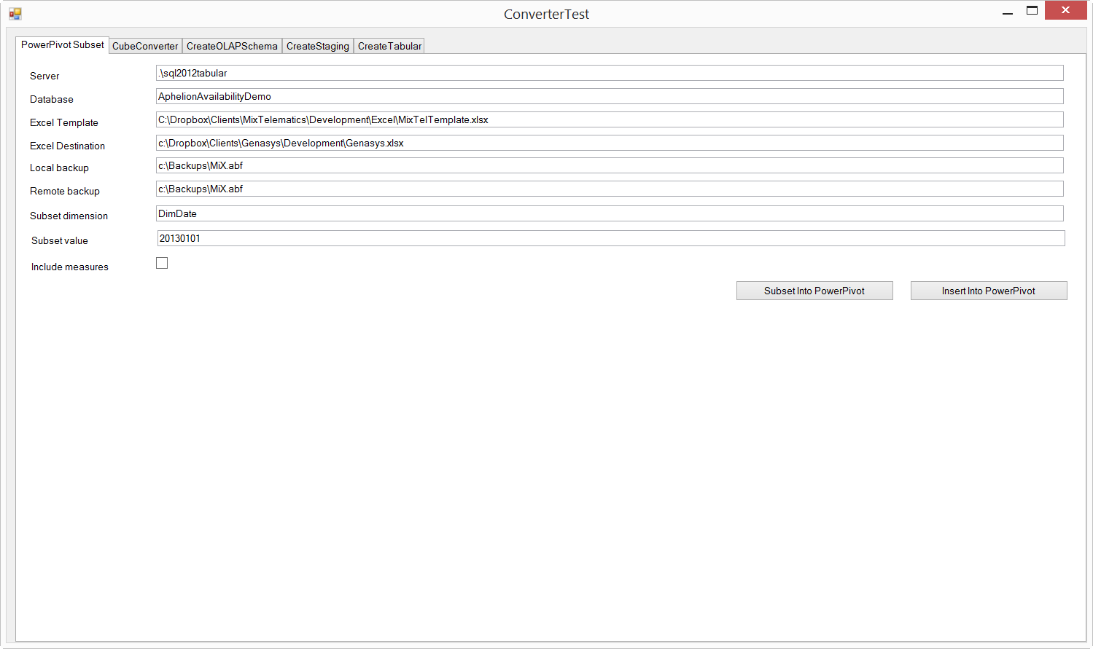

Slide 2
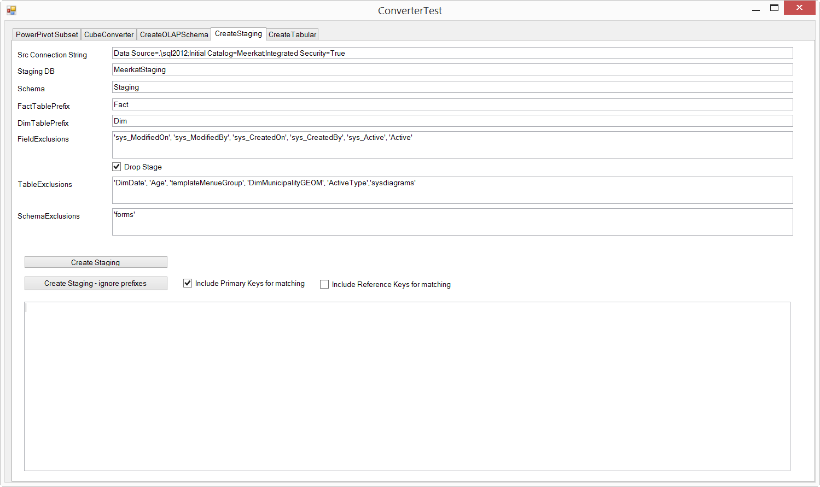
All the defaults have been set for Meerkat. We generate all tables, not prefixed, exclude some system tables (probably others we need to exclude too, e.g. gender)
“Include Primary Key” will include e.g. IndicatorID for Indicator. This will then indicate if a record is an insert or an update, e.g. if we exported the data, then it’s an update
We aren’t including the foreign key fields, eg OutcomeID, as we will use business key to do lookups

Slide 3
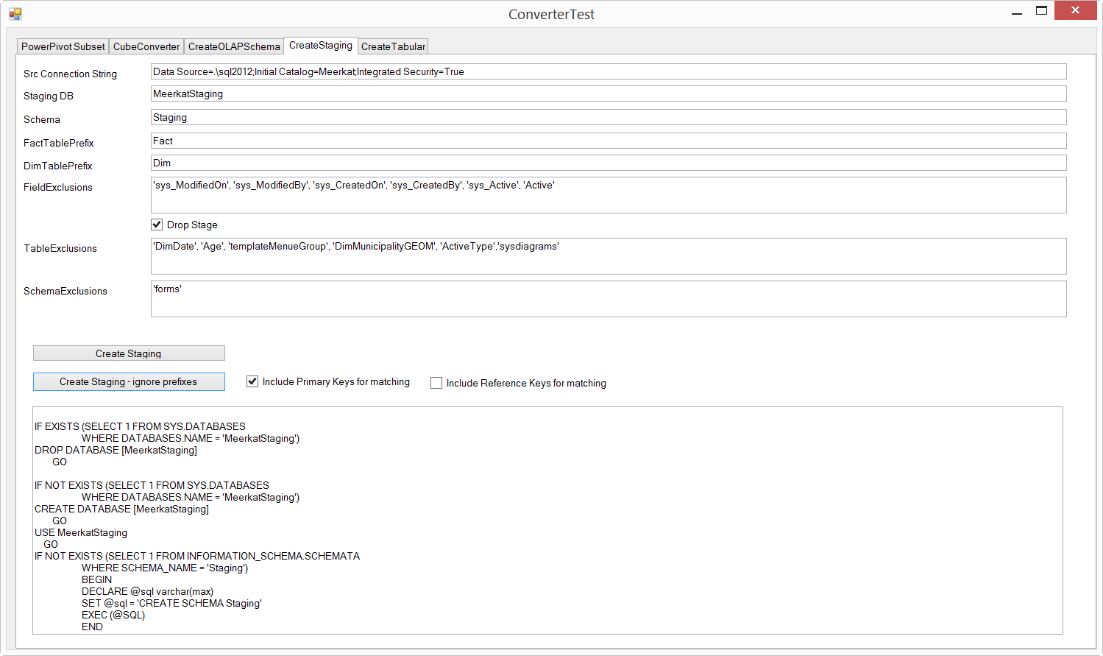
Final code to generate DB is here

