Slide 1
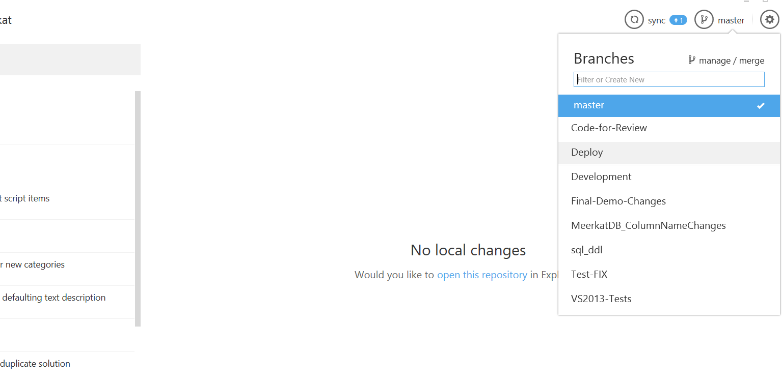
This deployment we are using branch
Deploy_CARESom_Release01
Notes:
Choose the appropriate branch

Slide 2
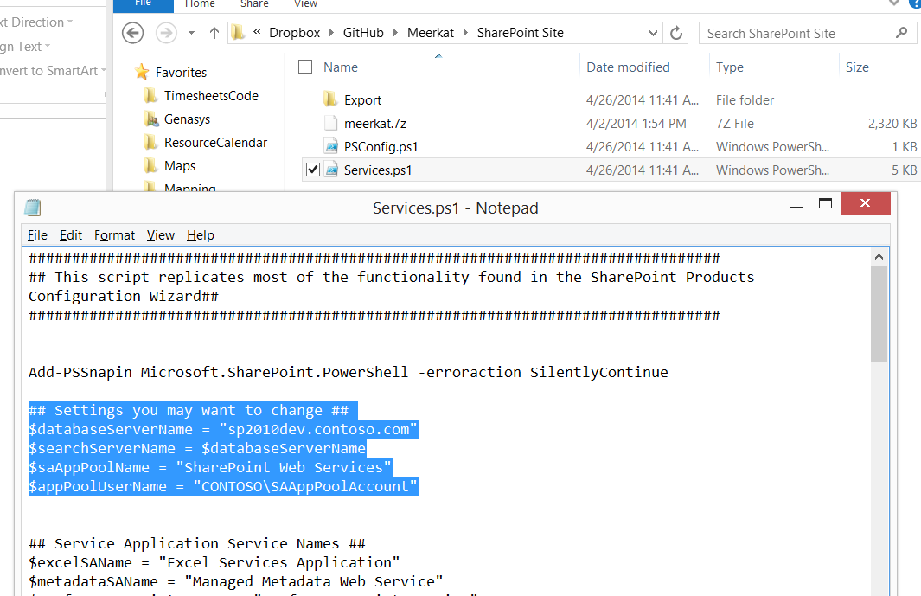
Set these to the appropriate…. lXXXXXX
Notes:
More detailed notes here.
EG \GitHub\Meerkat\SharePoint Site for URL

