Slide 1
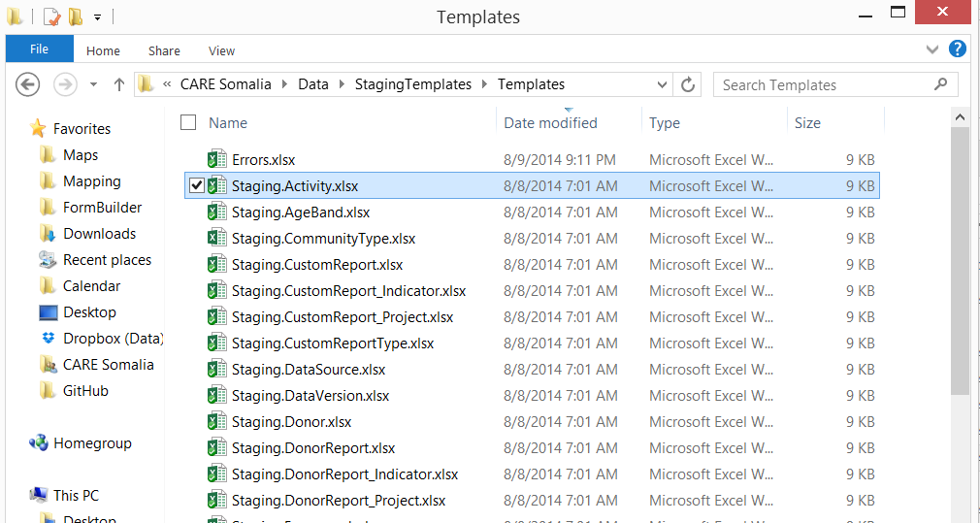
Start by finding your template for the area you need to load in the templates folder

Slide 2
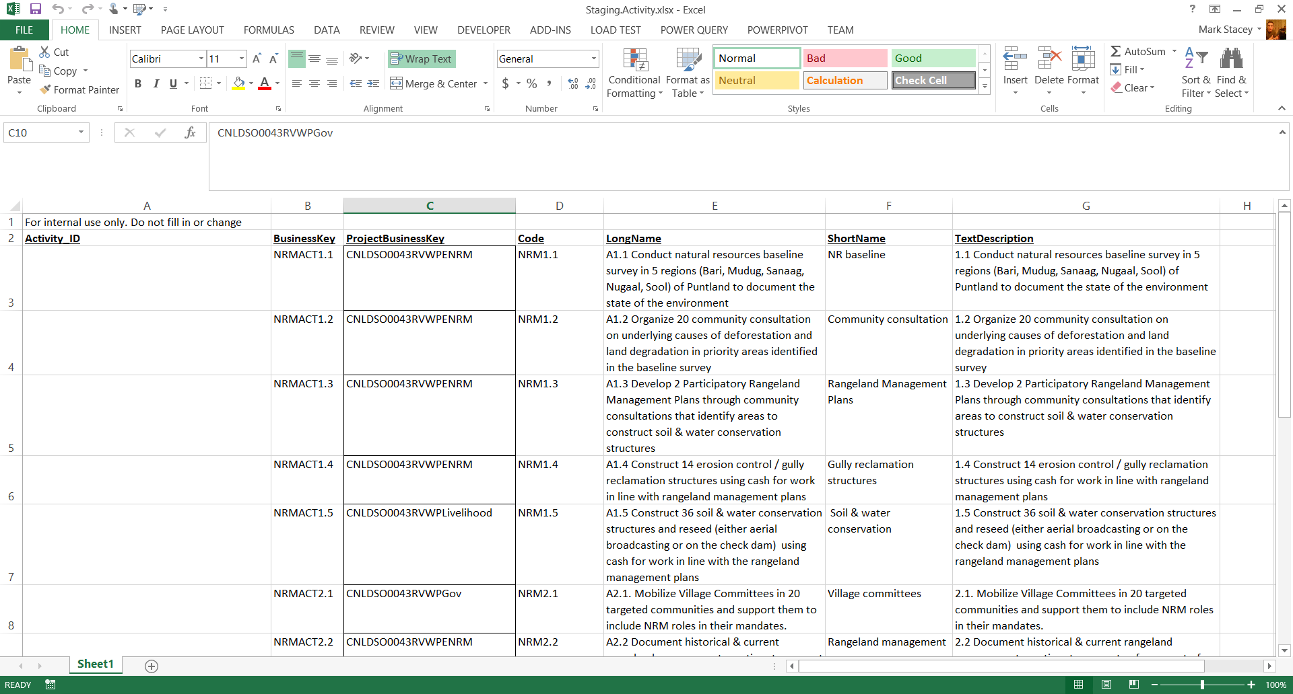
Edit the template, adding the information you need to add. Be sure to match business keys exactly – adding a space, using a 0 vs a O for looking up a project will fail. Also, the first column for ID – this is only used when the template has data, don’t edit it. And always ensure Businesskey is unique

Slide 3
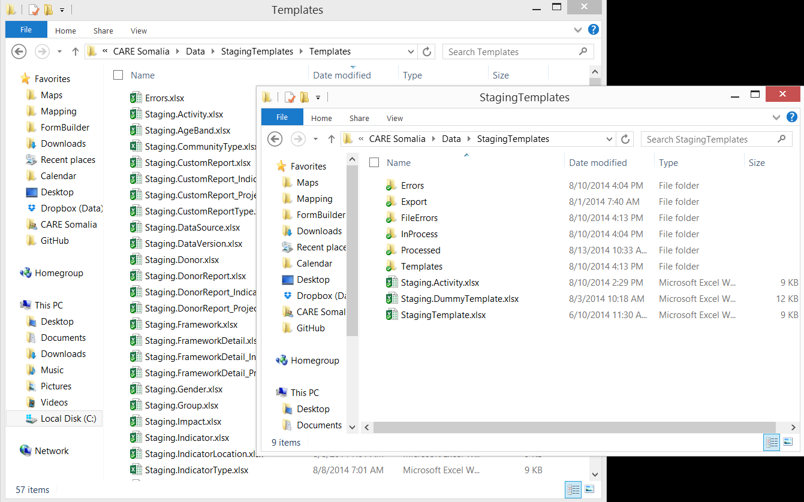
Place your file in the root to have the system pick it up

Slide 4
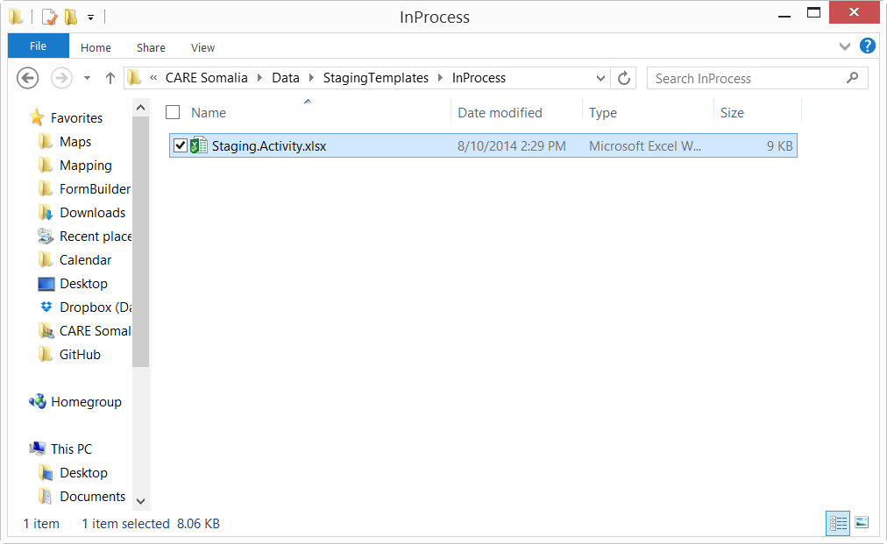
The system will automatically move it to InProcess when it’s busy

Slide 5
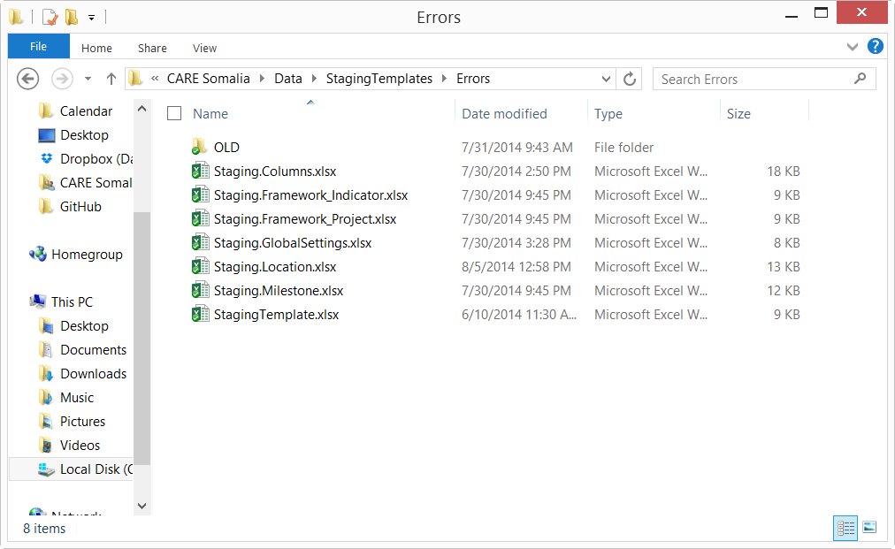
Files that have an incorrect format will be moved to Errors

Slide 6
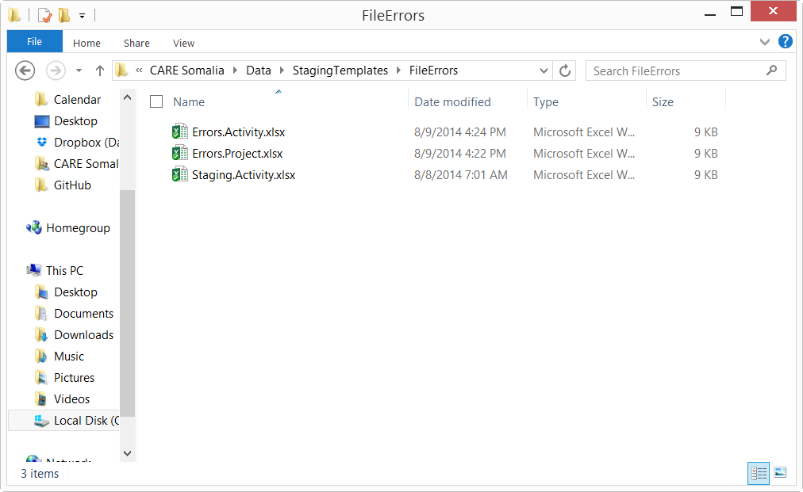
If there are DATA errors, rather than format, the files will be moved to fileErrors. A summary of the errors will be placed here as well.

Slide 7
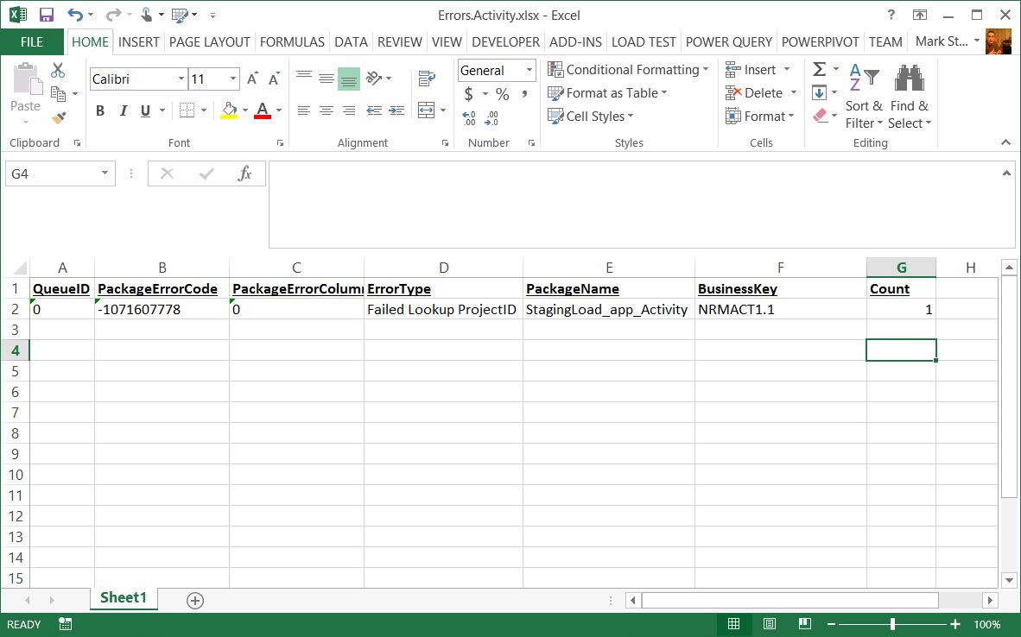
The errors will include some internal information, a description of the error (in this case that the project wasn’t found), the internal package name, and the business Key so you know which row was broken. The rest of the rows should have loaded however!

Slide 8
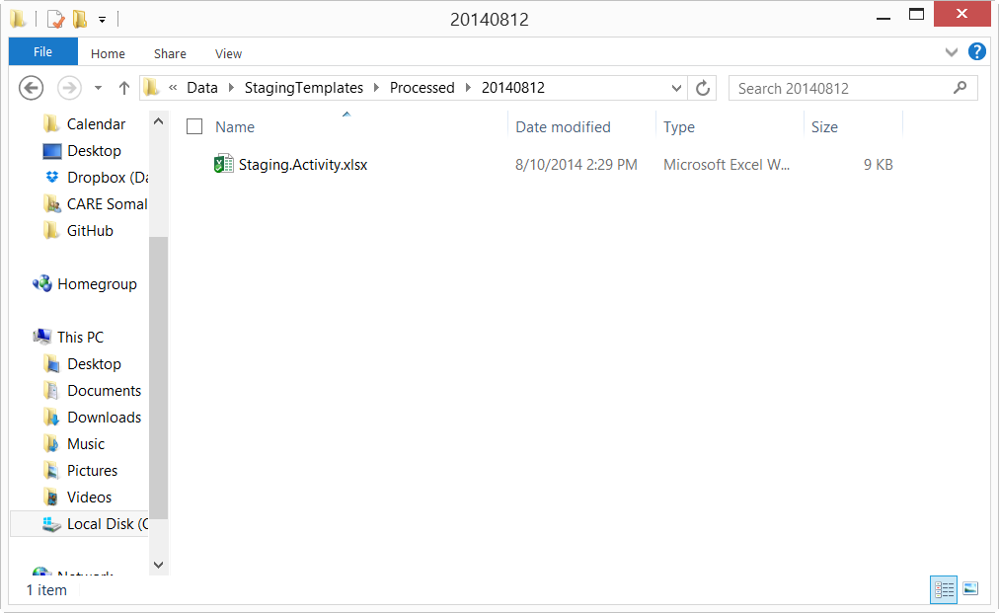
Successful loads are placed within a folder with todays date. Note that anything loaded within a day will be overwritten!

