Slide 1
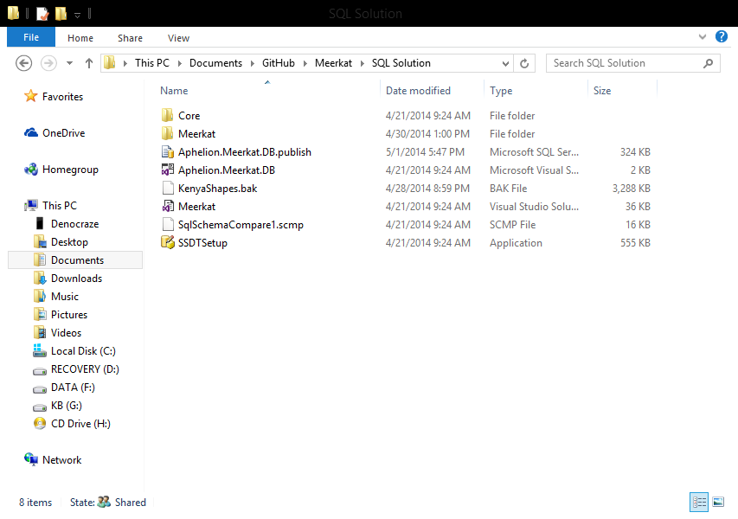
Access the script from Github under the SQLSolution folder of the Meerkat Repository Open the script to go to the SQL management studio

Slide 2
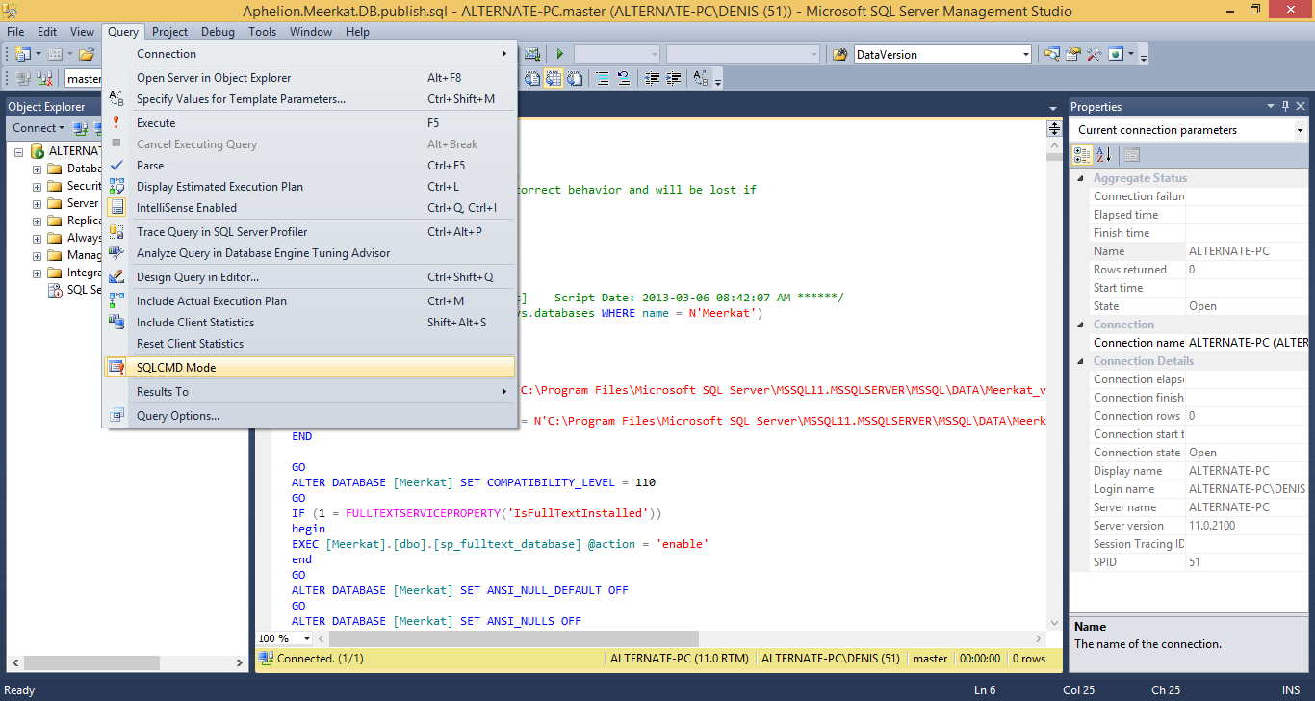
Click on the Query tab and under it click to select the SQLCMD Mode option.

Slide 3
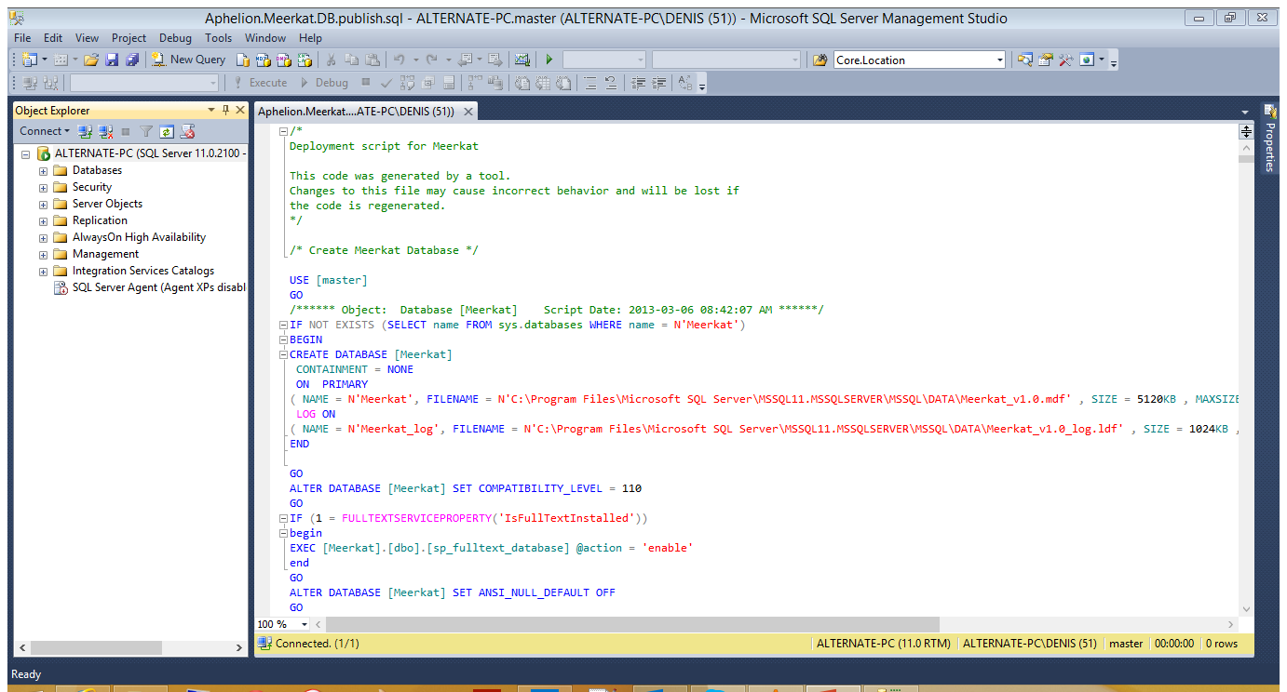
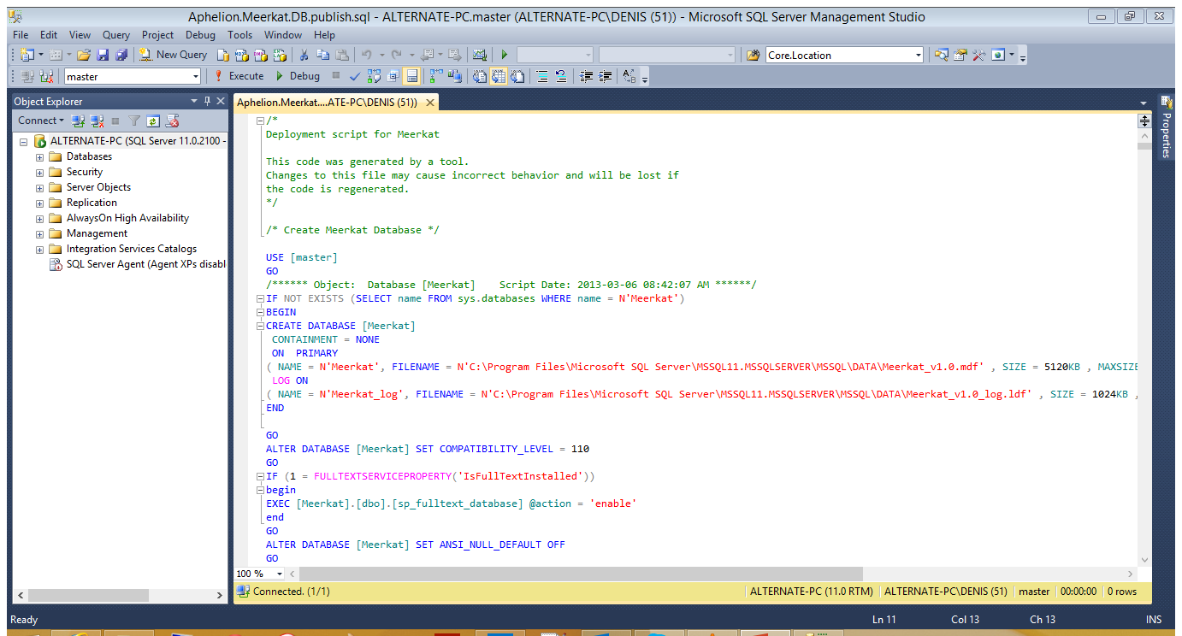
You can click anywhere in the script window to select it and/or make sure it’s the one you’re running then click Execute to run the script..

